Slide 3
Lesson11
一般、选择疑问句

Slide 4
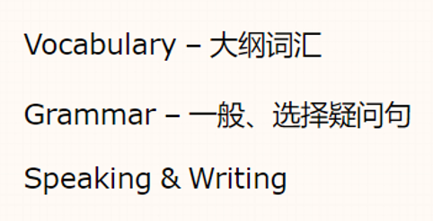
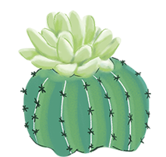
Content

Slide 5
Part
I
Vocabulary

Slide 6
nose /nEUz/ n.鼻子
blonde /blXnd/ adj.(blond)(头发）金黄色的
mouth /maUT/ n.嘴
round /raUnd/ adj.圆形的
face /feIs/ n.脸
eye /aI/ n.眼睛
singer /'sINE/ n.歌手
artist /'A:(r)tIst/ n.艺术家
crime /kraIm/ n.犯罪活动
criminal /'krImInl/ n.罪犯
a round face圆脸

Slide 7
put /pUt/ v.放
each /i:tS/ adj.&pron.每个;各自
way /weI/ n.方式;路线
describe /dI'skraIb/ v.描述
differently /'dIfErEntli/ adv.不同地
another /E'nVDE(r)/ adj.&pron.另一;又一
end /end/ n.结尾;尽头
in the end 最后
real /rIEl/ adj.真正的;真实的
jeans /dZi:nz n.牛仔裤
different adj. 不同的
be different from...
difference n.不同
make a difference (to...) 对......有作用；有影响
I think teachers are great. They _____ to students’ lives.
A.make a difference B.different kinds of
C.stay in shape D.for example
A
really adv.真正地
Notes:
.in the way意思:阻碍,挡道 2.on the way意思:在路上;在旅行中 3.by the way意思:顺便地;附带说一句in this way, 表示“用这种方法

Slide 8
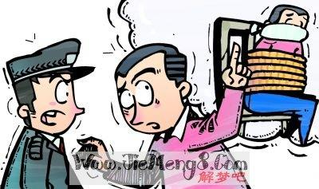
Mr. Li

Slide 9
Policeman: Mr. Li, _____ ____ ______(首先), can you d_______ the
appearance(外表) of the man who robbed you this morning?
Mr Li: Yes. I remember his face. He has a r______ face and curly hair. Oh,
his hair is _______(blonde). His ______ (eye) are blue. He is of
medium _________(high).
first of all
escribe
ound
blonde
eyes
height
1.first of all 首先
second（secondly），besides, What’s more
2.describe v.描述
Can you describe the robber to me?
They describe teacher as a gardener(园丁).
describe sth. to sb. 把......描述给某人
describe sb. as... 把某人描述为......
description n.描述
a description of sb./sth.对于某物或某人的描述
B
1) Peter ____ his new phone to us.
A.description B. describes
2) Please give us a detailed _____
of your robot.
A. describe B. description
B
Notes:
describe 冀教七下L9

Slide 10
Policeman: Is there anything else? Our police _______ (art) needs more to
draw a picture of the _________(crime).
Mr Li: Oh, he wears glasses and a pair of blue _____ (jeans).
artist
criminal
jeans
3.artist n.艺术家 police artist 警察素描艺术家
4.criminal n.罪犯
crime n.犯罪(活动)
commit a crime犯罪
Notes:
commit做出(错或非法的事); 犯(罪或错等);

Slide 11
Policeman: OK, where did you meet him?
Mr Li: On my w_____ home. I am a _______ (sing). I was invited
to attend a concert. When I was waiting for my car,I _____ (put)
my bag on the ground. A man ran past me and took it away. My
driver ran after him, but ____ ____ ______(在最后), the man
chose a______ way and disappeared.
ay
singer
put
in the end
nother
5.way n.方式;路线
the way of doing sth.做某事的方法
the best way to do sth. 做某事的最好的方法
on the way to ...在去……的路上
如果后面是home, here, there等副词，需省略to
B
1. Leo has thought of a way ___solving this problem.
A. to B. of C. at D. on
2. On the way to __, I met one of my old friends.
A. school B. home C. here D. there
3. We should find a way _____ there.
A. get B.getting C. to get D. got
A
C

Slide 12
Policeman: OK, where did you meet him?
Mr Li: On my w_____ home. I am a _______ (sing). I was invited
to attend a concert. When I was waiting for my car,I _____ (put)
my bag on the ground. A man ran past me and took it away. My
driver ran after him, but ____ ____ ______(在最后), the man
chose a______ way and disappeared.
ay
singer
put
in the end
nother
6.put-put-put
put on 穿上
put up 张贴，搭建,装饰
put away 收起来
put off 推迟
7.in the end 最后
=at last
at the end of...
在......的末尾/尽头
8.another 另一个
1. _____ your magazine and do your homework first.
You may read it later.
2. _____ your coat. It’s cold outside.
3. ______ these notice on the board.
A. Put on B.Put off C. Put up D.Put away
4. _____ end of the street, you can see the bookcase.
A. At B.In C. On D. By
5. The man tried several times (尝试了几次) to start
the car, and he succeeded (成功) _____.
A. in the past B. in the end C. at first D. at once
D
A
C
A
B

Slide 13
the other | 另一个 | 指两者中的另一个，是特指，常与one连用，构成“one...，the other...”结构 | Mr. Smith has two daughters. One is a doctor，and the other is a nurse.
the others | 其余的，剩余的 | 指三个或三个以上的人或物中除去已知部分以后“余下的全部”，是特指 | There are 20 students in the classroom. Some are reading books,the others are chatting.
other | 别的，其他的 | 用来修饰名词，泛指其他的人或物 | Do you have any other questions?
others | 另一些 | 所指的是三个或三个以上的人或物中除去已知部分后“余下部分中的某一些”，非特指 | I don't like these pens. Please let me see some others.
another | 另一个(的)，再 一个(的) | 指三者或三者以上中的“另一个”，非特指 常考语境:①东西好吃再来一个；②衣服/鞋子不喜欢，再来一个......；③拜访某人改天④another+基数词+名复 | Would you like another hamburger? 你还想再要个汉堡包吗？ I want another two apples. =I want two more apples.

Slide 14
other, the other, others, the others, another
other, the other + 名复
others, the others 表复数
有the 有范围， 无the 无范围。
another 另一个，再一个
1.I don’t like this pair of pants. Would you
like to show me ____?
A. other one B. the other one
C. another pair D. the other pair
2.If you take the red evening dress, you'll
have to pay ______ 30 dollars, because
It’s more expensive. it's made of silk.
A.other B. the other
C.others D. another
C
D

Slide 15
Exercises
一、根据句意及所给提示填空
1. Alice draws very well. She wants to be an a .
2. Please do it in different _________(way).
3. Chinese clay art(中华陶艺 ) is famous because the clay pieces are so small but they look very ________(really).
4. She wants to become a famous ________(sing) when she grows up.
5. My sister and I speak English _________ (different).
rtist
ways
real
singer
differently

Slide 16
Exercises
二、单选。
1. She looked everywhere for her book but ____ she had to go home without it.
A. at first B. in the end C. at the last D. in end
2. I am new here. I often get lost and can't find my ________.
A. ticket B. way C. wallet D. bus
3. I don't like this small bag. Would you please show me _____?
A. the other B. other C. another D. others
4. Can you describe your friend ________me?
A. of B. / C. to D. at
B
B
C
C

Slide 17
词汇练习
I.选择正确答案
A
1. We were thinking about going to Switzerland, but ______ we went to Austria.
A.in the end B. first of all
2.She enjoys painting, and she wants to be _______
A.a singer B.an artist
3.The police ask her to ______ the man.
A. describe B.say
4. This blue skirt doesn't suit me.Please show me _____ one.
A.another B.other
5.Do you know the way ______ the police station?
A. on B. to
B
A
A
B

Slide 18
词汇练习II.根据提示填空
6.She's got a small m_______ and two big eyes.
7.The twins are d_______ from each other.
8. Where_____ (be) my jeans?
9. She has a good voice, and she wants to become a s_____ in the future.
.0.The moon goes r _______ the earth.
outh
ifferent
are
inger
ound

Slide 19
Summary
和......不一样 通过不同的方式/方法
不同地(adv.) 有影响，有作为
收起来 写下来
put up 另一个
最后 每一个
金黄色的 嘴巴
不同之处(n.) 鼻子
be different from
in different ways
differently
make a difference（to)
put away
put down
搭建，张贴，装饰
another
each each of us
in the end / at last
blonde blond
mouth
difference(s)
nose

Slide 20
Part
II
Grammar

Slide 21
一般疑问句的几种情况
一、be 动词的一般疑问句
结构：be动词+主语+...
1. His father is an English teacher.
否定句 _________________________________________
一般疑问句______________________________________
肯定回答________________否定回答_________________
His father isn't an English teacher.
Is his father an English teacher?
Yes, he is. No, he isn't.

Slide 22
4. These are my grandparents.
否定句 _________________________________________
一般疑问句______________________________________
肯定回答________________否定回答_________________
7. Linda is playing football with her classmates.
否定句 _________________________________________
一般疑问句______________________________________
肯定回答________________否定回答_________________
8. There is someone outside the house.
否定句 _________________________________________
一般疑问句______________________________________
肯定回答________________否定回答_________________
These are not my grandparents
Are these your grandparents?
Yes, they are. No, they aren't.
Linda isn’t playing football with her classmates.
Is Linda playing football with her classmates?
Yes, she is. No, she isn't.
There is not anyone outside the house.
Is there anyone outside the house?
Yes, there is. No, there isn't.

Slide 23
二、情态动词的一般疑问句
结构：情态动词+主语+...
6. They can sing English songs.
否定句 _________________________________________
一般疑问句______________________________________
肯定回答________________否定回答_________________
They can’t sing English songs.
Can they sing English songs?
Yes, they can. No, they can’t

Slide 24
三、实义动词的一般疑问句
结构：Do/does /Did/have/has+主语+...
2. The sock has a big hole in it.
否定句 _________________________________________
一般疑问句______________________________________
肯定回答________________否定回答_________________
3 . Mr.Li and Mary watch TV at night.
否定句 _________________________________________
一般疑问句______________________________________
肯定回答________________否定回答_________________
5. The boy does some housework at home.
否定句 _________________________________________
一般疑问句______________________________________
肯定回答________________否定回答_________________
The sock doesn’t have a big hole in it.
Does the sock have a big hole in it?
Yes, it does. No, it doesn't.
Mr.Li and Mary don’t watch TV at night.
Do Mr.Li and Mary watch TV at night?
Yes, they do. No, they don’t.
The boy doesn’t do any housework at home
Does the boy do any housework?
Yes,he does. No, he doesn’t.

Slide 25
选择疑问句
根据图片提示回答。
1. Are you a teacher?
2. Are you a student?
3. Are you a teacher or a student?
No, I'm not.
Yes, I am.
I am a student.
一般疑问句用yes或no来回答;
选择疑问句的两种或两种以上的情况用or连接，回答时不能用yes或no,选择其一来回答。

Slide 26
语法练习---用所给词将下列句子变为一般选择疑问句。
1. I am a teacher. (engineer)
_____________________________
2. My sister is in Class Five. (Class Six)
_________________________________
3. Amy is drawing. (reading)
_________________________________
4. Tony can speak Chinese. (English)
_________________________________
5. Mark has lunch at school ( at home)
____________________________________
Are you a teacher or an engineer?
Is your sister in Class Five or Class Six?
Is Amy drawing or reading?
Can Tony speak Chinese or English?
Does Mark have lunch at school or at home?

Slide 27
一般疑问句的特殊答语
一、this ,that问，it来回答， these those 问，用they来回答。
Is that your car?
Yes，it is./ No,it isn’t
二、一般选择疑问句，不用yes或者no来回答。
Is your book on the desk or in the schoolbag?
It is on the desk./ It is in the schoolbag.

Slide 28
三、could 问，用can 来回答。
Could you help me?
Yes，I can./ No,I can’t.
四、must问，肯定回答must,否定回答needn’t/don’t have to.
Must I do the dishes now ?
Yes，you must./No,you needn’t/No you don’t have to.
五、特殊回答。
Would ...like ...? Yes,please./No,thanks.
Would ...like to do ...? Yes,I’d love to./
I ‘d like/love to ,but...

Slide 29
III.单项选择(课本80页)
14. - Is this your key？
- __________
A.No,this isn’t B.No,it isn’t C. No,it not D. No,this not
15 - ______Bob have a soccer ball?
- No, he ____. His brother Tom has two.
A. Does; hasn't B. Does; doesn't C. Do; doesn't D. Do; does
16. My mother _______shopping on weekends.
A. don’t B. doesn’t C. don’t go D.doesn’t go
17. Do you want to stay at home_________go shopping with us?
A. and B. but C.or D.so
B
B
D
C

Slide 30
18.- Is her sister a teacher or a student?
-________
A. Yes,she is. B. No,she isn’t. C.She’s a student. D. Yes,she’s a teacher.
19. -Do you like listening to country music or rock music ?
-_______________ It brings me pleasure.
A.Yes,I do B. No,I don’t C.I like music D.Country music
20. -How do you get to school every day , by bus or by bike?
- _____________.
A. Yes,by bus B. No,by bike C.What about you? D. By bike
C
D
D

Slide 31
书面表达
英语是我们学校的一门学科，它很重要,学会英语能
帮我们打开通往世界的大门。请以“How to Learn English Well”为题,根据下面的提示写一篇80 词左右的英文短文。
提示:(1)Why do we learn English?
(2) What should we do to learn English well in class?
(3) What should we do to learn English well after class?
How to Learn English Well
________________________________________________________________________________________________________________________________________________________________________________________________________________________________________________________________________________________________________________________________________________________________________________________________________________________

Slide 32
审题
人称
以第一人称为主
时态
一般现在时
体裁
说明文
写作要点
(1)说明我们为什么要学英语；
(2)分别说明我们在课上、课下应该做什么来学英语；
(3)鼓励大家学习英语。

Slide 33
第一段
第二段
第三段
提分词汇:not only...but also...,open the door to...,communicate with, all over the world.
抛出学习英语的原因，引起下文
英语不仅是......也是...... 。它为我们打开了通往世界的大门。它能帮助我们跟世界的人交流。
提分句型:It can help us...
提分词汇:be afraid to, Firstly, Secondly, Last but not least after class join an English club to improve our English
陈述要点
分别说明我们在课上、课下应该做什么来学英语.
提分句型:We should ... as much as we can. we’d better ... we need to ...
提分词汇:work hard
总结
鼓励大家学习英语。
提分句型:I’m sure... it’s easy to... if...

Slide 34
How to Learn English Well
English is not only an international language but also an important subject at school. lt can help us open the door to the world. It can also help us communicate with people from all over the world. But how do we learn English well?
Firstly, I think we should listen to the teacher carefully and take notes in class. We should speak English as much as we can. But don't be afraid to make mistakes.
Secondly , we can read some English newspapers and magazines after class.
Last but not least , we should always use a dictionary to look up new words and it can let us learn more.
I'm sure it's easy to learn English well if we work hard.

Slide 35
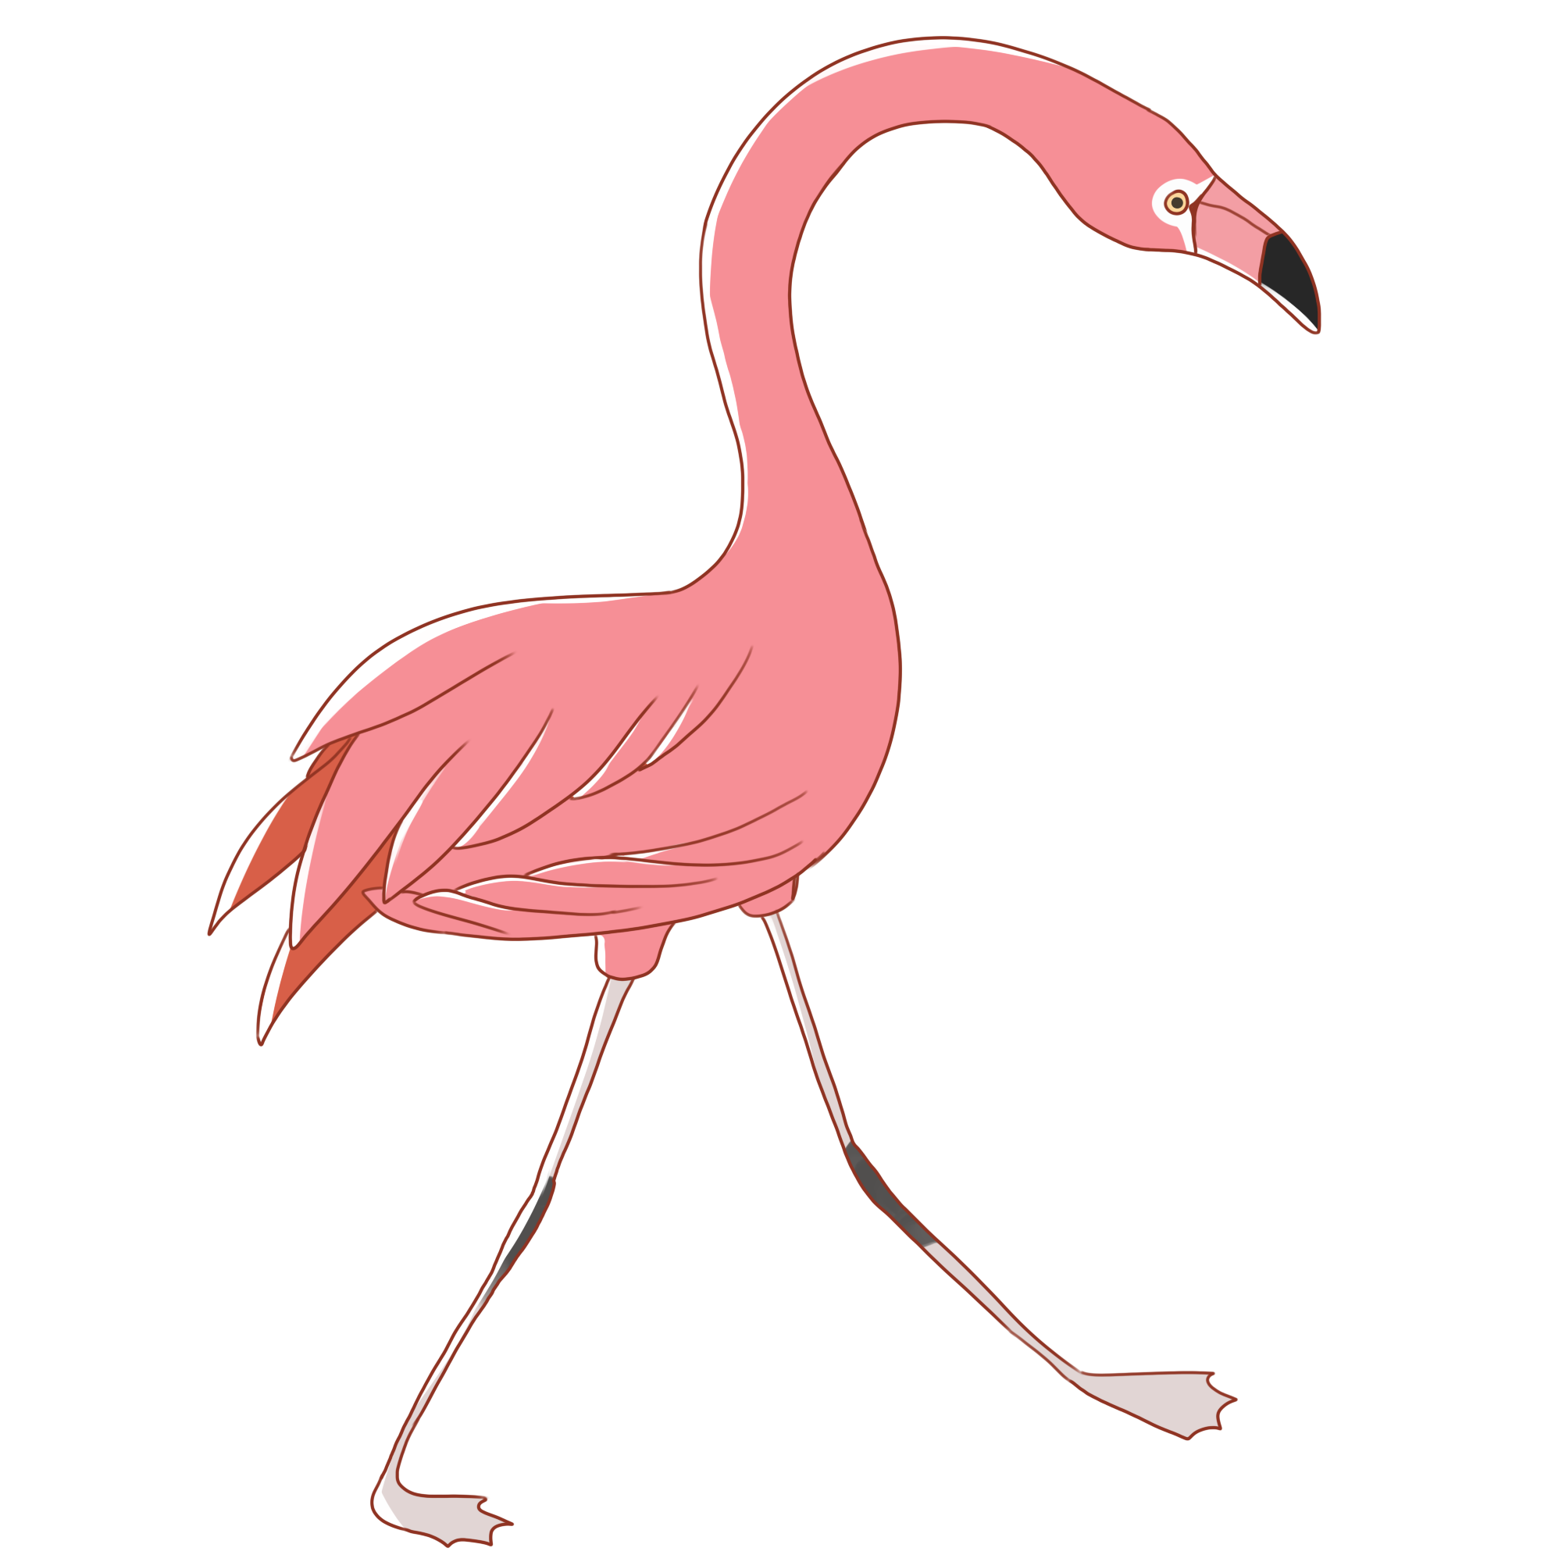
See you!

