Slide 1
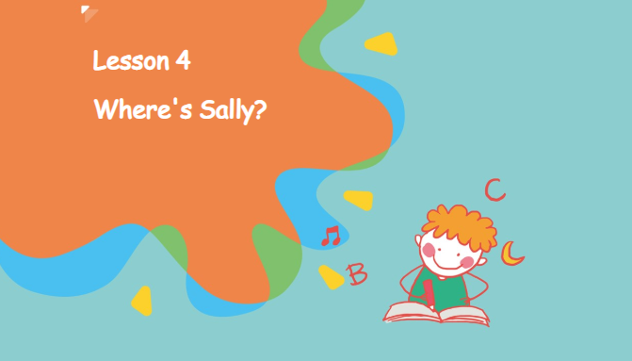

Slide 2
进门考
课堂落实（L29-30） P3

Slide 3
课堂落实
I.根据中文意思补全单词
（每小题10分，共50分）
1.卧室 b__dr __ __m
2.衣柜 w__ __dr__be
3.扫 sw__ __p
4.不整洁 __ __tidy
5.空的 __ __ __ ty
II.选词填空（每小题10分，共50分）
open sweep sharpen empty put
6.You must________ the floor. It is dirty.
7. Please ________the window and air the room.
8. It is cold. You must ________on your coat. Lily.
9. Tony, _______ your pencils.
10.The refrigerator is full. We must _______ it.

Slide 4
课堂落实
I.根据中文意思补全单词
（每小题10分，共50分）
1.卧室 b__dr __ __m
2.衣柜 w__ __dr__be
3.扫 sw__ __p
4.不整洁 __ __tidy
5.空的 __ __ __ ty
II.选词填空（每小题10分，共50分）
open sweep sharpen empty put
6.You must________ the floor. It is dirty.
7. Please ________the window and air the room.
8. It is cold. You must ________on your coat. Lily.
9. Tony, _______ your pencils.
10.The refrigerator is full. We must _______ it.
e o o
sweep
a r o
open
e e
put
u n
sharpen
e m p
empty

Slide 5
进门考 单词听写（L29-30）

Slide 6
1.关门
2. 卧室
3.不整洁
4. 必须
5. 打开
6. 使……通风
7. 放置
8. 衣服
9. 大衣柜
10. 掸掉灰尘
11. 扫
12. 倒空
13. 读
14. 削尖
15. 脱下
16. 穿上
17. 关闭 (家用电器)
18. 打开(家用电器)
19. 窗户
20. 扶手椅

Slide 7
1.关门
2. 卧室
3.不整洁
4. 必须
5. 打开
6. 使……通风
7. 放置
8. 衣服
9. 大衣柜
10. 掸掉灰尘
11. 扫
12. 倒空
13. 读
14. 削尖
15. 脱下
16. 穿上
17. 关闭 (家用电器)
18. 打开(家用电器)
19. 窗户
20. 扶手椅
shut
sweep
bedroom
empty
untidy
read
must
sharpen
open
take off
air
put on
put
turn off
clothes
turn on
wardrobe
window
dust
armchair

Slide 8
Recite the article

Slide 9
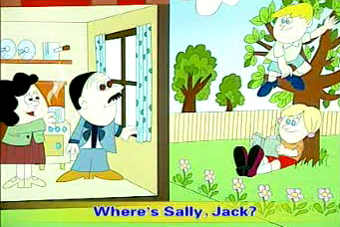
JEAN: _______ Sally, Jack?
JACK: She's in the ______, Jean.
JEAN: _______ she doing ?
JACK: She's _______ under the tree.
Where's
garden
What's
sitting

Slide 10
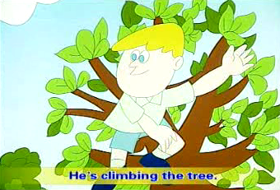
JEAN: Is Tim in the _______,too?
JACK: Yes, he is. He's ________the tree.
JEAN: I ____ your pardon? _______ climbing the tree?
JACK: Tim is.
garden
climbing
beg
Who's

Slide 11
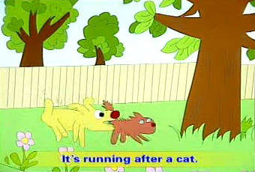
JEAN: What ______the dog?
JACK: The _____in the garden, too.
It's running ______the grass.
It's running ______a cat.
about
dog's
across
after

Slide 12
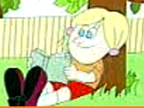
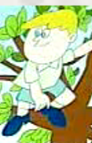
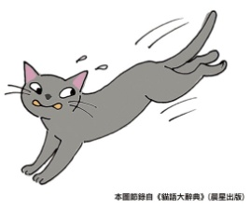
Lesson31 Where's Sally?
What
Where
beg
Who
Tim

Slide 13
Summary

Slide 14
New words
garden
under
tree
climb
who
run
grass
after
across
cat
type
花园
在…之下
树
爬，攀登
谁
跑
草，草地
在…之后
横过，穿过
猫
打字
letter
basket
eat
bone
clean
tooth
cook
milk
meal
drink
tap
信
篮子
吃
骨头
清洗
牙齿
做（饭菜）
牛奶
一顿饭
喝
（水）龙头

Slide 15
New words
garden
under
tree
climb
who
run
grass
after
across
cat
type
花园
在…之下
树
爬，攀登
谁
跑
草，草地
在…之后
横过，穿过
猫
打字
letter
basket
eat
bone
clean
tooth
cook
milk
meal
drink
tap
信
篮子
吃
骨头
清洗
牙齿
做（饭菜）
牛奶
一顿饭
喝
（水）龙头

Slide 16
Expressions
1.What's she doing ?
She's sitting under the tree.
be + doing 现在进行时 under the tree 在树下
2.What about the dog？
=What is the dog doing in the garden?
what about...？... ...怎么样？”
3.I beg your pardon?
口语中可以简单说成 Pardon？ 或者 Sorry？

Slide 17
Practice

Slide 18
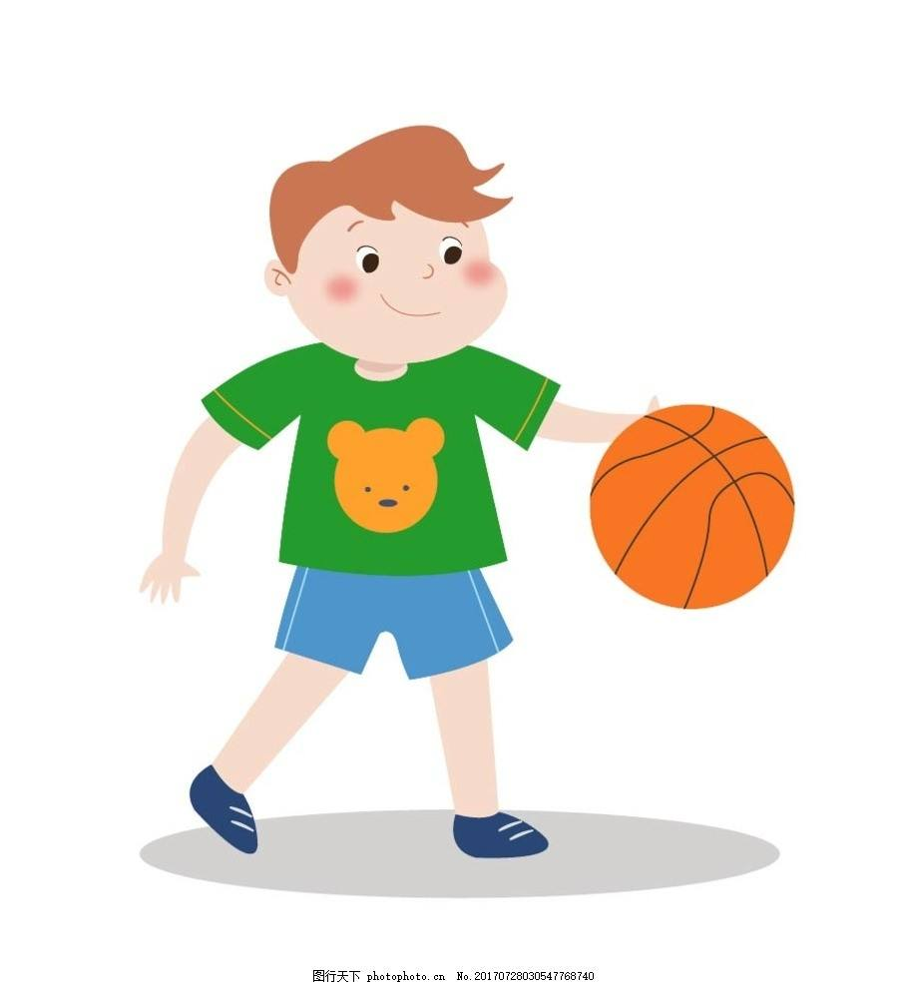
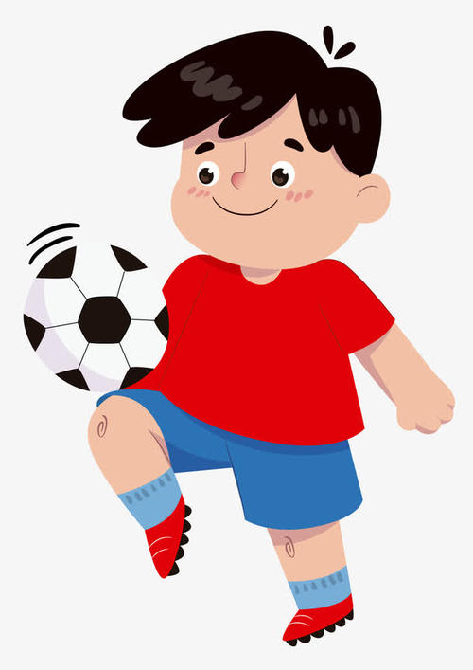
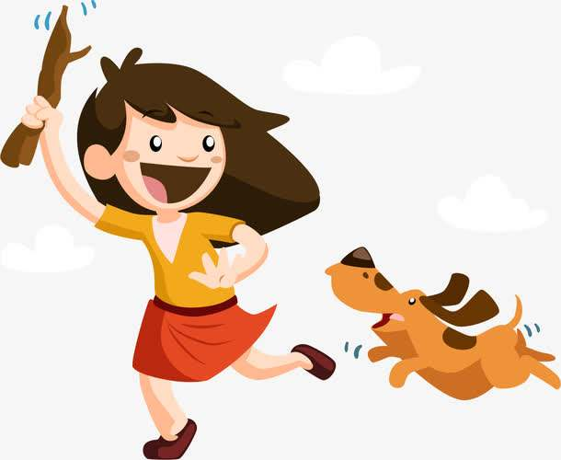
Practice 1: Talk about the picture
①
②
Example:
-- What is he doing?
-- He is playing football.
③
④

Slide 19
Practice 2: Read and match
climbing cleaning cooking typing drinking
1. A boy is ________the tree.
2. Lucy is _________a letter now.
3.John is __________his room.
4.Bob is __________ milk.
5.Mom is __________a meal.
climbing
typing
cleaning
drinking
cooking

Slide 20
出门考 学习手册-综合练习 P32

Slide 21
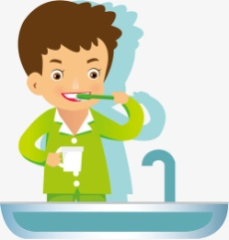
I.听录音，选出相应的图片
1.________ 2.________ 3.________ 4.________ 5._______
B
E
A
C
D
A B C D E

Slide 22
II.听录音，选出与听到的内容相符的一项。
1.A.Mary is eating a banana.
B. Mary is eating an apple.
C. Mum is eating an apple.
2.A.It is cold.
B. It is cool.
C. It is hot.
3.A. Sally is reading.
B. Sally is talking.
C. Sally is playing.
4.A. The children need some baskets.
B. The children need some cups.
C. The children need some plates.
5.A. Mr. Li is having a picnic.
B. Mrs. Li is having a picnic.
C. Miss Li is having a picnic.

Slide 23
III. 选词填空，每次限填一次
1.A naughty(调皮的)boy is ________the tree.
2.Be quiet! She is busy. She is _______a letter.
3.--What is mum doing ,Dad?
--She is __________a meal.
4.Look at the cat .It is _______its milk.
5.It is 8 o'clock. John is ________his room.
climbing cleaning cooking typing drinking
climbing
typing
cooking
drinking
cleaning

Slide 24
6.Look! John's dog is running ________Jason's cat!
7.The red book is on the blue book. The blue book is _____the red
book.
8.The dog is running ______the grass.
9.A sofa is _____the middle of the room.
10.The post office is ______our school.
near after under in across
after
under
across
in
near

Slide 25
IV.补全对话
Ben：Hi, Mrs. Green.
Mrs. Green: Hi, Ben.
Ben: 1._______
Mrs. Green: She is in the garden.
Ben: 2._______
Mrs. Green: She is playing (玩耍)with her cats.
Ben: How many cats are there in the garden?
Mrs. Green:3._______
Ben: Is Tony in the garden, too?
Mrs. Green:4.______He is in his bedroom.
Ben: In his bedroom?5.________
Mrs. Green: He is doing his homework.
A. No, he isn't.
B. What is he doing?
C. Where is Lisa?
D. What is she doing?
E. There are two.
C
D
E
A
B

Slide 26
今日巩固
APP端 - 看专题课
- 口语练习
- 背诵课文
温馨提示：
同学们，明天要考核课文背诵哦！

