Slide 2
进门考
课堂落实（L27-28）P2

Slide 3
课堂落实
I.根据中文意思补全单词
（每小题10分，共50分）
1.长裤 tr__ __sers
2.窗户 w__ __dow
3.门 d__ __r
4.墙壁 w__ __ __
5.扶手椅 __ __ __ chair
II.用some/any填空
（每小题10分，共50分）
6. Are there ________ coats in your room?
7.There are ________students in the classroom.
8.There are ________pictures on the wall.
9.There aren't _______bottles in this box.
10.Are there _________cookers in your kitchen?

Slide 4
课堂落实
I.根据中文意思补全单词
（每小题10分，共50分）
1.长裤 tr__ __sers
2.窗户 w__ __dow
3.门 d__ __r
4.墙壁 w__ __ __
5.扶手椅 __ __ __ chair
II.用some/any填空
（每小题10分，共50分）
6. Are there ________ coats in your room?
7.There are ________students in the classroom.
8.There are ________pictures on the wall.
9.There aren't _______bottles in this box.
10.Are there _________cookers in your kitchen?
o u
any
i n
some
some
o o
a l l
any
a r m
any

Slide 5
进门考 单词听写（L27-28）

Slide 6
1.长裤
2. 客厅
3. 在哪里
4. 在…里面
5. 扶手椅
6. 靠近
7. 窗户
8. 门
9. 图画
10. 墙
11. 夫人
12. 厨房
13. 电冰箱
14. 右边
15. 通电的
16. 左边
17. 炉子
18. 中间
19. 房间
20. 杯子

Slide 7
1.长裤
2. 客厅
3. 在哪里
4. 在…里面
5. 扶手椅
6. 靠近
7. 窗户
8. 门
9. 图画
10. 墙
11. 夫人
12. 厨房
13. 电冰箱
14. 右边
15. 通电的
16. 左边
17. 炉子
18. 中间
19. 房间
20. 杯子
trousers
Mrs.
living room
kitchen
where
refrigerator
in
right
armchair
electric
near
left
window
cooker
door
middle
picture
room
wall
cup

Slide 8
Recite the article

Slide 9
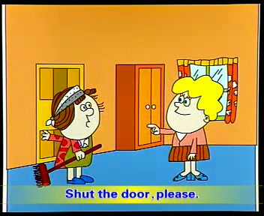
Mrs. Jones: ___________, Amy.
Shut the _______, please.
This _________ very untidy.
Come in
door
bedroom's

Slide 10
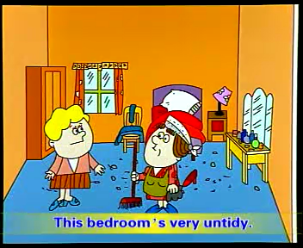
Amy: What ______I do, Mrs. Jones?
Mrs. Jones:_____ the window and ____the room.
Then ____these clothes in the ______.
Then _____the bed. _____ the dressing table.
Then _____ the floor.
must
Open
air
put
wardrobe
make
Dust
sweep

Slide 11
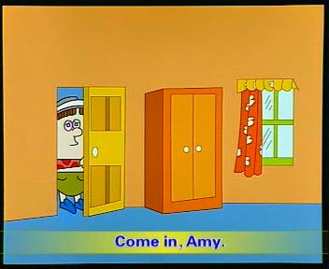
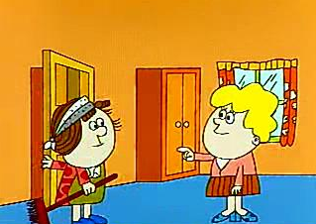
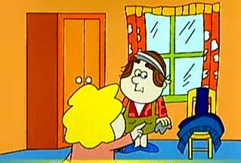
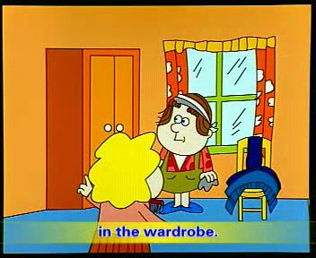
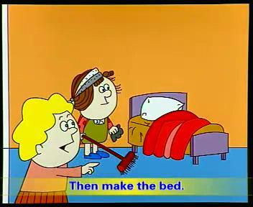
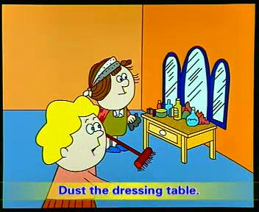
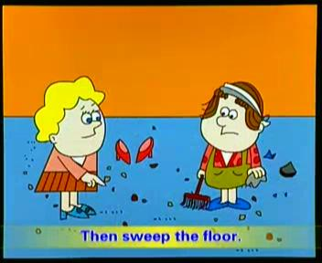
come
shut
untidy
must
open & air
put
make
dust
sweep
Notes:
去了动画

Slide 12
Summary

Slide 13
New words
shut
bedroom
untidy
must
open
air
put
clothes
wardrobe
关门
卧室
不整齐
必须；应该
打开
换换空气
放置
衣服
衣柜
dust
sweep
empty
read
sharpen
put on
take off
turn on
turn off
掸掉灰尘
扫
倒空
读
削尖
穿上
脱掉
开（电灯）
关（电灯）

Slide 14
Expressions
1.Come in, Amy.
祈使句，省略主语you，动词原形开头。祈使句有表达命令、请求、告诫、邀请等多种用法。
2. What must I do？
what引导的特殊疑问句。must是情态动词。表示”必须“, 常用于肯定句、疑问句中。
3. Then make the bed.
then 表示”然后“

Slide 15
Practice

Slide 16
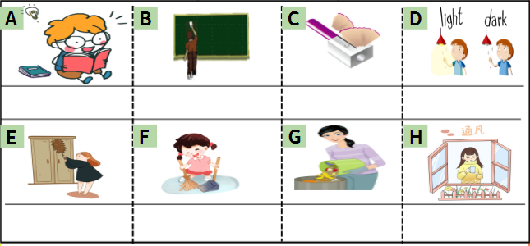
Practice 1: Look and match
1. Empty the trash. 5.Read the book.
2.Air the room. 6.Sharpen the pencil.
3.Dust the wardrobe. 7.Clean the blackboard.
4.Turn on /off the light. 8.Sweep the floor.
5
7
6
4
3
8
1
2

Slide 17
Practice 2: Write a to-do list
1.The beds are untidy.
2.It's a hot day and windows are shut.
3.The pencils in the desk are blunt.
4.The kitchen floor is dirty.
5.The dressing takble is dusty.
6.The living room is untidy.
7.The bedroom is dirty.
Make the bed.
Open the window.
Sharpen the pencils
Sweep the floor.
Dust the dressing table.
Tidy the living room.
Clean the bedroom.

Slide 18
出门考 学习手册-综合练习 P23

Slide 19
I.听录音，选出相应的图片
1._________2._________3._________4._________5._________
B
D
E
C
A
A B C D E

Slide 20
II.听录音，帮Jessica将要做的事情排序
1._________2._________3._________4._________5._________
A. Jessica must sweep the floor.
B. Jessica must clean the desk.
C. Jessica must make the bed.
D. Jessica must open the window and air the room.
E. Jessica must put the clothes in the wardrobe.
E
C
B
A
D

Slide 21
III.根据汉语提示完成句子，每空一词
1. 请进，玛丽。
Please ________ _______,Mary.
2.我应该做什么？
________ _______I do？
3.请把电视打开。
Please ________ _______ the television.
4.请把外套脱掉。
________ _______the coat, please.
5.请把衣柜打开。
________ ________ _______,please.
come
in
What
must
turn
on
Put
on
Open
the
wardrobe

Slide 22
IV.阅读短文，判断正（T）误（F）
My name is Sally. I must get up early every day. I must keep (保持) my bedroom tidy. My mother asks me to open the window and air the room. Then I must make the bed and dust the dressing table. After lunch, I must wash the dishes every day. I can't watch television on weekdays. I must sweep the floor, too. I am very tired. How about you ?Please write to me soon.
F
( ) 1.Sally must get up late every day.
( ) 2.Sally's mother asks her to close the window.
( ) 3.Sally can watch television on weekdays.
( ) 4.Sally isn't tired.
( ) 5.Sally must do a lot of housework(家务活)every day.
F
F
F
T

Slide 23
今日巩固
APP端 - 看专题课
- 口语练习
- 背诵课文
温馨提示：
同学们，明天要考核课文背诵哦！

