Slide 1
四年级公立校
Unit 1
L1 How Are You?
L2 Is This Your Pencil?

Slide 2
Phonetics

Slide 3
/iː/
/e/
/uː/
/ʊ/
Try to read.
sea
thread
moon
wood

Slide 4
Exercise
一、读一读，判断下列每组单词画线部分的读音是 (T)否(F)。
( ) 1. meat see
( ) 2. bread meet
( ) 3. zoo school
( ) 4. moon look
( ) 5. cold today
T
F
T
F
oo两读音，一长一短/uː/和/ʊ/
k, t, d 前发短/ʊ/(book cook foot good)
boot, food, noodles 是特殊， oo 发长/uː/
F

Slide 5
重点梳理

Slide 6
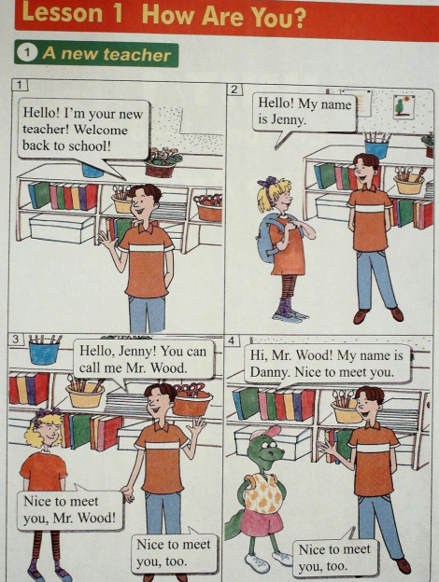
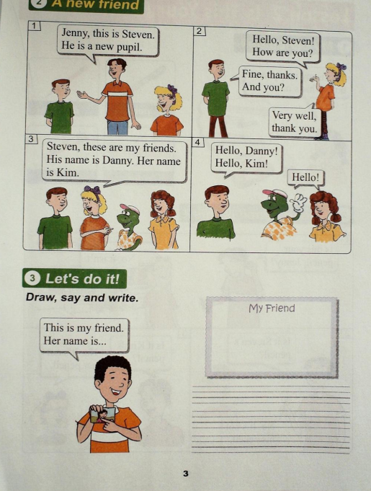
Notes:
注意动画顺序：1.打招呼用语
2.介绍自己及别人会用到哪些句型

Slide 7
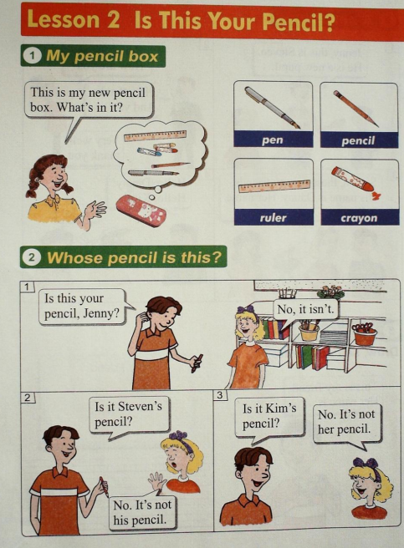
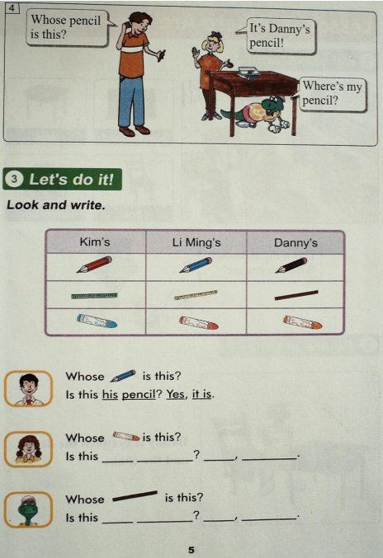
Notes:
注意动画顺序：1.强调特殊疑问词whose
2.回答whose引导的特殊疑问句会用到两种：形物代+名词/名词所有格
3.一般疑问句。this/that 问， it 来回答

Slide 8
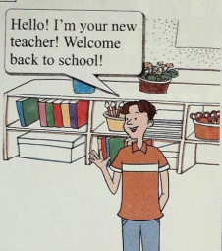
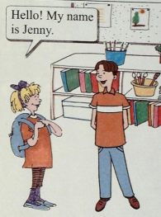
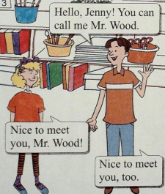
知识点 1
介绍自己的句型有哪些？
I’m=I am
I’m +名字/身份
My name is+名字
You can call me+名字
例句：
I am Mary.
My name is Mary.
You can call me Mary.
Notes:
本页介绍自己的句型，下页过渡到介绍别人及询问对方名字会用到的句型

Slide 9
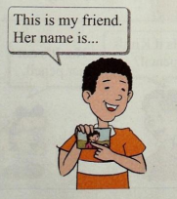
知识点 2
介绍别人用：This is…
____ is my friend, Mary.
例句：
This
询问对方的名字用：What’s your name?
例句：
他/她的名字叫什么？
What’s _____ name?
his/her
his/her是形容词性物主代词
我的my, 你的your, 男他的his, 女它的her, 物它的its不加’,our our 我们的，their their 他们的。
形物代后加名词。
Notes:
介绍别人及问对方名字

Slide 10
知识点 3
Welcome back to school!
“欢迎回到学校”
Welcome back to +地点名词
“欢迎回到…”
Welcome back +地点副词
例句：
Welcome back to Beijing.
“欢迎来到…”
Welcome to +地点名词
Welcome back home.
Welcome +地点副词
例句：
Welcome to our school.
常见地点副词： home, here, there, upstairs, downstairs
Welcome here.

Slide 11
知识点 4
Is this your pencil, Jenny?
Be动词引导的一般疑问句
用Yes/No, 来回答。
this/that 问， it 来回答
例句：
Is this your pen?
this-复数--these
that—复数-those
No, ___ isn’t.
it
例句：
Are these your pens?
Yes, ___ are.
they
these/those 问，用 they 来回答

Slide 12
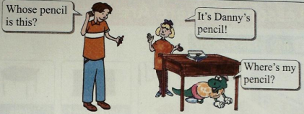
知识点 5
Whose pencil is this?
whose“谁的”
Whose +可数名词单数+is this/that？
Whose + 复数名词 +are+they/these/those?
翻译：
这是谁的铅笔盒？
Whose pencil box is this?
这些钢笔是谁的？
Whose pens are these?

Slide 13
知识点 6
Whose引导的特殊疑问句怎么回答
It’s Danny's pencil!
名词所有格（表示所属关系）
my brother's
Lily's
's 's 的的的
my parents' the students'
遇到s请注意，只加小'就可以。
Lily's and Lucy's
分别拥有，分别's (后者+名复)
They are Lily's and Lucy's mothers.
共同拥有，最后's (后者+名单)
Lily and Lucy's
She is Lily and Lucy's mother.

Slide 14
一 我会选。
( )1. What color is ________ dress?
A. you B. your C. she
( )2. You can call ________ Mr. Black.
A. his B. me C. she
( )3. Welcome ________ our school.
A. to B. in C. with
( )4. _____ name is Mary, _____ is my friend.
Her; her B. Her, she C. My, her
( )5. ___ is my father. He is a worker.
A. This B. He C. His
B
B
call是动词，动词后用宾格
I宾me, you宾you, he宾him, she宾her, it宾it.
A
B
A

Slide 15
二、按要求完成句子。
1. This is my ruler(改为一般疑问句)
________________________________________
2. Is this your pencil box? (做否定回答)
________________________________________
3. Whose pen is this? (回答：是Lily的钢笔)
________________________________________
4. My name is Tina?(写出同义句 )
________________________________________
Is this your ruler?
No, it isn’t.
It’s Lily’s pen.
I’m Tina./You can call me Tina.

Slide 16
三 阅读短文，连线。
Look! There is a blue pencil on the desk. Whose pencil is this? Is it Steven’s pencil ? No. It’s not his pencil. He has a red pencil. Is it Jenny’s pencil? No. It’s not her pencil. Jenny is drawing with her pencil. Is it Danny’s pencil ?Yes! Look! Danny is under the desk. He is looking for(寻找) his pencil.
( ) 1.The blue pencil is on the desk.
( ) 2.Steven has a blue pencil.
( ) 3.Danny is drawing with his pencil.
( ) 4.Danny is looking for his pencil.
T
F
F
T

Slide 17
Thanks

