Slide 2
Recite the article

Slide 3
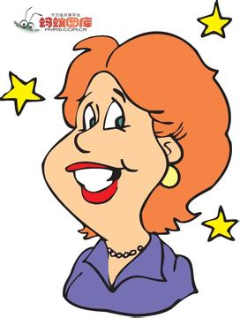
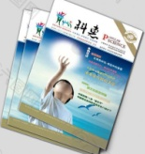
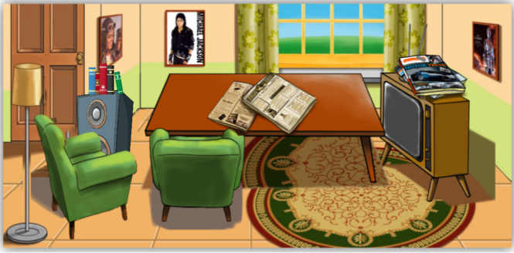
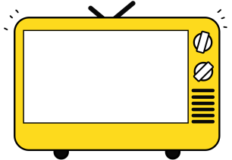
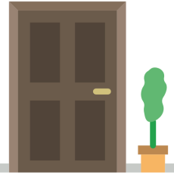
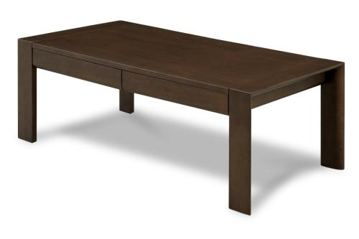
living room
large
Mrs. Smith
near

Slide 4
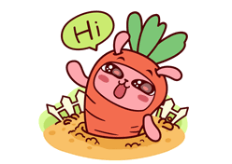
Greetings
Hello, everyone.
How are you !
How do you do?
Nice to see you!

Slide 5
Revision
PK to say the words

Slide 6
near
living room
window
armchair
door

Slide 7
picture
wall
trousers
stereo
magazine

Slide 8
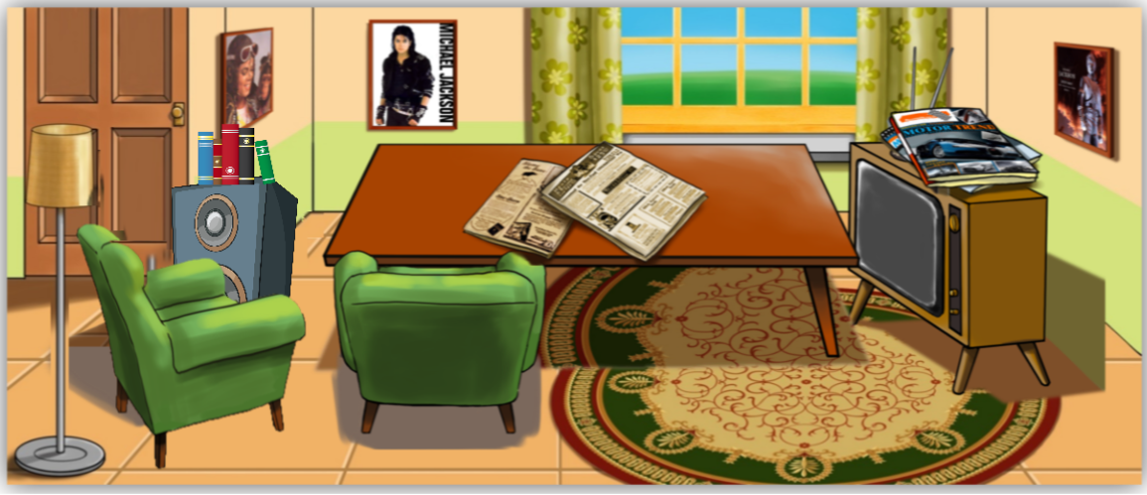
Speech
How about your living room？
Example
There is a table near the TV.
There are some magazines on the table.
Your turn
There is…
There are…

Slide 9
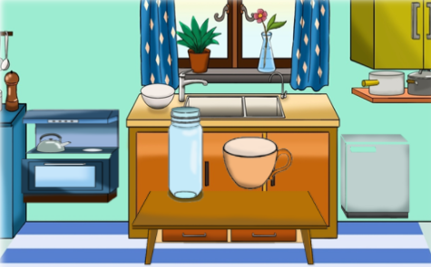
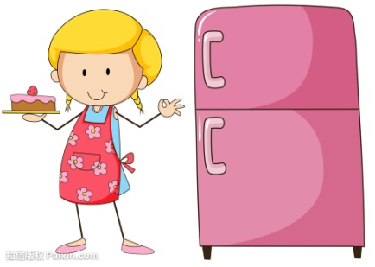
Grammar- 1
What are there in the kitchen?
living room?
Mrs. Smith
There is an electric cooker in the kitchen.
“某地有某物”
There is some water in the bottle.
There is +名单+ 地点.
There are some books on the stereo.
There is+名不+ 地点.
There are some newspapers on the table.
There are +名复+ 地点.

Slide 10
Exercise-1
用 be 的适当形式填空：
There ___ a student in the classroom.
is
2. There ___ many magazines on the table.
are
3. There ___ some milk in the galss.
is
are
4. There ___ two pictures in the room.
5. There ___ ten desks in the classroom.
are
is
6. There ___ a girl in the room.

Slide 11
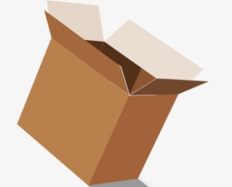
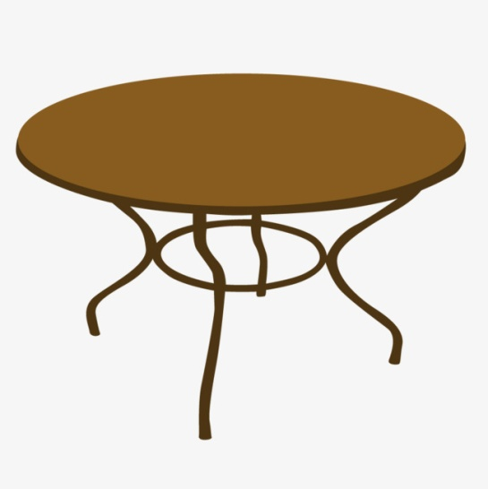
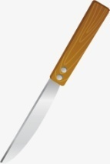
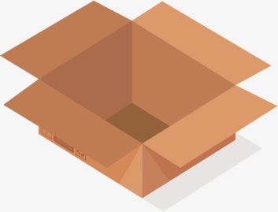
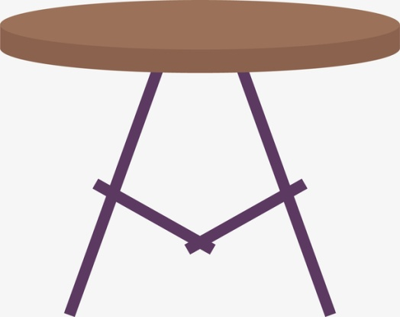
Exercise- 1
e.g. cigarettes/ on the table/ near that box
There are some cigarettes on the table.
They are near that box.
前名后代
knives/ on the table/ in that box
There are some knives on the table.
They are in that box.
Notes:
语言中有一种现象，前面出现了一个名词，为了避免重复和啰嗦，在后面出现的时候我们就可以用代词来进行替代。

Slide 12
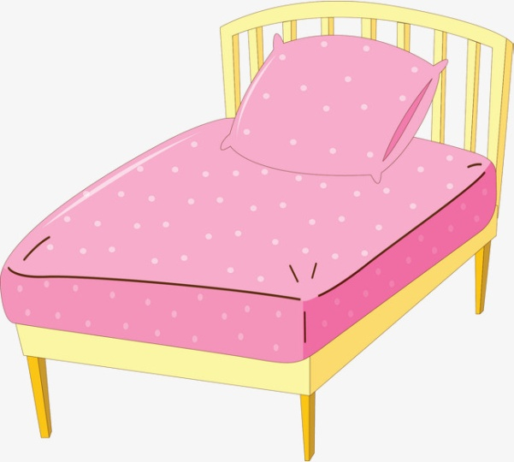
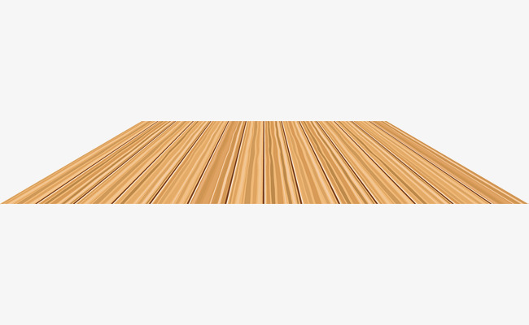
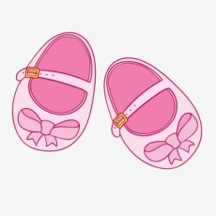
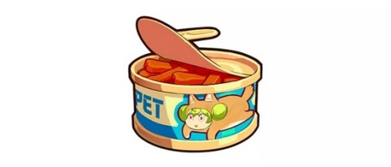
Exercise- 1
shoes/ on the floor/ near the bed
There are some shoes on the floor.
They are near the bed.
bottles/ on the cupboard/ near those tins
There are some bottles on the cupboard.
They are near those tins.

Slide 13
Grammar-2
There are some newspapers on the table.
否定句：
There aren't any newspapers on the table.
一般
疑问句：
Are there any newspapers on the table？
回答：
Yes, there are. No, there aren’t.
some
肯定句
There are some pencils on the desk.
一些
否定句
There aren’t any pencils on the desk.
any
疑问句
Are there any pencils on the desk?
Notes:
1.找同学造句2，找同学变否定，其他ss改正，直到句子正确 。1分钟自己练习，找ssPK。some any 讲完口头进行therebe口诀复习，老师问，ss接龙回答（T叫哪个ss回答，哪个再答）

Slide 14
Exercise-2
some/ any
Put ______ bread on the table.
Do you see ______ people?
There isn’t ______ water in the glass.
There are ______ armchairs in the room.
Are there ______ people in that kitchen?
some
any
any
some
any

Slide 15
Exercise-2
句型转换
1. There are some apples on the tree.
疑问句: __________________________
肯/否回答: __________________________
否定句: __________________________
2. There is some water in the cup.
疑问句: __________________________
肯/否回答: __________________________
否定句: __________________________
Are there any apples on the tree?
No, there aren’t.
Yes, there are.
There aren’t any apples on the tree.
Is there any water in the cup?
No, there isn’t.
Yes, there is.
There isn’t any water in the cup.

Slide 16
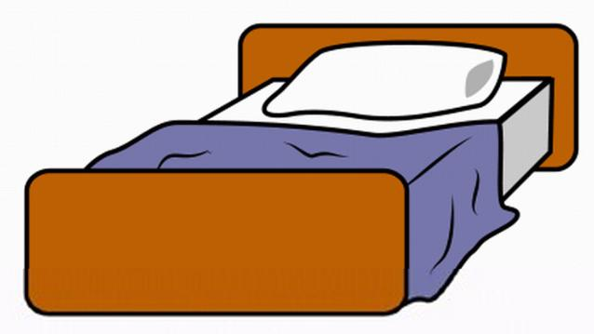
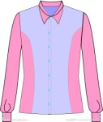
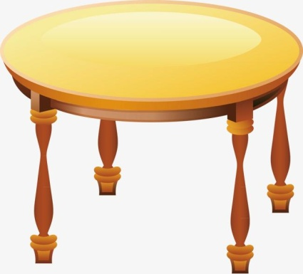
Exercise-2：一般疑问句
e.g. pictures/ near that box
Are there any pictures near that box?
No, there aren’t any pictures near that box.
trousers/ near that shirt
Are there any trousers near that shirt?
No, there aren’t any trousers near that shirt.
knives/ on the table
Are there any knives on the table?
Yes, there are some knives on the table.
Notes:
根据图片情景，练习对话

Slide 17
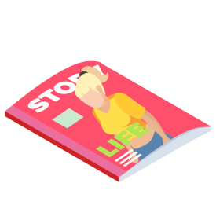
Grammar-3
桌子上有一本书和一些报纸。
There is a book and some newspapers on the table.
桌子上有一些报纸和一本书。
There are some newspapers and a book on the table.
就近原则
There be 句型中，如果“be”后是由and连接的两个或两个以上的名词，那么be的形式要遵循“就近原则”。
Notes:
引导 发现 为什么 总结规律

Slide 18
Grammar-3
There be ,There be , 表示某地有某物;
There is 接名单/名不, there are 接名复;
就近原则要记住；
变疑问,be 提前; 否定be后加not;
变疑问，变否定；some记得变any.
Notes:
口诀背诵

Slide 19
Exercise-3
用 be 的适当形式填空：
is
There ______ a pen near the ruler.
There ______ two books and one cup on the table.
There ______ some water and some apples on the table.
There ______ a ruler and three pencils on the table.
______ there a boy in the room?
There ______ any birds in the sky.
______ there any books on the desk?
are
is
is
Is
aren’t
Are

Slide 20
Exercise-4
1. There are some forks on the shelf. (改为否定句)
There _____ _____ forks on the shelf.
2. There are some shoes near the bed. (改为一般疑问句)
_____ _____ ______ shoes near the bed?
3. Are there any bottles on the cupboard? (作肯定回答)
Yes, ______ _______.
4. The cigarettes are on the dressing table. (对划线部分提问)
_______ ______ the cigarettes?
5. Is there a stereo in the room? (作否定回答)
No, ______ _______.
aren't any
Are there any
there are
Where are
there isn't

Slide 21
Practice

Slide 22
Practice
1. ______ pictures are on the wall.
A. A B. An C. The
2. The stereo is _____ the window.
A. in B. near C. on
3. ______ there a magazine on the shelf?
A. Am B. Is C. Are
4. There aren’t _______ dresses in the room.
A. any B. a C. some
5. There are _____ bottles on the table.
A. a B. an C. some
C
B
B
A
C

Slide 23
Practice
1. the, on, stereo, there, some, are, books （.)
________________________________________
2. table, near, the, are, armchairs, two, there (.)
________________________________________
3. any, there, the, cookers, are, in, not, kitchen (.)
________________________________________
4. where, the, pictures, are (?)
________________________________________
There are some books on the stereo.
There are two armchairs near the table.
There are not any cookers in the kitchen.
Where are the pictures?

Slide 24
Practice
1. 这张课桌靠近窗户。
_______________________________________
2. 桌子上有八本书。
_______________________________________
3. 梳妆台上有一些杂志吗？
_______________________________________
4. There aren’t any apples in the refrigerator.
_______________________________________
5. Are there any forks on the plate?
_______________________________________
The desk is near the window.
There are eight books on the table.
Are there any magazines on the dressing table?
冰箱里没有苹果。
盘子里有叉子吗？

Slide 25
Practice
Tony has a bedroom. It’s big and nice.
There is a bed, a desk, a chair in Tony’s bedroom. You can see a ball under the chair. There are some pictures on the wall. Tony likes listening to music. So, there is a stereo next to the window. Look, there is a cat sleeping on the chair. It is very lovely!
1. Is the bedroom big or small?
___________________________
2. Is there a chair in the bedroom?
___________________________
It is big.
Yes, there is.

Slide 26
Practice
Tony has a bedroom. It’s big and nice.
There is a bed, a desk, a chair in Tony’s bedroom. You can see a ball under the chair. There are some pictures on the wall. Tony likes listening to music. So, there is a stereo next to the window. Look, there is a cat sleeping on the chair. It is very lovely!
3. Where is the ball?
________________________________
4. Are there any cats in the bedroom?
_______________________________
It is under the chair.
Yes, there is a cat in the bedroom.

Slide 27
Summary

Slide 28
Grammar-1 there be单/复数句型：
There is +名单/名不+ 地点.
There are +名复+ 地点.
Grammar-2 some/ any的用法：
some
肯定句
一些
否定句
any
疑问句

Slide 29
Grammar-3 there be句型：就近原则
There be 句型中，如果“be”后是由and连接的两个或两个以上的名词，那么be的形式要遵循“就近原则”。
Grammar-4 there be句型口诀：
There be ,There be , 表示某地有某物;
There is 接名单/名不, there are 接名复;
就近原则要记住；
变疑问,be 提前; 否定be后加not;
变疑问，变否定；some记得变any.

Slide 30
出门考 课堂检测 P2

Slide 31
I 将下列单词与对应的中文意思连线。（每小题10分，共50分）
picture A. 墙
wall B. 靠近
near C. 窗户
trousers D. 长裤
window E. 图画

Slide 32
II 用is/ are填空。（每小题10分，共50分）
6. There ________ an armchair in the room.
7. There ________ two chairs near the table.
8. There ________ a window on the wall.
9. There ________ some bottles on the desk.
10. There ________ some spoons on the plate.
is
are
is
are
are

Slide 33
本周精进
周一： App端 - 自我巩固
线下 - 完成造句册作业
周三：手机端 - 微信教学
周五：App端 - 预习视频
温馨提示：
小朋友们，不要忘记背诵单词L27&28！

