Slide 2
Recite the article

Slide 3
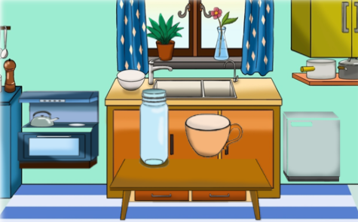
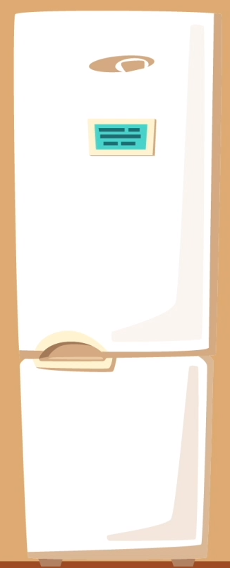
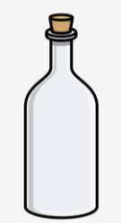
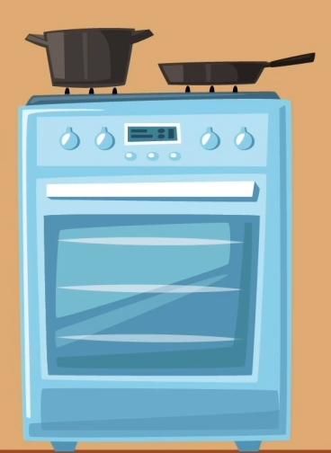
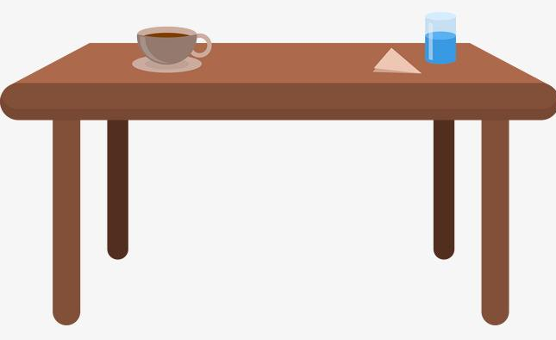
kitchen
small
Mrs. Smith
refrigerator
electric cooker
white
right
blue
left
cup
bottle
clean
empty
table
middle

Slide 4
New lesson

Slide 5
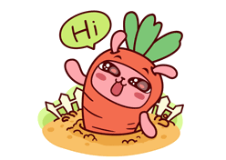
Greetings
Hello, everyone.
How are you !
How do you do?
Nice to see you!

Slide 6
Revision
连连看
房间
冰箱
厨房
炉子
夫人
右边
middle
electric
cup
左边
room
中间
Mrs.
refrigerator
kitchen
right
left
带电的
cooker
杯子
Notes:
老师点汉语图片，学生说英文，老师点击相应英文单词图片

Slide 7
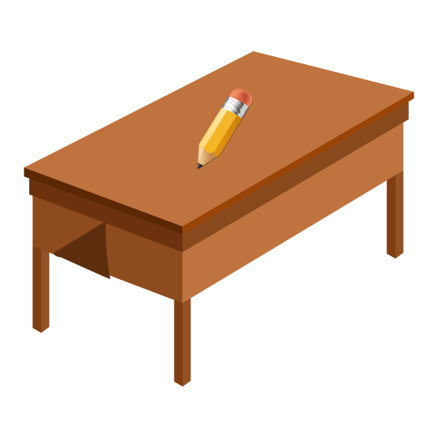
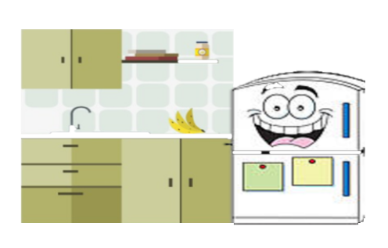
Speech
Example
Your turn
knife/on the plate/sharp
pencil/on the desk/yellow
There is a pencil on the desk.
box/on the floor/large
The pencil is yellow.

Slide 8
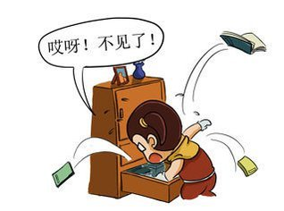
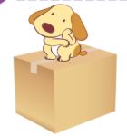
Lead in
Where is my dog?
It is on the box.
Where are the dogs?
They are on the box.

Slide 9
Grammar-1
Where is my dog?
名问代答
adv. 在哪里
It is on the box.
On the box.
Where are the dogs?
They are on the box.
where 疑问副词。引导特殊疑问句。询问人或者事物的位置。
回答可以是句子，也可以是短语。
Where is +名单？
It’s ,It’s 记心间。
Where are +名复？
They’re , they’re 要记住。

Slide 10
Exercise-1
1. - ______ is my hat?
- It is on your head.
B
A. Who B. Where C. Which
B
2. Where _____ my key？ I can’t find it.
A. are B. is C. am
B
3. –Where is my key? - ____ on the chair.
A. It B. It’s C. They are
A
4. –Where are my jackets? - ____ on the bed.
A. They’re B. It’s C. They
5. The book is on the desk.(对划线部分提问)
Where
is
______ ______ the book?

Slide 11
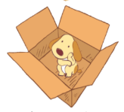
Grammar-2
Where is the dog?
It is on the box.
Where is the dog?
It is in the box.
on 为介词。表示位置关系。意思为“在…上面”
in 为介词。意思为“在…里面”

Slide 12
Grammar-2
under
in front of
behind
beside
on the left
on the right
in the middle of
next to

Slide 13
Grammar-2
on 在上面；in 在里面；
under在下面；next to紧挨着；
in front of 在前面；
behind 在后面；
beside 在旁边；
on the left在左边;
on the right在右边;
空间中间用：in the middle of
Notes:
学生记笔记，老师汉语提问，学生说英文

Slide 14
Exercise-2
next to
in front of
under
on the left
beside
in the middle of
on the right
behind

Slide 15
Exercise-2
next to
in the middle of
in front of
under
on the left
beside
on the right
behind

Slide 16
Exercise-2
A: Where____ the table?
B:It ____ in the _____ of
the room.
is
is
middle
is
A: Where ____ the cup?
B:It is ____ the table.
on
are
A: Where____ the bags?
B: They are ____ the box.
on

Slide 17
have
Grammar-3
have
I have a kitchen.
There is + a/an+ 名单+ 地点.
Mrs. Smith
某人拥有
“某地有某物”
There is a refrigerator in the kitchen.
There is
There is an electric cooker in the kitchen.
There is
There is a table in the middle of the room.
There is
There is a bottle on the table.
There is

Slide 18
Grammar-3:
have
There is a cup on the table.
There is some water in the glass.
Is there any water in the glass?
Is there a cup on the table?
Yes, there is.
No, there isn’t.
Yes, there is.
No, there isn’t.
There isn’t a cup on the table.
There isn’t any water in the glass.
There is + a/an+ 名单+地点.
There is + 名不+地点.
there be一般疑问句：Is there+...
回答：Yes, there is. / No, there isn’t.
there be否定句：There isn’t +...
Notes:
本讲只讲单数；下讲会讲复数 老师需要强调some变any

Slide 19
1. ( ) There __ an umbrella in the bag.
A. is B. am C. are
2. ( )There__ a book on the TV.
A. isn’t B .am not C. aren’t
3. ( ) ___ there a bottle on your desk?
A. Are B. Is C. Am
4. - _____ (be) there a TV on the table? -Yes, there ______ (be).
5. There is a lovely girl in the room. (变一般疑问句)
__________________________?
6. There is some water. (变否定句)
__________________________.
have
Exercise-3
A
A
B
Is
is
Is there a lovely girl in the room
There isn’t any water.

Slide 20
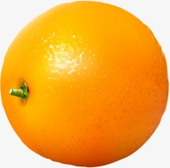
have
Grammar-4
a
There is _____ dog near the box.
____ dog is on the right .
第一次出现用a/an
The
再次出现时用the
an
There is _____ orange near the box.
____ orange is on the left.
The
定冠词
定冠词the表示特指。特质某（些）人或某（些）物。
冠 词
不定冠词
不定冠词a/an表示泛指，“一……”。

Slide 21
Exercise-4
1. There is ________ knife on ________ table.
2. Is there ________ fork on ________ plate？
3. Give me ________ glass on the refrigerator，please.
4. There is ________ empty cup on the table.
5. There is a girl. ________ girl is playing.
a
the
a
the
the
an
The

Slide 22
Prctice

Slide 23
Practice
Choose the right answer:
1. ______ is a refrigerator in the kitchen.
A. That B. This C. There
2. There ______ a table in the room. It is on the right.
A. is B. are C. be
3. There is a bottle in ______ middle of the room.
A. / B. a C. the
4. It is on ______ right.
A. a B. the C. /
5. - ______ is it?
- In the room.
A. Where B. What C. Who
C
A
C
B
A

Slide 24
Sum up
Practice
Complete the sentences:
1. There is a glass in the cupboard. (改为一般疑问句)
______ ______ a glass in the cupboard?
2. There is a box on the table. (改为一般疑问句)
______ ______ a box on the table?
3. The electric cooker is in the kitchen. (对划线部分提问)
______ ______ the electric cooker?
4. The book is in the middle of the desk. (对划线部分提问)
______ ______ in the middle of the desk？
Is there
Is there
Where is
What is

Slide 25
Summary

Slide 26
Grammar-1 where 疑问句
Where is +单数? Where are +名复？
Grammar-2 地点介词
on 在上面；in 在里面；under在下面；next to紧挨着；
in front of 在前面；behind 在后面；beside 在旁边；
on the left在左边; on the right在右边;
空间中间用：in the middle of

Slide 27
Grammar-3 there be句型：某地有某物
There is + a/an+ 名单+地点.
There is + 名不+地点.
there be一般疑问句：Is there+...
there be回答：
there be否定句：There isn’t +...
Grammar-4 a/an/the
定冠词
定冠词the表示特指。特质某（些）人或某（些）物。
冠 词
不定冠词a/an表示泛指，“一……”。
不定冠词

Slide 28
出门考 学习手册-综合练习P7

Slide 29
学习手册-综合练习
I.听录音,选出你所听到的单词。
1. A. cupboard B. television C. table
2. A. bottle B. plate C. cup
3. A. box B. case C. bed
4. A. coke B. cook C. cooker
5. A. cup B. glass C. bottle
II.听录音,选出最恰当的应答。
1. A. Yes, it is. B. Yes, there is. C. Yes, this is.
2. A. Three cups. B. The empty ones. C. The full on.
3. A. The books on the shelf. B. The red one. C. The book on the desk.
4. A. On the floor. B. It is large. C. Yes, there is.
5. A. It is new. B. It is sharp. C. It is green.

Slide 30
III. 根据汉语提示完成句子，每空一词。
1. 我的房间很小。
________ ________ is very ________.
2. 我的床在房间的中间。
My bed is ________ ________ ________ ________ the room.
3. 桌子上有一个杯子。
________ ________ a cup ________ the table.
4. 冰箱里有一个空瓶子。
________ ________ an empty bottle ________ the ____________ .
5. 左边有一个盘子。
________ is a plate ________ ________ ________ .
My
room
small
in
the
middle
of
There
is
on
There
is
in
refrigerator
There
on
the
left

Slide 31
IV.阅读短文，判断正（T）误（F）。
This is my room . It’s small, but it’s clean. There is a blue bed in the room. Look！That is my coat. It’s on the bed. There is a desk in the room, too. There is a bottle on the desk, but there is no water in it. It is empty. There is a cup on the desk, too. The cup is small.
( ) 1. I have a large room.
( ) 2. My shirt is on the bed.
( ) 3. There is a desk in the room.
( ) 4. There is a spoon in the bottle.
( ) 5. There is a small plate on the desk.
F
F
T
F
F

Slide 32
出门考 课堂检测 P1

Slide 33
Ⅰ.将下列单词与对应的中文意思相连。（每小题10分，共50分）
1. left A.电冰箱
2. kitchen B.右边
3. right C.厨房
4. refrigerator D.炉子；炊具
5. cooker E.左边
II.选词填空，每词限用一次。（每小题10分，共50分）
on in of a the
6. ______________ book on the desk is my teacher’s.
7. There is a new bed ______________ his room.
8. Look! A tall tree is in the middle ______________ two short trees.
9. There is ______________ nice hat on the chair.
10.An empty bottle is ______________ the left.
The
in
of
a
on

Slide 34
本周精进
周一： App端 - 自我巩固
线下 - 完成造句册作业
周三：手机端 - 微信教学
周五：App端 - 预习视频
温馨提示：
小朋友们，不要忘记背诵单词L25&26！

