Slide 1
Unit 1 Spring Is Coming!
Functions：weather，spring，outdoor activities
Grammar: word building (构词法)

Slide 2
Lesson 6 Stories about Spring
Words：
low 低的；浅的
below 在……下面
zero 零
until 直到……为止
groundhog 土拨鼠
bush 灌木
Phrases：
on the grass 在草地上
as low as 像……一样低；低达……
drops below zero （气温）降到零下
on snowy days 在下雪的日子
be fun 是有乐趣的
play in + clothes 穿……玩耍
Groundhog Day 土拨鼠日
so much + 如此多的……
fun activities 有趣的活动
in North America 在北美洲

Slide 3
Lesson 6 Stories about Spring
THINK ABOUT IT
·What clothes do you wear in spring?
·What interesting things do you see in spring?
Dear Wang Mei,
It isn’t snowing today, but there is still snow on the grass.
In Edmonton, the weather in March can be cold and snowy or warm and sunny. It’s a little wild. The temperature can be as low as -15℃, but it can also reach 15℃.
在草地上
在埃德蒙顿
可能是
低达

Slide 4
Lesson 6 Stories about Spring
Still, sometimes it snows in April and May! The temperature drops below zero on those snowy days. We probably won’t see any flowers until May or June!
After school today, we played outside. We played “snow” soccer. We had to wear our jackets and boots, but it was fun. Danny fell into the snow! Maybe next month we will play in our shorts and T­shirts!
下降
零度以下
在那些下雪天
掉进；跌落
穿……

Slide 5
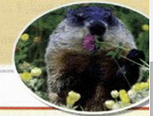
Lesson 6 Stories about Spring
I like the Chinese name for winter jasmine. It’s interesting. Here, we have Groundhog Day on February 2 for the coming of spring. In spring, many families drive to the countryside on weekends. A popular place to go is a sugar bush. It’s so much fun to make syrup.
I love spring because of all the fun activities.
Also, summer follows it!
Talk to you soon!
Jenny
……的中文称呼
土拨鼠日
驱车去某地
在周末
受欢迎的地方
枫糖林
制作枫糖浆

Slide 6
语法讲解
知识点 1
as. . . as. . . 和……一样……
eg：He is as busy as his brother.
他和他哥哥一样忙。
【难点】
as. . . as. . . 用于两者间的比较，
表示“和……一样……”，
中间要用形容词或副词的原级。
否定形式：not as. . . as. . . 或not so. . . as. . .
表示“不如/不及……”，
as. . . as＋数字．. . 意为“……达……”。

Slide 7
语法讲解
Liu Ying is as ________ as her sister.
A．tall B．taller C．the tallest
例题1：
A
例题2：
Jenny is shorter than Li Ming.
Jenny is ______ ________ ______ ________ Li Ming.
not as tall as

Slide 8
语法讲解
知识点 2
below prep. & adv. 在……下面，低于
eg：Shall I write my name below the line?
我把我的名字写在这条线下面好吗？
辨析 above, over, on, below, under。
above, over 和 on 都是“在……上面”，
below, under 都是“在……下面”。
【难点】

Slide 9
语法讲解
above | 表示在某物体的上方，与某物体不接触。反义词为below。 | Planes fly above the white clouds. 飞机在白云上面飞行。 All the fields are below the planes. 所有的田地都在飞机的下面。
over | 表示在某物体的正上方，与某物体垂直但不接触，反义词为under。 | There is a bridge over the river. 河上有座桥。 My shoes are under the bed. 我的鞋在床下面。
on | 表示在物体的表面之上，与物体接触。 | My books are on the desk. 我的书在书桌上。

Slide 10
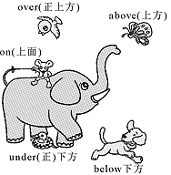
语法讲解
例题：
Ice is not often seen here in winter as the temperature normally
stays ________ zero.
A．up B．down
C．above D．below
C

Slide 11
语法讲解
知识点 3
not. . . until. . . 直到……才……
eg：He didn’t go to bed until 11 o’clock last night.
昨晚他直到11点钟才上床睡觉。
not. . . until. . . 意为“直到……才……”。
表示某一动作或状态一直到until所表示的时间为止才发生，
谓语动词通常为非延续性动词。
eg: I won’t leave here until my mother comes.
直到我母亲来我才会离开这儿。

Slide 12
语法讲解
直到她父亲告诉她，海伦才知道这件事。
(根据汉语补全句子)
Helen ________ know anything about it________
her father told her.
例题：
didn’t
until
【解析】宾语从句中主句从句时态一致。由told可知用一般过去时。

Slide 13
语法讲解
知识点 4
look forward to 期望，盼望 （课后题中）
eg：Spring is a time to look forward to flowers and fresh food from the garden. （课后题）
春季是期盼花朵和菜园中的新鲜食物的时节。
look forward to中的to为介词，
故后可跟名词、代词或动名词。
eg： I look forward to _________(receive) your e­mail.
我盼望着收到你的电子邮件。
考向：
receiving

Slide 14
课堂练习
一、根据句意及所给提示完成句子
1．The temperature tonight is l________．
2．Please do not write b________ this line.
3．It was 37 degrees above z________．
4．He wasn't here u________ one o'clock.
5．___________ (有时) I go by car.
ow
elow
ero
ntil
Sometimes

Slide 15
课堂练习
二、用方框中所给短语的适当形式填空
6． I________ leave ________ you come back.
7．I think this book is ___________ that one.
8．He has been to the UK ___________．
9．The temperature outside is ___________ now.
10．We are all __________________ your reply.
as good as below zero not...until look forward to some times
won't until
as good as
some times
below zero
looking forward to

Slide 16
课堂练习
三、单项选择
11．—You look so tired. What's wrong?
—I didn't go to bed ___I finished watching In the Name of People last night.
A．until B．if C．though D．unless
A
【解析】考查连词。句意：——你看起来非常累，怎么啦？——昨晚我一直看完《人民的名义》才去睡觉。not…until…意为“直到……才……”。故选A。

Slide 17
课堂练习
12．Though Betty and Lily are twins, Betty isn't so_____ as Lily.
A．more outgoing B．most outgoing
C．outgoing D. outgoinger
C
【解析】考查形容词的用法。句意：虽然贝蒂和莉莉是双胞胎，但是贝蒂不如莉莉外向。选项A是比较级；选项B是最高级，选项C是原级。not so … as …是固定句型，中间用形容词原级。故选C。

Slide 18
课堂练习
13．—Can I join Oxfam Trailwalker?
—Only if you are ________eighteen.
A．over B．on C．under D．below
14．My shirt needs________．
A．wash B．washed C．washing D．to wash
A
【点拨】考查介词。句意：——我可以参加乐施毅行者吗？——除非你超过十八岁。故选A。
C
【点拨】…need doing意为“……需要被做”，表被动，相当于…need to be done。

Slide 19
课堂练习
15．—What happened to Mark?
—He fell________the bike________a snowy morning.
A．off; in B．down; at C．off; on
C
【解析】考查介词的用法。fall off the bike表示“摔下自行车”，off含义为“脱离”；在具体某一天或某一天的早晨，用介词on。

Slide 20
总结
（1）重点单词：
low 低的；浅的 below 在……下面
zero 零 until 直到……为止
groundhog 土拨鼠 bush 灌木
（2）重点短语及用法：
as low as 像……一样低；低达……
drops below zero （气温）降到零下
on snowy days 在下雪的日子
be fun 是有乐趣的
play in + clothes 穿……玩耍
so much + 如此多的……
fun activities 有趣的活动
in North America 在北美洲

Slide 21
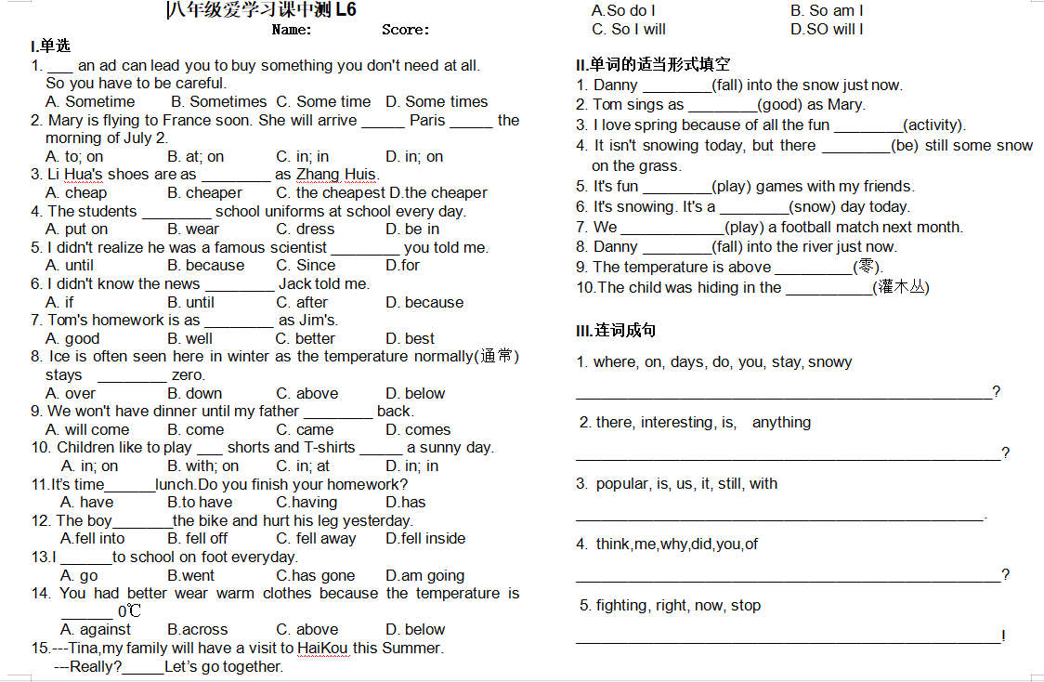
fell
well
activities
is
to play
snowy
will play
fell
zero
Where do you stay on snowy days
bush
Is there anything interesting
It is still popular with us
Why did you think of you
Stop fighting right now

