Slide 1
Unit 1 Spring Is Coming!
Functions：weather，spring，outdoor activities
Grammar: word building (构词法)

Slide 2
Lesson 5 Babysitting on a Spring Day
words：
babysit 照顾婴儿
Debbie 黛比（女）
bar 栏；门栓；酒吧
instead 代替
push 推
soccer （英式）足球
shall 将；会
phreses：
turn around 转身
monkey bar 攀爬架
hold on 抓住；抓紧
come down 下来
give....a push 推....一下

Slide 3
Lesson 5 Babysitting on a Spring Day
照看小孩
·What outdoor activities do you usually do in spring?
·Have you ever been a babysitter?
户外活动
临时保姆
Danny is babysitting his cousin Debbie on the playground. Brian is with them.
Danny：Thank you for helping me, Brian. This is my
first time babysitting.
Brian：You’re welcome, Danny. But where is Debbie？
(Danny turns around. Debbie is on the monkey bars.
She is climbing very high. )
转身
攀爬架

Slide 4
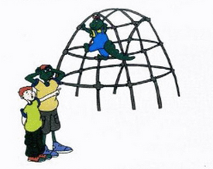
Danny：Hold on❶ , Debbie! Don’t fall off !
(Danny runs towards Debbie. )
Danny：Come down, please!
Debbie：I want to climb higher!
Brian： Come down, Debbie. You’re too high up. Let’s play
on the swings instead❷, OK？Danny will push you.
抓紧
摔下来
朝向
下来
代替

Slide 5
Debbie：OK, I love swings!
(She climbs down, runs to the swing and climbs on. )
Debbie：Push me, Danny! Push me up higher!
Danny：OK. (He gives her a push. )
Debbie：(She laughs. )Push harder!
Brian：Can I give you a push?
Debbie：No, I want Danny to! Higher, Danny!
Danny：(He is tired and hot. )It’s time to stop swinging, Debbie.
Debbie：(She gets off the swing. )Let’s run! Let’s play catch.
Or soccer？What about basketball？Let’s play!
爬下来
再用力点推！
传球游戏

Slide 6
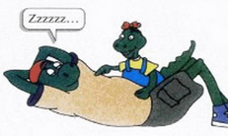
Danny：I know a good game. Let’s play “Lie on the Grass”．
Brian：Shall we look at the clouds, Debbie？
Debbie：OK! That one looks like a big, white rabbit! It’s
jumping up and down! I want to jump, too！
Come on, Danny! Danny？
看起来像
上上下下

Slide 7
知识点讲解 1
babysit v.
babysitting
babysitter n
临时照顾
.
eg：I will babysit the children when you are absent.
你不在的时候我来照看孩子。
eg：She couldn't always afford a babysitter.
她并非总能雇得起临时保姆

Slide 8
知识点讲解2
Thank you for helping me, Brian. This is my first time babysitting.
Thank you for doing / n.
Thanks for doing / n.
eg：Thank you for helping me.
Thanks for helping me.
Thanks for your help.
感谢你的帮助。
This is my first time doing sth...
It is the first time(for sb.) to do sth...

Slide 9
知识点讲解3
Hold on , Debbie!
hold on 抓紧；
别挂断（打电话）
eg：—May I speak to Jenny, please?
请找詹妮接电话好吗？
—Hold on, please. 请稍等。

Slide 10
（ ）— May I speak to Mr. Smith?
—________ please. Here he comes.
A．Hang out B．Pick up
C．Take up D. Hold on
D
【解析】考查动词短语辨析。句意：———我可以和史密斯先生
通电话吗？———请________。他过来了。Hang out闲逛；Pick
up捡起；Take up占有；Hold on稍等，不要挂电话。结合句意可
知答语第一句为“请不要挂电话”。

Slide 11
知识点讲解4
Don’t fall off !
fall off 跌落，从...掉下来
eg：Leaves fall off the trees in the autumn.
秋天树叶从树上落下来。
fall down 摔倒，倒下
eg：The boy hit the tree so hard that he fell down.
那个男孩重重地撞在树上，结果自己倒下了。

Slide 12
知识点讲解5
Danny runs towards Debbie.
towards prep. 朝向
动词 + towards
eg：Jane walked towards the door.
简向门口走过去。
The teacher is coming towards us.
老师正向我们走过来。

Slide 13
知识点讲解6
instead/ɪn'sted/ adv.代替，更换
eg：Tom was ill so I went instead.
汤姆病了，所以我替他去了。
辨析 instead与instead of
instead | 代替，顶替，常用于句尾。 | I didn’t have a pen, so I used a pencil instead. 我没有钢笔，因此我就用铅笔代替了。
instead of | 代替，后接 名词、代词或 动名词。 | I will go instead of you. 我将代替你去。 They went there on foot instead of by bike. 他们没骑自行车而是步行去了那里。

Slide 14
（ ）—How will she deal with the work?
—She doesn’t want to do it by herself. She wants
to ask someone else to do it________.
A．yet B．instead
C．also D．either
B
【解析】此题采用句意分析法。答语句意“她
不想自己做这份工作。她想让别人代替她做。”

Slide 15
知识点讲解7
It’s time to stop swinging, Debbie.
It's time to do sth.
It's time for sth.
该做某事了。
eg：It's time to go home.
该回家了。
It's time for class.
该上课了。

Slide 16
知识点讲解8
It’s time to stop swinging, Debbie.
stop doing sth.停止正在做的事
stop to do sth.停止当前的事，去做另外一件事
eg：I stopped reading when my mum asked me to have supper.
当妈妈叫我去吃晚饭的时候，我停止了看书。
I was watching TV . When my mum came into the room, I
stopped to do my homework.
那会我正在看电视。当妈妈走进房间的时候，我停下来
去写作业了。

Slide 17
英语中用来提建议的常用句型：
答语：
Shall we. . . ？
—Good idea.
Shall we go swimming?
我们去游泳好吗？
—That's a good idea.
Let's do sth, shall we？
Let’s have a rest, shall we？
我们休息一会儿，好吗？
—Great!
Why not do sth.？
—I'd love to, but.....
Why not join us？
为什么不加入我们呢？
—I'd like to, but I'm afraid ...
What / How about doing sth.？
What/How about (drinking) some milk？
(喝点)牛奶怎么样？

Slide 18
（ ）—Shall we make a cake by ourselves instead of buying one?
—________.
A．That’s a good idea B．Don’t worry
C．Never mind D．The same to you
A
【解析】考查交际用语。由问句句意“咱们亲手做个蛋糕，
别去买了好吗？”可知是在提出建议。

Slide 19
一、用方框中所给短语的适当形式填空
1． Shall we ________ the clouds?
2．____________, Ann. Let's go shopping.
3．Please ___________ and you will see your mother. She is waiting for you near the river.
4．I ________________to help him get on the bus.
5．________! Wait until I get my camera.
turn around hold on come down look at give sb. a push
look at
Come down
turn around
give him a push
Hold on

Slide 20
二、单项选择
6．—What a fine day! Let's go fishing.
—________. When shall we go?
A．Very well B．Good idea
C．Well done D．My pleasure
7．Would you please ________ your MP3 a little? Your baby sister is sleeping.
A．turn up B．turn down
C．turn on D．turn in
B
B

Slide 21
B
8．It's sunny. Let's go sighting________watching TV in our hotel room.
A．thanks to B．instead of C．as well as
9．—Can I speak to Mr. Brown, please?
—________．
A．I'm Mr. Brown B．Hold on, please
C．No, you can't D．Yes, you can
B
A
10．—We can invite Nick and Paul to Shanghai Disneyland with us.
—________ I'll give them a call right now. A．Why not? B．What for?
C．Of course not. D．Not at all.
Notes:
go sighting 观光what for…怎样; 为何; 处罚; 为什么

Slide 22
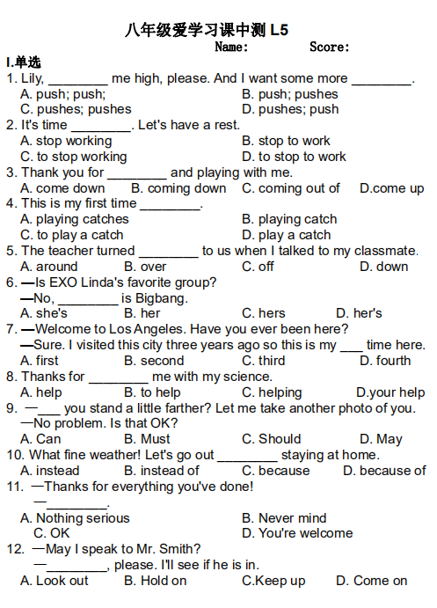
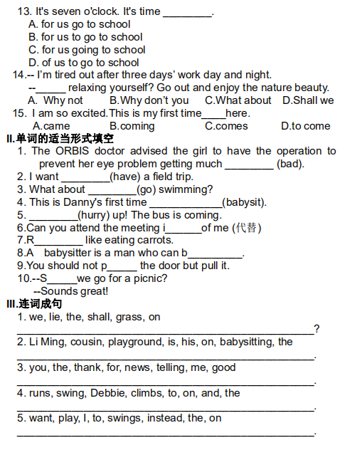
课中测试
worse
to have
going
babysitting
Hurry
instead
Rabbits
babysit
push
Shall
Notes:
洛杉矶

