Slide 1
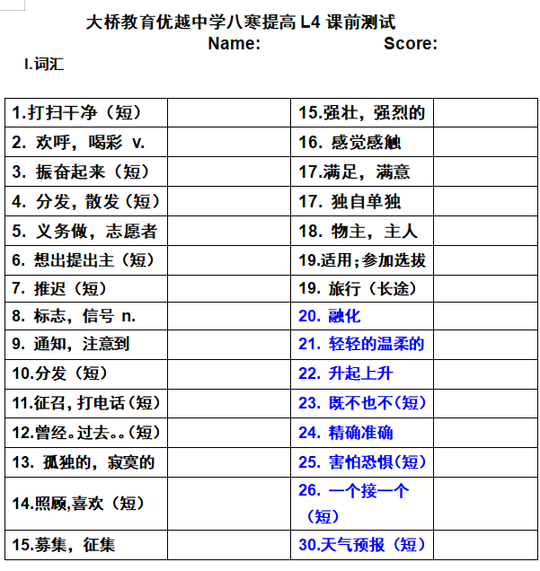
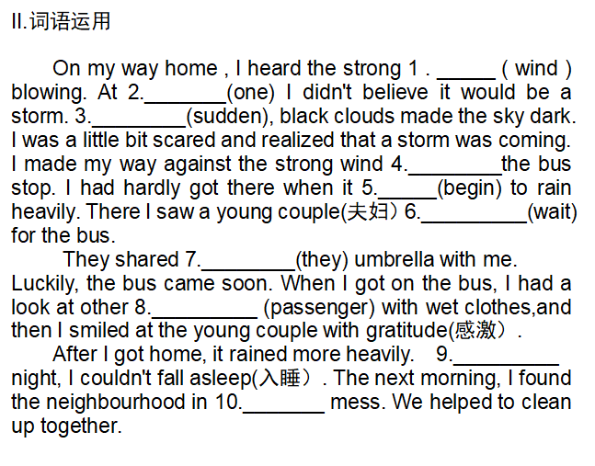

Slide 2
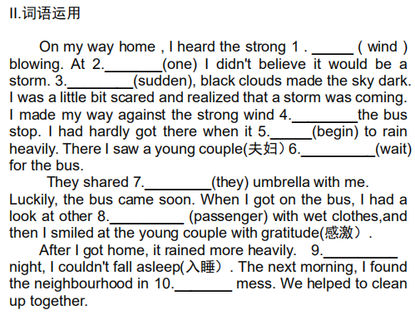
课前测试
wind(s)
first
Suddenly
to/towards
hardly...when...”是固定句型，意为“刚…就...
began
waiting
their
passengers
At
a

Slide 3
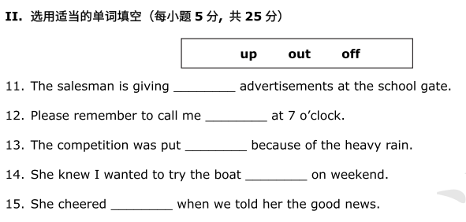
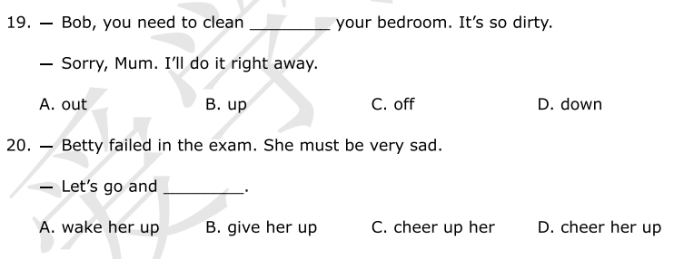
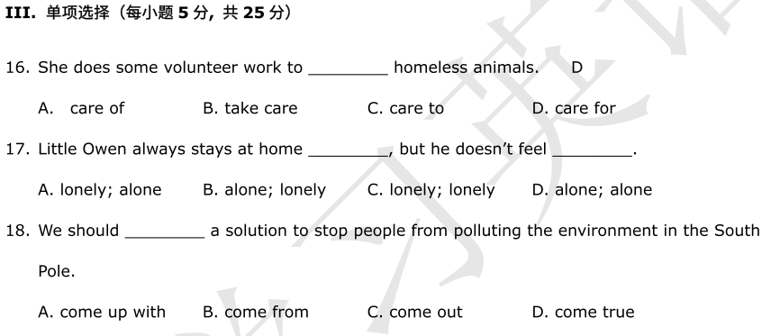
课堂落实
out
B
up
off
out
up
D
D
B
A

Slide 4
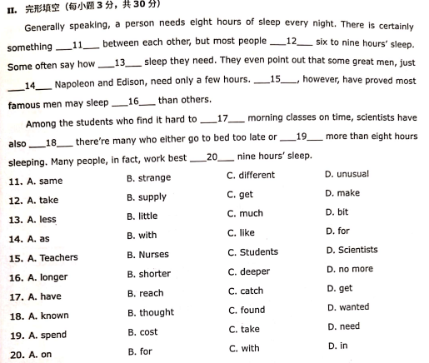
自我巩固 L2
c
c

Slide 5
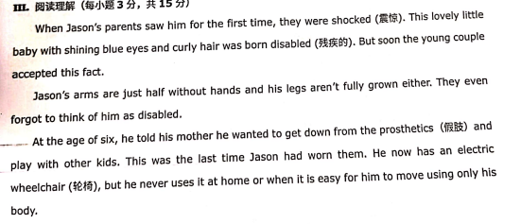
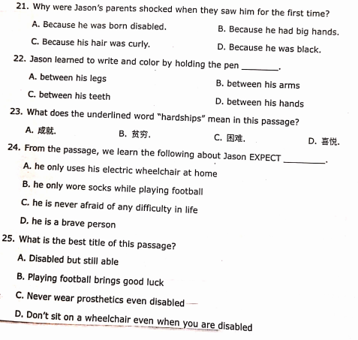
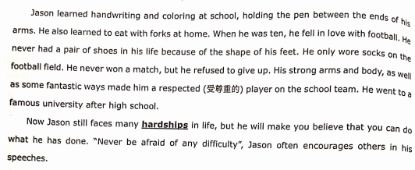

Slide 6
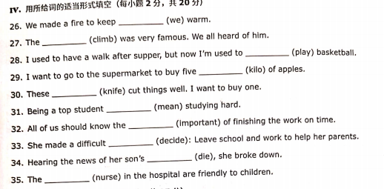
ourselves
climber
playing
kilos
knives
means
importance
decision
death
nurses

Slide 7
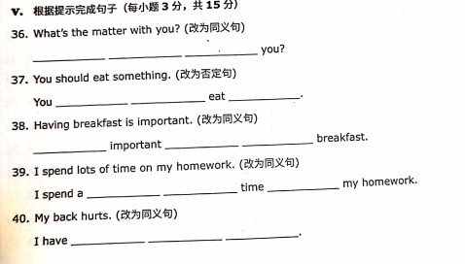
What's wrong with
should not anything
It's to have
lot of doing
a sore throat

Slide 8
八年级爱学习L1-3复习

Slide 9
content
1.重点单词回顾
2.重点短语回顾
3.重点语法

Slide 10
1.重点词汇
matter
lie
rest
cough
X-ray
break
trouble
foot
passenger
n.问题，事情
v.躺，位于，说谎
v.&n. 放松，休息
n.&v. 咳嗽
n.X射线，X光
n.间歇，休息 v. 打碎/弄坏/打断/违反
n.问题，苦恼
n.脚
n.乘客，旅客
break up with 与某人断绝关系
break out 爆发（战争疾病等）
break into 闯入
get into trouble/be in trouble
Notes:
get into trouble/be in trouble 遇到麻烦，陷入困境

Slide 11
1.重点词汇
press
sick
breathe
ourselves
climber
risk
situation
knife
mean
importance
death
decision
v.压；挤；按；
adj. 生病的；有病的
v.呼吸
我们自己
n.登山者；攀登者
n.&v.危险；风险；
n. 情况，状况
n.刀子
v.意思是，打算，意欲
n.重要性
n.死亡
n.决定，抉择
pressure n.压力
under the pressure of...
breath n.呼吸
take a deep breath 深呼吸
out of breath 上气不接下气
take risks of doing sth... 冒险做某事
in a difficult situation 处境困难
different/difference
confident/confidence
distant/distance

Slide 12
1.重点词汇
cheer
volunteer
notice
lonely
alone
sign
joy
satisfaction
owner
raise
midnight
v.欢呼；喝彩
v.义务做；自愿做 n志愿者
n.通知；通告；v.注意 注意到；意识到
adj.孤独的；寂寞的
adv.独自；单独
n.标志；信号 ; v.签名,签署
n.高兴；愉快
n.满足；满意
n.物主；主人
v.募集；征集 ;举起，养育
n.午夜；子夜

Slide 13
I.用括号中所给单词的适当形式填空
1.He felt much better after________(rest)for a while.
2.Yesterday,he _______(cough)all the night .
3.This cup is______.The naughty boy ______it lask week.
4.The old man didn’t go home because he was afraid to bring _______(trouble) to his son.
5.A duck has two _____.(foot)
6.There are many ___________(passenger) on the
bus.
resting
coughed
broken
broke
trouble
feet
passengers

Slide 14
6.Under the________(press) of winning the football game, he didn't sleep well yesterday.
7.We can look after ________(our)well.
8.He took a deep ________(breathe) and jumped into the water.
9. I’m feeling _____(sick). I have to see a doctor.
10.He is a perfect mountain_________.(climb)
11.You can't get rich without taking _______.(risk)
12.There are two ______(knife) and a fork
on the table.
pressure
ourselves
breath
sick
climer
risks
knives

Slide 15
13.Mr Brown tells his son that the red light ______ (mean) “stop”.
14.The study shows us the ___________(important) of fresh food.
15.His dog _____two years ago. He felt sad for its_____.(die)
16.He made a_________(decide) to study hard.
means
importance
died
death
decision

Slide 16
II.单项选择
C
1. --________?
--I have a headache and I don't feel like eating anything.
A. How old are you B. What can I do for you
C. What's the matter with you D. How do you like it
2.I took the medicine and __________down on the bed.
A.lie B.lay C.lied D.laid
3.--Candy, I have a toothache. What should I do?
--You'd better see a dentist and take __ X­-ray.
A. a B. an C. / D.the
B
B

Slide 17
4. Are you facing a ____that looks impossible to handle?
A.information B.direction C.instruction D.situation
5.He volunteered ____the old last year.
A.look after B.to look after
C.looking after D.looked after
6.I noticed Peter ____on his chair when I went into the classroom.
A. lie B. lying C. to lie D. lies
7.He lives______.But he never feels _____.
A. alone; alone B.lonely;lonely
C.alone;lonely D.lonely;alone
D
B
B
C
Notes:
handle 处理应对

Slide 18
8. His mother is satisfied_____his grade.
A.on B.with C.at D.about
9.He_____up his hand and answered the question.
A.raised B.rose C.risen D.rise
10.He arrived at home _____midnight yesterday.
A.at B.on C.in D.for
11.Lucy and Lily enjoyed______at the party.
A.herself B.themselves
C.ourselves D.yourselves .
B
A
A
B

Slide 19
2.重点短语
1.怎么了?出什么事了?
2.感冒
3.咳嗽
4.拍X光
5.发烧
6. 量体温
7.使...惊讶的;出乎...意料
8. 立即;马上
9.陷入;参与
What's the matter?
have a cold
have a cough
take an X-ray
have a fever
take one's temperature
to one's surprise
right away
get into

Slide 20
10.深呼吸.
11.上气不接下气
12.习惯于...
13.被用于做...
14.过去常常...
15. 偶然地；非故意地...
16.切断（水，电，燃气);切除
17. 打算做某事...
18.意味着...
19.离开；从...出来...
20.做决定做某事...
21.掌管，管理...
22.失控...
23.放弃
10.take a deep breath
11.out of breath
12.be used to doing...
13.be used to do...
14.used to do
15.by accident
16.cut off
17.mean to do...
18.mean doing...
19.get out of...
20.make a decision to do...
21.be in control of
22.out of control
23.give up

Slide 21
24.分发
25.散发光，热，气味
26.使高兴，振奋
27.想出，提出（主意，计划)
28.推迟...
29. 搭建，建立，张贴...
30.上交...
31. 打电话给...
32.想要做某事...
33.对...满意的...
34.玩的开心...
35.参加...选拔;试用...
36.筹款，募捐...
37.在子夜
24.give out /hand out...
25.give off...
26.cheer up
27.come up with...
28.put off...
29.put up...
30.hand in...
31.call up/ring up
32.feel like doing...
33.be satisfied with...
34.enjoy oneself
35.try out...
36.raise money
37.at midnight

Slide 22
Exercise
I.单项选择
1. My brother often ________ his spare time to help me with my spoken English. A. puts up B. gives up C. opens up D. tidies up
2. ________ our surprise, Larry came here earliest today.
A. To B. With C. Without D. In
3. Lucy is used ________ a walk after dinner.
A. to take B. taking C. to taking D. take
B
A
C

Slide 23
4. My sister ________ be lazy. But now she works really hard.
A. used to B. is used to
C. was used to D. were used to
5. You could visit the sick people in the hospital to ________.
A. cheer up him B. cheer him up
C. cheer up them D. cheer them up
6.Larry wants to fix up these bikes and ________ to the poor children.
A. give away them B. give away it
C. give it away D. give them away
A
D
D

Slide 24
7. It seems that we are in a very difficult situation. However, we won't____ hope.
A. run out B. lie down C. get into D. give up
8. Toby isn't tall enough, so he has ____ in reaching the book on the top of the bookcase.
A. difficulty B. feeling C. control D. experience
9.Lisa had a___, so she decided to see a dentist.
A. headache B. stomachache
C. toothache D. cold
D
A
have difficulty in doing sth. 做某件事很困难
C

Slide 25
10. When the old man ___the bus,the driver asked him to be careful.
A. got off B. turned off C. took off D. cut off
11.Were you just pretending not___in what we are talking about?
A.being interesting B. to be interested
C. being lnterested D. to be interesting
12.--Mom, I don't know which skirt to choose.Can
you make a___for me?
--OK. Let me see.
A. decision B. decide C. situation D. situate
A
B
A

Slide 26
13. Sally is my best friend.She is always there whenever I'm__.
A. in trouble B.in control
C. in surprise D. by accident
14.You need to stay___your emotions.
A. in control of B. out of control of
C. in control D. out of control
15.We are sure that we'll ___an idea to solve the difficult problem soon.
A. put up B. come up with
C. give out D. give up
A
A
B

Slide 27
16. Studying hard means_______a good result.
A. to get B.getting C. get D. gets
17.Mary feels like ______with her friends.
A.to chat B.chatting C.chat D.chatted
18.--Mom, can I leave my homework for tomorrow?
--I'm afraid not. Don't_____what you can do today till
tomorrow.
A. put away B. put out
C. put off D. put up
B
B
C
put out扑灭
Notes:
扑灭

Slide 28
3.重点语法
定义
反身代词
和
相互代词
句法功能
反身代词
固定短语
相互代词

Slide 29
I.反身代词
1.定义
表示“某人自己”的代词称为反身代词。
2.变化规则
一，二形，第三宾，遇到“自己”变反身。
3.句法功能
1）作宾语 2）作表语 3）作同位语 4）不能作主语
4.固定短语
enjoy oneself help oneself to teach/learn by oneself
by oneself dress oneself hurt oneself
talk to oneself

Slide 30
II．相互代词
意为“互相，相互”的代词
each other和one another两种形式
We should learn from each other/one another.
The students corrected each other's/one another's mistakes in their homework.
相互代词做宾语
所有格形式为each other's和one another's，在句中作定语。

Slide 31
Exercise:
I.反身代词填空
1.The old man lives by_______.
2.The food_____was very good, but I was not hungry.
3.We should think to __________that it is our duty to finish the work on time.
4.Mary is old enough to take care of_______.
5.Can you carry this box upstairs by________,Tom?
6.Did you enjoy_________at the party yesterday, girls?
7.Look, is this room beautiful? I painted it_______.
himself
itself
ourselves
herself
yourself
yourselves
myself

Slide 32
II.单项选择
8.David made the model gun _____.He really enjoyed_____
when he did it.
A. him; him B. himself; himself C. him; himself D. his; him
9.She is so young that you can't leave her by_____.
A. oneself B.herself C. myself D.yourself
10.Boys and girls, help_____to some fish. It's very nice.
A. himself B.themselves C. yourself D. yourselves
11. People didn't really know___at the party last weekend.
A. one another B. one another's
C. another D.other
B
B
D
A

Slide 33
12.Those girls enjoyed____in the party last night.
A. them B.they C. themselves D. herself
13.Those students are always copying___homework.
A.one another B.each other C.others D.one another's
14.Help_______to some fish, children.
A. yourself B. your C.yours D. yourselves
15.--Who teaches_______to dance?
-- I teach________because I am talented in dancing.
A. your; myself B.you; myself
C.you; me D. you; herself
C
D
D
B

Slide 34
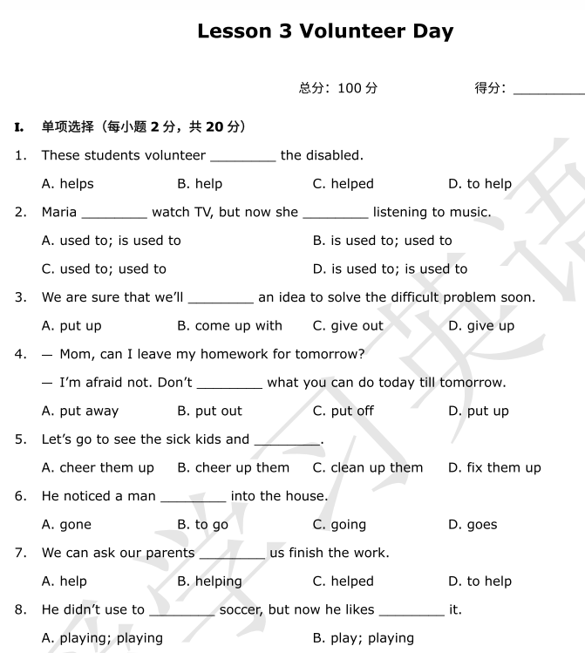
自我巩固
D
A
B
C
A
C
D
B

Slide 35
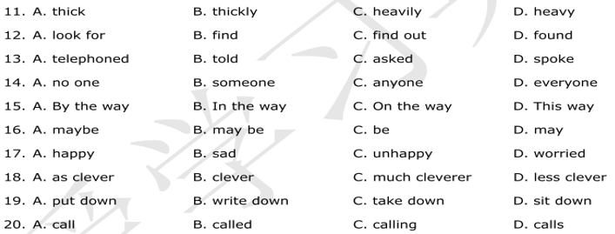
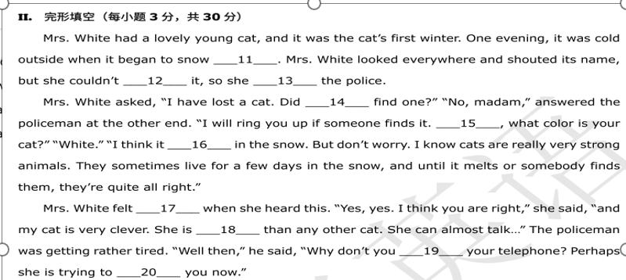

Slide 36
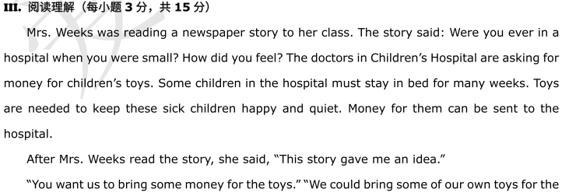

Slide 37
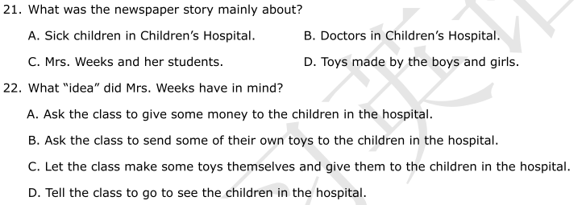
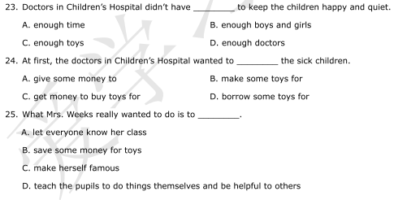
A
C
C
C
D

Slide 38
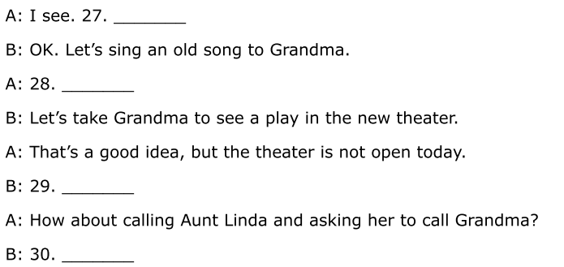
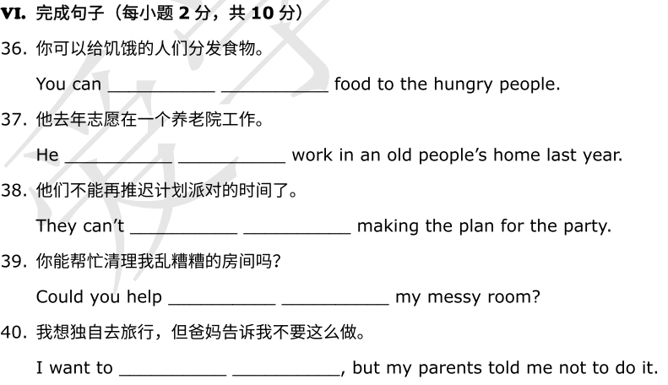
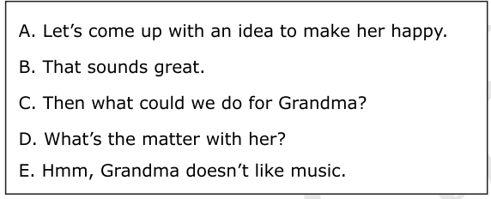
D
heer
olunteer
A
ign
eeling
E
lone
C
hand out
B
volunteered to
put off
clean up
travel alone

