Slide 1

Unit 1
A Trip to the Silk Road
Lesson 4
A visit to Lanzhou
Main points
Verbal Phrases
Grammar
Numerals 数字
will 一般将来时

Slide 2
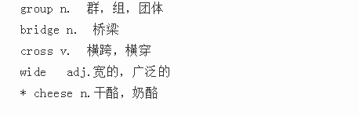

Lesson4 重点短语
Words:
group n. 群；组；团体
bridge n.桥梁
cross v.横跨；横穿
wide adj.宽的；广泛的
cheese n.干酪；奶酪
Phrases:
in front of 在.....前面
lead sb. to... 带领某人去......
go for a walk 去散步
take a picture 照相

Slide 3
课文呈现
乘火车
The group takes a train to Lanzhou. Then they go to the hotel. Later, they go for a walk along the Yellow River.
Li Ming：All right. Let’s go down this street and turn left at the traffic lights. This road will lead us to the Yellow River.
Danny：Look! A bridge！
Li Ming：This is the Lanzhou Zhongshan Bridge. It was the first bridge over the Yellow River. The Silk Road crossed the Yellow River in Lanzhou.
Danny：Wow, the Yellow River is so wide！
去散步
沿着
向左转
带领我们去...
跨越在黄河的上面
横跨
宽广

Slide 4
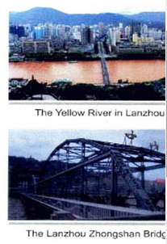
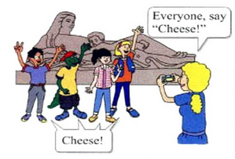
Li Ming：Yes. It’s wide and long. The Yellow River is about 5 400 kilometres long. We call it the Mother River.
Danny：Look! A statue beside the Yellow River! A mother with a baby！
把它叫做母亲河
一位抱着婴儿的母亲
Li Ming：Oh, that’s the Mother River Statue.
Ms. Martin：It’s beautiful！
Danny：Can we take a picture in front of the statue, Ms. Martin？
Ms. Martin：Sure！
拍照
在.....前面

Slide 5
知识讲解
The group takes a train to Lanzhou.
知识点 1
group 群，组，团体
in groups 成群地，成组地
a group of... 一群，一组...
考向
Students are standing in _________(group) waiting
for their new teacher.
groups

Slide 6
知识讲解
Later, they go for a walk along the Yellow River.
知识点 2
go for a walk 去散步＝ take a walk ＝ go for walks
考向
go ＋for ＋a /an ＋ n．去做某事
go for a drive 开车兜风
go for a swim 去游泳
go for a walk 去散步

Slide 7
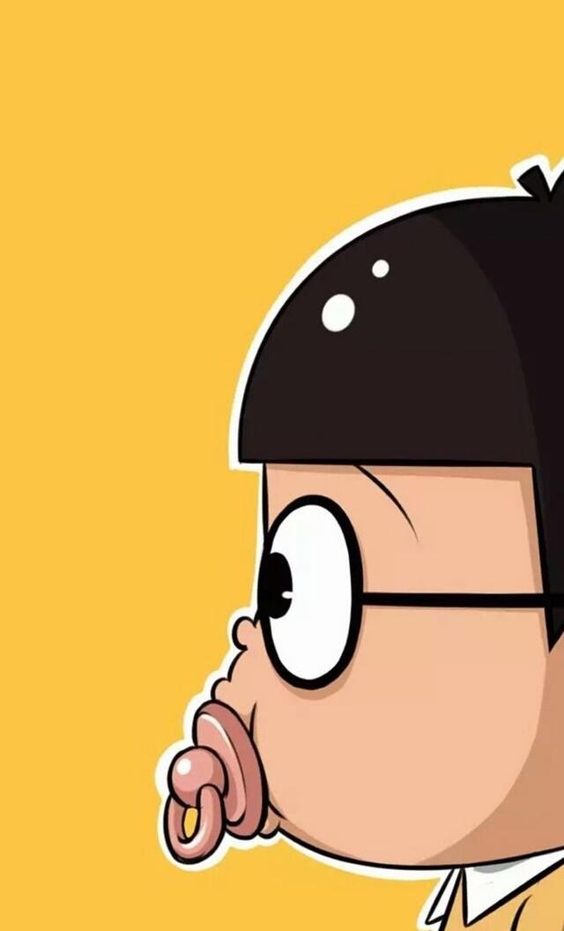
知识讲解
Many people like to go for ___ walk after supper.
A. a B. an
C. / D. the
A

Slide 8
知识讲解
Let’s go down this street and turn left at the traffic lights.
知识点 3
go down 沿着...＝walk down＝go along
让我们沿着街道走，然后找一家饭店吧。
Let's ____ _______ the street and find a restaurant.
go down
walk down
go along

Slide 9
知识讲解
This road will lead us to the Yellow River.
知识点 4
lead sb. to +地点 带领某人去......
This road will________ us________ the cinema.
A. lead; to B. lead; for C. take; for D. take; with
A

Slide 10
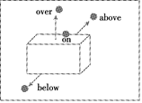
知识讲解
It was the first bridge over the Yellow River.
over “在……上面”
表示一个物体在另一个物体的垂直上方且不接触。
知识点 4
考向【易错点】
辨析 on，above，below, over
over
above
on
below

Slide 11
on | 在……上， 接触 | Look! There is a note on the desk. 看！桌子上有一个便条。
above | 在……上方， 不接触，正上方 / 斜上方 | There is a picture above my bed. 我的床上面有一幅画。
below | 在……下方， 一般笼统地指在……下方 | There are some shoes below the bed. 在床下有一些鞋子。
over | 在……上方， 不接触，正上方 | There is a sign over the door. 门上方有一个标记。

Slide 12
知识讲解
The workers are building a bridge
______the river.
A. over B. to
C. across D. through
A

Slide 13
知识讲解
The Silk Road crossed the Yellow River in Lanzhou.
知识点 5
cross /krɒs / v. 横跨；横穿
辨析 cross & across
cross = 动词+ across
横穿 | cross (v.) | We will cross the road. 我们将横穿马路。
 | across (prep.) | We will go across the road. 我们将横穿那条马路。

Slide 14
知识讲解
We must teach children how to go
________ (横穿) the road safely.
across

Slide 15
知识讲解
It’s wide and long.
知识点 6
wide /waId/ adj.宽的；广泛的
that, wide, bridge, how, is
______________________?
How wide is that bridge

Slide 16
知识讲解
A mother with a baby！
知识点 7
with ① 带有... 表伴随 ②和......一起
Liu Yang is a tall man _____ short black hair.
A. of B. has C. like D. with
D

Slide 17
知识讲解
Can we take a picture in front of the statue, Ms. Martin？
take a picture = take a photo 拍照
take a picture of sb. = take a photo of sb. 给某人拍照
知识点 8
Wei Hua asked a boy ________photos ________her.
A. to take; of B. to take; in C. take; of D. take; in
A

Slide 18
知识讲解
Can we take a picture in front of the statue, Ms. Martin？
知识点 9
in front of “在……前面”
考向
【重点】【易错点】
辨析 in front of & in the front of
里 the 外不 the
in front of | 在……前面，强调一个物体在另一个物体外部的前面 | There is a big tree in front of my house. 我家房前有一棵大树。
in the front of | 在……前部/端，强调一个物体在另一个物体内部的前面。 | Put the shortest flowers in the front of the bunch. 把最短的花放在花束的靠前位置。

Slide 19
知识操练
There is a sofa ___ the TV. John likes
to watch TV on the sofa.
A．in the front of B．in front of
C．above D．over
B

Slide 20
知识总结
（1）重点单词：
over 在……上面(不接触)
cross 横跨；横穿
across 横跨；横穿
（2）重点短语及用法：
go for a walk 去散步
go down 沿着...
lead sb. to ... 带领某人去......
take a picture of sb.
= take a photo of sb. 给某人拍照
in front of 在……前面

Slide 21
课堂练习
【点拨】语境分析法
一、单项选择
1．Turn right __________ the traffic lights.
A．in B．on
C．for D．at
2. Look! There is a bridge __________ the river.
A．over B．at
C．on D．under
D
A

Slide 22
C
3. My parents like__________ after supper.
A．take a picture B．go to work C．going for a walk D．going down
【点拨】固定搭配法。like doing sth.喜欢做某事。
C
4．Mingming is taller than me，so I sit ____ him in our classroom.
A．at the back of B．near C．in front of D．in the front of
5. There are many cars in the street. Don't ____ the road.
A．go B．cross C．walk D．across
B

