Slide 1
四年级公立校
Unit 2
L7 Homework
L8 TV and Phone

Slide 2
Phonetics

Slide 3
Try to read
ship beach
fish watch

Slide 4
Exercise
判断下列每组单词划线部分发音是否相同，相同的写Y，不同 的写N。
( ) 1. A. shirt B. ship C. wash
( )2. A. chicken B. beach C. ship
Y
N

Slide 5
重点梳理

Slide 6
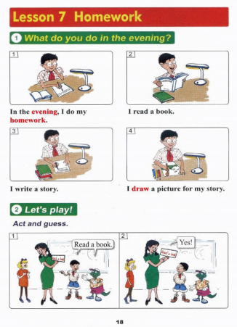
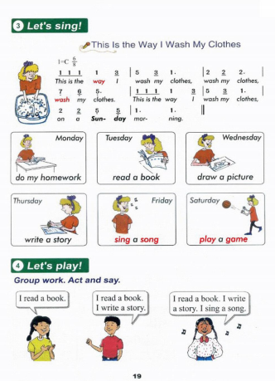

Slide 7
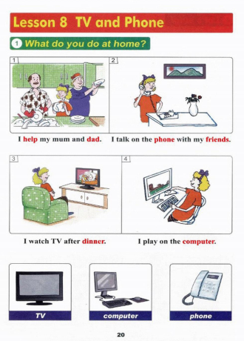
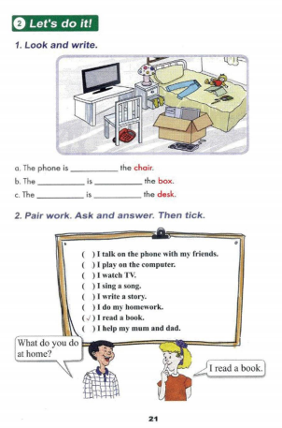

Slide 8
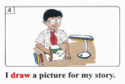
知识点 1
v. (动词)画
She draws a picture for her friend.
她为她的朋友画了一幅画。
近义词：paint 绘画
固定搭配：draw… for… 为……画……

Slide 9
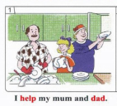
知识点 2
v. (动词)帮助；协助；援助
I help my brother.我帮助我的弟弟。
help… with… 表示“在某方面给予帮助”，
如：Tom can help me with my English.(汤姆能帮助我学英语);
help sb.(to)do sth.表示“帮助某人做某事”，
如：I help my mother do the housework.(我帮助妈妈做家务)。

Slide 10
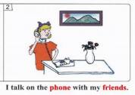
v. (动词)交谈；讨论
知识点 3
Let's have a talk.让我们谈一谈。
talk with/to sb.和某人谈话 talk about sth.谈论某事
n. (名词)电话
What's your phone number? 你的电话号码是多少？
phone number 电话号码 on the phone 通过电话
talk on the phone意为“通过电话交谈”。
talk on the phone with...意为“和...通过电话交谈”。

Slide 11
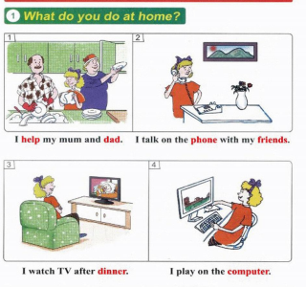
知识点 4
What do you do at home?
这是一个以what引导的特殊疑问句。
用来询问对方在某地做什么事
其中前一个do是助动词，无意义；
后一个do是实义动词，表示“做”。
句型：特殊疑问词＋助动词 ＋主语＋ 动词原形＋ 其他？
答语：I ＋ 动词原形 ＋ 其他．

Slide 12
I read a book at school.(对画线部分提问)
________ do you ________ at school?
What do
对划线部分提问，即特殊疑问句：
1.找特殊疑问词2.变一般疑问句3.抄在一起4.去掉划线部分5.添do
1.根据答语及画线部分可知，用来询问对方在某地做什么事用疑问词what；
2.变一般Do you read a book at school?
3.抄一起What do you read a book at school?
4.去画线What do you at school?
5.添do

Slide 13
选出下列每组中不同类的一项。
( )1. A. write B. sing C. story
( )2. A. song B. game C. read
( )3. A. pencil box B. homework C. ruler
( )4. A. Friday B. Sunday C. sun
( )5. A. evening B. river C. morning
C
C
B
C
B

Slide 14
单项选择。
( )1. I ________ a picture for my ________.
A. draw; story B. draw; read C. look; story
( )2. My mother ________ a song in the evening.
A. singing B. sing C. sings
( )3. What ________ you ________ in the evening?
A. does; do B. are; do C. do; do
( )4. This is ________ I do my homework.
A. ways B. the way C. way
( )5. Lucy ________ a book.
A. is read B. reads C. reading
A
C
C
B
B

Slide 15
( )6. ________ do you do at home?
A. What B. Where C. What's
( )7. I ________ TV after dinner.
A. look B. watch C. see
( )8. I ________ my mother and father.
A. talk B. read C. help
( )9. This is my ________. I play on it.
A. book B. computer C. homework
( )10. The phone is ________ the bed.
A. for B. on C. of
A
B
C
B
B

Slide 16
A. on B. for C. with D. under E. in
1. I talk on the phone ________ my friends.
2. I play________ the computer.
3. I do my homework ________ the evening.
4. I draw a picture ________ my story.
5. I can see your shoes ________ the bed.
C
A
E
B
D

Slide 17
阅读短文，选择正确的选项。
Hello! My name is Lucy. There are four people in my family, my mother, my father, my brother and me. We often do different things at home. I do my homework after school. My mother washes the clothes in the bathroom. My father watches TV. My brother plays on the computer with his friends. After dinner, I talk on the phone with my friends. We are happy.
A
A
B
( )1. How many people are there in Lucy's family?
A. Four. B. Five.
( )2. What does Lucy do after school?
A. She does her homework after school. B. She sings a song after school.
( )3. The word “bathroom” should be “________”.
A. 卧室 B. 卫生间
( )4. What does Lucy's brother do at home?
A. He plays on the computer with his friends. B. He reads a book.
( )5. What does Lucy's father do at home?
A. He watches TV. B. He washes the clothes.
A
A

Slide 18
Thanks

