Slide 1
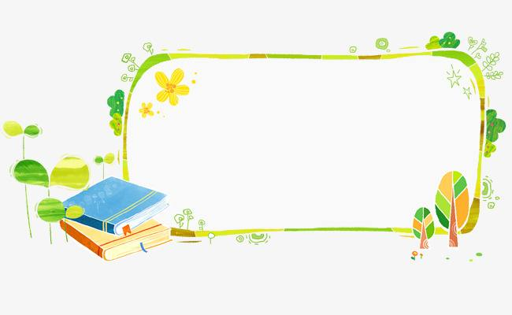
四年级上公立校
Revision
Unit 1 The Clothes We Wear
Unit2 At Home
Unit 3 Let's Go！
Unit4 Shopping in the City

Slide 2
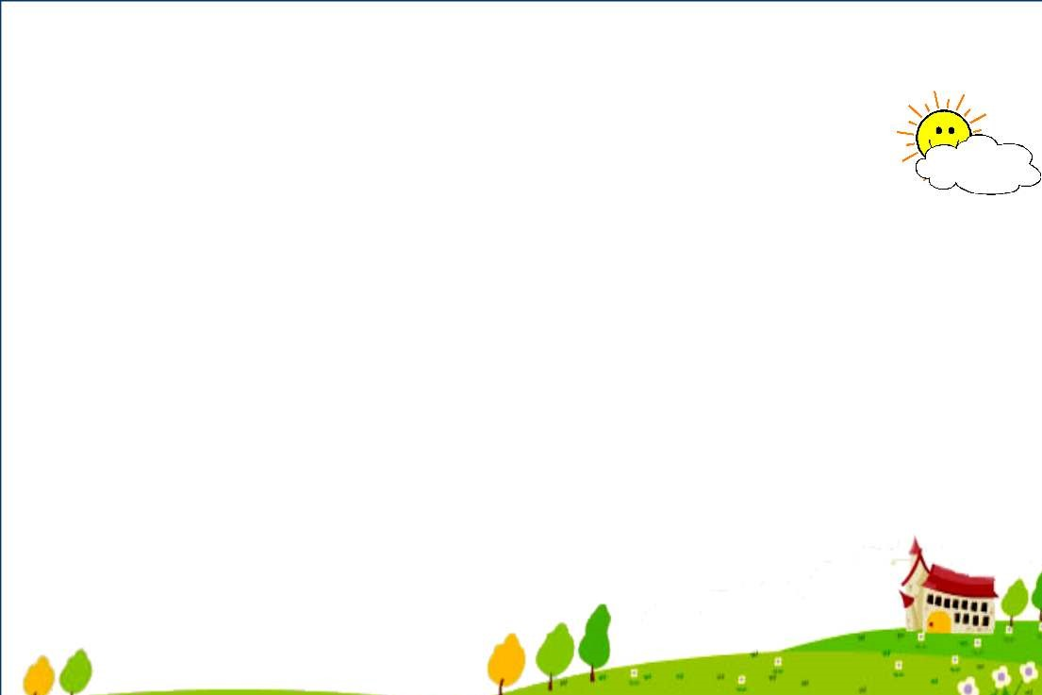
Unit1 The Clothes We Wear
Unit2 At Home
Lesson1 Skirt and Trousers
Lesson7 Homework
Lesson2 New and Old
Lesson8 TV and Phone
Lesson3 Coat and Scarf
Lesson9 In the Bedroom
Lesson4 Shoes and Socks
Lesson10 Brush and Wash
Lesson5 Days of the Week
Lesson11 Toys
Lesson6 Betty's Clothes
Lesson12 John and Jack

Slide 3
Unit3 Let's Go！
Unit4 Shopping in the City
Lesson13 At School
Lesson19 Let's Go Shopping!
Lesson14 Near and Far
Lesson20 At the Shop
Lesson15 In the City
Lesson21 Cinema and Park
Lesson16 Cars and Buses
Lesson22 At the Supermarket
Lesson17 I'm Lost!
Lesson23 Shopping Online
Lesson18 Lost in the City
Lesson24 Etta's Teddy Bear

Slide 4
一、选出每组单词中画线部分读音不同的一项。
( ) 1. A. black B. cap C. face ( ) 2. A. desk B. left C. we ( ) 3. A. is B. nice C. his ( ) 4. A. hot B. not C. today ( ) 5. A. ruler B. bus C. duck
C
C
B
C
A

Slide 5
二、选出不同类的一项。
( ) 1. A. morning B. evening C. library ( ) 2. A. fish B. meat C. fifteen ( ) 3. A. milk B. juice C. coat ( ) 4. A. twenty B. thirty C. yellow ( ) 5. A. socks B. bread C. milk ( ) 6. A. buy B. go C. Miss ( ) 7. A. Tuesday B. day C. Sunday ( ) 8. A. wash B. listen C. TV ( ) 9. A. bus B. green C. car ( ) 10. A. skirt B. coat C. play
C
C
C
C
A
C
B
C
B
C

Slide 6
三、根据句意填写单词。
1. These ________ new trousers. 2. I like to ________ TV on Saturday. 3. The sweater is ________. I want to buy a new one. 4. We read ________ in the library. 5. —________ are the dresses? —Here they are. 6. —How many days are there in a________?
—Seven. 7. The traffic lights are________. Let's go!
are
watch
old
books
Where
week
green

Slide 7
四、单项选择。
( ) 1. Is it far ________ here? A. from B. / C. to ( ) 2. —What is Danny wearing? —He is ________ shorts. A. wears B. wear C. wearing ( ) 3. I talk ________ the phone ________ my friends. A. with; on B. on; with C. to; to ( ) 4. —________is the park? —It's near my school. A. Who B. What C. Where ( ) 5. —________is it ? —It's thirty­seven yuan. A. How old B. How much C. How many
far from 意为“离……远”。
A
C
B
C
talk on the phone 意为“通过电话交谈”；with意为“和”。
B
How much…? 意为“……多少钱？”

Slide 8
How many…? 意为“……有多少？”后跟可数名词复数。
( ) 6. ________days are there in a week? A. How much B. How C. How many ( ) 7. —Do you like to fly kites? —________. A. Yes, I like B. Yes, I do C. No, I do ( ) 8. I go to the park to________. A. read books B. watch a film C. fly kites ( ) 9. ________do you want to go? A. What B. Which C. Where ( ) 10. The zoo is ________ the school. A. near B. / C. to
C
B
C
C
A

Slide 9
五、连词成句。
1. day it What is (?) ______________________________________________ 2. her new Is dress this (?) ______________________________________________ 3. books Let's to to go library the read (. ) ______________________________________________ 4. a buy I shirt red want to (. ) ______________________________________________ 5. good isn't for Candy teeth your (. ) ______________________________________________
What day is it ？
Is this her new dress?
Let's go to the library to read books.
I want to buy a red shirt.
Candy isn't good for your teeth.

Slide 10
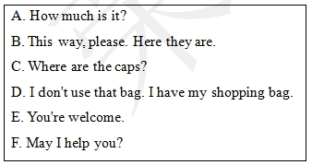
六、补全对话。
A: 1. ________ B: Yes, please. I want to buy a cap. 2. ________
A: I'll show you. 3. ________ B: 4. ________ A: It's thirty yuan. B: I'll take it. A: Okay. I will wrap(打包) it for you. B: 5. ________ A: You're a good boy. B: Thanks. A: 6. ________
F
C
B
A
D
E

Slide 11
七、阅读理解。
It's Sunday today. It's warm. On Sundays, Tom and John like to play with a ball on the playground. Jenny and Danny like to draw pictures at home. I
like to go to the library. It's near my home. There are many books in it. I like
to read books. It is fun. But this Sunday I want to go to the clothes shop. I want to buy a new shirt. My old shirt is too small. ( ) 1. How's the weather today? A. It's warm. B. It's cold. C. It's snowy. ( ) 2. Tom and John like to ________ on Sundays. A. play football B. play with a ball C. play basketball ( ) 3. Jenny and Danny like to ________ on Sundays. A. read books B. play with a ball C. draw pictures ( ) 4. —Where is the library? —It's________. A. far from my home B. near my home C. near the shop ( ) 5. My old shirt is ________. A. too big B. too small C. just right
A
B
C
B
B

Slide 12
八、阅读理解。
My name is Lily. It's Saturday today. I don't go to school. In the morning, I brush my teeth and wash my face. Then I do my homework. I play with my friends in the afternoon. In the evening, I listen to music and watch TV. I am happy today.
根据文章内容判断正(T)误(F)。
( ) 1. Today is Sunday. ( ) 2. Lily brushes her teeth in the afternoon. ( ) 3. Lily plays with her friends in the afternoon. ( ) 4. In the evening, Lily listens to music and watches TV. ( ) 5. Lily is sad today.
F
F
T
T
F

Slide 13
以Let’s go Shopping.为题写一篇作文。
要求:语言准确
30个单词以上（不包含标点符号）
时态：一般现在时
内容：
写几句话描述你想干什么 What do you want to do？
1.提出购物建议(Let's...)
2.想买什么(I want to buy...I like...I don't like...)
3.反问他人(Do you want to go shopping with me?)

Slide 14
Sample Writing
Let’s go Shopping.
Today is sunny. Let’s go Shopping.
I want to go to the clothes shop to buy a new dress. I don’t like the blue one. But the red one is nice. So I want the red dress. How about you ? Do you like the red dress?
Shopping is fun. Do you want to go shopping with me?

Slide 15
Thanks

