Slide 1
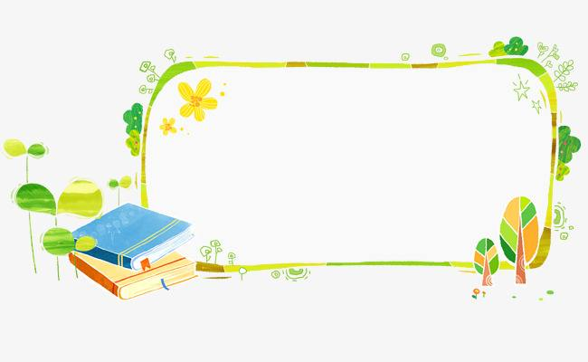
四年级上公立校
Revision
Unit 3 Let's Go！
Unit4 Shopping in the City

Slide 2
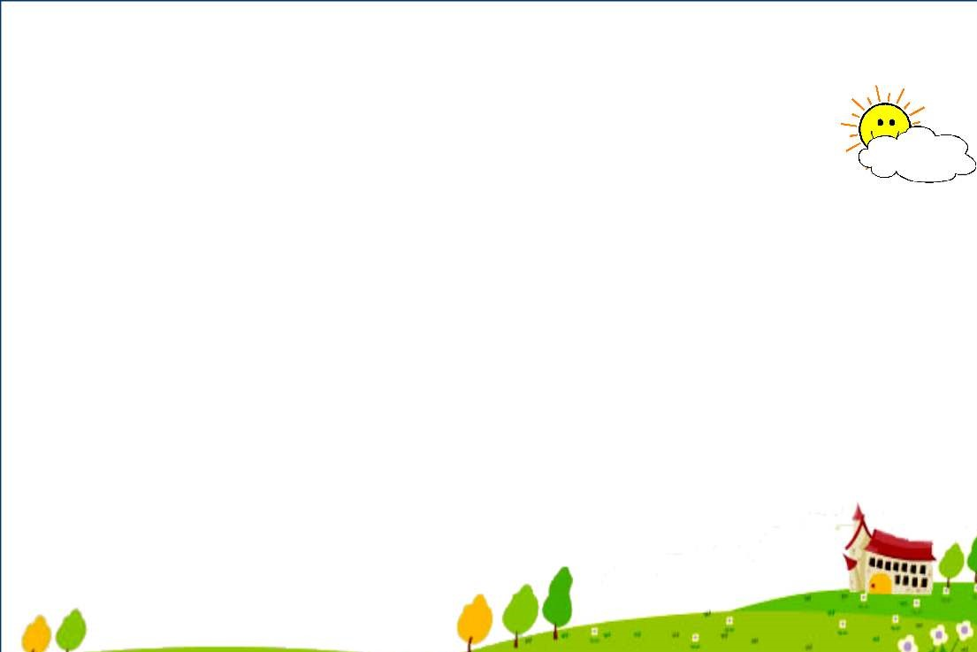
Unit3 Let's Go！
Unit4 Shopping in the City
Lesson13 At School
Lesson19 Let's Go Shopping!
Lesson14 Near and Far
Lesson20 At the Shop
Lesson15 In the City
Lesson21 Cinema and Park
Lesson16 Cars and Buses
Lesson22 At the Supermarket
Lesson17 I'm Lost!
Lesson23 Shopping Online
Lesson18 Lost in the City
Lesson24 Etta's Teddy Bear

Slide 3
一、判断每组单词中画线部分发音是(T)否(F)相同。
( ) 1. this they
( ) 2. beds kids
( ) 3. cats shorts
( ) 4. what who
T
T
T
F

Slide 4
二、看图写单词，完成句子。
1. I go to school by ________.
bus
2. They play catch with a ________ in the park.
ball
3. Let's go to the ________ on Sunday.
cinema
4. I ________ a book at home.
read
5. I want to go to the clothes shop to buy a ________.
shirt

Slide 5
三、将下列单词归类。
①twelve ②cinema ③ skirt ④ car ⑤Monday ⑥fifteen ⑦ship ⑧sweater ⑨Tuesday ⑩library ⑪supermarket ⑫taxi ⑬trousers ⑭Wednesday ⑮thirty
1.
2.
3.
4.
5.
①⑥⑮
③⑧⑬
②⑩⑪
⑤⑨⑭
④⑦⑫
四、单项选择。
( )1. I do my homework________ Sunday.
A. in B. on C. at
( )2. ________ do you want to go?
A. What B. There C. Where
( )3. She wants to buy some________.
A. tomato B. tomatos C. tomatoes
B
具体日期，星期前用on
C
问地点用where
some 一些，后面加可数名词复数
C

Slide 6
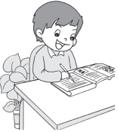
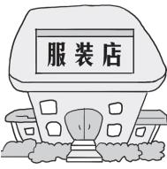
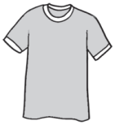
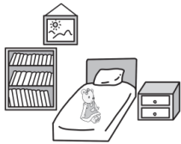
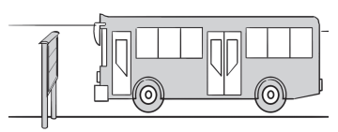
( )4. I play ________ my friend in the park.
A. on B. for C. with
( )5. He is ________ shorts.
A. wear B. wears C. wearing
五、读句子，选出与之相对应的图片。
( )1. Mark is wearing a T-shirt.
( )2. Danny does his homework in the evening.
( )3. The teddy bear is on the bed.
( )4. I go to the restaurant by bus.
( )5. Let's go to the clothes shop.
A. B. C. D. E.
C
play with 和...一起玩儿
C
be动词加ing
B
D
C
A
E

Slide 7
六、情景交际。
( )1. 如果你想问对方书店在哪里时，你可以说：________
A. This is a book shop. B. Where is the book shop?
( )2. 如果你想知道你的同伴星期天做什么时，你可以这样说：________
A. What do you do on Sunday? B. I play with a ball on Sunday.
( )3. 当你想告诉同学，你在家会给你的朋友打电话时，你应该说：________
A. I play on the computer at home.
B. I talk on the phone with my friends at home.
( )4. 当你想告诉妈妈，你的画在桌子上时，你应该说：________
A. The picture is in the desk. B. The picture is on the desk.
( )5. 当你想问别人“这条短裤是不是丹尼的”时，你可以说：______
A. Is this Danny's shorts? B. Are these Danny's shorts?
B
A
B
B
B

Slide 8
七、选择正确的句子补全对话。
B
A：Hi, Lucy. 1. ________
B：It's Sunday.
A：2. ________
B：I go to the clothes shop.
A：3. ________
B：I want to buy a dress. Let's go together.
A：4. ________
B：It's near the cinema.
A：5. ________
B：We can go on foot.
A：Great! Let's go.
D
A. How do we go to the clothes shop?
B. What day is today?
C. Where is the clothes shop?
D. What do you do on Sunday?
E. What do you want to buy?
E
C
A

Slide 9
八、阅读理解。
Today is Tuesday. Boys and girls are all at school. They go to school by bus. Their teacher is at the school too. The teacher's name is Lily. She goes to the school on foot. Look at the classroom. You can see a boy and a girl in the classroom. The boy is eleven. His name is Jack. The girl is Emma. She is twelve. John is Jack's friend. He is twelve too.
( )1. Boys and girls are all at school on Tuesday.
( )2. Lily goes to the school by bus.
( )3. Jack is eleven years old.
( )4. Emma is in the classroom.
( )5. Jack's friend is Lily.
T
F
T
T
F

Slide 10
九、作文
1.根据所给信息，写出对话： 作文的字数不少于30字。
假如你想去公园，可是迷路了，一位叔叔帮助了你，告诉你要先直走，向左转，然后向右转。你很开心的到达了，并感谢了叔叔。
2.写几句话描述如何去某地 How do you go to the...
A: Excuse me.
B: Yes?
A: I want to go to the park, but I’m lost.
B: I can show you. Go straight. Turn left, and then turn right. You can see it.
A: Thank you.
B: You are welcome.

Slide 11
四年级上公立校
Revision
Unit 1 The Clothes We Wear
Unit2 At Home

Slide 12
Unit1 The Clothes We Wear
Unit2 At Home
Lesson1 Skirt and Trousers
Lesson7 Homework
Lesson2 New and Old
Lesson8 TV and Phone
Lesson3 Coat and Scarf
Lesson9 In the Bedroom
Lesson4 Shoes and Socks
Lesson10 Brush and Wash
Lesson5 Days of the Week
Lesson11 Toys
Lesson6 Betty's Clothes
Lesson12 John and Jack

Slide 13
一、判断每组单词中画线部分发音是(T)否(F)相同。 ( ) 1. shirt shoes ( ) 2. three this ( ) 3. lunch chicken ( ) 4. teeth math
T
F
T
T

Slide 14
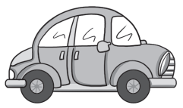
二、根据单词选出正确图片。
( )1. T­shirt A.
B.
A
( )2. ball A.
A
B.
( )3. hand A.
B
B .
B
( )4. bedroom A.
B.
( )5. kite A.
A
B.

Slide 15
三、选词填空。
A.in B.on C.with D.after E.at
B
1. I put________ my clothes. 2. She reads a book________ home. 3. What do you do ________ the evening? 4. Mark talks ________ the phone ________his mother. 5. I brush my teeth ________ dinner.
E
A
B
C
D

Slide 16
四、单项选择。
have breakfast 吃早饭，固定搭配
( )1. I ________breakfast with my mum.
A. play B. have C. give
( )2. We play ________ with a ball.
A. can B. catch C. on
( )3. We go to school ________ Monday.
A. in B. on C. at
( )4. She________ music in the morning.
A. listen B. listens C. listens to
( )5. The TV is________the desk.
A. at B. on C. of
B
B
play catch 玩接球游戏，固定搭配
B
星期前面要用on
C
listen to music 听音乐，固定搭配
B
on the desk 在桌子上

Slide 17
五、为下列句子选择合适的图片。
( )1. I do my homework on Sunday.
( )2. I fly a kite in the park.
( )3. This is a new dress.
( )4. I wash my face every day.
( )5. I like your scarf.
B
D
E
C
A
A.
B.
C.
D.
E.

Slide 18
六、连词成句,填序号就可以。
1. ①old ②This ③an ④is ⑤coat
_________________________________________________.
2. ①on ②clothes ③put ④I ⑤my ___________________________________________________.
3. ①green ②sweater ③It ④a ⑤is ___________________________________________________.
4. ①they ②wearing ③What ④are __________________________________________________?
5. ①coats ②My ③are ④favourite ⑤clothes _________________________________________________.
②④③①⑤
④③①⑤②
③⑤④①②
③④①②
②④⑤③①

Slide 19
七、根据问句选答语。
( )1. What is he wearing? A. I help my mum and dad.
( )2. How do you go to the zoo? B. I go to the zoo by bus.
( )3. Is this your sweater? C. He is wearing a new shirt.
( )4. Are these your gloves? D. No, it isn't.
( )5. What do you do at home? E. Yes, they are.
C
B
D
E
A

Slide 20
八、阅读理解。
Today is Sunday. The family are all at home. Jim's father is wearing a black coat. He watches TV after breakfast. Jim's mother is wearing a red dress. She cleans Jim's bedroom. Where is Jim? Oh, he's behind the door. What is Jim wearing? He is wearing a blue T­shirt. He and his sister are playing games. They have no homework on Sunday.
( )1. What day is today?
A. Today is Monday. B. Today is Sunday. C. Today is Saturday.
( )2. What is Jim's father wearing?
A. His father is wearing a blue coat. B. His father is wearing a black coat.
C. His father is wearing a blue T­shirt.
( )3. What does Jim's mother do on Sunday?
A. His mother reads a book. B. His mother watches TV.
C. His mother cleans his bedroom.
( )4. Where is Jim?
A. He is behind the door. B. He is in the park. C. He is in the bedroom.
( )5. What are he and his sister doing?
A. They are doing their homework. B. They are playing football.
C. They are playing games.
B
B
C
A
C

Slide 21
九、作文 ：以 “My Day”为题，写一篇小作文。
要求:语言准确
30个单词以上（不包含标点符号）
写几句话描述平时做点什么 What do you do at home?
时态：一般现在时
人称：第一人称 I
关键词(句)：
In the morning...
After breakfast...
In the afternoon...
In the evening...
brush my teeth , wash my face, clean the room, read books...

Slide 22
Sample Writing
My Day
Hello, my name is Emma! Today is Saturday.
In the morning, I brush my teeth and wash my face at 7 a.m. . After breakfast, I help my mum and dad clean the room .Then I play on the computer. In the afternoon, I play with my friends. We play catch with a ball and fly kites. In the evening, I read books after dinner.
I have a happy Saturday! How about your day?

Slide 23
Thanks

