Slide 1
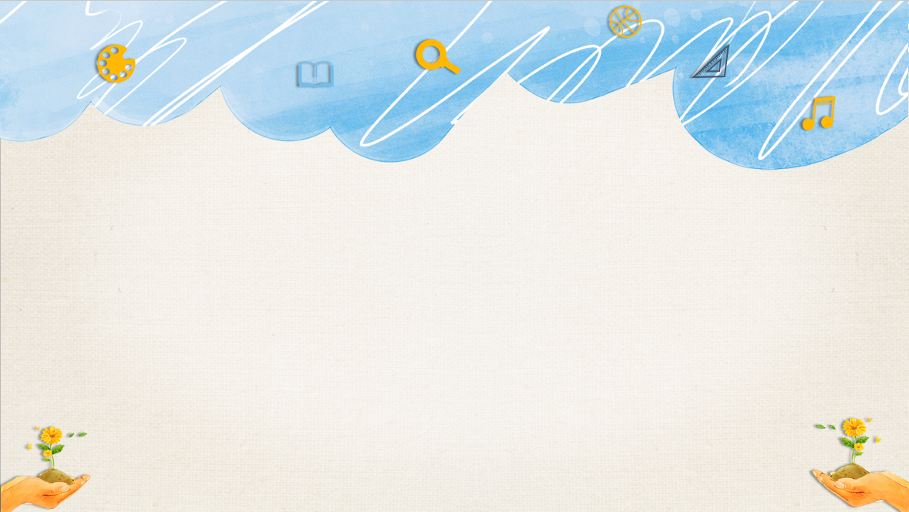

爱学习新概念Lesson 23-24 微信教学

Slide 2
I. 选择。
( ) 1. -- Which ones? -- The ones ________ shelf.
A. on B. on the C. in the
( ) 2. -- Give ________ some glasses, please.
A. your B. us C. my
( ) 3. Some spoons and forks ________ on the desk.
A. am B. is C. are
( ) 4. -- ________. -- Thank you very much.
A. Here are you B. Here you are C. You are here
( ) 5. Give me ________ tins, please.
A. their B. them C. they
B
B
C
B
A

Slide 3
II. 根据句意，用所给单词填空。（每个单词只限使用一次）
shelf those them ones on
1. ________ nice carpets are brown.
2. -- Give me some books, please.
-- Which books? The new ________ ?
3. I want the big glass on the ________ .
4. Give ________ some ice creams. They are tired and thirsty.
5. The plates are ________ the desk.
Those
ones
shelf
them
on

Slide 4
III. 按要求完成下列各题。
1. Give me some tickets. (同义句转换)
Give some tickets _______ ________.
2. Give them the heavy one. (改为复数句)
Give them the ________ ________.
3. Don’t come here, please. (改为肯定句)
________ ________, please.
4. desk, bottle, the, the, is, on,(连词成句)
_____________________________________.
5. bed, those, boxes, the, are, on (连词成句)
_____________________________________?
to me
heavy ones
Come here
The bottle is on the desk
Are those boxes on the bed

Slide 5
See you.

