Slide 1
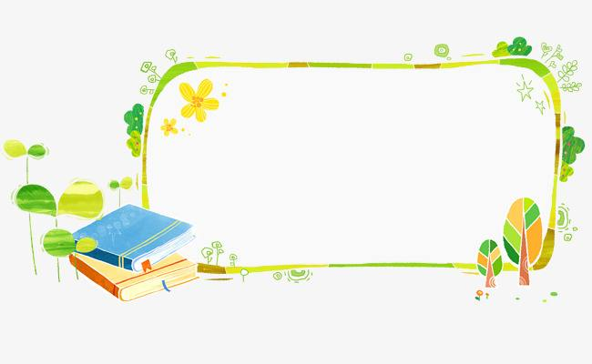
四年级上公立校
Revision
Unit 1 The Clothes We Wear
Unit2 At Home

Slide 2
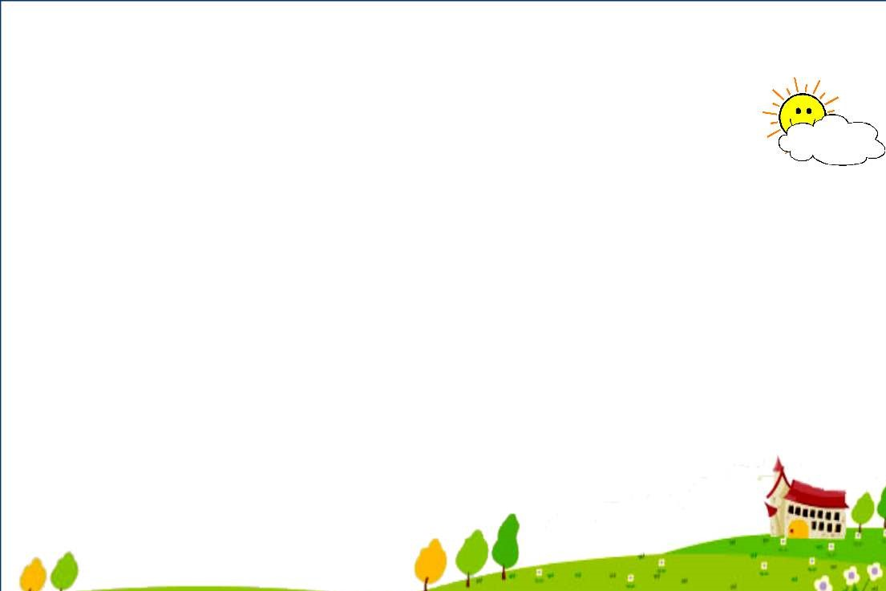
Unit1 The Clothes We Wear
Unit2 At Home
Lesson1 Skirt and Trousers
Lesson7 Homework
Lesson2 New and Old
Lesson8 TV and Phone
Lesson3 Coat and Scarf
Lesson9 In the Bedroom
Lesson4 Shoes and Socks
Lesson10 Brush and Wash
Lesson5 Days of the Week
Lesson11 Toys
Lesson6 Betty's Clothes
Lesson12 John and Jack

Slide 3
一、判断每组单词中画线部分发音是(T)否(F)相同。 ( ) 1. shirt shoes ( ) 2. three this ( ) 3. lunch chicken ( ) 4. teeth math
T
F
T
T

Slide 4
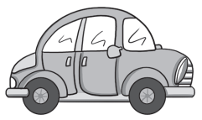
二、根据单词选出正确图片。
( )1. T­shirt A.
B.
A
( )2. ball A.
A
B.
( )3. hand A.
B
B .
B
( )4. bedroom A.
B.
( )5. kite A.
A
B.

Slide 5
三、选词填空。
A.in B.on C.with D.after E.at
B
1. I put________ my clothes. 2. She reads a book________ home. 3. What do you do ________ the evening? 4. Mark talks ________ the phone ________his mother. 5. I brush my teeth ________ dinner.
E
A
B
C
D

Slide 6
四、单项选择。
have breakfast 吃早饭，固定搭配
( )1. I ________breakfast with my mum.
A. play B. have C. give
( )2. We play ________ with a ball.
A. can B. catch C. on
( )3. We go to school ________ Monday.
A. in B. on C. at
( )4. She________ music in the morning.
A. listen B. listens C. listens to
( )5. The TV is________the desk.
A. at B. on C. of
B
B
play catch 玩接球游戏，固定搭配
B
星期前面要用on
C
listen to music 听音乐，固定搭配
B
on the desk 在桌子上

Slide 7
五、为下列句子选择合适的图片。
( )1. I do my homework on Sunday.
( )2. I fly a kite in the park.
( )3. This is a new dress.
( )4. I wash my face every day.
( )5. I like your scarf.
B
D
E
C
A
A.
B.
C.
D.
E.

Slide 8
六、连词成句,填序号就可以。
1. ①old ②This ③an ④is ⑤coat
_________________________________________________.
2. ①on ②clothes ③put ④I ⑤my ___________________________________________________.
3. ①green ②sweater ③It ④a ⑤is ___________________________________________________.
4. ①they ②wearing ③What ④are __________________________________________________?
5. ①coats ②My ③are ④favourite ⑤clothes _________________________________________________.
②④③①⑤
④③①⑤②
③⑤④①②
③④①②
②④⑤③①

Slide 9
七、根据问句选答语。
( )1. What is he wearing? A. I help my mum and dad.
( )2. How do you go to the zoo? B. I go to the zoo by bus.
( )3. Is this your sweater? C. He is wearing a new shirt.
( )4. Are these your gloves? D. No, it isn't.
( )5. What do you do at home? E. Yes, they are.
C
B
D
E
A

Slide 10
八、阅读理解。
Today is Sunday. The family are all at home. Jim's father is wearing a black coat. He watches TV after breakfast. Jim's mother is wearing a red dress. She cleans Jim's bedroom. Where is Jim? Oh, he's behind the door. What is Jim wearing? He is wearing a blue T­shirt. He and his sister are playing games. They have no homework on Sunday.
( )1. What day is today?
A. Today is Monday. B. Today is Sunday. C. Today is Saturday.
( )2. What is Jim's father wearing?
A. His father is wearing a blue coat. B. His father is wearing a black coat.
C. His father is wearing a blue T­shirt.
( )3. What does Jim's mother do on Sunday?
A. His mother reads a book. B. His mother watches TV.
C. His mother cleans his bedroom.
( )4. Where is Jim?
A. He is behind the door. B. He is in the park. C. He is in the bedroom.
( )5. What are he and his sister doing?
A. They are doing their homework. B. They are playing football.
C. They are playing games.
B
B
C
A
C

Slide 11
九、作文 ：以 “My Day”为题，写一篇小作文。
要求:语言准确
30个单词以上（不包含标点符号）
写几句话描述平时做点什么 What do you do at home?
时态：一般现在时
人称：第一人称 I
关键词(句)：
In the morning...
After breakfast...
In the afternoon...
In the evening...
brush my teeth , wash my face, clean the room, read books...

Slide 12
Sample Writing
My Day
Hello, my name is Emma! Today is Saturday.
In the morning, I brush my teeth and wash my face at 7 a.m. . After breakfast, I help my mum and dad clean the room .Then I play on the computer. In the afternoon, I play with my friends. We play catch with a ball and fly kites. In the evening, I read books after dinner.
I have a happy Saturday! How about your day?

Slide 13
Thanks

