Slide 1
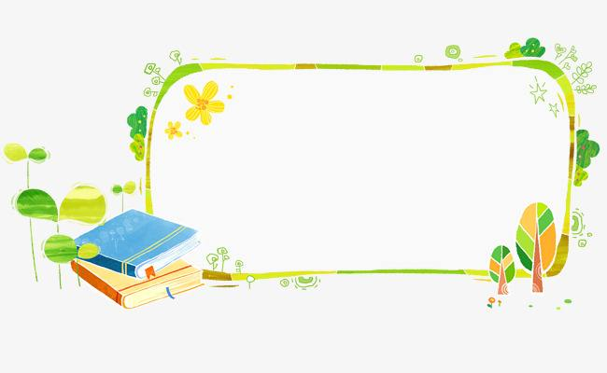
四年级上公立校
Revision

Slide 2
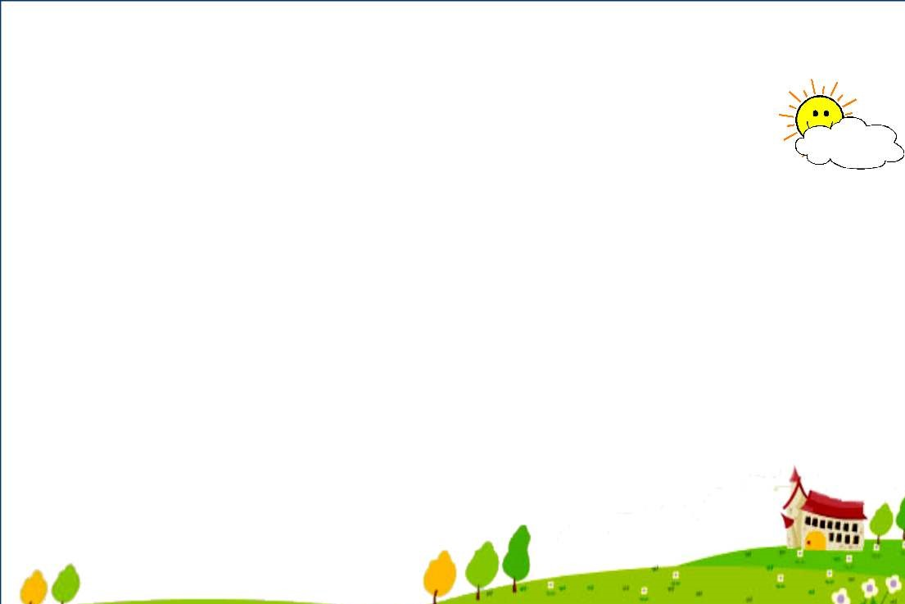
Key words:
shirt （尤指男士的）衬衣
skirt 裙子
trousers 裤子
sweater 毛衣，绒衣
this 这，这个
these 这些
is 是（单数后）
are 是（复数后）
new 新的
old 旧的；年老；……岁的
day 一天；一日
today 今天
it 它
they 他们；她们；它们
coat 大衣；外套
cap （有帽舌的）帽子
Miss 小姐，女士（未婚）
dress 连衣裙
shoe 鞋
sock 短袜
shorts 短裤（复数）
not 不是；不，没
week 星期

Slide 3
Key words&phrases:
do 做，干
my 我的
homework 家庭作业
read 读；阅读
book 书
watch 看；注视
TV 电视；电视机
bed 床
clean 打扫；干净的
listen （注意地）听
listen to （注意地）听；倾听
wash 洗；洗涤
face 脸；面
toy 玩具
ball 球
kite 风筝
fly 飞，放飞
play 玩；做游戏
with 和……在一起；同，跟
play with 拿……玩；和……一起玩

Slide 4
shirt
coat
watch
play
read
sweater
these
listen
today
clean

Slide 5
Key words&phrases:
school 学校；上课（或上学）时间
classroom 教室
library 图书馆
playgroud 操场；游乐场
where 在哪里；到哪里
near 在附近
far 远的；遥远的
from 从……来；离……
far from 离……远
the 这（那）个 ；这（那）些
street 街道
bike 自行车
taxi 出租车司机
car 小汽车；轿车
bus 公共汽车
thirty 三十
light 灯
red 红色；红色的
yellow 黄色；黄色的
green 绿色；绿色的

Slide 6
Key words&phrases:
shop 商店；购物
let's(=let us) 让我们……
go 出发，离去；行走；去
go shopping 购物
want 想要
to 朝……；向……；无词义
buy 买
way 方向；方法；方式；道路
cinema 电影院
park 公园
supermarket 超市
tomato 西红柿
potato 马铃薯，土豆
bag 包；袋

Slide 7
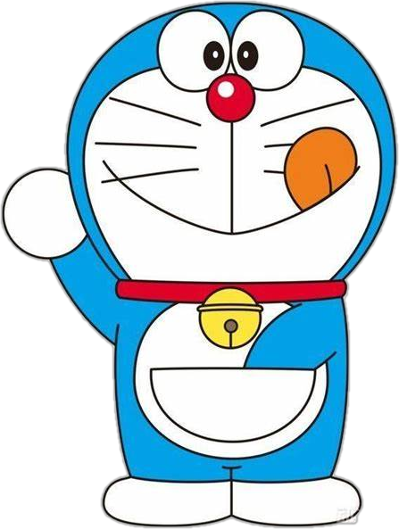
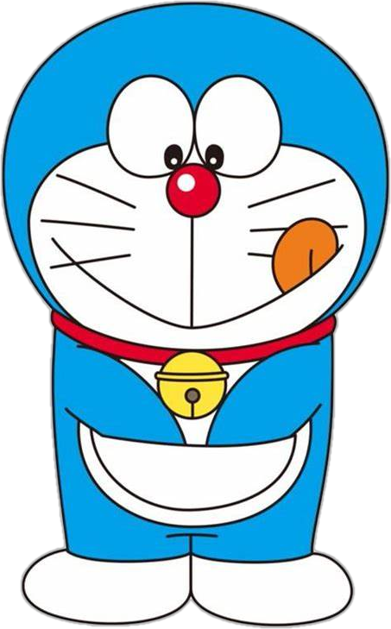
street
far
school
bike
shop
want
buy
where
tomato
potato

Slide 8
Exercises

Slide 9
选出不同类的一项。 ( ) 1. A. morning B. evening C. library ( ) 2. A. fish B. meat C. fifteen ( ) 3. A. milk B. juice C. coat ( ) 4. A. twenty B. thirty C. yellow ( ) 5. A. socks B. bread C. milk ( ) 6. A. buy B. go C. Miss ( ) 7. A. Tuesday B. day C. Sunday ( ) 8. A. wash B. listen C. TV ( ) 9. A. bus B. green C. car ( ) 10. A. skirt B. coat C. play
C
C
C
C
A
C
B
C
B
C

Slide 10
看图，选出正确的句子。 ( ) 1. A. I go to school by bike. B. I walk to school.
A
B
( ) 2. A. I draw a picture. B. I read a book.
A
( ) 3. A. I do my homework. B. I make my bed.
A
( ) 4. A. They are trousers. B. They are shorts.
A
( ) 5. A. I brush my teeth. B. I wash my face.

Slide 11
根据句意填写单词。 1. These ________ new trousers. 2. I like to ________ TV on Saturday. 3. The sweater is ________. I want to buy a new one. 4. We read ________ in the library. 5. —________ are the dresses? —Here they are. 6. —How many days are there in a________?
—Seven. 7. The traffic lights are________. Let's go!
are
watch
old
books
Where
week
green

Slide 12
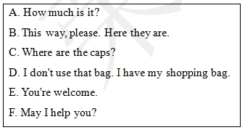
补全对话。
F
A: 1. ________ B: Yes, please. I want to buy a cap2.________
C
B
A: I'll show you. 3. ________ B: 4. ________ A: It's thirty yuan. B: I'll take it. A: Okay. I will wrap(打包) it for you. B: 5. ________ A: You're a good boy. B: Thanks. A: 6. ________
A
D
E

Slide 13
连词成句。
1. day it What is (?) _______________________________________________________ 2. her new Is dress this (?) _______________________________________________________ 3. books Let's to to go library the read (. ) _______________________________________________________ 4. a buy I shirt red want to (. ) _______________________________________________________ 5. good isn't for Candy teeth your (. ) _______________________________________________________
What day is it?
Is this her new dress?
Let's go to the library to read books.
I want to buy a red shirt.
Candy isn't good for your teeth.

Slide 14
看图回答问题。
1. —How does he go to the zoo? —He goes to the zoo________ ________.
by
car
2. —Do you watch TV? —________, I________.
Yes
do
Where
3. —________do you want to go? —I want to go to the________.
park
4. —What do you do in the morning?
—I ________ my________.
wash
face
days
week
5.—There are seven ________ in a________.

Slide 15
单项选择。
( ) 1. Is it far ________ here?
A. from B. / C. to
( ) 2. —What is Danny wearing?
—He is ________ shorts.
A. wears B. wear C. wearing
( ) 3. I talk ________ the phone ________ my friends.
A. with; on B. on; with C. to; to
( ) 4. —________is the park?
—It's near my school.
A. Who B. What C. Where
( ) 5. —________is it ?
—It's thirty­seven yuan.
A. How old B. How much C. How many
A
far from 远离……
C
B
talk on the phone
打电话聊天、交谈
with 和……
C
B
how much 打电话

Slide 16
( ) 6. ________days are there in a week?
A. How much B. How C. How many
( ) 7. —Do you like to fly kites?
—________.
A. Yes, I like B. Yes, I do C. No, I do
( ) 8. I go to the park to________.
A. read books B. watch a film C. fly kites
( ) 9. ________do you want to go?
A. What B. Which C. Where
( ) 10. The zoo is ________ the school.
A. near B. / C. to
C
how many 问数量
B
Do you...? 回答：
Yes, I do.\No, I don't.
C
C
A
near 在附近

Slide 17
排序。
A
( ) I go to school at 7:40 in the morning .
( ) At 7:00 in the morning, I brush my teeth and wash my face.
( ) Then I have breakfast.
( ) At 4:00 in the afternoon, I go home.
( ) After dinner，I do my homework.
3
1
2
4
5

Slide 18
排序。
B
( ) Let's go shopping!
( ) I want to buy some apples. What about you?
( ) Okay. What do you want to buy?
( ) I like candy. I want to buy some candy.
( ) Candy isn't good for your teeth.
1
3
2
4
5

Slide 19
阅读短文。
Hello, boys and girls! My name is Lisa. Look! This is a picture of my family. This is my father. He is wearing a blue shirt. This is my mother. She is wearing a yellow dress. Look at this boy! He is wearing black shorts. He is my brother. And look at this girl! This is me. I am wearing a white T­shirt and a red skirt.
根据文章内容判断正(T)误(F)。
( ) 1. This is a picture of Lisa's friends.
( ) 2. Lisa's father is wearing a blue shirt.
( ) 3. Lisa's mother is wearing a yellow dress.
( ) 4. Lisa's brother is wearing black trousers.
( ) 5. Lisa is wearing a red T­shirt and a white skirt.
F
T
T
F
F

Slide 20
阅读短文，选择正确的选项。
Hello! My name is Bill. I'm ten years old. I'm 1. 5 metres tall. Now I'm wearing a T­shirt, shorts, socks and shoes. I like purple. It's my favourite colour. I like to draw pictures. It's my favourite schoolwork. I like pizza and ice cream. They are my favourite food. I don't like hot dogs.
阅读短文，选择正确答案。
( ) 1. How old is Bill?
A. Nine. B. Ten. C. Eleven.
( ) 2. What's Bill wearing now?
A. A T­shirt. B. A skirt. C. A coat.
( ) 3. What's his favourite colour?
A. Black. B. White. C. Purple.
( ) 4. What's his favourite food?
A. Donuts. B. Hot dogs. C. Pizza and ice cream.
( ) 5. What's his favourite schoolwork?
A. Singing songs. B. Drawing pictures. C. Reading books.
B
A
C
C
B

Slide 21
阅读短文。
It's Sunday today. It's warm. On Sundays, Tom and John like to play with a ball on the playground. Jenny and Danny like to draw pictures at home. I like to go to the library. It's near my home. There are many books in it. I like to read books. It is fun. But this Sunday I want to go to the clothes shop. I want to buy a new shirt. My old shirt is too small.
阅读短文，选择正确答案。
( ) 1. How's the weather today?
A. It's warm. B. It's cold. C. It's snowy.
( ) 2. Tom and John like to ________ on Sundays.
A. play football B. play with a ball C. play basketball
( ) 3. Jenny and Danny like to ________ on Sundays.
A. read books B. play with a ball C. draw pictures
( ) 4. —Where is the library? —It's________.
A. far from my home B. near my home C. near the shop
( ) 5. My old shirt is ________.
A. too big B. too small C. just right
A
B
C
B
B

Slide 22
Thanks

