Slide 3
content
重点短语回顾
重点句型回顾
重点语法
完形、阅读点拨

Slide 4
重点短语

Slide 5
Phrases
1.写下；记下
2.成长；长大
3.参与做某事
4.不同种类的
5.各种各祥的
6.有点儿，稍微
7.确信;对…有把握
8.必定，务必(去做)
1. write/take down
2. grow up
3. play a part/role in doing sth.
4. different kinds of….
5. all kinds of
6. kind of +adj.
7. make sure=be sure of/about
8. make sure to do=be sure to do
Notes:
前面无a different的时候 不表示种类 动+名=be+形

Slide 6
Phrases
1.处于危险之中
2.脱离危险
3.与…有关
4.做完某事
5.太…而不能
6.练习做某事
7. 记得/忘记去做某事
8. 记得/忘记做过某事
1. in danger
2. out of danger
3. have to do with…
4. finish doing …
5. too…to…
6. practice/practise doing…
7. remember/forget to do
8. remember/forget doing
Notes:
practice mind finish enjoy remember stop to do 、doing 做过的或者正在做的用doing

Slide 7
Exercises
1. 现在很多动物都处于危险之中，让我们尽我们所能
帮助它们脱离危险。
Many animals are _________now, let’s do what we
can to help them _____________.
in danger
out of danger
2. 许多决定与自我提升有关。
Many resolutions _____________ self-improvement.
have to do with
3. 我昨天没有读完那本杂志。
I didn't____________(read) that magazine yesterday.
finish reading
4. 他走的太慢而不能跟上我们。
He walked _______________________ us.
too slowly to catch up with
Notes:
与so 。。。that的替换。 补全句子，考试不考，但是我们课本上有很多。去掉汉语意思相同的部分，再翻译剩下的部分。

Slide 8
Exercises
5. 离开房间的时候记得把灯关了。
__________________the light when you leave.
Remember to turn off
6. 务必保证出门的时候锁好门。
_________ you lock the door when you go out.
Make sure
7. 我每天不得不练习唱歌一小时。
I ___________________ (sing) for an hour every day.
have to practice singing
8. 他并没有参与做这个决定。
He didn’t _____________ in making the decision.
play a part/role

Slide 9
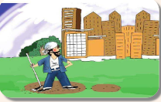
take up 开始做，学着做
他辞去城里的工作，开始务农。
He left a job in the city to ________ farming.
take up
●take off
●take over
●take on
●take in
●take away
脱掉;起飞
接管
呈现;雇佣
吸收;欺骗
拿开;减去
Notes:
take up 占据 too much room （take） up介词中考考占据 居多。 take off 起飞，落地land。cheat 八年级二单元。take on 考呈现多。take in 吸收海绵吸收很多水。

Slide 10
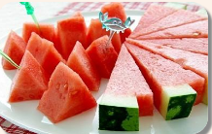
cut up…切碎
男孩切开了西瓜，把它们分给别人。
The boy _______the watermelon and shared
them with others.
cut up
●cut off
●cut down
●cut out
切断
减少;砍倒
删除
Notes:
cut in 插话 shared 过去式前面cut-cut-cut 切断水电煤气 cut out =delet cut off 切断水电气。cut out 删除这些单词。

Slide 11
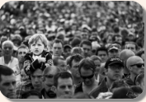
look for …寻找
她在人群里寻找她的母亲。
She __________ her mother in the crowd.
looked for
● look for trouble自找麻烦
● look/long for 盼望;渴望
e.g. look for an improvement.
● look forward to(doing)sth期待、期望
● look after 照顾
● look up 查找;向上看
● look around 环顾四周
Notes:
long for 考的比较多 look through =look into look out look down apon look like （介词）+doing看起来像个打球的，其实不是？

Slide 12
重点句型回顾

Slide 13
1. It's a kind of promise.它是一种承诺。
● promise n.允许;承诺
● make/keep/break a promise许下/信守/违背承诺
● promise v.
● promise to do sth.承诺做某事
● promise + that从句承诺做某事
练习1:
1. He promised_____his old friend during his stay in Tianjin.
A. see B. to see C. seeing D. will see
2. 他向老师承诺上学不会再迟到。( 完成译句)
He ______a _______ to his teacher that he wouldn't
be late for school again.
B
made promise
Notes:
动词注意时态

Slide 14
2. Will people use money in 100 years?
100年以后人们还需要用钱吗?
●in+时间段(将来时，提问用How soon)
●after+时间段(过去时)=时间段+later
练习2:
1. He came back safely______ two days.
A. in B. after C. for D. later
B
Notes:
after some time after a long trip after +时间点 用于将来时态。

Slide 15
3. Some scientists believe that there will be more
robots in the future.
有些科学家相信在将来将有更多的机器人。
It is believed that 据相信/认为
believe sb. 相信某人
believe in sb. 信仰；信任某人(人格，力量，品行）
练习3
We believe _____him because we know he has never deceived (欺骗) anyone.
A. of B. in C. with D. to
2. 他相信只要他足够努力，他就会成功。( 完成译句)
He ____________ as long as he works hard enough, he will
succeed.
B
believes that
Notes:
相信。when as soon as 时间状语从句表条件。

Slide 16
4. They agree it may take hundreds of years.
他们同意可能花费上百年。
●(dis)agree with sb. (不)同意某人的观点
●(dis)agree to do sth. (不)同意做某事
●(dis)agree on 在....(未)达成一致
练习4:
The two sides didn't agree_____ the date of the meeting, and they argued with each other.
A. on B. for C. against D. to
2. 莉莉，恐怕我不能在这件事上同意你。(补全句子)
Lily, I'm afraid I couldn't___________you on this point.
A
agree with
Notes:
名词。agree +on+sth /with sb.

Slide 17
5. Turn on the blender.打开榨汁机。
● turn on打开
● turn off关掉
● turn up调高;出现
● turn down调低;拒绝(代词放中间，注意单复数)
练习5:
1. To be honest, I was so surprised that he_____ my
invitation face to face.
A. turned on B. turned down C. turned off D. turned up
2. I can hardly hear the radio. Could you please____ it_____ ?
A. turn; up B. turn; off C. turn; on D. turn; down
B
A
Notes:
turn down your help shouder on shouder hand in hand 某某

Slide 18
6. Fill the turkey with this bread mix.
用面包碎片把火鸡填满。
Fill A with B 用B把A装满
A be full of B= A be filled with B
练习6:
1. She____ the bottle ____ colorful stones and some water.
A. filled; of B. filled; with C. filled; of D. fulled; with
2. 她太激动了，并且眼里充满了泪水。(补全句子)
She was excited and her eyes were______________ tears.
B
filled with/full of
Notes:
介词的区分 动词的过去分词词性就是adj词性。考介词搭配

Slide 19
Exercise
1. Would you please be kind enough to _____ the radio a little?
The baby is sleeping.
A. turn on B. turn down C. turn off D. turn up
2. Nowadays, when the old fall off the bike,____people will help them.
A. a little B. little C. a few D. few
3. It may take ___ years to make such robots.
A. hundreds of B. two hundreds C. hundred of D. hundred
4. They____ Laura on building a museum here.
A. waited for B. handed in C. agreed with D. knocked at
5. Your paper is ____ mistakes. You can't be too careful next time.
A. filled of B. fill with C. full of D. full with
B
D
A
C
C
Notes:
fall down from can't wait fo do 迫不及待做某事。记住。 never too late to learn。

Slide 20
P47,48

Slide 21
重点语法内容
Notes:
完成时：1 since for already yet 。其他看语境。2 have gone 、been to in 3.延续非延续 buy borrow。
一般现在时态：1.注意单三。go have do 2.
将来时：主将从现。will -won‘t 好多ss 不认识。
时间标志词。

Slide 22
一般过去与现在完成的区别
1.定义
2.对现在是否有影响
3.助动词
4.时间标志词
Notes:
现完：1.since for 2.have been to 、gone to 3.持续性动词 非。。。until now 将来时态时间标志词 in the future there be 句型的叠加 现进表将来。 be about to 表示“计划去某地”直接用“be going to+地点”

Slide 23
一般将来时
1. 构成：“will+动词原形” 或“be going to+动词原形”
变疑问，把will或be提前；变否定，在will或be后加not。
2. “be going to+动词原形” 强调
(1) 主观打算或计划 (2) 根据目前情况推测。
“will+动词原形” 侧重表示
(1) 没有计划的将来 (2) 不以人意愿为转移的将来。
3. there be句型的一般将来时结构: there will be/there is going to be.
4. 如果表示“计划去某地”直接用“be going to+地点”
Notes:
第一人称还可用shall。there be 句型的一般将来时态的运用。

Slide 24
Exercise P49
C
1. There __ a meeting tomorrow afternoon.
A. will be going to B. will going to be
C. is going to be D. will go to be
2. Charlie __ here next month.
A. isn't working B. doesn't working
C. isn't going to working D. won't work
3. He __ very busy this week, but he ___ free next week.
A. will be ; is B. is ; is
C. will be; will be D. is; will be
4. There ___ a dolphin show in the zoo tomorrow evening.
A. was B. is going to have
C. will have D. is going to be
5.—____you____ free tomorrow?
—No . I _____ free the day after tomorrow.
A. Are; going to; will B. Are; going to be; will
C. Are; going to; will be D. Are; going to be; will be
D
D
D
D
Notes:
找关键词。改

Slide 25
L6 易错Top3
A
--____ can we tell him about the exciting news?
--By _____ an email.
A. How; sending B. How; send
C. What; sending D. What; send
2. The teacher marked(打分) the exam ___ and wrote the grades on a piece of ___.
A. papers; paper B. paper; papers
C. paper; paper D. papers; papers
3. I think flying to the moon for vacation will ____ one day.
A. come true B. come on
C. come over D. come out
A
A
Notes:
by表示通过一种方式+by sth、doing sth come over 过来。 come out 出来

Slide 26
阅读点拨—完形填空
命题特点：
首尾不设空
结合上下文做题
考查实词为主
英语十类词：
名代动形副
介连冠感数
Notes:
多考词义辨析。把文章读懂。根据首尾句看整体意思。有的答案 常考虚词。介词连词。冠词在词语运用比较多。常考的是：除冠感数。虚词为：介词连词冠词感叹词

Slide 27
实词为主
虚词为辅
词义辨析
adj.
1.A. heavy B. full C. much D. long
2. A. read B. watch C. guess D. listen
3. A. glass B. weight C. water D. height
4. A. minute B. night C. day D. week
5. A. mother B. teacher C. doctor D. friend
6. A. rest B. shake C. look D. work
7. A. this time B. some time
C. next time D. all the time
8. A. give up B. put down C. pick up D. think about
9. A. after B. since C. before D. until
10. A. save B. help C. care D. relax
v.
n.
n.
n.
v.
adv.
v.
conj.
v.
Notes:
通读全文，读懂文章。

Slide 28
完形填空做题步骤
速浏览抓大意
扣大意做易题
细推敲攻难题
读全文纠失误
快速浏览全文，全面了解文章，抓住文章大意。
速度要
快
重点读首尾段
结合生词汉译确定主旨
划出关联词、高频词
Notes:
首尾不设空。大概了解意思。没有把握的题先不做， 有无漏题。检查谨慎改动

Slide 29
体裁：记叙文
话题：压力与调节
A teacher was giving a talk to his students on stress(压力) management. He raised a glass of water and asked them, "How 1 do you think this glass of water is?"
The students began to think and 2 . Their answers are different, from 20g to 500g.
"It does not matter on the real 3 . It depends on how long you hold it. If I hold it for a 4 it is OK. If I hold it for an hour, I will have an ache in my right arm. If I hold it for a day, you will have to call a 5 . It is the exact same weight, but the longer I hold it, the heavier it becomes. What we have to do is to put the glass down, 6 for a while before holding it up again.“
“If we carry our burdens (负担) 7 sooner or later, we will not be able to carry on. The burden will become increasingly heavier. We have to 8 the burden every now and then, so that we can be refreshed and are able to carry on."
So 9 you return home from work tonight, put the burden of work down. Don't carry it back home. You can pick it up tomorrow.
Whatever burdens you have, let them down for a moment if you can. And learn to 10 ourselves.
Life is short but amazing. Enjoy it!
Notes:
享受珍惜生活，怎么减少排解压力。第一题无把握不要急着做。有问有答，从答语里找answer。guess 20-50g

Slide 30
A teacher was giving a talk to his students on stress(压力) management. He raised a glass of water and asked them, "How 1 do you think this glass of water is?"
The students began to think and _2 . Their answers are different, from 20g to 500g.
"It does not matter on the real 3_. It depends on how long you hold it. If I hold it for a 4 it is OK. If I hold it for an hour, I will have an ache in my right arm. If I hold it for a day, you will have to call a 5 . It is the exact same weight, but the longer I hold it, the heavier it becomes. What we have to do is to put the glass down, 6 for a while before holding it up again.“
1. A. heavy B. full C. much D. long
2. A. read B. watch C. guess D. listen
3. A. glass B. weight C. water D. height
4. A. minute B. night C. day D. week
5. A. mother B. teacher C. doctor D. friend
6. A. rest B. shake C. look D. work
A
C
B
A
C
A
Notes:
OK an hour ache 有问有答

Slide 31
“If we carry our burdens (负担) 7 ,sooner or later, we will not be able to carry on. The burden will become increasingly heavier. We have to 8 the burden every now and then, so that we can be refreshed and are able to carry on."
So 9 you return home from work tonight, put the burden of work down. Don't carry it back home. You can pick it up tomorrow.
Whatever burdens you have, let them down for a moment if you can. And learn to 10_ourselves.
Life is short but amazing. Enjoy it!
7. A. this time B. some time
C. next time D. all the time
8. A. give up B. put down C. pick up D. think about
9. A. after B. since C. before D. until
10. A. save B. help C. care D. relax
D
B
C
D
Notes:
carry on 坚持继续 逐渐增加变得更加重 now and then 时而 时不时 fresh 新鲜的 refreshed 恢复精力变得充沛、。let down 让。。。失望。把他们放下一会。

Slide 32
完形填空答案
B
1. A.their B.your C.our D.one’s
2. A.necessary B.important C.interesting D.good
3. A.change B.finish C.improve D.care
4. A.way B.plan C.problem D.resolution
5. A.breakfast B.lunch C.supper D.dinner
6. A.stopping B.beginning C.trying D.enjoying
7. A.much B.more C.less D.little
8. A.easy B.difficult C.nice D.fun
9. A.early B.late C.high D.low
10. A.but B.so C.or D.and
D
C
D
A
A
C
B
C
B

Slide 33
阅读点拨—阅读理解
题型分布
细节理解题
主旨大意题
推理判断题
词义猜测题
A, B, C, D篇
B, C, D篇
A, B, C, D篇
D 篇
Notes:
推理判断title 和主旨大意考的越来越多。

Slide 34
细节理解
特点：针对文章中的事实和细节进行提问。
如 when, where, why, how, who, which, what 等提问。
方法：查读法
★ 通读全文
★ 读题干，快速翻译选项
★ 带着问题中的关键词去原文中找答案，勾画出处
★ 作答，检查
Notes:
细节理解减少。细致，从原文找出处，都能找到答案。注意一般选项中出现比较绝对的词的情况，这个选项一般都是错误的。

Slide 35
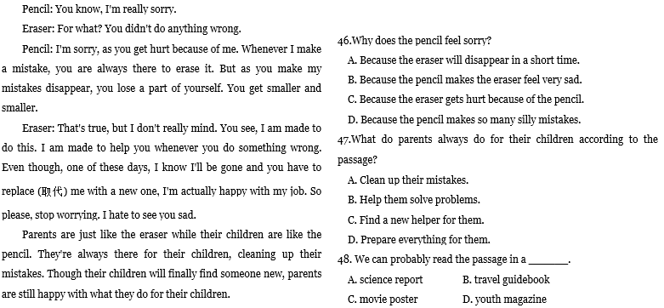

Slide 36
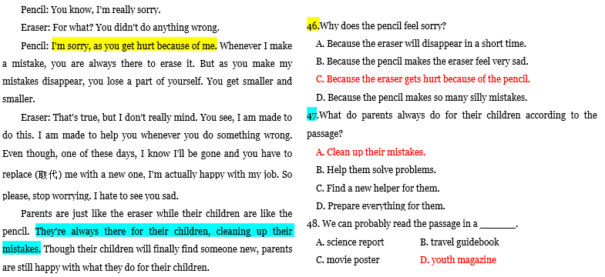

Slide 37
推理判断
特点：
1. 考查对文章言外之意的理解。
2. 不能直接从文中找到答案。
常考类型：
1. 细节推断
2. 文章出处或读者对象
3. 写作意图或观点态度
Notes:
青年杂志

Slide 38
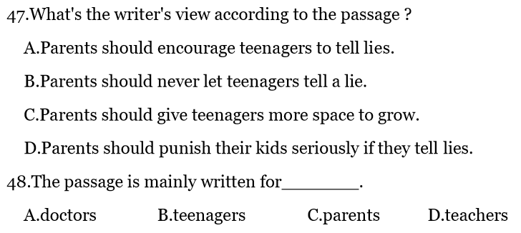
写作意图或观点态度
读者对象
细节推断
文章出处

Slide 39
阅读P50

Slide 40
授课重点
Phrases
1.写下；记下
2.成长；长大
3.参与做某事
4.不同种类的
5.各种各祥的
6.有点儿，稍微
7.确信;对…有把握
8.必定，务必(去做)
1. write/take down
2. grow up
3. play a part/role in doing sth.
4. different kinds of….
5. all kinds of
6. kind of +adj.
7. make sure=be sure of/about
8. make sure to do=be sure to do

Slide 41
Phrases
1.处于危险之中
2.脱离危险
3.与…有关
4.做完某事
5.太…而不能
6.练习做某事
7. 记得/忘记去做某事
8. 记得/忘记做过某事
1. in danger
2. out of danger
3. have to do with…
4. finish doing …
5. too…to…
6. practice/practise doing…
7. remember/forget to do
8. remember/forget doing

Slide 42
授课重点—短语辨析
look for trouble自找麻烦
look for 寻找；期待；期望
look forward to期盼
look after 照顾
look up 查找;向上看
look around 环顾四周
take up 开始做，学着做
take off 脱掉;起飞
take over 接管
take on 呈现;雇佣
take in 吸收;欺骗
take away 拿开;减去
cut off 切除;剪断
cut down 减少;砍倒
cut out 停止;减下
cut up… 切碎
turn on打开
turn off关掉
turn up调高;出现
turn down调低;拒绝(代词放中间)

Slide 43
完形填空做题步骤
速浏览抓大意
扣大意做易题
细推敲攻难题
读全文纠失误
快速浏览全文，全面了解文章，抓住文章大意。
速度要
快
重点读首尾段
结合生词汉译确定主旨
划出关联词、高频词

Slide 44
细节理解
特点：针对文章中的事实和细节进行提问。
如 when, where, why, how, who, which, what 等提问。
方法：查读法
★ 通读全文
★ 读题干，快速翻译选项
★ 带着问题中的关键词去原文中找答案，勾画出处
★ 作答，检查

Slide 45
推理判断
特点：
1. 考查对文章言外之意的理解。
2. 不能直接从文中找到答案。
常考类型：
1. 细节推断
2. 文章出处或读者对象
3. 写作意图或观点态度
4. 篇章结构（段落组织方法或写作手法）

