Slide 2
Topic
Vocabulary-大纲词汇
Grammar-条件状语从句
Speaking&Writing

Slide 4
1. travel /ˈtrævl/
2. agent /ˈeIdʒənt/
3. expert /ˈekspɜːt/
4. keep ...to oneself
5. teenager /ˈtiːnˌeidʒə/
6.normal /ˈnɔ(r)ːml/
7.unless /ənˈles/
8.certainly /ˈsɜː（r)tnli/
9.wallet /'wɒlɪt/
v. &n. 旅行、游历
n.代理人；经纪人
Our agent deals with all the sales.
n.专家，能手
a medical expert
an educational expert
be an expert at/on/in...
保守秘密
keep (it) a secret
n.(13-19岁的）青少年
adj.正常的，一般的
conj. 除非，如果不
if...not
adv.无疑；肯定；当然，行
sure, of course
n.钱包
purse n.钱包
Notes:
我们的代理商经办所有的销售

Slide 5
10. mile /maɪl/
11. angry /'æŋgrɪ/
12. understanding /,ʌndə'stændɪŋ/
13. careless /'keəlɪs/
14. mistake /mɪs'teɪk/
15.himself /hɪm'self/
16.careful /'keəfʊl/
17.advise /əd'vaɪz/
18.solve /sɒlv/
n.英里
kilometer千米公里
adj.发怒的，生气的
be angry with sb at/about sth
adj.善解人意的；体谅人的
adj.粗心的
n.错误，失误
pron. 他自己
adj.小心的；细致的；
v.劝告，建议
v. 解决，解答
solve the problem
Notes:
mile是英制长度单位，现在美国还在用，相当于1609米，而kilometer是公制单位，世界其他国家其本通用，等于1000米。anger

Slide 6
take a step 迈出一步、采取措施
19. step /step/
20. trust /trʌst/
21.experience /ɪks'pɪərɪəns/
22. in half
23.halfway /ˈhɑːfˈweɪ/
23. else /els/
n.步，步骤
step by step/ gradually 逐步地
v.相信，信任
believe
n.经验，经历
分成两半
Please cut the cake in half.
adv&adj 在中途，部分的做（或达到）
adv.别的，其他的
when else ,what else...
Notes:
What else do you want to say ?

Slide 7
travel v.&n.旅行
travel
e.g. How about your business last week?
e.g. Tom across the desert last month.There
were lots of __________.
traveled
travelers
traveler /traveller n.旅行者
travel across/around/in/to
Notes:
横贯。。的旅行

Slide 8
keep. ..to oneself 保守秘密;把问题/烦恼埋在心底
e.g. I don’t want anyone to know it, so I will until I die.
keep it to myself
反身代词
teach/enjoy /help/take care of/look after oneself
by oneself 独自地 单独地
He is too careless to solve the problem by himself .

Slide 9
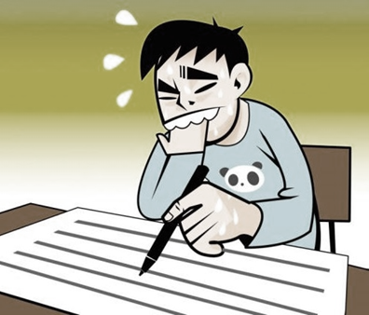
normal adj.正常的;一般的
abnormal不正常的，反常的
近义词 unusual 不寻常的
e.g. It is normal for you to feel nervous before exams.
It’s+normal / abnormal / unusual（for sb.） to do sth.
Notes:
目前，当下，现如今 quite an important thing 、a very important thing 作文、翻译：主语是to do 不定式

Slide 10
normal adj.正常的;一般的
abnormal/unnormal不正常的，反常的
近义词 unusual 不寻常的
e.g. It is normal for you to feel nervous before exams.
It’s+normal / abnormal / unusual（for sb.） to do sth.
保护环境很重要。
It's important to protect the environment.
It's important for everyone to protect the environment.
It's very/ quite important for everyone to protect the environment.
It's quite important for everyone to protect the environment nowdays / at present.
I think It's quite important for everyone to protect the environment nowdays.
In my opinion, It's quite important for everyone to protect the environment nowdays.
Notes:
目前，当下，现如今 quite an important thing 、a very important thing 作文、翻译：主语是to do 不定式

Slide 11
angry adj.发怒的;生气的
e.g. Tom is with me because I broke his favorite cup yesterday.
be angry with sb.生…….的气

Slide 12
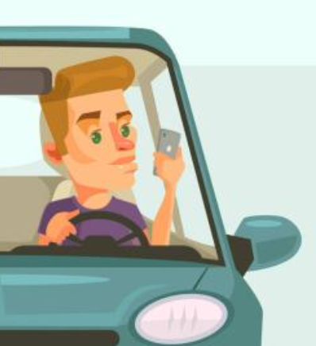
careless adj.粗心的;不小心的
e.g. The boy made many mistakes in his exam,because he was very .
careful/carefully careless/ carelessly
例题: If you drive ,you won't have an accident.
A.more careful B.careful C.careless D.more carefully
Notes:
care about、for

Slide 13
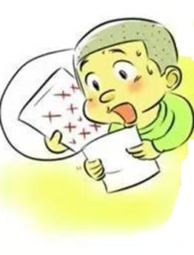
mistake n.错误;失误
e.g. Mr. White is angry with Alex because his paper is full of .
mistakes
e.g. Tom must have taken your dictionary by mistake.
make a mistake/make mistakes 犯错误
by mistake 错误地、无意地 （非故意的）
例题: He often in spelling last year. A.makes a mistake B. makes mistakes C. made mistake D. made mistakes
Notes:
by chance

Slide 14
experience υ.&n, 经验; 经历
经历【C】 经验【U】
experience
experiences
1. He is a police officer with a lot of and has many strange .
2. I will never forget the pleasant ___when working in that village.
3. If you have some __of working with kids，you will be perfect for the job.
experiences
experience

Slide 15
understand /unless /normal / advise / mistake
词汇练习 Ⅰ.从方框中选择恰当的单词填空
1. I made three in my English examination. 2.-Helen, Joe didn't us to stay in the hotel. -He's right. It's too noisy. 3. Alice is a(n) girl. We all want to make friends with her. 4. Don't come I tell you to come. 5. Will you be late for lunch or will you have it at the time?
mistakes
advise
understanding
unless
normal

Slide 16
词汇练习 Ⅱ首字母填空
1. My father was very a when I broke the window. 2. Be c , there' s broken(破损的) glass on the floor. 3.—I don't want to go to the farm this Sunday. I want to do something e . - Then what do you want to do? 4.-May I use your car this afternoon, Dad? -C _. Here's the key. 5.-Do you need my help, Mike? -No, thanks. Please t me.I can do it by myself.
ngry
areful
lse
ertainly
rust

Slide 17
Summary
1.保守秘密,把问题/烦恼埋在心底
2.对...来说，做..是...
3.除非
4.和某人生气
5.错误地（非故意的）
6.经验；经历
keep ...to oneself
be +adj for sb to do
unless
be angry with
by mistake
experience

Slide 19
条件状语从句的个绍
翻译句子,并说出逗号前后句子之间的关系
1.If I have money , I will buy a big house.
2. If I have money, I will travel around the world.
在复合句中做条件状语的从句称为条件状语从句，表示在某种条件下某事很可能发生。

Slide 20
条件状语从句的引导词
最常用引导词有if和unless：
引导词
as/so long as 也可引导条件状语从句，意为“只要”。
还有其他的一些引导词如：in case(万一）， on condition（that）（只要，如果）等等也可以引导条件状语从句。

Slide 21
条件状语从句的引导词
最常用引导词有if 和 unless：
引导词
as/so long as 也可引导条件状语从句，意为“只要”。

Slide 22
1) if引导条件状语从句表示“如果”
If it doesn’t rain tomorrow, we will go boating.
主将从现
Please call me if Mary comes tomorrow.
主祈从现
Lucy may fall behind her classmates if she doesn't study hard.
主情从现

Slide 23
if条件状语从句与祈使句的互换
If you get up early, you'll see the stars in the sky.
=Get up early, and you'll see the stars in the sky.
那么（或不翻译）
If you don' t study hard, you'll fall behind your classmates.
=Study hard, or you'll fall behind your classmates.
要不然

Slide 24
If从句和倒装句
If Jim goes swimming tomorrow, so will Tom.
If Jim doesn't go swimming tomorrow, neither will Tom .
“so+助动词/情态动词/be动词主语”的结构, 表示“某人也怎么样” “so +主语+助动词/情态动词/be动词”的结构，表示“某人的情况的确如此”

Slide 25
unless conj,除非;如果不
unless引导条件状语从句,相当于if…not…,在 许多情况下可以互换。
e.g. Don't come unless I call you.
eg. If I don’t call you, please don’t come.
练习1:The sports meeting will continue it rains this afternoon. A. if B. since C. as soon as D.unless 练习2: The sports meeting won' t continue it rains this afternoon. A. if B.since C. as soon as D.unless
Notes:
如果做题过程中对unless 反应不过来，就可以用if not 进行替换，帮助理解 翻译：先说条件再说结果

Slide 26
2).unless引导表示“除非”
I won't go to the party unless he goes there.
unless 可与 if…not…互换
=I won’t go to the party if he doesn’t go there.

Slide 27
3)as/ so long as引导表示“只要……”
As/So long as you’re happy, it doesn’t matter what you do.
You may borrow my book as/ so long as you keep it clean.
As/So long as you promise to come, I will wait for you.
翻译:你可以用我的汽车,只要你小心点儿开。
You can take my car as/so long as you drive carefully

Slide 28
4)in case引导表示“万一”(了解)
In case he comes, please let me know. In case it rains, do not wait for me.
5)on condition that引导表示“只要”(了解）
I can tell you the truth on condition that you promise to keep it a secret.
You can go swimming on condition that you don' t go too far from the river bank.

Slide 29
Ⅰ.选用if 或 unless 填空
if
1. The volleyball match will be put off it rains tomorrow. 2. you read the book, you will understand the story better. 3. I'll go to meet you I am free then. 4. bad weather stops me, I go for a walk every day. 5. you call me to say you're not coming, I will see you at the theatre.
If
if
Unless
Unless

Slide 30
Ⅱ.根据中文句子填英文
6.如果努力学习,你就会取得好成绩。 If you , you good grades. 7他如果看电视太久了,他的父母会不高兴。 If he Tv too much, his parents unhappy. 8如果我们为他组织生日聚会,大家都会来的。 Everyone if we a birthday party for him. 9如果明天不下雨,我会和你一起去公园的。 If it tomorrow, I go to the park with you. 10如果她睡过头了,就会旅游迟到的。 She the trip if she .
study/work hard
will get
watches
will feel
will come
hold
doesn't rain
will
will be late for
oversleeps

Slide 32
Complete the conversation with your partner. The phrases in the box can help you.
A: Hey. Will you go to Sally a birthday party? B: No, I think I will stay at home. A: Oh, why? Sally is your friend. If you don't go, she will be sad. B:Yes,I know.But I have to…first. I won' t have enough time to get there on time after that. And if I take the taxi, it will be too expensive. A: Well. We can take a taxi together. That will be cheaper. B: That’s a great idea. Will you...? A: Of course, I will. I think if Sally gels something she likes, she will be happy.
B: I agree with you.
study for the exam have a piano lesson play a basketball game
… take a gift draw a birthday card buy an expensive giit prepare a pesent for her
…

Slide 34
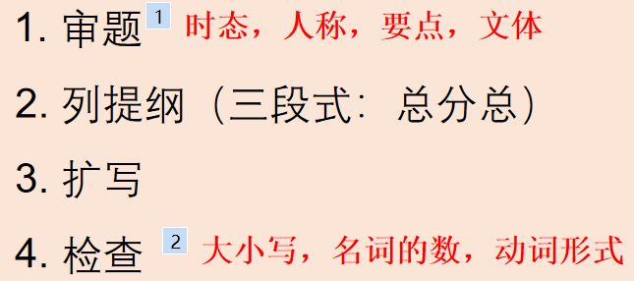
Time to write
假如你想成为老师，请根据下列提示,参考以下有用句式及范文,写一篇不少于80词的文章。
要点: 1. What is your dream?
2. How do you make your dream come true?
3. What will you do when you become a teacher?

Slide 35
Time to write
总：
Everyone has his own dream.
Different people have different dreams.
分： I want to be....... But how can I make ......?
I should/would like to work hard so that /in order that I can become an expert on education. Because of that, my students can gain /learn more knowledge . To be a good teacher, I also should get more experience of working with students(more teaching experience) step by step.
When/If I become a ... teacher, I will ....(be kind/friendly/patient to... encourage...to...) Also/Besides/ What's more , I will expect ... to take part in all kinds of activities/join different clubs... At last, ....
总：All in all/In a word, I will try my best to make my dream come true.
Notes:
recover/ get well early. increase organize /hold activities.

Slide 36
Time to write
总：Everyone has his own dream.
Different people have different dreams.
分：I want to be an English teacher .But how to make my dream come true? First of all, I have to study English well . Because I want my students to learn more knowledge about English. What's more , I will give them less homework on weekends. In my opinion , they need time to do things they are interested in.Last but not least,I will be kind to my students. I believe we will be frineds with each other.
总：I will try my best to mak my dream come true.

Slide 37
Ⅰ.参考句式
1.如果我有很多钱,我将能够做很多事情。 If I have a lot of money, I will do a lot of things. 2.最好用这些钱来做一些好的事情。 do good things with the money. 3.首先,我会捐钱给慈善机构来帮助那些常要帮助的人。 First , I'll give some money to charities to help those . 4.我会给贫穷的小孩子买衣服和礼物,让他们开心。 I will buy poor children clothes and presents_____________________.
be able to
It‘s best to
in need
to make them happy

Slide 38
5.然后,我会尽全力来保护环境。 Then, I will to help protect the environment. 6.现在,环境已经变得越来越褶糕了。 Nowadays, the environment is getting . 7.最后,我打算把钱花在我的学习上。 At last. I will my study. 8.如果我能学到很多知识,将来就能帮助世界交得更好。 If I am knowledgeable, I can help make .
9.I am sure I will use the money as well as possible.
try my best
worse and worse
spend the money on
a better world

Slide 39
Time to write
假如你突然变得非常富有,你会用这些钱做什么呢?请根据下列提示,参考以下有用句式及范文,写一笃不少于80词的文章。
要点: 1. What will you do if you have a lot of money? 2. Why do you want to do that?

Slide 40
Brain storm
step | plot | Expressions
1 | 引入话题
2 | 描述你的计划
3 | 话题总结、感情升华
If I have a lot of money, I will…
First, I will help the poor…? Second, I will help to protect the earth…;Third ,I will spend Some money…
I am sure…
Notes:
what' more in addition besides.描述原因时可以用

Slide 41
Ⅰ.参考句式
1.如果我有很多钱,我将能够做很多享情。 If I have a lot of money, I will do a lot of things. 2.最好用这些钱来做一些好的享情。 do good things with the money. 3.首先,我会捐钱给慈善机构来帮助那些常要帮助的人。 First , I'll give some money to charities to help those . 4.我会给贫穷的小孩子买衣服和礼物,让他们开心。 I will buy poor children clothes and presents_____________________.
be able to
It's best to
in need
to make them happy

Slide 42
5.然后,我会尽全力来保护环境。 Then, I will to help protect the environment. 6.现在,环境已经变得越来越糟糕了。 Nowadays, the environment is getting . 7.最后,我打算把钱花在我的学习上。 At last. I will my study. 8.如果我能学到很多知识,将来就能帮助世界交得更好。 If I am knowledgeable, I can help make .
9.I am sure I will use the money as well as possible.
try my best
worse and worse
spend the money on
a better world

Slide 43
Ⅱ.写作练习
If I have a lot of money, I will be able to do a lot of things. First, I think it‘s best to do good things with the money. So first, I will give some money to charities to help those in need, especially children of my age. I a will buy poor children clothes and presents to make them happy, Then, I will try my best to help protect the environment. As we all know the environment is getting worse and worse nowadays. Last but not least, I will spend the money on my study. I believe if Iam knowledgeable, I can help make a better world. If you have a lot of money, what would you like to do？

