Slide 1
八年级上册考辅课二
课中考
The more you practice, the better you will be!

Slide 2
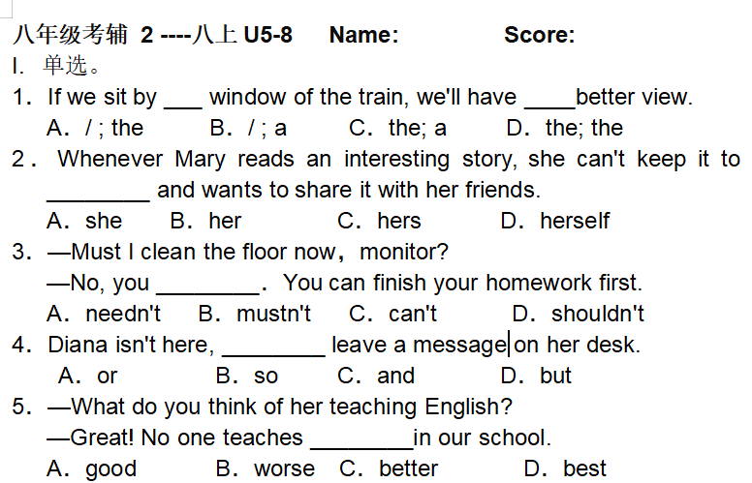
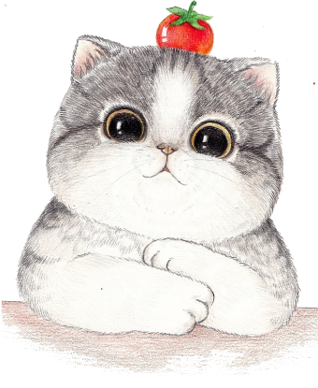
单选
view风景/景色；看法/意见(可)
C
keep ...to oneself 把...保留在心里
D
A
B
C
Notes:
by 通过经过，在。。旁边

Slide 3
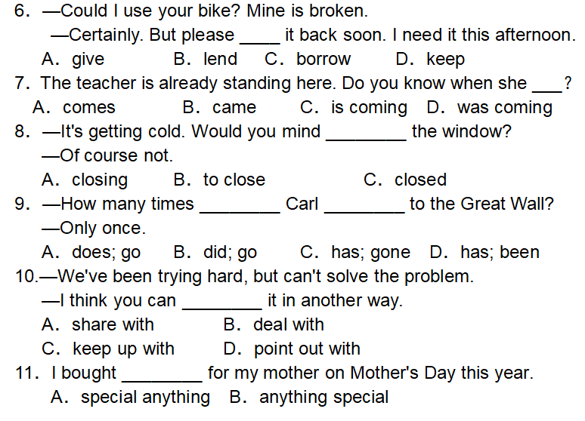
单选
give...back=return
A
B
A
D
B
D
Notes:
keep up with 追上赶上 point out with hapiness/pride

Slide 4
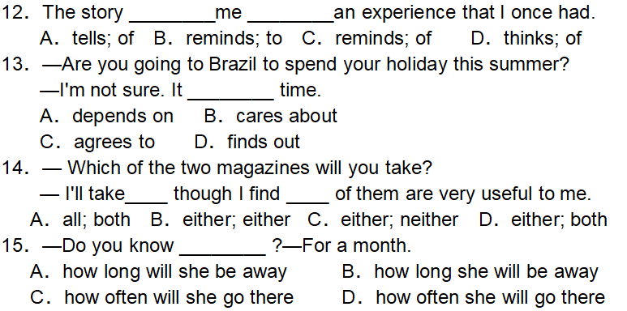
单选
C
A
Brazil[brəˈzɪl]巴西
D
B
Notes:
[brəˈzɪl]巴西

Slide 5
You have probably heard the saying(谚语), "When life gives you lemons, make lemonade(柠檬水)." Lemons are considered not tasty while lemonade is considered sweet. The saying tells you to make the best out of a bad situation. But when something bad happens, it's common for most people to complain about life, " Why me? " That's like getting a bag of lemons and thinking, "Lemons taste bad! I just want chocolate! " If you don't do anything with the lemons, they will go bad. But what if you did something with them? What if you made lemonade? Isn't it possible to do something similar with a bad situation(处境)? Here's an example: Let's say you're about to go to the movies, but you discover you have a flat tire (瘪胎). You consider this a terrible thing. After all, you are really looking forward to spending some time with your favorite film stars. Now you're very worried, hating the tire, the car, and your life. But what if you called AAA (美国汽车协会) to get your tire fixed or caught up on things that you'd been meaning to do? What if you did some reading, or had coffee with a friend instead? A bad experience can be turned into something good. Almost everything can work itself out into something better. You can't change what has happened, right? So make the best of it. I'm not saying it will be easy. The easy thing to do is to be disappointed(失望的) about what has happened and to not consider what it could be turned into.
Next time when some bad things happen, stop and think," How can I turn this around? How can I make it a positive (积极的) experience?"
Notes:
tasty美味的可口的 善处逆境 what if 假如、如果 go bad 变质 mean to do 打算 work

Slide 6
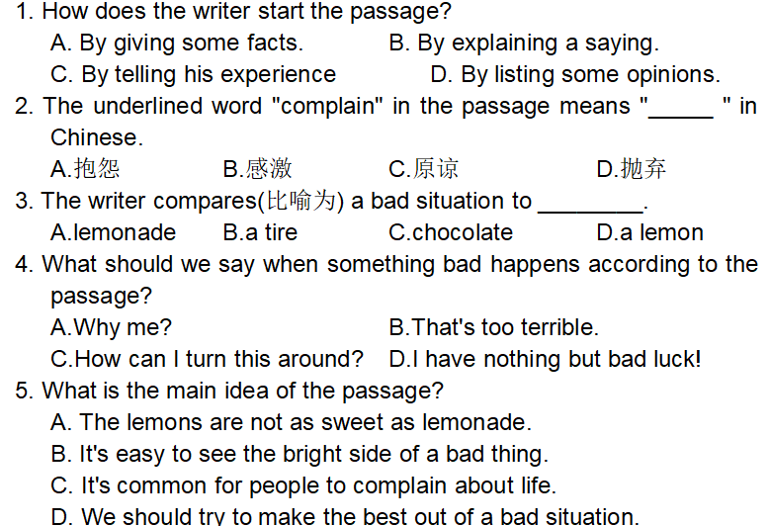
B
A
D
C
D
Notes:
tasty美味的可口的 善处逆境 what if 假如、如果 go bad 变质 mean to do 打算 work

Slide 7
break down损坏、失败
English learners have different opinions about grammar. Some are very interested in finding out or learning grammar rules. Others hate grammar and they think it is boring to learn grammar.
However, you cannot get away from grammar. It is in every sentence you read or write, speak or hear. We need those rules in the same way as we need the rules in a game. If there are no rules, or if everybody follows their own rules, the game will soon break down. It's the same with language; without rules we will not be able to communicate with other people.
Don't give up learning English grammar. Many teachers believe in the importance of grammar lessons. Other teachers feel that grammar is best learned by doing different language activities without paying too much attention to the rules. No matter which way you are taught, here is some advice that may help you learn grammar more effectively (有效地).
Read a lot. Reading is the most important step in improving your English skills. You will see how to use words correctly in sentences.
Keep a diary or a blog. After you have read a book, it will be useful to put what you have learnt into practice. Start a diary or a blog. In this way you will not forget what you have learned. You will also be able to practice the proper usage of the language.
Listen to English songs. Songs are stories of how people feel—or, at least, a lot of them are. Listening to them will give you an idea of how to express certain things.
Watch TV and movies. There are a lot of dialogues in them. You can learn how to use English words in daily conversation.
Notes:
tasty美味的可口的 善处逆境 what if 假如、如果 go bad 变质 mean to do 打算 work

Slide 8
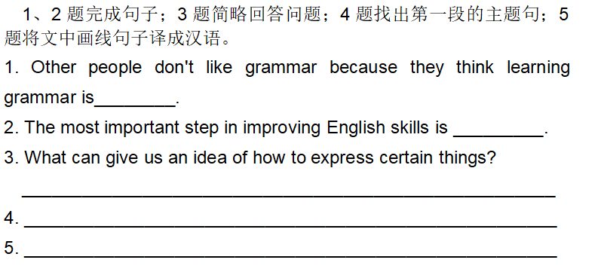
boring
reading a lot
Listening to English songs can give you an idea of how to express certain things.
English learners have different opinions about grammar.
你可以学会如何在日常对话中使用英语单词。
Notes:
tasty美味的可口的 善处逆境 what if 假如、如果 go bad 变质 mean to do 打算 work

