Slide 1
八年级上册考辅课一
The more you practice, the better you will be!

Slide 2
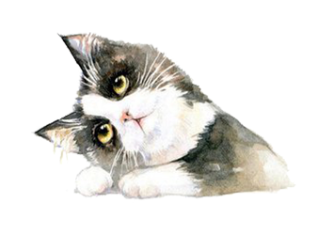
Exercises
目录 contents
Key phrases and Sentence structures
Grammar

Slide 3
Unit One
Me and My Class

Slide 4
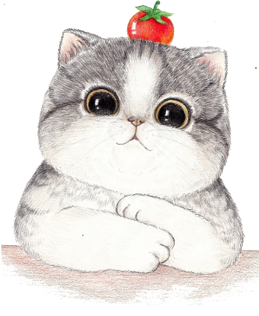
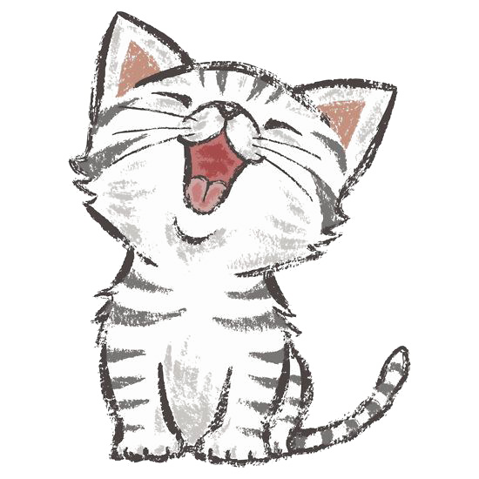
根据句意或用词的适当形式填空。
1. We are happy __________(hear) the good news.
2. I have two friends. One is Sandra and ___________ is Mary.
3. I want to learn how __________(exercise) healthily.
4. I i___________ my cousin to Jenny and they became good friends soon.
5. Do you agree _____ me ____ this problem?
6. I love to eat many different ______(food), but I like donuts best.
7. It will take her two _______(many) hours to finish the work.
8. My mother asks me ________(clean) my bedroom twice a week.
9. You should stop __________(smoke). It's bad for your health.
10. The boy is good. He spends much time _______(look) after his grandpa.
to hear
the other
to exercise
ntroduced
with
on
foods
more
to clean
smoking
looking
Notes:
allow sb to do expect sb to do encourage sb to do advice、promise 、teach sb to do sth fruit fish

Slide 5
根据句意或用词的适当形式填空。
following
11. Please repeat the _________(follow) sentence after me.
12. The old man left the office _______(angry) without saying a word.
13. I feel lucky ________(have) such a good friend.
14. Ms. Liu is my favourite teacher. She is very ______________(knowledge).
15. My mom always encourages me _________(study) hard.
16. Just be p________. You can't learn a language well in a day.
17. After ________(win) the game, the students were excited.
18. May I have the _________(please) of seeing you again?
19. Can I invite him ________(come) to my birthday party?
20. Next Sunday is my brother's _________(twelve) birthday.
angrily
to have
knowledgeable
to study
atient
winning
pleasure
to come
twelfth
Notes:
following 接下来的、下列的。跟我读下列句子 please 使满意使愉快。 博学的知识渊博的 the+名词、代词/形容词副词最高级/序数词。序数词前+the 、形物代及名词所有格、a third time再一次又一次。

Slide 6
单选
B
1.Lily's hair is the same colour ____ her mother's.
A. with B. as C. to C. about
2. Every year a lot of tourists travel to Hainan, because it's _____ island.
A. so a beautiful B. so beautiful
C. such a beautiful D. a such beautiful
3. ---Could you help me _____ the picture on the wall?
--OK, no problem.
A. put up B. put on C. put off D. put out
4. Li Ming's mother makes him _____ his own clothes.
A. clean B. cleans C. to clean D. cleaning
5. I can't remember your phone number. Please ______.
A. write it down B. write down it C. write them down D. write down them
C
A
A
A
Notes:
put up 张贴搭建装饰。 put off 推迟 put out 扑灭 go out

Slide 7
单选
A
6. --May I use your computer, Mr. Black?
--_______. I will use my ipad instead.
A. Go ahead B. It's up to you
C. Sorry, you can't D. I'm afraid not
7. --Can I use your bike, Sam?
--Sorry, I lent it ____ Mary last night.
A. from B. to C. for D. with
8. This pair of shoes ____ me well, but the shoes ____ expensive.
A. fit; are B. fits; are C. fit; is D. fits; is
9. ___ my surprise, Jin Ming did well ____ playing football when he was young.
A. To; of B. At; at C. To; in D. In, about
10. Look! ____ is standing at the door. Do you konw him?
A. Everyone B. Someone C. Anyone D. No one
B
B
C
B
Notes:
请吧、说吧、做吧、用吧、进行吧、拿去吧。1.某人提出建议或请求。你能帮我吗？我可以开始了吗？我抽烟你介意吗？2.请人继续说继续做。Go ahead，We are all listening。继续说我们都听着呢，Go ahead ，What are you waiting for？继续走呀，你再等什么呢？ 3.你先请的意思。上电梯进门，go ahead please。

Slide 8
key words
physics
recent
perform
immediately
cheat
embarrassed
enemy
deal
local
抽象名词 不可数
recently
performer/ performance
at once
embarrassing
enemies
make a deal
deal with
Notes:
adj physical Education身体的肉体的 cheat 动词欺骗、蒙骗、作弊。名词 作弊者、骗子、欺骗行为 make a deal 达成协议、交易 成交。

Slide 9
Key phrases and sentence structure
one…and the other…
introduce …to…
advise…to do…
be up to
agree with …
go ahead
play the violin
two peas in a pod
spend…（in）doing
to one’s surprise
make a deal
feel lucky to do…
encourage…to do… play the piano have the pleasure of doing
一个…另一个
给…介绍
建议…做某事
由…定
同意…
(口语)请吧，说吧
拉小提琴
一个豆荚里的两个豆子（比喻两个人很要好）
花费（时间）干…
让…感到惊奇的是
达成协议
做…感到幸运
鼓励…做某事
弹钢琴
很高兴做…

Slide 10
Key sentences
1. When you have trouble finding answers to questions on your own, there are a few things you can do.
2. I don't have any good recent pictures of myself.
3. Please ask your classmates about their interests.
4. I also like to go for walks.
5. Sometimes I hate to get out of bed early.
6. Do you mind if I open the window?
7. At the end of the game, the two friends looked at each other.
8. She started teaching seven years ago.
9. Last Saturday, my mother bought a pair of jeans for me.
10. I wore my new clothes to school on Monday.
Notes:
on one's own 独自 have trouble doing 做某事有困难

Slide 11
Grammar
句子结构--简单句
主谓
主谓宾
主系表
双宾语
主谓宾宾补
I don't agree.
The two boys made a deal.
He felt awful.
I won't lend you my homework.
The movie made me feel sad.

Slide 12
Unit Two
My Favourite School Subjects

Slide 13
根据句意或用词的适当形式填空。
for
1. Don't be late ____ class! We must be on time.
2. I hope _______(see) them sometime.
3. I am much ______(good) at art this year.
4. I'll be back ____ two minutes.
5. The best way _________(learn) English is by reading English magazines.
6. We all went to the zoo e_______ Jim because he had to do some shopping.
7. Lin Tao is hardworking. I see him _____ (read) English every morning.
8. Thank you for helping me _____ my science.
9. It's very kind of you ________(say) that.
10. It s______ that the little boy doesn't like his new school.
to see
better
in
to learn
xcept
read
with
to say
eems
Notes:
see sb do 看见某人经常做某事或做了某事。似乎看起来

Slide 14
根据句意或用词的适当形式填空。
11. The __________(library) told me to return the book in two weeks.
12. Lisa and I are going to work o_____ our basketball project together.
13. Fujian is in the ________(south) part of China.
14. Marisa likes math _______(well) of all the subjects.
15. I would like _________(learn) more about China in the future.
16. The picture always reminds me _____ that holiday.
17. Do you know how to stay _________(health)?
18. Mark's father ____________(be) to Greece twice.
19. He ___________(study) Chinese for two months.
20. You ________________(not; finish) your homework yet. Can I help you?
librarian
n
southern
best
to learn
of
healthy
has been
has studied
haven't finished

Slide 15
单选
B
1.--When will you leave Beijing?
--_______ next week.
A. Sometimes B. Sometime C. Some times D. Some time
2. --Will it be convenient ____ you to start work tomorrow?
-- No problem.
A. for B. with C. of D. on
3. She _____ in this factory since 2008.
A. works B. worked C. has worked D. have worked
4. --Let me take your bag.
--_____, but I can manage it myself.
A. I'm sorry B. That's very kind of you
C. Good idea D. It doesn't matter
A
C
B

Slide 16
单选
B
5. Jack has learned more about teamwork _____ he joined the soccer team.
A. until B. since C. while D. though
6. ____ of us in our class has an English name.
A. All B. Every C. Each D. Both
7. --Where is Li Ming?
--He _____ Beijing. He ____ back in two weeks.
A. has been to; will be B. has gone to; will be
C. has gone to; comes D. has been to; comes
8. --We have _____ you for half an hour. Where did you go?
--Oh, I went to the library.
A. looked for B. looked at C. looked around D. looked over
9. --_____ have you been a teacher, Mr. Lee?
--Since 20 years ago.
A. How often B. How long C. How soon D. How far
C
B
A
B
Notes:
look aroud 环顾四周，四处转转 look over快速浏览翻阅的意思

Slide 17
key words
geography
tonight
cough
rush
shout
quarter
recently
tourist
discussion
不可数
have a cough
rush into
recent
have a discussion about sth

Slide 18
Key phrases and sentence structure
be late for in two minutes physical education（P.E.) miss class/school have a cough not…at all be convenient for No noise，please！
a quarter Mother’s Day Father’s Day remind···of···
迟到
两分钟之内
体育
误课/耽误课
一点也不
对…方便
请保持安静
一刻钟
母亲节
父亲节
提醒…想到…

Slide 19
Grammar
现在完成时
1. 过去的动作对现在产生影响
2. 过去发生的动作持续到现在还有可能继续
标志词：
already, yet, since, for, just, ever, recently...
区别：
have gone to/ have been to/ have been in
since/ for
already/ yet

Slide 20
Unit Three
Families Celebrate Together

Slide 21
根据句意或用词的适当形式填空。
1. The Canadian Thanksgiving is on the ________(two) Monday of October.
2. The girl _______(name) Mary is standing under the tree.
3. Thank you for __________(celebrate) the exciting moments of my life with me.
4. Both of the jackets look nice on me. I can't decide which one to c_________.
5. When family members get t_________, they talk and laugh.
6. My mother still stays in t______ with her old friends now.
7. You can t_____ on this red jacket. I think you will like it.
8. I like the T-shirt. But it's not the right ______ for me. It's too big.
9. I can never get clothes to f___ me very well.
10. When I first came here, I _______(feel) very lonely.
second
named
celebrating
hoose
ogether
ouch
ry
size
it
felt

Slide 22
根据句意或用词的适当形式填空。
11. All of us were _________ to hear the _________ news. (excite)
12. I really don't know the man's a_________ and telephone number.
13. The ruler is one of the _________(present) from my friends.
14. We _______(hold) a party for our teacher yesterday.
15. She took a deep _________(breathe) and ______(blow) out the candle.
16. Is there anything new in ________(today) newspaper?
17. He will send me an e-mail when he ________(arrive) in Canada.
excited
exciting
ddress
presents
held
breath
blew
today's
arrives
时间、距离的名词所有格直接在单位后面加上’s或复数s’
3 hours’ walk two miles’ distance

Slide 23
单选
B
1.We all expect the _____ summer holiday after the exam.
A. two month B. two-month C. two-months D. two months
2. There is so much noise in the next room. I wonder _______.
A. what are they doing B. what were they doing
C. what they are doing D. what they were doing
3. --I called you last night, but nobody answered.
--Sorry, I ____ out when you called me.
A. was B. am C. will be D. have been
4. --Would you like to ____ the book ___ me?
--OK, no problem. Here you are.
A. pass; to B. passed; to C. pass; with D. passing; for
5. ____ the dinner was all over, everyone helped wash the dishes.
A. What B. Why C. How D. When
C
A
A
D

Slide 24
单选
B
6. The students were singing an English song _____ the teacher came in.
A. after B. when C. before D. while
7. Please take your ID card when you _____ next time.
A. come B. will come C. is coming D. came
8. Don't forget to ____ the lights before you leave the classroom.
A. turn off B.turn down C.turn up D. turn on
9. Peter, please turn off the TV ____ no one is watching it.
A.so that B.though C.when
10.Tom ____ the piano every day when he was in primary school.
A.plays B.played C.was playing D.has played
11.When looking at the old photos, I always ____my middle school life.
A.think of B. think up C. think about D. think over
A
A
C
B
A
think up想出、发明

Slide 25
key words
round
however
wonder
record
lively
attend
conversation
fashion
around
but
wonderful
set a record
take part in
have a conversation with sb.
in fashion/ out of fashion
Notes:
adv周而复始地 想知道、好奇；名词奇迹 创造纪录set keep break attend 参加、出席会议、派对、音乐会

Slide 26
Key phrases and sentence structure
Mid-Autumn Festival
Thank you for such as get together too···to···
add···to··
face to face
stay in touch with…
the same size as
try on
中秋节
为…感谢你
例如
聚会
太…（以至于）不能
把…加入…
面对面的
与…保持联系
和…一样的号码，和…一样的尺寸
试穿

Slide 27
Key phrases and sentence structure
give…a big hug
give thanks to …for
best wishes to…
on the top of
All ready！
have no luck
in fashion fit well turn off make a wish blow out
给…一个热情的拥抱
为…感谢…
给…最好的祝福
在…的顶上
一切都准备好了
未能如愿，不走运
时尚，流行
非常合身
关掉
许愿
吹熄，吹灭
Notes:
fit well 尺寸size 与shape suit well 款式颜色等合适 go well with 与。。。衣服搭配得好

Slide 28
Grammar
名词所有格
1.'s
一般词尾加's
以s结尾的复数加'
特殊复数名词后加's
以s结尾的人名后加'或's
分别拥有分别's
共同拥有后者加's
3. to
the way to
the key to
mine
2. of a friend of _____(I)
a friend of my ________(father)
father's

Slide 29
Grammar
when引导的时间状语从句
一般过去时
主将从现

Slide 30
Unit Four
My Neighbourhood

Slide 31
根据句意或用词的适当形式填空。
hirsty
1. Could you give me a bottle of water? I'm too t_________.
2. She added a restaurant ______________(complete) her map.
3. You can take Jenny to the park when she _________(come) for a visit.
4. Many people like dogs b________ they are cute.
5. There are so many books _______(read) in the library.
6. You must look left and the right when you __________(across) the street.
7. He told me to turn left at the third __________(cross).
8.Linda _______(lose) her way home when it was dark.
9. I often listen to music to relax __________(I) after a busy day.
10. Can you tell me the _______ to the nearest shop? I'm lost.
to complete
comes
ecause
to read
cross
crossing
lost
myself
way

Slide 32
根据句意或用词的适当形式填空。
hole
11.It took me the w______ day to finish reading the book.
12. It's only three ________(block) from my house.
13. It s________ like someone is knocking at the door.
14. Everyone was busy ________(chat), so no one noticed him.
15. Lisa got up early _________(catch) the first bus.
16. The bookstore is ________(cross) from a beautiful park.
blocks
ounds
chatting
to catch
across

Slide 33
单选
A
1. ____ Anna ____ her brother like listening to soft music.
A. Both;and B. Neither; nor C. Either; or D. Not only; but also
2. Li Mei can't go to the zoo with us. She has a lot of clothes ______.
A. to wash B. wash C. washes D. washing
3. --Would you please tell me the way to the zoo?
--Go ____ the post office, and you'll find it on the left.
A. pass B. past C. to pass D. passed
4. I ____ tell her the news when I ______ her house.
A. will; pass B. will; past C. /; cross D. /; pass
5. The sunshine comes into my room _____ the window.
A. through B. cross C. across D. past
A
B
A
A

Slide 34
单选
C
6. This book ____ be Lucy's. Look! Her name is on it.
A. can B. may C. must D. might
7. Would you please tell me ______?
A. where is the shop B. where the shop is
C. where are the shop D. where the shop are
8. There was a car accident on the road yesterday. _____, nobody was hurt.
A. Lucky B. Luckily C. Unlucky D. Unluckily
B
B

Slide 35
key words
perfect
complete
entrance
cost
interview
enjoyable
treat
flu
completely
spend, take, pay
interviewer
enjoy
n.美食、款待v. 对待 、处理
treatment
have the flu
Notes:
interview 采访面试

Slide 36
Key phrases and sentence structure
go past/by··· tea biscuit be/get lost Can you tell me the way to…？
Turn right/left at the…crossing. It’s … blocks（away）from… be busy doing… sound like I’m doing well. have the flu across from
走过，路过
茶点
迷路，走失
你能告诉我去…的路吗？
在第几个路口向右/左拐。
距…有…个街区
忙于…
听起来像
我很好
感冒
在对面

Slide 37
Grammar
原因状语从句

Slide 38
01
听 力
专项讲解
02
完形填空

Slide 39
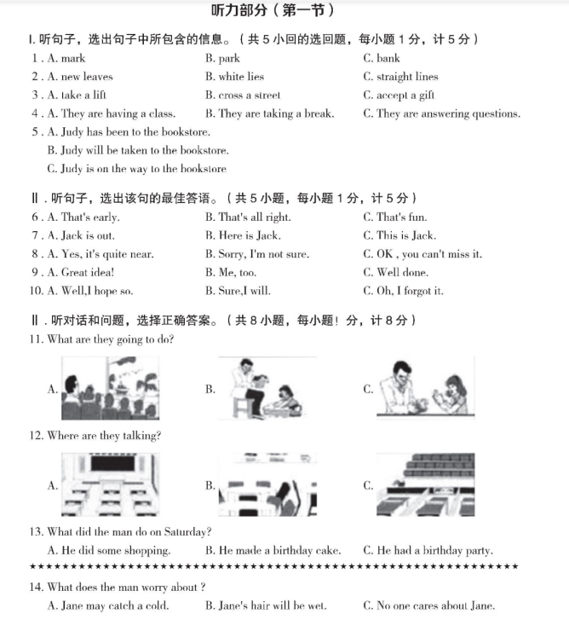
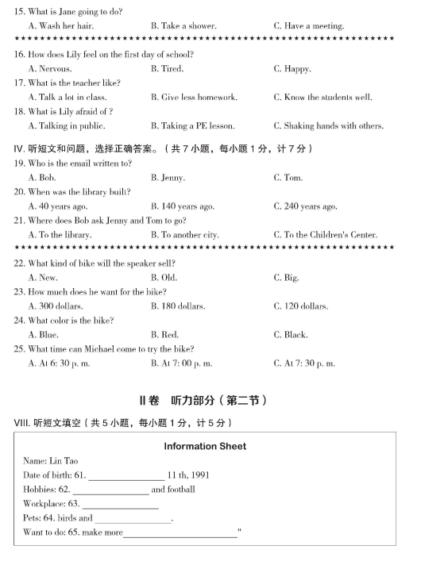

Slide 40
一、听力专项
满分30分
1）选择：25小题，每题1分，总计25分
2）填空：5小题，每题1分，总计5分
。

Slide 41
I、 听句子，选择包含的信息。
II、 听句子，选择最佳答语。
III、听对话和问题，选正确选项。
IV、听短文和问题，选择正确答案。
V、听短文，填空。
小听写

Slide 42
I、 听句子，选择包含的信息。
1--3
动词，名词，形容词
数字多为时间点
短语（动词短语，名词短语）
4--5
选择听到的句子的同义句

Slide 43
II、 听句子，选择最佳答语。
多为交际，生活用语
打招呼/天气
提建议
介绍人
打电话
求帮助
求鼓励
求安慰
问，看病
问路
饭店旅店车站商店邮局电影院…

Slide 44
III、听对话和问题，选最佳选项。
11-12 /13 题为一个对话对应一个问题
推测对话发生的场景，捕捉信息
13/14-18题为一个对话对应多个问题
IV、听短文和问题，选择正确答语。
两篇短文分别对应19-21和22-25. 多为特殊疑问句

Slide 45
V、听短文，填空。
名词：单复数
动词：时态和搭配
形容词/副词：拼写
数词：基数词写阿拉伯数字
大小写问题：开头，星期，月份，专有名词等

Slide 46
01
先读题，确认信息
02
预测问题
听力
03
推测对话发生的场景听关键信息
04
书写清晰正确，注意时态，人称，单复数
05
大小写，数字写阿拉伯数字

Slide 47
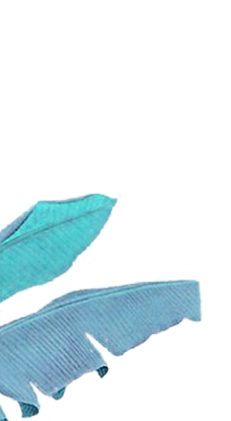
完成听力练习

Slide 48
完形填空做题技巧
速浏览抓大意
扣大意做易题
细推敲攻难题
读全文纠失误
快速浏览全文，全面了解文章，抓住文章大意。
速度要
快
首尾段重点读，结合生词汉译
确定主旨
划出关联词、高频词

Slide 49
One winter morning , I woke up early and stood beside the window. The 1 decorated the land and Avon River in white. I stood 2 and watched what nature had painted over the night.
I stood close to the 3 . Suddenly , I cried out, "There is a goose(鹅）out there." It stood there quite still. Its wings folded to its sides, 4 its feet were frozen to the ice. Then from the dark sky, I saw a line of swans(天鹅). They 5 down from the top of the sky and at last landed on the ice. As the swans stood around the frozen goose,I 6 that it might be killed by those great swan beaks(鸟喙）.
1.A.sky B.snow C. flower D. picture
2 . A.quietly B . simply C.happily D.nervously
3 A. land B.river C.feather D.window
4.A.so B.for C.and D.or
5.A.moved B.flew C.turned D.fell
6.A.tried B.feared C.hoped D.knew

Slide 50
Surprisingly, those beaks began to work on the ice. Their long necks went up and down, again and again. It went on for a long time. At last, the goose was 7 and stood up on the ice. However, the goose didn't move. It seemed as if it was crying,"I can't fly."Then four of the swans came down 8 it. Their powerful beaks cleaned the goose's body from top to bottom(底部). The ice fell off from the feathers(羽毛). When at last the goose's wings were free, the four swans 9 and joined the group again.
I watched them until they 10 . Only then did I realize that my eyes were wet. This is a true story. I just think of it in the bad moment, and from it comes only one hopeful question: If so for birds, why not for man?
7. A . glad B.sad C.free D.lucky
8.A.across B.over C.through D.around
9.A. took off B.took up C.got back D.got up
10.A. climbed B. stopped C. landed D. disappeared

Slide 51
One winter morning , I woke up early and stood beside the window. The 1 decorated the land and Avon River in white. I stood 2 and watched what nature had painted over the night.
I stood close to the 3 . Suddenly , I cried out, "There is a goose(鹅）out there." It stood there quite still. Its wings folded to its sides, 4 its feet were frozen to the ice. Then from the dark sky, I saw a line of swans(天鹅). They 5 down from the top of the sky and at last landed on the ice. As the swans stood around the frozen goose,I 6 that it might be killed by those great swan beaks(鸟喙）.
1.A.sky B.snow C. flower D. picture
2 . A.quietly B . simply C.happily D.nervously
3 A. land B.river C.feather D.window
4.A.so B.for C.and D.or
5.A.moved B.flew C.turned D.fell
6.A.tried B.feared C.hoped D.knew
B
A
D
C
B
B

Slide 52
Surprisingly, those beaks began to work on the ice. Their long necks went up and down, again and again. It went on for a long time. At last, the goose was 7 and stood up on the ice. However, the goose didn't move. It seemed as if it was crying,"I can't fly."Then four of the swans came down 8 it. Their powerful beaks cleaned the goose's body from top to bottom(底部). The ice fell off from the feathers(羽毛). When at last the goose's wings were free, the four swans 9 and joined the group again.
I watched them until they 10 . Only then did I realize that my eyes were wet. This is a true story. I just think of it in the bad moment, and from it comes only one hopeful question: If so for birds, why not for man?
7. A . glad B.sad C.free D.lucky
8.A.across B.over C.through D.around
9.A. took off B.took up C.got back D.got up
10.A. climbed B. stopped C. landed D. disappeared
C
D
A
D

Slide 53
完成完形练习

