Slide 1
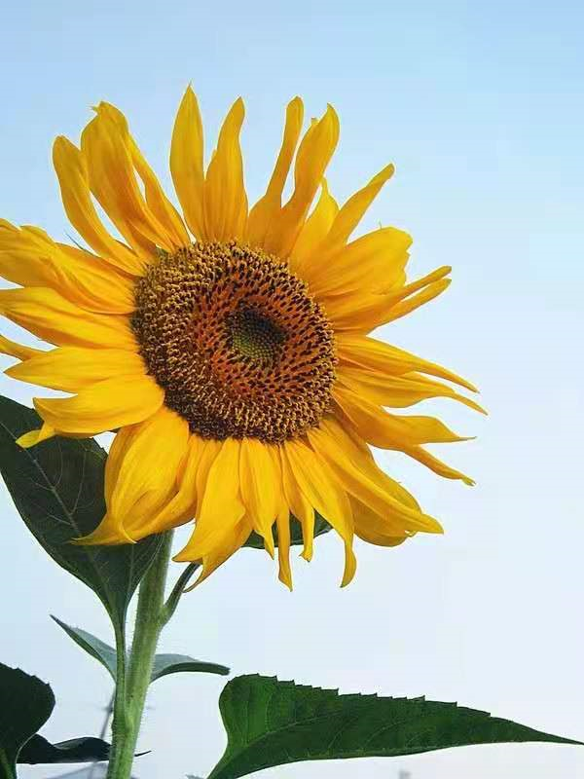
考 辅 一
U1--U4重点短语
U1--U4重点习题
听力专项，完型专项

Slide 2
U1 Revision
来自：
你叫什么名字？
我叫...
你好吗？
我很好。你呢？
见到你也很高兴
购物单
be from
come from
What's your name?
My name is.../ I'm...
How are you?
I'm fine. And you?
Nice to meet you, too.
shopping list

Slide 3
U1 Revision
早上好。
在那里
指导老师
访问生
带领...参观
上课
进行体育运动
Good morning.
over there
homeroom teacher
visiting student
show...around
have lessons
play sports

Slide 4
U1 Revision
玩得愉快
猜谜游戏
抱歉/打扰.我可以借...吗？
给你。
不客气。
再见。
...怎么样？
have fun
guessing game
Excuse me. May I have...?
Here you are.
You're welcome.
See you later.
What about...?

Slide 5
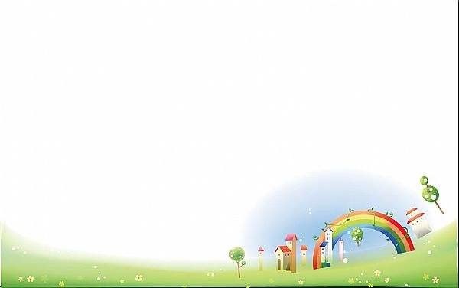
U1 Grammar--be动词
1.意思：________。
2.包括：________, _______, _______。
3.原则：跟 _______保持一致。
I用_______,单数/不可数名词用__________, 复数名词用_________。
4.考试题型：
_______, ________, _________, __________.
是
am
is
are
主语
am
is
are
选择
完型
连词成句
作文

Slide 6
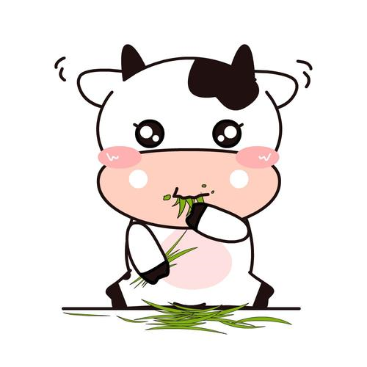
borrow ... from ...
从某处借入......
lend ... to ...
把某物借给......
一. 单项选择。
1. — ____________? — No, I am Betty. A. What's your name B. Are you Lingling
C. How are you D. What's this
2. --- Excuse me, can I _____ your pen？
--- Sure, but you can’t ______ it to others. A. borrow, lend B. borrow, borrow C. lend, borrow D. lend, lend 3. We can ________ books from the library. A. borrow B. lend C. buy D. read

Slide 7
一.单项选择。
4. Do you have ________ pencils?
A. some B. any C. no D. much
5. Can you get some water ________ me?
A. to B. on C. for D. in
6. We don't need ________ them. They can do it.
A. help B. to help C. helps D. helping

Slide 8
一.单项选择。
7．— Hello! ________ —Hello! My name is Li Ming！ A．How are you? B．I'm fine. C．I'm Jenny. D．I am good.
8. --- Thanks a lot for your help.
--- ______.
A. All right. B. My pleasure. C.That’s right. D. Good idea. 9. Nice ________ you. A．see B．seeing C．sees D. to see

Slide 9
10. — Is the boy your brother?
—Yes,_______.
A . he is B . he's C. I am D. you are
11. Jenny and Danny live in ________ Canada.
A. a B. an C. the D. /
12．Li Ming is ________ China. He is Chinese.
A. from B. on C. for D. to
13. Betty and Kitty are sisters. ______mother often dresses them in colourful clothes.
A. They B. Their C. Them D. Theirs

Slide 10
14. I have _____ eraser and three _____ in my pencil case.
A. an; pencil B. a; pencil C. a; pencils D. an; pencils
15. Let us ______ a bottle of orange juice.
A. eat B. to eat C. drink D. to drink
16. -- Is this your English book?
-- _______.
A.Yes, it's B. No, it is C. It's a Chinese book D.No, it isn't
17. His skirt is ________ the window, and the window is ______ the wall.
A. on; on B. on; in C. in; in D, in; on
18. Welcome _______ our school.
A. to B. for C. with D. in

Slide 11
19. Alice is a ______ girl and I know her_________. A. well; good B. well; well C. good; well D. good; good
20. --Do you like watching ping-pong matches(比赛)?
--Yes, and______favourite ping-pong player(运动员) is Ma Long.
A. we B. our C. I D. me
21. When do you get________?
A. home B. to home C. at home D. in home

Slide 12
22. My new friends are nice ________ me. I love them.
A. to B. on C. with D. for
23. Please buy all the things ________ the list ________ our dinner.
A. in; on B. on; for C. for; with D. with; in
24. The children have fun _____in the river every summer.
A. to swim B. swimming C. for swimming D. swims
25. Can you show me ______your school?
A. to B. in C.around D.about

Slide 13
二. 词语运用。
1. The tall man is a _________ (sport) star. 2. Tom is a _________ (visit) student from the U.S. 3. The students have__________ (lesson) from Monday to Friday. 4. Her sister is in the ______ (one) photo. 5. It’s fun to play _________ (guess) games. 6. It’s your turn ___________ (sing), Tom. 7. It ________ (be not) my pen. It’s her pen.
8. I have fun _________ (have) English lessons.
sports
visiting
lessons
first
guessing
to sing
is not
having

Slide 14
二. 词语运用。
9. This is my ________ (shop) list. 10. We can ______ (play) sports after school. 11. What about ___________ (practice) swimming this summer vacation？ 12. These are ________ (thing) for school. 13. All my ________ (ruler) are here.
14. Sit down and show _____ (I) three.
shopping
play
practicing
things
rulers
me

Slide 15
U2 Revision
浅蓝
下午好。
...怎么样？
看...
你能看到多少种 颜色？
出现
在天空中
light blue
Good afternoon.
How about...?
look at
How many colors can you see?
come out
in the sky

Slide 16
U1 Revision
刚刚好
患感冒
准备去...
回去
穿上
和...很相配；协调
把所有的...取出
just right
catch a cold
be ready for...
go back
put on
go well with
take...all out of

Slide 17
U1 Revision
看上去很漂亮
身穿黑白相间的衣服
去购物
在购物中心
一双，一对
look so pretty
in black and white
go shopping
at the shopping centre
a pair of

Slide 18
U2 Grammar--人称代词
1.主格：________。
2.包括：____, ______, _____, ______, _____, ____, _______。
3.用法：_______________._________________。
4.形物代：_______
5.包括：______,______,_____,______,_____,______,______.
6. 用法：_____________.
放在句首
I
you
he
she
it
we
they
主格+ be动词
主格+ 实义动词
某人的
my
your
his
her
its
our
their
形物代+名词

Slide 19
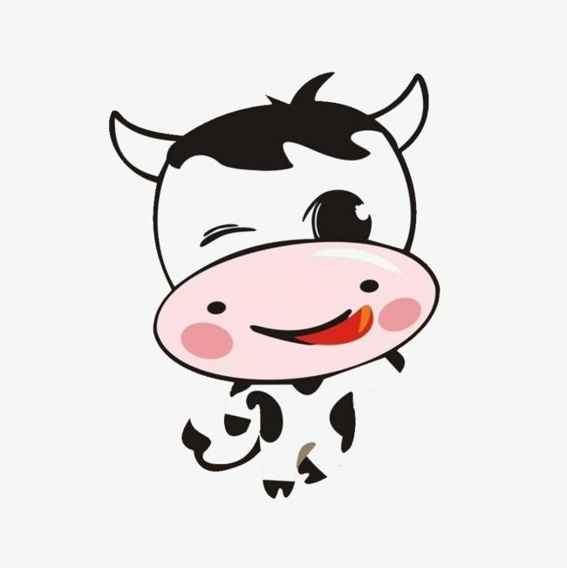
1. It’s ______turn _________now. A. you; read B. your; read C. your; to read D. you; to read
2. Our school is big______clean(干净的). A. and B. but C. or D. so
3. Your book can ______ on the desk.
A. be B. is C. are D. do
4. I can sing the song, but he_________.
A. doesn't B. does C. can D. can't
5. There are some apples ______ the tree and some birds are singing _______ the tree.
A. on; on B. in; on C. on; in D. at; in

Slide 20
6. — Do you have a TV? — ______________ A . Yes , it is. B. Yes , we are. C.Yes, we have. D. Yes, we do.
7. Mom, Jim's coat is nice. I want to buy ________. A. it B. one C. this D. that
8. Your MP5 is quite cheap. Where did you buy ______? I want to buy ______, too. A. one; one B. it; it C. it; one D. one; it
9. — Do you need ________ new blouse? — Yes, my old one is short. A. a B. an C. the D．/
10．What can you wear ________ this coat? A. to B. with C. of D．From

Slide 21
11. Jim is in ________.
A. Class One, Grade Seven B. Grade Seven, Class One
C. Class one, Grade seven D. Grade seven, Class one
12.How many______ can you see?
A. boxes of apple B. box of apples
C. box of apple D. boxes of apples
13. ________ the blackboard. What can you ________ on it？
A. Look; see B. Look at; see
C. See; look D. See; look at
14.My brother______an apple.
A. want eat B.wants eating C.wants to eat D.wants eat

Slide 22
15．Every day I go to school ________ breakfast.
A．with B．before C．for D．after
16．Do you know the colours ________ the rainbow?
A．at B．out C．of D．to
17．Many stars (星星) are ________ the sky at night.
A．on B．in C．to D．Out
18．How about ________ the wall green?
A．paint B．to paint C．painting D．paints

Slide 23
19. You can buy some crayons ________ pictures.
A. draw B.drawing C.draws D. to draw
20．I can mix blue and yellow ________ green.
A. makes B. make C. making D. to make
21．________ you want to play with me?
A. Are B. Do C. Is D. Does
22. --- _________car is this?
--- I think it’s Gao Hui’s.
A. Whose B. Who C. Where D. How

Slide 24
23. This is not my shorts. They are too small. _________ they are Brian’s.
A. May B. Just C. Maybe D. Can
24. The blouse is just________for me. I will take it.
A. big B. long C. right D. small
25. _________ you ready to order?
A. Do B. May C. Will D. Are
26. Dick works very hard. He often forgets __________ a rest.
A. have B. to have C. having D. has

Slide 25
27. --- ________ is your English teacher?
--- The man________ a white shirt.
A. Who; in B. What; wears C. Which man; wears D. Who; on
28. It’s raining. You had better ___________ your raincoat when you go to school.
A. put on B. wear C. puts on D. wears
29. Look at the shoes. They are in different _______ : red, black and blue.
A.sizes B. colours C. prices D. styles

Slide 26
30. --- Is the woman a teacher?
--- Yes, she teaches _______ English.
A. you B. us C. our D. your
31. Tony likes a white sweater, ________ he wears a black sweater today.
A. so B. and C. but D. or
32. --- Dongdong, ____________toy car is that?
--- It’s______________.
A. who’s; hers B. whose; mine C. whose; her D. who’s ;my

Slide 27
33. We like the books ________animals.
A. into B. about C. in D. at
34. — Tina wears a new blouse. She looks so ________.
— Yes, it goes well with her pants.
A. happily B. pretty C. sad D. beautifully
35. We write a report about colours________the world.
A. at B. into C. around D. to
36. They are beautiful________black and red.
A. wear B. in C. on D. for

Slide 28
37．The man ________ a doctor. The ________ are nurses.
A．is；woman B．are；women C．is；women D．are; woman
38．The lady can speak ________ because she comes from _______.
A．India; India B．Indian; Indian C．Indian; India D．India; Indian
39．________ is the last (最后的) day of a week.
A．Saturday B．Sunday C．Monday D．Tuesday
40．You ________ the red coat and look nice today.
A．wear B．put on C．is in D．dress

Slide 29
41. This pair of shoes ________ new. Whose ________ the shoes？
A. is; are B. are; are C. are; is D. is; is
42. He ________ us around their school this afternoon.
A. show B. shows C. will show D. will shows
43. The girl has two________.
A. pair of shoes B. pairs of shoe C. pair of pants D. pairs of pants

Slide 30
二. 词语运用。
1. Rose is _______ (real) nice girl.
2. She has two green __________ (scarf).
3. ________ (this) pants are only sixty yuan.
4. Oh, the coat is too big for _____ (I).
5. Grandma is seventy years old, but she likes to wear _____ (color) clothes.
6. --- ________ (who) scarf is this?
--- It’s my mom’s.
really
scarves
These
me
colorful
Whose

Slide 31
7. John ________ (look) nice in his blue jacket.
8 These are my ________ (cloth). They look nice.
9．I'm glad ________ (meet) you here.
10．They are my good ________ (friend). We help each other.
11. Drinking tea is ________ (tradition) in China.
12. The ________ (dress) look nice.
13. Your dress ______(go) well with your shoes.
looks
clothes
to meet
friends
traditional
dresses
goes

Slide 32
U3 Revision
和...一起玩
听...
挥手
火冒三丈
他/她多高？他/她身高...米。
有点儿；稍微
靠着...站
play with
listen to
wave one's hand
see red
How tall is he/ she? He/She is...metres tall.
a bit
stand against/ upon

Slide 33
U3 Revision
你感觉怎么样？我感觉...
怎么了？
看医生
你还好吗？
我肚子(胃)痛/头痛
你最好...
出什么事了？
How do you feel? I feel...
What's wrong?
see a doctor
Are you OK?
I have a stomachache/ headache.
You'd better/ You had better
What's the matter?

Slide 34
U3 Revision
gan'm
感冒
待在家里
休息一下
他/她长什么样？
看起来很酷/很可爱/很滑稽/不同
have a cold
stay home
have a rest
What does he/she look like?
look cool/ cute/ funny/ different

Slide 35
U3 Grammar--have & has + 名词变复数
1.有：________。
2.主语 I / you / we / they ：_______ 否定：_____________。
主语 he / she / it ：______ 否定：_________________。
4.名词单数变复数：___________________
————————————
—————————————
——————————————
_________________________________________
have / has
have
don't have
has
doesn't have
一般词尾+s
哑e结尾+s
以s , x , ch , sh 结尾+es
hero / tomato / potato+es
foot-feet tooth-teeth

Slide 36
1．Don't worry about your children. I can look after(照顾) ________.
A．their B．them C．my D．Me
2．I often talk ________ my friends ________ football after class.
A．about; with B．with; in C．of; with D．with; about
3．My ________ are very small.
A．foot B．foots C．feet D．feets
4.My mother likes flowers. My sister ________ likes them.
A．too B．either C．also D．not

Slide 37
5. Helen has no friends to _________. She feels lonely (孤独的).
A. talk B. talk with C. talking about D. talking of
6．________ you have ________ homework to do every day?
A．Are; much B．Do; many C．Do; much D．Are; many
7. The students always have _________ to do.
A. much homeworks B. many homeworks
C. many homework D. much homework
8.Mum,what are you cooking? It _______ so good.
A . tastes B . feels C.sounds D.smells

Slide 38
9. I don’t feel like _________ anything. I feel terrible (糟糕).
A. eat B. to eat C. eating D. ate
10．Many people are _______. Let's look after the _______ people.
A．sick; illness B．ill; ill C．ill; sick D．sick; ill
11.Tom likes ________ music.
A．listening B．listen to C．listening to D．to listen
12. — What’s the ________ of the word “pretty”?
— It ________ “ beautiful”.
A. meaning; meaning B. means; meaning
C. mean; mean D. meaning; means

Slide 39
13.---What’s ___________matter with you?
--- I have____________toothache.
A. a; the B. the; / C. / ; a D. the; a
14.---Do you have a headache or a stomachache?
--- ______________________.
A. I have a headache. B.Yes, I do.
C. No, I don’t. D. No, I have a stomach
15.Look ___Miao Jun. She has____ hair and looks like a foreigner(外国人).
A. at; blond short B. like; short blond
C. at; short blond D. /; short blond

Slide 40
16.--- It’s cold here.
--- Yeah. You’ll be_________ if you move about.
A. smart enough B. enough smart C. warm enough
17. It's cold outside. You'd better _____ the window.
A. close B. to close C. open D. to open
18. Helen and Jenny look _____, but they are sisters.
A. the same B. different C. cute D. pretty
19. --Is Bob ___ his homework now?
--No. He often______ his homework in the evening.
A. does;does B. do;do C.doing; do D. doing;does

Slide 41
U4 Revision
是...的时间了
早饭有什么？
你想要什么？我想要...
一玻璃杯/杯...
不得不
你想跟我一起去吗？
充满...
Time for...
What's for breakfast?
What would you like? I would like...
a glass / cup of...
have to
Do you want to come with me?
be full of...

Slide 42
U4 Revision
你想买什么？
写下来
做得好！
准备好点餐了吗？
...多少钱？
你想要...吗？
没问题/别客气。
What would you like to buy?
write down
Good job!
Are you ready to order?
How much is/ are/ for...?
Would you like ...?
No problem.

Slide 43
U4 Revision
gan'm
一听/瓶...
便利店
你想要点什么？/需要帮忙么？
让我想想。
拿下，取下
分发，传送
a can/ bottle of...
corner store
Can I help you?
Let me see.
take down
pass around

Slide 44
U4 Revision
gan'm
不在，离开
得到充足的休息
看电视
每天
be away
get enough rest
watch TV
every day

Slide 45
U4 Grammar--一般现在时
1.一般现在时定义：_________________________________________。
2.结构：__________________________________________________
3.标志词：________________________________________________
4.动词：主语三单：_____________________.
主语非三单，动词________________.
动词原形变三单：
表示经常或者习惯性发生的动作 / 现在存在的状态
(1)主语+动原 / 动词三单+其他
(2) 主语+am/ is/ are+其他
(1) 频度副词
(2) every 系列
(3) 次数
一直，总是
通常
经常
有时候
从来不
位置：
1次
2次
≥3次
动词三单
once
always
usually
twice
动词原形
often
普通动词：
元音+y
辅音+y
以s,x,ch,sh结尾
have go
+s
... times
sometimes
+s
never
y变i+es
+es
情/be/助后，实义动词前
has
goes

Slide 46
U4 Grammar--可数名词 & 不可数名词
1.可数名词：____________, _____________.
不可数名词：__________________________.
可以用__________________________________________来修饰。
一双： 两双：
一瓶： 两瓶：
一茶杯： 两玻璃杯：
单数
复数
不能用 a / an来修饰; 不能+s
some, any，
a lot of/ lots of，
much，
量词
a pair of...
two pairs of...
a bottle of...
two bottles of...
a bup of...
two glasses of...

Slide 47
U4 Grammar--不可数名词
麦片粥 饮料
色拉 面包
糖 茶
巧克力 水果
肉 牛奶
牛肉 可乐
cereal
juice
salad
bread
sugar
tea
chocolate
fruit
meat
milk
beef
coke

Slide 48
1. The ice-cream tastes_________ and sells __________.
A. good; good B. good; well C. well; good D. well; well
2. -- Do you like dresses, Kate?
-- ______. I don't like to wear dresses at all.
A. Yes, I am. B. No, I can't. C. Yes, I do. D. No, I don't.
3. John ______ ice cream, but Jane _______ it.
A. like; don't like B. like; doesn't like
C. likes; doesn't like D. likes; don't like

Slide 49
4. We don't have ______ rice. Would you like _____ noodles, please?
A. any; any B. some; some C. some; any D. any; some
5. Look! I see _______ delicious over there. Let's have a look.
A. something B. anything C. nothing D. somebody
6. Some water _____ in the bottle.
A. am B. is C. are D. be

Slide 50
7. His father has_____ things and ______ old money.
A. much; many B. many; much C. much; much D. many; many
8. -- I like the fish. Can you _____ it to me?
A. buy B. pass C.eat D. have
9. Lily and her friends will stay in China ______ five days.
A. in B. to C. for d. at

Slide 51
10. Tom has _______ sandwiches and _____ juice, so he feels sick.
A. too many; to much B. too much; much too
C. too much; too many D. much too; too many
11. _______ me to do many things. I'm tired
A. Not ask B. No ask C. Don't ask D. Ask
12. We should have ______breakfast every day to keep healthy.
A. a B. an C. / D. the

Slide 52
二. 词语运用。
1. My uncle and my grandpa _______ (be) away for five days.
2. Don't eat too much ________ (meat) every day.
3. Here ______(be) five hamburgers and some milk for you and your friends.
4. How many _______ (day) do you stay here?
5. _______________(not watch) too much TV.
are
meat
are
days
Don't watch

Slide 53
三. 连词成句
1. very，my，much，like，donuts，friends
________________________________________.
2. rice，I，and，lunch，meat，for，want
_________________________________________.
3. or，like，you，sandwiches，do，hot dogs
_________________________________________?
My friends like donuts very much
I want rice and meat for lunch
Do you like sandwiches or hot dogs

Slide 54
三、连词成句
4. noodles，food，is，favourite，your
_________________________________________?
5. only, a, he, of, water, two, drinks, glasses, day
_________________________________________.
Is your favourite food noodles
He only drinks two glasses of water a day

Slide 55
.听句子，选出句子中所包含的信息。(共 5 分)
一.听句子，选择句子中所包含的信息。
1. A. a map of America B. a map of China C. A map of England
2. A. grey B. brown C. green
3. A. do my housework B. do her homework C.did my homework
4. A. The shorts are 5 yuan
B. The shorts are 4 dollars
C. The shorts are 5 dollars
5. A. I like to play soccer after school.
B. I played soccer after school.
C. I don't play soccer after school/

Slide 56
II.听句子，选出该句的最佳答语。
6. | A. Science. |  | B. Subject. |  | C. Mr. Cool.
7. | A. They’re nice. |  | B. Yes, he does. |  | C. Yes, I do.
8. | A. On Sunday. |  | B. At home. |  | C. At six o’clock.
9. | A. Sure. |  | B. OK. |  | C. You’re welcome.
10. A. Sounds great. |  |  | B. I don’t think so. |  | C. Yes, please.

Slide 57
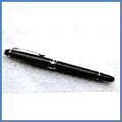
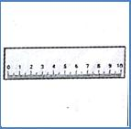
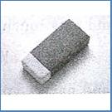
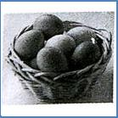
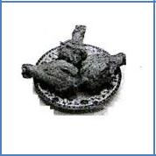
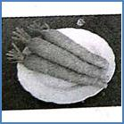
III.听对话和问题，选择正确的选项。
11. A. B. C.
12.A. B. C.
13. | A. Bob’s math teacher. | B. Bob’s Chinese teacher. |  |  | C. Bob’s English teacher.
14. | A. At 7:15. | B. At 7:30. |  |  | C. At 7:45.
15. | A. 8 dollars. | B. 10 dollars. |  |  | C. 18 dollars.

Slide 58
IV.听短文和问题，选择正确答案。
16. | What color is the bed?
A. White. |  | B. Yellow. |  |  | C. Red.
17. | What’s on the desk?
A. Some books. |  | B. The clock. |  |  | C My family photo.

Slide 59
V. 听短文填空。(共 3 分)
Name | Favorite day | Favorite subject | Reason
Mary | Tuesday | History | 18.( )
Mike | 19.( ) | P.E. | Relaxing
Lily | Friday | 20.( ) | Interesting
听前：
看横竖格，了解大意
观察大小写
猜测空缺词义和词性
听中：
写词
听后：
检查
Fun
Wednesday
Music

Slide 60
完形填空二
Dear Kim, Thanks for your email. My __1__is Li Ming. I am a student in China. I don't have a __2__. It's nice for you to have a sister.I am 1.65 metres tall and I have two big__3__. I can write __4__my left hand. Maybe it's not so common (常见的). We have six lessons a day. After school we can play sports __5__the playground. Then my father __6__me home. I always feel__7__and I always smile at others. In English we use many __8__for our feelings. Are you blue__9__happy? What about you and __10__school? Please write to me soon. 1.A.room B.school C.name D.class 2.A.brother B.mother C.father D.sister 3.A.mouths B.eyes C.noses D.hairs 4.A.with B.for C.at D.on 5.A.to B.about C.on D.for 6.A.take B.takes C.taking D.to take 7.A.sad B.angry C.scared D.happy 8.A.word B.name C.action D.colours 9.A.or B.but C.and D.so 1o.A.her B.his C.your D.our
做题方法：
1.速浏览，抓大意
2.做易题
3.结合上下文，做难题
4.读全文，纠失误。

