Slide 1
复习课
重点短语
重点句型
重点语法
任务型阅读

Slide 2
重点短语
1. 见到你很高兴。
2. 这是什么？
3. 这是...
4. 这些是...
5. 那是...
6. 那些是...
7. 给...打电话
1. Nice to meet you.
2. What's this?
3. This is...
4. These are...
5. That is...
6. Those are...
7. call ... at ...

Slide 3
重点短语/句型
8. 向某人求助
9. 看...
10. ...怎么了？
11. 带领某人参观
12. 一张...的照片
13. 早餐你想吃什么？
14. 看起来不一样
8. ask ... for help
9. look at
10. What's the matter with...
11. show ... around
12. a picture of...
13. What would you like for breakfast?
14. look different

Slide 4
重点短语
15. 非常喜欢某物
16. 购物
17.听音乐
18. 有趣的故事
19. 我真地喜欢你。
20. 如此美丽
14. 在星期天的早晨
8. like ... very much
9. go shopping
10. listen to music
11. funny stories
12. I really like you.
13. so pretty
14. on Sunday morning

Slide 5
Exercises
eally
1. The students r______ like Mary.
2. You can ask Mary ________(help).
3. _______is Mary and ______are her students.
A. This; these B. These; Those
C. That; Those D. That; That
4. Mary has _____ book, _____ book is on the desk.
A. a; an B. a; the
C. the; a D. /; the
for help
A
B

Slide 6
Exercises
10. show; you; around; can; me
_________________________?
11. him; likes; very; much; Jenny
____________________________.
12. Mary; would; for; like; dinner; what
_______________________________?
Can you show me around
Jenny likes him very much
What would Mary like for dinner

Slide 7
复习课
重点短语
重点句型
重点语法
任务型阅读

Slide 8
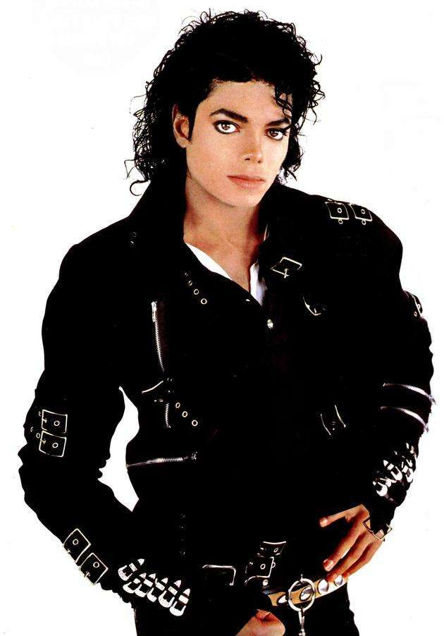
重点语法
1. 姓名表达
Michael Jason
————— is his last name.
_________ is his first name.
Jason
Michael

Slide 9
重点语法
2. 物主代词
形物代 & 名物代-----“ ... 的 ”
形物代 + 名词 = 名物代
--- Is this ____ (you) bike？
--- Yes, it's ________(I).
your
mine

Slide 10
复习课
重点短语
重点句型
重点语法
任务型阅读

Slide 11
The food in the U.K. is different from our Chinese food.The English people eat a lot of potatoes. They like to eat them every day. They like to eat fish, potatoes and other vegetables. They often have bread for breakfast. They eat their bread with butter(黄油)，cheese(奶酪) or jam. They don't eat much rice in China. English people drink a lot of tea, too. They often put some sugar into the tea. They drink the most tea in the world. They like Chinese tea, but they like the tea from India better. In the afternoon, they always have some cookies and tea.
1--2 题完成句子；3题简略回答问题； 4题找出并写下全文的主题句； 5题将文中画线句子翻译成汉语。
1. English people often have ______ for breakfast.
2. English people don't eat much __________.
3. Which tea do English people like better? ___________________________.
4. _________________________ 5. ________________________________.
段首 / 段尾
文中开头 / 结尾
bread
rice
The tea from India.
The food in the U.K. is different from our Chinese food.
在下午，他们总是吃饼干，喝茶。

