Slide 1
冀教版七年级上册
U2 L12

Slide 2
Lesson 12 Let Go Shopping
重点单词：
centre 中心，中央
Saturday 星期六
will 将要
pair 双，对

Slide 3
Lesson 12 Let Go Shopping
重点短语：
Let's go shopping. 让我们去购物吧。
a pair of shoes. 一双鞋
shopping centre 购物中心
come with... 和...来
have fun 玩得开心

Slide 4
1. Let's go shopping. 让我们去购物吧。
swimming 去游泳
fishing 去钓鱼
go
skating 去滑冰
boating 去划船
I like to go ___________ (skate) with my friends in winter.
skating
Notes:
shop 、fish 、skate、boat 本身就是动词

Slide 5
拓展
(1) shop for sth. “去商店买某物”
He likes to shop for food at the supermarket.
他喜欢到超市买食物。
There is a shop near my home.
在我家附近有个商店。
(2) shop “商店”= store

Slide 6
2. Let's meet at the shopping centre at 1:00 p.m. this Saturday . 让我们这个星期六下午1：00在购物中心见面吧。
在英语中,小的时间在前，大的时间在后,钟点前面用at.
We have a geography class________ two o'clock in the afternoon. A. at B. in C. on D. from
A
in+ 年/月/季节
in the+ morning / afternoon / evening
on+ 星期 / 具体日期
at+ 时间点

Slide 7
3. I want to buy a pair of shoes and a pink blouse for school !
我想买一双鞋和一件粉色的衬衣上学穿!
a pair of... 一双；一条
two pairs of... 两双；两条
His father buys two ______ shoes for him. A. a pair of B. pairs C. pairs of D. pair
C

Slide 8
4. I will wear my favourite dress.
我将要穿着我最喜欢的连衣裙。
时态：一般将来时
结构：主语＋will＋动词原形＋其他
They will_______(go) to Beijing womorrow.
go

Slide 9
1)You may catch❶ a cold.
To：jenny@compmail.ca；danny@compmail.ca；
kate12@supermail.com；steven@supermail.com
From：kim15@compmail.ca
Date：12/10 10:15 a.m.
Subject：A Shopping Date！
Hi friends，
Let's go shopping❶
Let's meet at the shopping centre at 1:00 p.m.❷ this Saturday. You can come with your mum！
You can wear your favourite clothes.

Slide 10
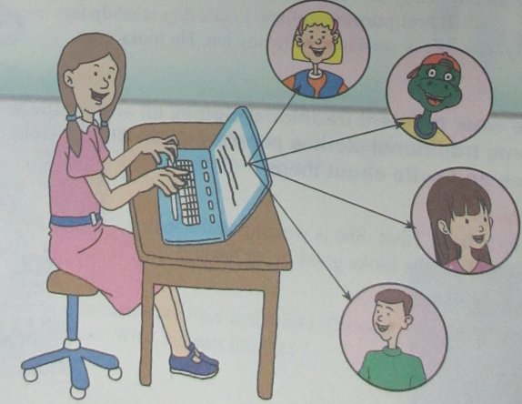
I will wear my favourite dress. ❸
I want to buy a pair of shoes and a pink blouse for school！
What do you want to buy？
Can you come？
We can have FUN，FUN，FUN！！！
Kim

Slide 11
the shopping centre go shopping have fun buy meet
1.A：Where is______________________？
B：It's near the park.
2.A：Let's go to the zoo.
B：OK. We can __________there.
3.A：I'm so glad to _______you.
B：Me too.
4.A：What do you want to_______？
B：A pink skirt.
5.A：Let‘s_____________. B：Good idea.
the shopping centre
have fun
meet
buy
go shopping

Slide 12
二、单项选择
6. Tom and Jim often________on the playground.
A．have fun B．have funs
C．has fun D．has funs
7. The girl has two________.
A．pair of shoes B．pairs of shoe
C．pair of pants D．pairs of pants
A
做题方法：主谓一致法。Tom and Jim是复数，用have。
句意：汤姆和吉姆经常在操场上玩得开心。
D
做题方法：语法判定法。two+名词复数，鞋或裤子应用复数。

Slide 13
一、根据汉语提示写出单词
1. They_______(将要) go shopping this afternoon.
2. It is in the________(中心) of the town.
3. Can we go to play sports this_________(星期六)?
4. My mother wants to go swimming ________(和) me.
5. This is a ________(双) of shoes for my mother.
will
centre
Saturday
with
pair

Slide 14
8. We often go________on Sundays.
A．shop B．shops
C．to shopping D．shopping
9. Do you want to go fishing with________？
A．I B．you C．me D．my
D
C
做题方法：语法判定法。
with是介词，介词+宾格。

Slide 15
10. He will________his friend at home.
A．to meet B．meeting
C．meets D．meet
D

Slide 16
三、连词成句
11. come， you, me, can, with
___________________________________.
12. will, dress, I, wear， favourite, my
___________________________________.
13. want, buy, a, of, I, to, pair, shoes
___________________________________.
14. can, fun, we, have
___________________________________.
15. let's, to, zoo, go, the
___________________________________.
You can come with me
I will wear my favourite dress
I want to buy a pair of shoes
We can have fun
Let's go to the zoo

