Slide 1
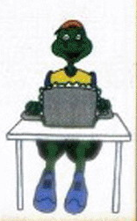
Unit 2
My Favourite School Subject
Lesson 8 E-mail Helps！

Slide 2
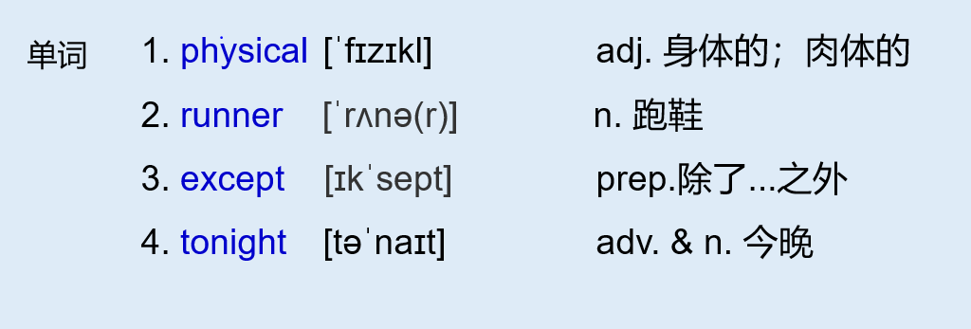
冀教八上 L8 E-mail helps!
physical education（P.E.） 体育
短语

Slide 3
L8 E-mail helps!
THINK ABOUT IT
·Do you like to write e­mails or letters in English?
·Do your classmates help each other in class? How?
From： danny@compmail.ca To：liming@net.cn
Subject：P.E. Date：15/09 6:59 p.m.
Hi Li Ming，
I have a lot of homework this year! All of our teachers make us study very，very hard. I am very tired.
Some of my classes are a lot of fun. My favourite class is physical education (P.E.)．Yesterday in P．E. class，I put Brian's shorts on my head and his runners on my hands. Everyone laughed except the teacher. “That's not funny，Danny,” he said. But I saw him smile.
Time for supper！Write to me soon!
Danny

Slide 4
L8 E-mail helps!
From： liming@net.cn To：danny@compmail.ca
Subject：English and Maths Date：16/09 6：15 p．m.
Dear Danny，
I have written three e­mails in English today. Our English teacher told us to use English every day. It is the best way to learn the language. You have helped me a lot.
Ms. Liu gives us lots of interesting projects in English class. This week，we are talking about our favourite subjects in school.
I like English best. I also like maths. My friend Wang Mei is very good at maths. She has helped me with my maths homework a lot. We will have a maths exam this Friday. We are going to study together tonight.
Your friend，
Li Ming

Slide 5
课文讲解
句子 1
All of our teachers make us study very，very hard.
考向一
make sb.do sth. “使某人做某事”
eg：His story made us all laugh.
他的故事使我们大家都笑了。
典例
—Do you like Zhou Libo's talk show?
—Yes. His talk show is very funny. It always makes people _____．
A．laugh B．laughed
C．laughing D．to laugh
A
后接不带to的动词不定式 作宾补的动词(词组)有：
一感 (feel)，二听 (hear, listen to)，三让 (let, make, have)，
四看 (watch，see，notice, look at)，半帮助 (help）
魔法记忆

Slide 6
课文讲解
句子 2
But I saw him smile.
see-saw-seen
考向二
see sb. do sth. 看见某人做某事
see sb. doing sth. 看见某人正在做某事
eg：I saw him playing basketball on the playground.
我看见他正在操场上打篮球。
(1) 凯特看见她的数学老师走进了办公室。
Kate saw her maths teacher _____ ______ the office.
(2) 那位老人看见一个年轻人正在偷杰克的钱。
The old man saw a young guy ______ Jack's money.（steal）
典例
walk into
stealing

Slide 7
课文讲解
考向三
help sb. (to) do sth. 帮助某人做某事
eg：The boy helps his mother (to) do some housework.
这个男孩帮助他妈妈做家务。
典例
我们帮助这位老人过了马路。
We helped the old man ____________(cross) the road.
cross / to cross

Slide 8
课文讲解
句子 3
It is the best way to learn the language.
考向
the best way to do sth. 做...的最好方法
eg：The best way to go there is riding.
骑车是去那的最好方式。
典例
让他停下来的最好方式是什么？
What is the best way ________(stop) him ?
to stop

Slide 9
课文讲解
句子 4
Everyone laughed except the teacher.
except 除了 “-”
besides 除了 “ + ”
考向
eg：We goes to Beijing except Li Ming. He is ill.(减去李明)
eg：We goes to Beijing besides Li Ming. He enjoys himself.(加上李明)
—Alice, Would you like to go hiking with us?
—What a pity! I am free every day _____ today．
A．for B．except C. besides D．beside
典例
B

Slide 10
课文讲解
句子 5
My favourite class is physical education (P.E.)．
考向
physical education (P.E.)． 体育--身体方面的教育
典例
My favourite subject is _______ ________.
我最喜欢的科目是体育。
physical education

Slide 11
现在完成时
I have written three e­mails in English today.
You have helped me a lot.
She has helped me with my maths homework a lot.

Slide 12
现在完成时（一）
1. 含义
2. 标志词
3. 结构
动作发生在过去，到现在已经完成并强调对现在造成的
影响和结果，翻译为“已经”。
动作或状态从过去某一时刻开始，一直持续到现在，而且
可能持续到将来。
already 已经 (肯) , yet 还没 (否疑)
主语+ have/has + 动词过去分词（done）+其他
have/has 是助动词，没有实际意义
变一般,将 have/has 提前；变否定在have/ has 后加not。

Slide 13
现在完成时（二）- 过去分词
I have written three e­mails in English today.
You have helped me a lot.
She has helped me with my maths homework a lot.
结构：主语+ have/has + 动词过去分词+其他

Slide 14
动词 变 过去分词的规则变化
构成规则
1、一般末尾加– ed
look - looked - looked
2、哑e结尾 只加 -- d
live - lived - lived
3、元辅重读双写结尾辅
音字母，再加—ed
stop - stopped - stopped
4、“辅音字母+y”结尾
变“y”为“i”再加—ed
study - studied - studied
规则变化的过去式和过去分词一致

Slide 15
过去分词小练兵-规则变化
动词原形 | 过去式 | 过去分词
play | played | played
hope | hoped | hoped
drop | dropped | dropped
carry | carried | carried

Slide 16
动词 变 过去分词的不规则变化
ABB
1. have-had-had buy—bought—bought
AAA
2. cut—cut—cut set—set—set
ABC
3. eat-ate-eaten do—did—done
ABA
4. come—came—come run—ran—run
不规则变化的过去式和过去分词特殊记

Slide 17
冀教八下P145

Slide 18
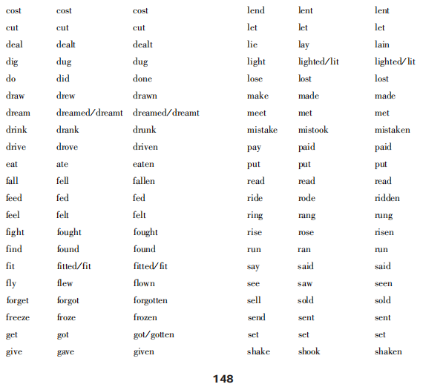

Slide 19
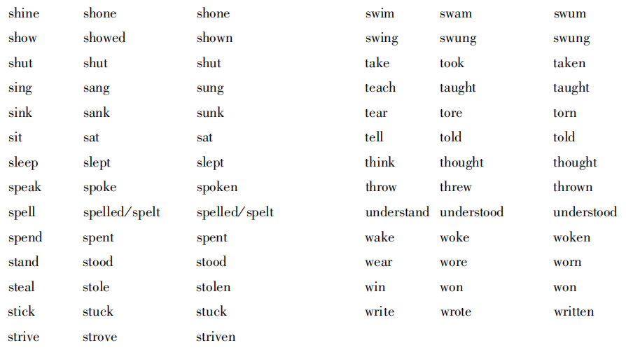

Slide 20
I.写出下列各词的过去分词
had
1.have- 8.come-
2.go- 9.read-
3.eat- 10.jump-
4.buy- 11.run-
5.find- 12.swim-
6.cut- 13.take-
7.do- 14.fly-
come
gone
read
eaten
jumped
bought
run
found
swum
cut
taken
done
flown
Notes:
改 ABB结构

Slide 21
课本P21 第3题 写出下列单词的过去分词
regular verbs irregular verbs
1.laugh_______
2.play_______
3. study ______
4.close_______
5.talk_______
6.listen_______
7.walk_______
8.help _______
9.smile_______
taught
laughed
1.teach______
2.tell_______
3.run_______
4.write_______
5.see______
6. know_______
7.say_______
8.make______
9.put_______
played
told
run
studied
written
closed
seen
talked
known
listened
said
walked
made
helped
put
smiled

Slide 22
冀教八上 L8 E-mail helps!
单词
1. adj. 身体的；肉体的
2. n. 跑鞋
3. prep.除了...之外
4. adv.&n. 今晚
physical
runner except tonight
短语
1. 让某人做某事
2. 看到某人正在做某事
3. 帮助某人做某事
4. 做...最好的方法
5. 体育
make sb. do sth.
see sb. doing sth.
help sb. (to) do sth.
the best way to do
physical education（P.E.）
语法
现在完成时：
过去分词 1）规则变化 （同变过去式）
2）不规则变化 (背诵课本P145)

Slide 23
Practice L8
一、单项选择
1. —The show was so funny that it made everyone _____again and again.
A. laugh B. laughed C. laughing D. to laugh
2. His mother often tells him ____ too much time playing games.
A. not to spend B. don't spend C. spends D. spending
3．______ running after success, we have a lot of other interesting things
to do in our lives.
A. By B. On C. Besides D. Except
4. The students have many ______ at the end of each term.
A. quiz B. test C. exam D. exams
5. Only a few teenagers help their parents ______ the housework.
A. to B. on C. in D. with
A
A
C
D
D
Notes:
run after success 追求成功

Slide 24
Practice L8
二、用方框中所给单词的正确形式填空
6. We are going to study together ________.
7. ________ are a kind of shoes. You can wear them and run.
8. ________ education is also an important class for us.
9. All the students went to the concert ______ Bill because he was ill.
10. The bad weather made us ______ at home.
except, tonight, stay, runner, physical
tonight
Runners
Physical
except
stay

Slide 25
Practice L8
三、按要求完成下列各题。
11. I have a lot of friends.(同义句转换)
I have ________ friends.
12. It's time for lunch.(同义句转换)
It's time ______ ________ lunch.
many
to have
13. She has written some letters to her father.(改为否定句)
She ______ _______ _____ letters to her father.
14. next, Lily, exam, have, week, an, will, English(连词成句)
_____________________________________.
15. teacher，have, your, talk, not, why, a, with (连词成句)
____________________________________?
hasn't written any
Lily will have an English exam next week
Why not have a talk with your teacher

