Slide 2
Topic-Your Town
Vocabulary-大纲词汇
Grammar-形容词、副词的比较级和最高级（二）
Speaking & Writing

Slide 4
creative adj. 有创造力的；创造性的
performer n. 表演者；演员
talent n. 天赋；天资
have…in common 有相同特征；（想法、兴趣等方面）相同
magician n. 魔术师
all kinds of 各种类型的；各种各样的
beautifully adv.美好地；漂亮地
be up to sb. 是……的职责；由……决定
role n. 作用；职能；角色
play a role 发挥作用；有影响
winner n. 获胜者；优胜者
prize n. 奖；奖品；奖金
talented (adj.)
有天赋的
magic n.魔法/adj.有魔法的
有魔力的
神奇的、棒极了
Notes:
约定俗成
place 表示“名次”时，通常与序数词连用，其前的定冠词通常省略。表示获得第几名，常与动词get, take, win, gain, be (come, finish) in等连用。如：

Slide 5
everybody pron. 每人；人人；所有人
make up 编造（故事，谎言等）
example n. 实例；范例
for example 例如
poor adj. 贫穷的；清贫的
seriously adv. 严重地；严肃地；认真地
take...seriously 认真对待......
give v. 提供；给
crowded adj. 人多的；拥挤的；挤满的
American Idol 美国偶像（电视节目名称）
America’s Got Talent 美国达人秀（电视节目名称）
China’s Got Talent 中国达人秀（电视节目名称）
Notes:
一大群 a large crowd of 。。。

Slide 6
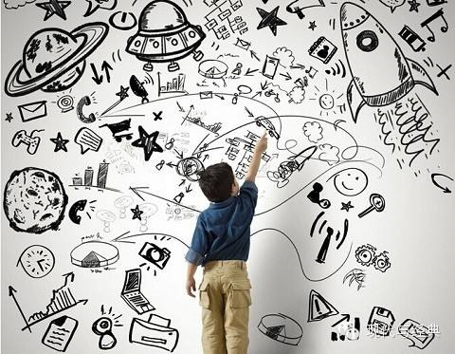
creative adj. 有创造力的，创造性的
Sometimes kids are more _________ than the adults. （成年人）
creative
create (vt.) 创造
Notes:
create more jobs 、wealth、a new dish

Slide 7
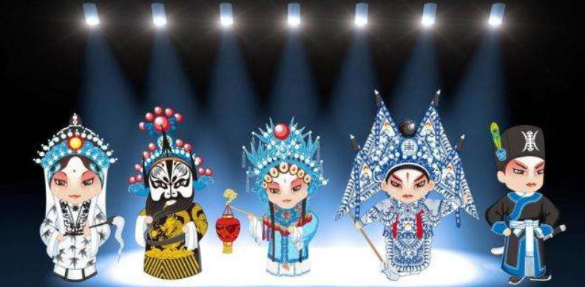
performer n. 表演者；演员
The _________ on the stage are _________Beijing Opera.
performers
performing
perform (v.) 表演 performance (n.) 表演

Slide 8
have...in common 有.....共同点、在...上有共同点
e.g. Tom and I have the same interest in common.
e.g. My twin brother and I have a lot in common.
例题： My friend David and I have something _____ common.
A.from B. in C.at D.for
B

Slide 9
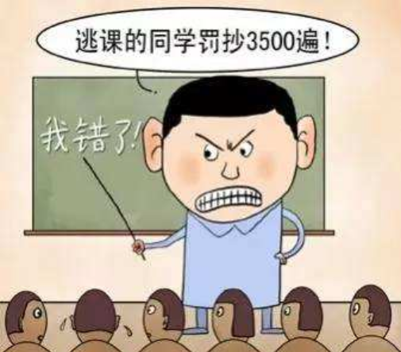
role n. 作用；角色；职能
e.g. Teachers ______________________ in our growth.
play an important role
play a role (in) 发挥作用； 有影响
make a difference 有影响，起（重要）作用
My friend makes a difference to my life.
Notes:
我的朋友对我的生活产生了影响 良师益友

Slide 10
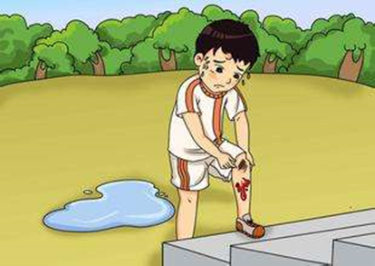
take sth./sb. seriously 认真对待某事(人)
e.g. You'd better take your studies seriously.
seriously 严肃地；严重地
be serious about 对某事认真
eg. They are serious about their work.
eg. Tom's leg was seriously hurt.

Slide 11
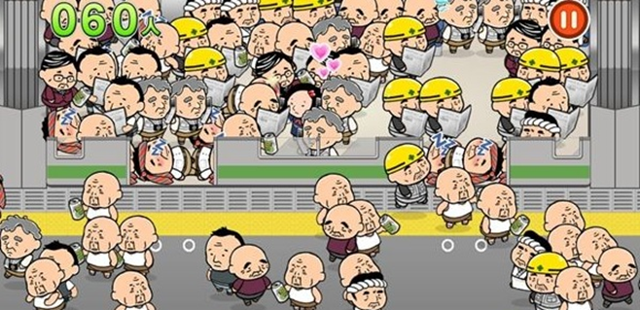
crowded adj.拥挤的；人多的
This place is so __________.
crowded
The bus is crowded with people.
crowd n.人群
in the crowd 在人群中

Slide 12
Revision
1.有创造力的
2.表演者
3.拥挤的
4.有....共同点
5.发挥作用
6.认真对待某人(事)
7.在人群中
8.由....决定
9.编造
10.例如
creative
performer
crowded
have...in common
play a role (in)
take...seriously
in the crowd
be up to
make up
for example

Slide 13
词汇练习 I，用括号内所给词的正确形式填空。
P88
1.Do these young _________ (magician) come from Hong Kong?
2.Who's the _______(win) of the boat race?
3.Helen could play the piano __________(beautiful) at the age of 7.
4.I _______(give) Tom a model plane for his birthday last year.
5.Don't laugh. You must take this __________(serious).
magicians
winner
beautifully
gave
seriously

Slide 14
词汇练习II，用方框中词语的正确形式填空。
P88
have something in common, all kinds of,
be up to, play a role, make up
We have 1.__________ avtivities in class. Today the teacher asked us to 2.________a dialogue. And it 3. _______ us to decide about the topic. Tom and I are in the same group. Our dialogue was like this:
--Jenny and her sister 4._______________________.
--Yeah, they both like music.
--Actually they are very good friends in their everyday life.
--Yes, of course. I think friends 5.__________in our life.
--Certainly.
all kinds of
make up
is up to
have something in common
play a role

Slide 16
形容词、副词的比较级和最高级
1. Jim is tall.
Jim runs fast.
2. Jack is taller than Jim.
Jack runs faster than Jim.
3. John is the tallest in the class.
John runs fastest in the class.
原级
比较级
最高级

Slide 17
一、形容词、副词的原级
1.Jim runs so fast that I can't follow him.
2.He is coming here as fast as possible.
3.He doesn't study as/so well as his brother.
too/ so / quite/ enough+原级
as....as possible
尽可能......
as+原级+as.... 和...一样
not as / so+原级+as....
不如...

Slide 18
Exercises
( ) 1. When we heard the bad news, my father felt as ______as me.
A.happy B.happily C.sad D.sadly
( ) 2. Tom is as _____as Jack. Because they both made no mistakes.
A.careless B.more careful C.careful D.carefully
( ) 3. He runs so _____ that I couldn't catch up with him.
A.quick B.quickly C.more quickly D.quicker
C
C
B
根据句意，判断词性

Slide 19
一、形容词、副词比较级，最高级变化规则
1. 一般情况下加-er/-est
young---younger---youngest
2. 哑e结尾+ -r/ -st
nice---nicer---nicest
3.元辅重读双写辅音字母，再加-er/ -est
big---bigger--- biggest
4. “辅音字母＋y”结尾的双音节词，变“y”为“i”，再加-er/-est
early---earlier---ealiest
5. 多音节词和部分双音节词， more / most+ 原级
popular ---more popular---most popular
6. 由形容词+ly变成的副词，more/ most + 原级
slowly ---more slowly---most slowly

Slide 20
写出下列词的比较级和最高级
tall ____________ quickly ____________
pretty ____________ heavy ____________
fat ____________ early ____________
cold ____________ exciting ____________
cheap ____________ interesting ____________
taller--tallest
more/most quickly
prettier--prettiest
heavier--heaviest
fatter--fattest
earlier--ealiest
colder--coldest
more/most exciting
more/most interesting
cheaper--cheapest
课本P26

Slide 21
二、形容词、副词比较级，最高级不规则变化
原级 | 比较级 | 最高级
good/well
bad/ill/badly
many/much
little
few
far
old
两好
两坏
两多
两少
一远
一老
better
best
worse
worst
more
most
less
least
fewer
fewest
farther
further
farthest
furthest
older elder
oldest eldest
Notes:
病情比较严重的，病情最严重的

Slide 22
原级 |  | 比较级 |  | 最高级
good/well |  | better |  | best
bad/ill/badly |  | worse |  | worst
many/much |  | more |  | most
little |  | less |  | least
二、形容词、副词比较级，最高级不规则变化
far | farther further | farthest furthest
old | older elder | oldest eldest

Slide 23
三、形容词、副词的比较级
1. ① A + 谓语动词 + 形容词/副词比较级 + than + B
② A or B
You drive more carefully than Bob.
Who is heavier , Lucy or Lily?
③
the + 比较级 + of the two 表示 “两个中比较....的那个”
Mary is the taller of the two girls.

Slide 24
三、形容词、副词的比较级
2. ① 比较级+ and +比较级“越来越......”
② more and more + 多音节词
1. 天气变得越来越热了。
2. Lucy 变得越来越高了。(tall)
3. 这种运动越来越流行了。
4. 雨下得越来越大。(heavily)
The weather is getting hotter and hotter.
Lucy is getting taller and taller.
This kind of sport is becoming more and more popular.
It rained more and more heavily.
Notes:
强壮、聪明、勤奋

Slide 25
三、形容词、副词的比较级
3. the +比较级.....，.. the +比较级....
表示“越... ，就越...”
eg. The younger you are , the easier it is to learn.
The more you know, the more you will find you don't know.
1) _________(much) you make, ________(much) you spend.
2) _________(fast) I type, _________(many) mistakes I make.
The more
the more
The faster
the more

Slide 26
三、形容词、副词的比较级
4. 修饰比较级的词有：
much 许多，even甚至，far 远，a lot 许多，a little /a bit 一 点
eg. Tom is much shorter than his brother.
This book is even more useful than that.
Don't go by plane. It's a lot more expensive.
1) He writes even ______________ (carefully) than before.
2) The experiment was much _______ (easy) than we had expected.
more carefully
easier

Slide 27
形容词，副词的比较级总结
1. ① A+谓语动词+形容词副词比较级+than+B
② A or B
③ the +比较级+of the two 表示 “两个中比较....的”
2. “越来越......” ① 比较级+ and +比较级
② more and more+多音节词
3. the +比较级..., the +比较级... “越..., 就越...”
4. 修饰比较级的词：
much 许多，even甚至，far 远， a lot 许多，a little /a bit 一 点

Slide 28
P92
I. 用所给词正确形式填空。
1. Tony is _____at maths, much ______ at Chinese and the ______at English.(bad)
2. Annie plays the piano very _____. Sue plays it _______ than Annie.
And Sally plays it the _____.(good)
3.He comes to school much_______(early) than I.
4.The ______(much), the _______.(good)
5.John jumps very ____. Jack jumps even ________ than John, and Tom jumps
the _________ in their class.(far)
6.There are ______(few) hours of sunlight a day in winter than in summer.
7.This is the ______(good) film I have ever seen.
8. Africa is the second ________(large) continent.
9. What he said made his mother much ________.（angry)
10.Ther weather is getting ______ and ________.(hot)
bad
worse
worst
good
better
best
earlier
more
better
far
farther
farthest
fewer
best
largest
angrier
hotter
hotter

Slide 29
四、形容词、副词的最高级
1. A + be + 最高级+比较范围(in/of/among/I have ever seen...).
eg. Spring is the best season in a year.
This book is the most interesting of the three.
Shanghai is the most beautiful city that I have ever seen.
2. Which is +最高级，A，B or C？
eg. Which is the biggest, the sun, the moon or the earth?

Slide 30
四、形容词、副词的最高级
3. A +be +one of+最高级 +复数名词 +范围
eg. Computer is one of the most important inventions in the world.
This is one of the most interesting stories I have ever heard.
Exercises:
1.Tom is one of _______________(careful) students in our class.
2.The Yellow River is one of ___________(long) rivers in China.
the most careful
the longest
4. the + 序数词 + 最高级，表示“第几最.....”
eg.The Yellow River is the second longest river in China.
第二长的河流

Slide 31
五、比较级和最高级之间的转换
李雷是班级里最高的学生。
Li Lei is the tallest student in his class.
Li Lei is taller than any other student in his class.
这部电影是我看过最好笑的。
This is the most amusing film that I have ever seen.
I have never seen a more amusing film.

Slide 32
II. 单项选择。
A
1. Of the two cups, he bought ________ one.
A. the smaller B. the smallest C. small D. smaller
2. My ________ brother is three years _____ than l.
A. elder; elder B. older; oldest
C. elder; older D. older; elder
3. To live a green life, we should try to save ____ energy and produce
________ pollution.
A. more; less B. less; more
C. more; fewer D. most; least
C
A

Slide 33
C
4.The experiment was ____ easier than we had expected.
A. more B. much more C. much D. more much
5.The weather in London is worse than ______.
A. Paris B. in Paris C. that in Paris D. it in Paris
6. Beijing is one of ________ in China.
A. the largest city B. the large cities
C. the larger cities D. the largest cities
7. Dear students, please read every sentence carefully. ____ you are,
______ mistakes you'll make.
A. The more carefully; the fewer B. The more careful; the less
C. The more carefully; the less D. The more careful; the fewer
C
在比较结构中，that 代指前面提到的名词单数或不可数名词。
D
D

Slide 34
C
8. The earlier kids learn to be independent, the ____it is
for their future.
A. good B. best C. better D. well
9. I work hard this term, but Peter works much_______.
A. hard B. harder C. hardest D. the hardest
10. We have a lovely room. It's one of _____ in the hotel.
A. nice B. nicer C. nicest D. the nicest
11. --The picture is, I have to say, not a bit beautiful.
--Why? It’s _______ than any picture I have ever seen.
A. far more beautiful B. much less beautiful
C. no more beautiful D. any less beautiful
B
D
A
一点也不

Slide 35
C
12. --Many boy students think maths is _______ English.
--l agree. I'm weak in English.
A. so difficult as B. much difficult than
C. less difficult than D. more difficult than
13. Bob jumps farther than _______ in his class.
A. the other B. any other boys
C. any other boy D. another boy
14. You have to study a little _____ if you are not as ____ as others.
A. hard; clever B. harder; cleverer
C. hard; cleverer D. harder; clever
15. This is ______ idea I can think of. I can’t see any better one.
A. good B. the best C. better D. well
C
D
B

Slide 37
Time to speak
Complete the conversation with your parter. The phrases in the box can help you.
A: Hi, I am...I am new in town.
B: Hi, I am...Welcome to the neighborhood.
How do you like it so far?
A: It's fantastic, but I still don't really know my
way around.
B: Well, maybe I can help you!
A: Wow ! It's kind of you. I want to know
which...is best?
B: The one on Center Street is the best.
You can...there.
A: Thanks for telling me .
B: No problem.
cinema
restaurant
supermarket
clothes store
......
sit the most comfortably
buy the freshest food
buy clothes the most cheaply
enjoy the most delicious food

Slide 38
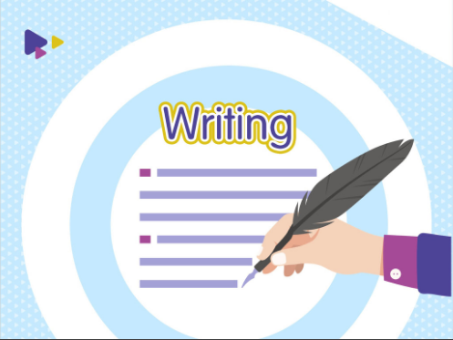

Slide 39
写作练习
1. 审题
2. 列提纲（三段式：总分总）
3. 扩写
4. 检查：
时态，人称，要求/要点
大小写，名词的数，动词形式

Slide 40
Time to write
假如你的好朋友刚刚搬到你所在的镇上。他非常爱吃蛋糕，向你询问镇上蛋糕店的情况。请按照表格内所给信息，参考作文本上的有用句式，写一篇不少于60词的文章。
Names | Quality(质量） | Service | Prices
Sweet Cake Store | best | friendly | most expensive
Hope Cake Store | good | friendliest | cheaper
Love Cake Store | worst | worst | cheapest

Slide 41
Brain storm
step | plot | Expressions
1 | 开门见山 引出话题
2 | 蛋糕店对比
3 | 总结推荐
There are three cake stores
in the town. They are...
...has the best cakes; the cakes are most expensive there;...friendlier service than...; As for the price,... is
the most expensive among
the three...
I like...best because...

Slide 42
I. 参考句式
1. 镇上总共有三家蛋糕店。
There are three cake stores in the town __________.
2. Sweet Cake Store的蛋糕是三家店里面最好的。
Sweet Cake Store has the best cakes ________ the three stores.
3. Hope Cake Store的蛋糕比Love Cake Store的要好。
Cakes in Hope Cake Store _____________those in Love Cake Store.
4. Hope Cake Store提供最友好的服务。
Hope Cake Store has ___________________.
in total
among
are better than
the friendliest service
Notes:
in total in all

Slide 43
I. 参考句式
5. Love Cake Store的服务是最糟糕的。
Service in Love Cake Store is ___________.
6. 至于价格，Sweet Cake Store是最责的。
______the prices, cakes in Sweet Cake Store are the most expensive.
7. 尽管Love Cake Store的价格最便宜，但是质量也是最差的。
_______________cakes in Love Cake Store are the cheapest, the
quality is the worst.
8. 我最喜欢Sweet Cake Store。
I like Sweet Cake Store __________.
the worst
As for
Although/Though
(the) best

Slide 44
L10 授课重点
短语
have...in common 有相同特征
all kinds of 各种类型的；各种各样的
for example 例如
make up 编造（故事，谎言等）
play a role (in) 发挥作用； 有影响
take sth. /sb.seriously 认真对待某事或者某人
in the crowd 在人群中
be up to 由...决定；是...的职责
not a bit 一点也不
as ....as possible 尽可能...

Slide 45
L10 语法：形容词、副词的比较级、最高级（二）
原级 |  | 比较级 |  | 最高级
good/well |  | better |  | best
bad/ill/badly |  | worse |  | worst
many/much |  | more |  | most
little |  | less |  | least
一、形容词、副词比较级，最高级 不规则变化
far | farther further | farthest furthest
old | older elder | oldest eldest

Slide 46
L10 授课重点
二、形容词，副词的比较级总结
1. ① A+谓语动词+形容词副词比较级+than+B
② A or B
③ the +比较级+of the two 表示 “两个中比较....的”
2. “越来越......” ① 比较级+ and +比较级
② more and more+多音节词
3. the +比较级..., the +比较级... “越..., 就越...”
4. 修饰比较级的词：
much 许多，even甚至，far 远， a lot 许多，a little /a bit 一 点

Slide 47
L10 授课重点
三、形容词，副词的最高级句型
1. A + be + 最高级 + 比较范围 (in/of/among/I have ever seen...)。
2. Which is +最高级，A，B or C？
3. A + be + one of + 最高级 + 名词复数 + 范围。
4. the + 序数词 + 最高级，表示“第几最.....”。

Slide 48
范文
There are three cake stores in the town in total, and they are Sweet Cake Store, Hope Cake Store and Love Cake Store.
Sweet Cake Store has the best cakes among the three stores, so 1. it's no wonder that the cakes are also the most expensive. Hope Cake Store has the friendliest service, and cakes in it are cheaper than those in Sweet Cake Store. As for the prices, cakes in Love Cake Store are the cheapest. At the same time, the service in Love Cake Store is also the worst. Both Sweet Cake Store and Hope Cake Store offer better service than it.
In general, I like cakes in Sweet Cake Store best.

