Slide 1
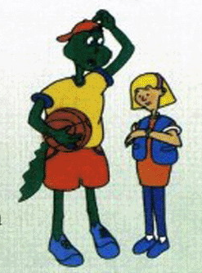
Unit 2
My Favourite School Subject
Lesson 10 Looking for Lisa

Slide 2
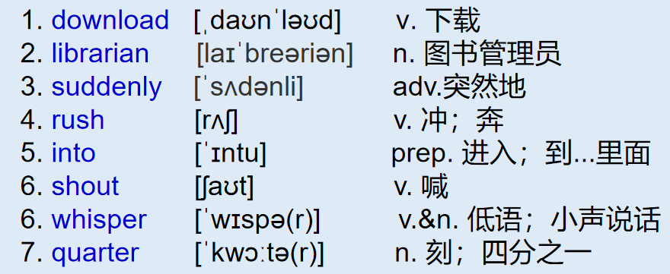
冀教八上 L10 Looking for Lisa
单词
1. No noise, please! 请保持安静！
2. a quarter 一刻钟
短语
Notes:
shout at 、shout to

Slide 3
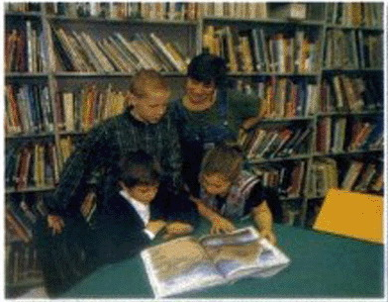
冀教八上 L10 Looking for Lisa
00:00--00:36
THINK ABOUT IT
·Is there a library in your school? What can you do there?
·Is it important to be on time? Why?
Jenny and Bill meet at 3 o'clock to work on their project. They are in the library. Jenny is on the computer.
Jenny：Look，Bill. I have downloaded some more pictures of Beijing.
Bill：Good work，Jenny! We have lots of photos for our talk now.
Have you found any Chinese music?
Jenny：Yes，I have. The librarian helped me find some.
Bill：That's great！

Slide 4
冀教八上 L10 Looking for Lisa
00:36--
(Suddenly the door opens. Danny rushes into the library with a basketball
in his hand. He is wearing shorts and a T­shirt.)
Danny：(He shouts loudly.) Is Lisa here? Lisa! Lisa! Are you here?
Jenny：Danny, be quiet! Lisa is not here.
Librarian：No noise，please!
Danny：(He whispers.) Oops! Sorry. Lisa and I are going to work on our
basketball project together. I told her to meet me at a quarter to three.
What’s the time，Jenny?
Jenny：(She looks at her watch.) It's a quarter after three.
Danny：She’s half an hour late! I have looked for her everywhere—in the
classroom, in the office, and now in the library. Where is she?
Bill：Relax, Danny! Have you looked in the gym?
Danny：No, I haven't. Maybe she's there!
Bill and Jenny：(They laugh.)Yes. Maybe she is. See you tomorrow, Danny.
Notes:
rush into rush out of project 项目 课题 方案 look for find find out

Slide 5
课文讲解
句子 1
Is it important to be on time?
考向
on time 准时、按时 eg. Be on time . Don't be late!
强调按时间表执行
in time 及时 eg. Luckily, I came in time. I didn't miss the train.
强调没有错失或延误
典例
He comes here ____ time.他及时到达了这里。
I got here ____ time.我准时到达了这里。
in
on
Notes:
on time 按时 （按照时间表执行）
in time 及时（没有错失或者延误）

Slide 6
课文讲解
句子 2
Jenny and Bill meet at 3 o'clock to work on their project.
考向
work on 从事于，致力于
eg：They are working on their writing.
他们正在从事他们的写作。
拓展
work有关的短语：
work out解决，算出；at work在工作；out of work失业
eg：He is at work.他在工作。
典例
Bob was a geography teacher three years ago. Now he gives
up teaching and starts to __ astronomy research(天文学研究)．
A．work out B．work in
C．work on D．work at
C

Slide 7
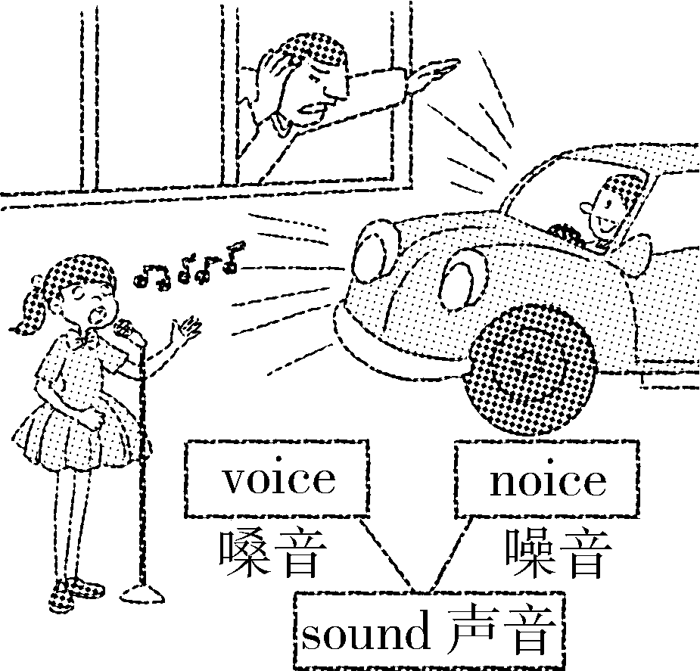
课文讲解
句子 3
No noise，please!
noisy adj. 吵闹的
反义词：quiet
Be quiet! / Keep quiet！安静！
考向
noise n. 噪音，吵闹声
make (a) noise 制造噪音
魔法记忆
eg：Don’t make any noise, children.
孩子们，不要吵闹。

Slide 8
考向【难点】
辨析voice，sound和noise
voice | 主要指人在讲话或唱歌时发出的声音，也可指鸟叫声、各种乐器的声音，它侧重于悦耳之声。
sound | 为一般用语。泛指用耳朵所能听到的自然界的各种声音，如人声、机器声等。
noise | 可以作可数名词，也可以作不可数名词。包括人们不愿意听到的各种声音，尤其指机器等发出的“噪音”，或者公共场所的“吵闹声，嘈杂声”。
Please speak in a loud voice.
请大声说话。
He can't hear sound.
他听不见声音。
Don't make so much noise.
别这么吵吵闹闹的。

Slide 9
Li Ming is in the library. He is borrowing a book.
A．Can I help you?
B．Then you must come back and renew it.
C．How long can I keep it?
D．Can I write on the book?
八上课本P25习题3
A
Librarian：________
Li Ming：Yes，please. I want to borrow Harry Potter.
Librarian：Let me see. Here you are.
Li Ming：________
Librarian：For two weeks.
Li Ming：But I can't finish it in two weeks.
Librarian： ________
Li Ming：Thanks. I will try to finish it on time.________
Librarian：No，you can't. You must keep it clean.
Li Ming：All right. I understand. Thank you.
C
How long 提问
for +时间段 作答
B
D
Notes:
reset 再 重新 renew 重新开始、延长。。。的期限

Slide 10
4. 辨析 how often, how long 和how soon
1. —___________ do you go to the movies? 你多久看一次电影？
考向
How often
—Once a month.一个月一次。
2. —__________ do you stay in Beijing every year？
你每年在北京呆多久？
How long
—For three months.3个月。
3. —_________can you finish the work?你多久能完成这项工作？
How soon
—In half an hour.半小时后。
典例
A
—______ were you away from school last term?
— More than two weeks.
A．How long B．How often
C．How soon D．How far
Notes:
how soon 多久以后

Slide 11
复习
Grammar: 现在完成时标志词总结
1. already, yet, ever, never
already 已经 (肯定句句中) ,
yet 还没 (否定句和疑问句句尾)
never “绝不、从来没有”, 通常用于陈述句。
ever “曾经、在任何时候”，通常用于疑问句中。
2. for+时间段
since ① + 时间点
② + 一般过去时的句子
3. 与次数连用：once, twice, three times...

Slide 12
时间表达法
3：00
Jenny and Bill meet at 3 o'clock to work on their project.
I told her to meet me at a quarter to three.
What’s the time，Jenny?
It's a quarter after three.
2：45
3：15

Slide 13
(点钟+分钟)
6:00 six o'clock
6:30 six thirty
直读法
7:15 seven fifteen
7:45 seven forty-five
时间表达法
≤30分钟：past / after 过
分钟+past+点钟
“几点过几分”
逆读法
(分钟+...+点钟)
6:30 thirty past six (half)
7:15 a quarter after seven
7:45 fifteen to eight
>30分钟：to 差
（60-分钟） +to +下一点钟
“差几分几点”

Slide 14
Practice 八上课本 P25
twelve o'clock
five past / after twelve
a quarter past / after twelve
half past / after twelve
a quarter to one
twelve five
twelve fifteen
twelve thirty
twelve forty-five
1. 12:00
2. 12:05
3. 12:15
4. 12:30
5. 12:45

Slide 15
冀教八上 L10 Looking for Lisa
1. v. 下载
2. n. 图书管理员
3. adv.突然地
4. v. 冲；奔
5. prep. 进入；到...里面
6. v. 喊
7. v.&n. 低语；小声说话
8. n. 刻；四分之一
1. download
2. librarian
3. suddenly
4. rush
5. into
6. shout
7. whisper
8. quarter
单词
短语
1. 请保持安静！
2. 一刻钟
3. 准时
4. 及时
5. 从事于；致力于
No noise, please!
a quarter
on time
in time
work on
语法
时间表达法

Slide 16
Practice L10
一、单项选择
1．______ you speak, ______ your English will be.
A. The less; the more B. The more；the better
C. The less；the better D. The more; the less
B
C
2．—What are you doing?
—I'm ______ the key to the door.
A．finding B．looks after C．looking for D．find
3．—Where is Mom now?
—I'm not sure. ______ she is in the kitchen.
A．May B．Maybe C．May be D．Can
4．The boy didn't sleep well last night because of the ____ from the factory.
A．voice B．noise C．music D．song
5．—I think it's necessary to learn how to work in groups.
—I quite agree. Sometimes it's even ____ than grades.
A．less important B．more important
C．the least important D．the most important
B
B
B
Notes:
成绩

Slide 17
Practice L10
二、用方框中所给单词的正确形式填空
6．I ________ at the driver.I didn't know what he did.
7．More than a ________ lost more than half of their wealth.
8．Mr. Black. is __________ a new project instead of finishing
this boring one.
9．Why not take some _______? The place is so beautiful.
10．He ______ into his room to help put out the fire.
rush quarter shout work on photo
shouted
quarter
working on
photos
rushed
Notes:
超过四分之一的家庭损失了过半的家庭财富。(3) at the beginning of 开头，开端，开始部分We are going to America at the beginning of July.
(4) from the very beginning 从一开始

Slide 18
Practice L10
三、根据汉语完成句子
11．格林先生正在写一部新小说。
Mr.Green is ________ ______ a new novel.
12．我能借用这些光盘一整周吗？
Can I _______ these CDs _____ a whole week?
13．你为什么不试着骑自行车去上学呢？
Why don't you _____ ______ a bike to go to school?
14．安静！不要制造噪音！
Be ______！ Don't _______ any _______！
15．我很抱歉让你等了快两个小时。
I'm very sorry to have kept you _______ ____ almost two hours.
working on
keep
for
try riding
quiet
make
noise
waiting for
Notes:
使。。保持某种状态keep the room warm keep。。。doing使你保持等待的状态就是让你一直等两个小时。

