Slide 1
Unit 1
Me and My Class
Lesson 5
Meet Ms. Liu

Slide 2
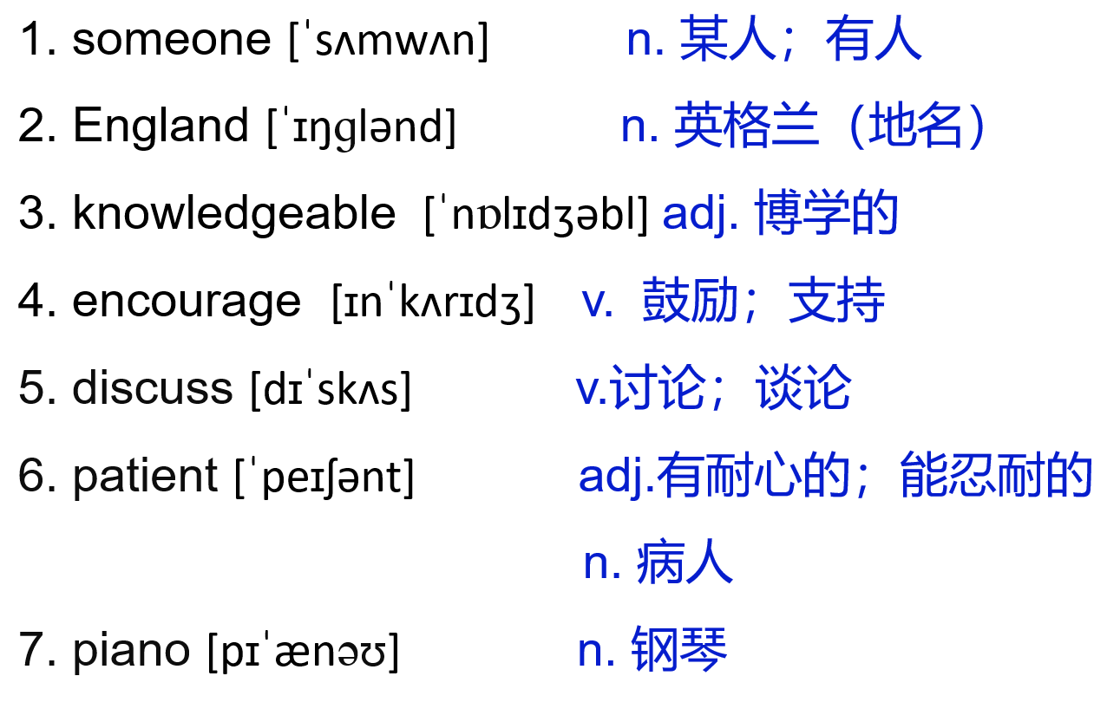
冀教八上 L5 Meet Ms. Liu
1. feel lucky to do
做……感到很幸运
2. encourage…to do…
鼓励……做……
3. play the piano
弹钢琴

Slide 3
THINK ABOUT IT
·What is your teacher's name? What do you know about him/her?
·How do you feel when you talk in front of your class?
It's English class. Li Ming is standing at the front. He is ready to give
his report to the class.
I talked to someone very special —our English teacher，Ms. Liu.

Slide 4
I feel lucky to have her as my English teacher. She learned English at a university in London，England. She started teaching seven years ago. She is knowledgeable，and her lessons are interesting. She encourages us to ask questions and discuss the answers with each other. She is kind and patient. After class，she is our good friend.
Ms.Liu has many interests. She likes to swim for exercise. She plays the piano, and she is a very good singer, too. What does Ms.Liu hate? Walking to school in January! It's cold in January.That's Ms.Liu.Thank you!
Learning Tip
My name is Yang Hui. I'm married. My husband is “Mr.” Liu. You can call
me“Ms.”Yang or “Mrs.” Liu. My daughter is single，so you can call her “Miss”
or “Ms.” Liu.

Slide 5
课文讲解
句子 1
He is ready to give his report to the class.
他已经准备好给全班做报告了。
考向
be ready to do sth. 乐意/准备好做某事
be/get ready for + n. 为……做准备
eg：He’s always ready to help others.
他总是乐意帮助别人。
Be ready for the lesson in five minutes.
准备好五分钟后上课。

Slide 6
典例
—Why does everyone like that boy?
—Because he _______________________________________.
(总是乐于助人) (ready)
is always ready to help others (other people)

Slide 7
课文讲解
句子 2
I talked to someone very special —our English teacher，Ms. Liu.
我同一个非常特别的人——我们的英语老师刘老师谈过。
考向
 | -one | -body | -thing
some- | someone | somebody | something
any- | anyone | anybody | anything
every- | everyone | everybody | everything
no- | no one | nobody | nothing
1）复合不定代词 作主语时，谓语动词要用第三人称单数。
2）形容词、不定式等修饰复合不定代词时，要放在复合不定代词的后面。

Slide 8
用单词的适当形式填空。
1.Well,everyone_________( want) him to win.
2. Nobody________(know) what the future will be like.
3. There__________(be) something wrong with my watch.
典例
wants
补全句子。
4. 这台电脑没问题。
There isn’t _____________ with the computer.
5. 你有什么要说的吗？
Do you have______________?
knows
is
anything wrong
anything to say

Slide 9
课文讲解
句子 3
I feel lucky to have her as my English teacher.
我感到很幸运有她作为我的英语老师。
考向
feel lucky to do...意为“做……感到很幸运”
I feel lucky to be a volunteer.
作为一名志愿者我感到很幸运。

Slide 10
lucky拓展： 名词: luck 副词: luckily 反义词：unlucky
1.Our teacher says ‘Good______!’ to us.
2. _______, you are a number of student in Class One.
典例
luck
Luckily
lucky
3. You bought the last ticket for the concert. How _____ you are！
4. She was _________to lose her books on her way home.
unlucky
Notes:
happy important necessary healthy

Slide 11
课文讲解
句子 4
She encourages us to ask questions and
discuss the answers with each other.
她鼓励我们互相提问，讨论答案。
考向
1) encourage sb.to do sth.意为“鼓励某人做某事”。
eg：His parents encourage him to speak in public.
他的父母鼓励他在公众场合讲话。
名词：encouragement 鼓励
典例
他妈妈经常鼓励他努力学习。
_____________________________________________
His mom often encourages him to work/study hard.

Slide 12
考向一
2) discuss sth. with sb.意为“与某人讨论某事”。
eg：He discussed the problem with his parents.
他和他父母讨论了这个问题。
考向二
名词：discussion
have a discussion about sth. “对某事进行讨论”。
Do you want to have a discussion about the culture of China?
你想讨论一下中国文化吗？
discusses
典例
Jack often ___________(discuss) the pollution problems with his friends.
Jack had a __________(discuss) with his classmates.
discussion

Slide 13
课文讲解
句子 5
I'm married.
married adj.已婚的 marry v. 嫁娶；结婚
1）marry sb. 嫁给/娶 某人；与某人结婚。
eg：John married Mary last week.
上星期约翰和玛丽结婚了。（娶了玛丽）
2）get married to sb. 表示与某人结婚。
eg：Jane got married to a doctor last month.
上个月简和一位医生结婚了。
3）be married 已婚的
Lucy has ______ (to William) for 50 years.
A. got married B. been married C. married D. marry
典例
B

Slide 14
Summary L5
1. someone
knowledgeable
patient
2. be patient with 对某人有耐心
feel lucky to do 做……感到很幸运
encourage sb. to do 鼓励某人做某事
discuss with sb. 与某人讨论某事
play the piano 弹钢琴
be ready for/to do 乐意/准备好做某事
be/get married to sb. 和某人结婚

Slide 15
Practice L5
一、用方框中所给词的适当形式填空。
1. We felt __________ to have so many good friends.
2. We always get some ______________ from our family.
3. I want to make friends with _________ very special.
4. Let's have a ___________ about the wonders of the world.
5. Tom and Linda have been ________ for ten years, but
they've never quarreled.
someone, encourage, discuss, luck, marry
lucky
encouragement
someone
discussion
married

Slide 16
二、单项选择。
6. Alice _____Peter last year.
A. married to B. got married to C. got married with D. married with
7. Why not ask ______ to help you?
A. somebody B. anybody C. nobody D. everybody
B
B

Slide 17
8. Jack feels _____ to have a chance to visit the famous film star.
A. lucky B. luck C. luckily D. lucks
9. Jessica's parents always encourage her ___ out her opinions.
A. speak B. speaking C. to speak D. will speak
10. Are you ready _______ talk about your hobby？
A. to B. for C. with D. on
A
C
A

Slide 18
三、连词成句。
11. Mr. Li, ready, is, have, a, birthday, to, for, son, his, party
_____________________________________________.
12. friend, feel, I, to, have, lucky, my, her, as
_________________________________________.
13. Ms. Li, us, to, questions, encourages, ask
_________________________________________.
14. waiting for, someone, is, at the, gate, you, school
_________________________________________.
15. Mary , was ,married, to, Tom
_________________________________________.
Mr. Li is ready to have a birthday party for his son
I feel lucky to have her as my friend
Ms. Li encourages us to ask questions
Someone is waiting for you at the school gate
Mary was married to Tom

Slide 19
Thank you!

