Slide 1
Unit 1
Me and My Class
Lesson 6
Jenny's week!

Slide 2
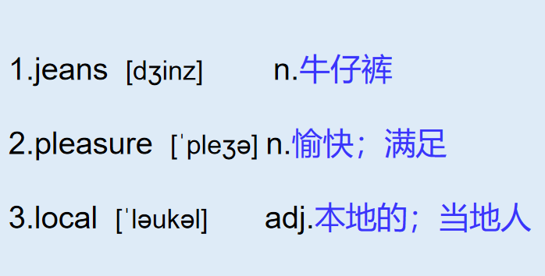
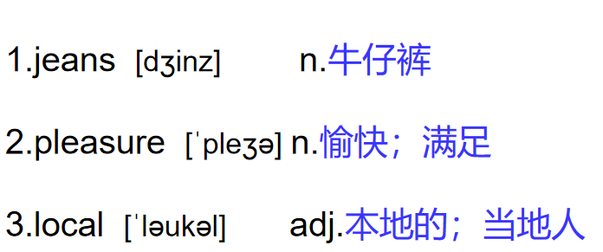
八上 L6 Jenny's week!
1. have the pleasure of doing
很高兴做...
n.当地人

Slide 3
L6 Jenny's week
THINK ABOUT IT·What do you like to do after school or on weekends / holidays?
·Do you like to watch movies? What is your favourite movie?
Date：September 10
Weather：No rain today，but cloudy，windy and cool.
Dear Diary,
Today Danny introduced us to his new friend, Sandra.
We played football together after school. Steven and I were on one team, and Sandra and Danny were on the other. It was a fair competition. The score was four to three. We lost. I hate to lose. I like winning!

Slide 4
L6 Jenny's week
Last Saturday，my mother bought a pair of jeans for me. She and I love to shop for clothes! She also bought me a purple blouse. I wore my new clothes to school on Monday. Everyone liked them.
In English class this morning，we talked to our classmates.I had the pleasure of talking to Mary —a girl from Hong Kong. Her English is very good. She invited me to go to the movies with her next Sunday. Mary's parents work in a local restaurant. After the movie，we will have supper there.
On Wednesday，my cousin Brian is arriving from the U．K. He will stay with my family for the next two years.
Time for bed!

Slide 5
课文讲解
句子 1
Today Danny introduced us to his new friend，Sandra.
introduce (v.) introduce A to B 把A介绍给B
eg. Lucy introduced Tom ____her parents.
eg. I __________(introduce) my friends to my parents yesterday.
考向
to
introduced

Slide 6
课文讲解
句子 2
Steven and I were on one team，and Sandra and Danny were on the other.
考向
one... the other ...（两者） 一个，另一个
e.g. Danny has two elder brothers. One is a doctor and
the other is a teacher.
C
My family has two dogs. One is white, and _____ is black.
A. other B. another C. the other D. others
典例

Slide 7
课文讲解
句子 3
Last Saturday，my mother bought a pair of jeans for me.
jeans 牛仔裤 trousers glasses
buy sth. for sb. =buy sb. sth. “给某人买某物”
考向
eg：I am going to buy some flowers for my mother on Mother's Day.
母亲节我将为我母亲买些花。

Slide 8
课文讲解
句子 4
I had the pleasure of talking to Mary.
pleasure n.愉快; 快乐; 令人高兴的事
1) have the pleasure of doing sth. 很荣幸/高兴做某事
考向一
eg：He had the pleasure of ________(play) tennis with Nat.
playing
考向二
2) ① With pleasure. “很乐意” --回答别人的请求（帮助前）。
② It’s my pleasure. / My pleasure. “不客气”--回答感谢（帮助后）。
eg：—Could you help me carry the box?
—With pleasure. 乐意效劳。
eg：—Thank you for helping me.
—It’s my pleasure. /My pleasure. 不客气。

Slide 9
课文讲解
句子 5
She invited me to go to the movies with her next Sunday.
invite ① invite sb. to do sth. “邀请某人做某事”
② invite sb. to sp. “邀请某人去某地”
考向
eg：I’ll invite my friends to have dinner tonight.
今晚我将邀请我的朋友们吃晚餐。
明天我将邀请我的朋友们来我家。
I will invite my friends to my house tomorrow.
A
—Why are you so excited?
—Peter invited me _______ on a trip to Yuntai Mountain.
A. to go B. go C. going D. went
典例

Slide 10
八上 L6 Jenny's week!
单词 牛仔裤
愉快；满足
本地的；当地人
短语 把A 介绍给B
给某人买某物
一个...另一个...
很高兴做某事
邀请某人去...
1. jeans
2. pleasure
3. local
1. introduce A to B
2. buy...for...
3. one... the other...
4. have the pleasure of doing
5. invite sb. to...

Slide 11
U1 Grammar：句子基本结构
简单的句子成份
1）S: subject 主语
2） V： verb 谓语
3） O: object 宾语
4） P：predictive 表语
5） OC：object complement （宾补）
6） IO： indirect object （间宾）
7） DO： direct object （ 直宾）

Slide 12
U1 Grammar：句子基本结构
1. S+V 主谓
2. S+ V+ O主谓宾
3. S+V+ P 主系表
4. S+ V+ IO+DO主谓双宾
5. S+V+O+ OC 主谓宾宾补
We work(不及物）
He plays the piano.(及物）
We are students.
She gave me a pen.
He made the boy laugh.

Slide 13
Practice L6
一、根据句意及汉语提示完成句子
1. My friend Lily often __________(邀请) me to her home.
2. We _______(输) the basketball match yesterday.
3. It is my p to give a report here today.
4. Danny b a coat for his mother as a birthday present last month.
5. Can we a in Beijing on time?
invites
lost
leasure
ought
rrive

Slide 14
二、单项选择
6. —When will Mr. Green_____ Beijing？
—In a week.
A. reach B. get C. arrive D. come
A
C
7. — Your coat fits you well.
—Thank you. I ________ it when I was on vacation.
A. have bought B. buy C. bought
8. —Thanks a million for your help.
—________.
A. Never mind B. My pleasure C. Good idea
B
Notes:
百万

Slide 15
B
9. ________played badminton last Friday. He did much better
than ________.
A. I and Bob; I B. Bob and I; I
C. Me and Bob; me D. Bob and me; me
10. The shy girl never invites her classmates _____ dancing.
A. practice B. practices C. practicing D. to practice
D
Notes:
than 后可＋I /me 但是如果是than I do ，一定用主格

Slide 16
三、连词成句
11. I, had the pleasure, of, playing football, you, with
________________________________________.
12. my mother, is going to, buy, a, bike, new, me
________________________________________.
13. thank, inviting, for, you, me
________________________________________.
14. I, and , my mother, are going to, Canada
________________________________________.
15. wasn’t, the boy, happy, because, lost, his team
________________________________________.
I had the pleasure of playing football with you
My mother is going to buy me a new bike
Thank you for inviting me
My mother and I are going to Canada
The boy wasn’t happy because his team lost

Slide 17
Thank you!

