Slide 1
冀教版七年级上册
U1 L3

Slide 2
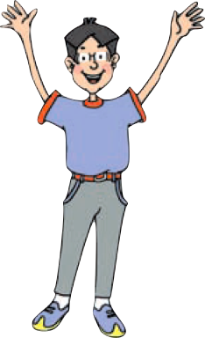
Unit 1
School and Friends

Slide 3
Lesson 3 Welcome to Our School!
重点单词：
show 指示;带路
around 到处;在附近
plan 计划
fun 有趣的事;
玩笑
重点短语：
welcome to… 欢迎来到某地
show sb. around 带领某人参观
have fun 玩得开心
have classes 上课
plan one's lessons 备课

Slide 4
1.welcome v. 欢迎
welcome to+地点 “欢迎来到某地”
welcome+地点副词（here,there.等）
答语：Thank you. / Thanks.
选择填空。
---Welcome to China, Jenny!
---____________.
A. Welcome to China, too. B. Thanks.
C. Fine, thanks. D. Yes, I am.
B

Slide 5
2. show v. 指示;领路 n. 节目
(1). show sb. around “带领某人参观”
(2). show sb. sth.= show sth. to sb. “给某人看某物”
(3). a TV show “一档电视节目”
a game show “一个游戏节目”
你能带领我参观你的新家吗？ Can you _________ _________ _________ your new house?
show me around

Slide 6
3. have fun 玩得开心 fun 乐趣（不可数名词）
同义短语
have a good time
enjoy oneself
固定搭配：
have fun doing sth. 做某事很开心

Slide 7
1.The children often have fun in the park.(改为同义句）
The children often______ _____ ______ _____ in the park.
2. The children have fun ___in the river every summer.
A. to swim B. swimming
C. for swimming D. swims
have a good time
B

Slide 8
4. have classes 上课
同义短语
have lessons 上课
have...lessons 上...课

Slide 9
1.学生们每天上英语课。
The students ______ _______ _______ every day.
2. 用所给词的适当形式填空。
The students have____________(lesson) from Monday to Friday.
have English classes
lessons
lessons

Slide 10
5. plan v.计划
固定搭配
plan to do sth. 计划去做某事
plan one's lessons 备课
Jack plans_____________(go) to school.
to go

Slide 11
Text
Jack is from Canada . He is a visiting student in Li Ming's school.
Hello，Jack. Welcome to our school.
Let me show you around.
This is our classroom.
We have lessons here.
This is an office.
Our teachers plan their lessons here.

Slide 12
Text
That is the playground.
We play sports and have fun there.
That is the library.
We get books there.
What’s that？
It's a lab. We have our science classes there.

Slide 13
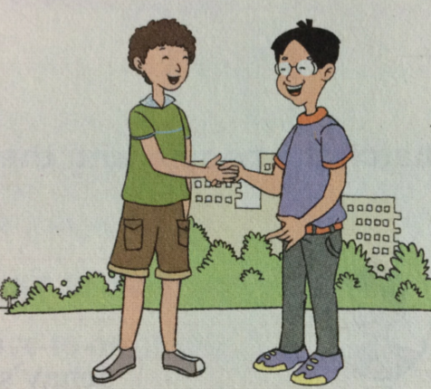
He is a visiting student in Li Ming's school.
a visiting student 一位访问生
visit v.参观，访问
visit sb./ places
visiting adj.参观的，访问的
visiting 是visit的现在分词
e.g. He is visiting Beijing now.
他现在正在参观北京。

Slide 14
Let v.让
Let +人称代词宾格
肯定句
Let sb. do sth. 让某人做某事 (祈使句)
否定句
Let sb. not do sth.不让某人做某事 (祈使句)

Slide 15
We play sports and have fun there.
sport n.运动
sports star n.体育明星
sports meeting n.运动会
play sports= do some sports 做运动

Slide 16
辨析 a, an, the
易混词语 | 用法辨析 | 典型例句
a | a用在单数名词之前，表示一类人或事物中“一个”，相当于汉语中的“一 ”，但不强调数目概念。a用在辅音音素开头的单词之前。 | This is a pen. 这是一支钢笔。
an | an也用在单数名词之前，表示一类人或事物中的“一个”，相当于汉语中的“一”，但是不强调数目概念。an 用在以元音音素开头的单词之前。 | This is an old man. 那是一位老人。
the | (1)特指说话双方都明白的人或物。 (2)上文提到过的人或物； (3)指世上独一无二的事物； (4)与单数名词连用表示一类事物； (5)与复数名词连用，指整个群体； (6)用在表示乐器的名词之前 | This is a book. The book is Jim's. 这是一本书， 这本书是吉姆的。

Slide 17
用a 或者 an 填空。
1. It's ______ old dress from my sister.
2. Mr. Green plans his lessons in_________ office.
3. This is _____ big lab.
4. We can have________ egg every day.
5. I see _______ apple on my desk.
an
the
a
an
an

Slide 18
Exercises
A
1．Welcome ________ Shanghai.
A．to B．at C．in D．too
2．This is ________ office.The teachers plan lessons in it.
A．a B．an C．not D．/
3．Let me show you ________.
A．around B．at C．in D．to
4．—Where can we get the books?
—From the ________.
A．lab B．playground
C．library D．classroom
5．We ________ in our classroom.
A．have lessons B．show around
C．play sports D．get books
B
A
C
A

