Slide 1
冀教版七年级上册

Slide 2
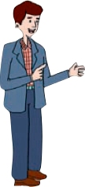
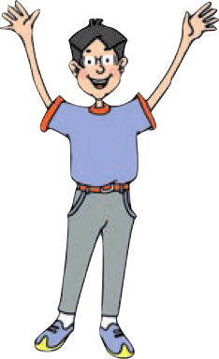
Unit 1
School and Friends

Slide 3
Lesson 4 What Is It?
重点单词：
1.eraser 橡皮
2.first 第一；首先
3. guess 猜测
4．wall 墙
重点短语：
5.play a guessing game 玩猜谜游戏
6.It’s one’s turn to do sth.现在轮到某人做某事了。
7.on the wall 在墙上
8.first of all 首先；第一
9.go first 先来、先说、先请、先走

Slide 4
1.eraser n. 橡皮
____ eraser
an
—What's that in English?
—It's ________ eraser.
A．a B．an C．the D．/
B

Slide 5
2.first adv.&num. 首先
基数词是one
短语：
first of all 首先；第一
go first 先来、先说、先请、先走
Her sister is in the ______(one)photo.
first

Slide 6
3. guess 猜测
play a guessing game 玩猜谜游戏
guessing是guess的动名词，可以位于名词前作定语。
考向一
考向二
play games意为“做游戏”。
eg：I like playing games.
我喜欢做游戏。

Slide 7
Exercises
1.Let's ________ a game! A. play B．playing C．plays D．to play
2.It's fun to play__________(guess)games.
A
guessing

Slide 8
4.wall 墙
考向【易错点】
辨析on the wall和in the wall
易混短语 | 用法辨析 | 例句
on the wall | 意为“在墙上”，常指图画、地图、黑板等在墙上 | There is a beautiful picture on the wall. 墙上有一张漂亮的图画。
in the wall | 也指“在墙上”，但强调在墙的里面，常指洞、窗户、门等在墙上 | There is a hole in the wall.墙上有一个洞。(洞在墙的里面)
Look! Some pictures are ________ the wall.
A．in B．on C．to D．at
B

Slide 9
5.It’s one’s turn to do sth. 现在轮到某人做某事了。
考向
It’s one’s turn to do sth. now. 现在轮到某人做某事了。one’s指形容词性物主代词或名词所有格形式。
eg：It’s your turn to read English now.
现在轮到你读英语了。
It’s Li Ming’s turn to play a guessing game now.
现在轮到李明玩猜谜游戏了。
It's ________ turn ________ now. A.you; read B.your; read C.your; to read D.you; to read
C

Slide 10
文章讲解
Class，let’s play a guessing game. Li Ming，you go first.
Li Ming：It’s long and thin.
What is it？
Can you guess？
Wang Mei：Is it a ruler？
Li Ming：No，it isn’t.
You can write with it.
Wang Mei：A pencil？
Li Ming：Yes，you are right！
Now it’s your turn.

Slide 11
Wang Mei：It’s big and black.
It’s on the wall.
What is it？
Li Ming：It’s a blackboard！
Wang Mei：Very good！

Slide 12
1. You can write with it.
with“和...一起 / 用 / 伴随带有”
考向【易错点】
辨析with,in,by
使用 | 用法辨析 | 例句
with | 表示使用有形的工具时，通常用with来表示 | 用钢笔写 write with a pen
in | in+语言 | in English
by | 表示采用某种方式或手段时，用by表示。 | 用手工制造 make by hand

Slide 13
2. --What is it？
--It’s a blackboard！
blackboard （C）n. 黑板
blackboards
There are two ____________(blackboard) in our classroom.
What is it?= What's this?
回答用It's... .
this, that 问， it来回答

Slide 14
Exercises
1．—What's this in English?
—________.
A．It's a pen B．It's your book
C．It's four D．It's yellow
2．—Is this a ruler?
—________. It's a pencil.
A．Yes, it is B．Yes, this is
C．No, it isn't D．No, that isn't
A
C

Slide 15
Exercises
一、根据首字母或汉语提示填空
1.Your ________(橡皮) is over there, under the computer.
2.The little boy likes drawing pictures___________(在墙上)．
3.The mouse(老鼠) ran into a small hole(洞) ___________(在墙上)．
4.Let's play a g________ game.
5.It's your t_____ to clean(收拾，清扫) after the meal.
eraser
on the wall
in the wall
uessing
urn

Slide 16
二、单项选择
6．The blackboard is________the wall.
A．in B．at C．on D．To
7．Not many people can write ________ their left hands.
A．in B．at C．on D．with
8．You can ________ books from the library.
A. get B. getting C. gets D. to get
9．—________ you go and buy some crayons?
—Sorry, I can't.
A．Do B．Are C．Can D．Must
10．Now it is________turn to sing.
A．my B．you C．I D．he
C
D
A
C
A

Slide 17
综合练习
L3-4

Slide 18
综合题L3-4
1．This is ________ office. It's near our classroom.
A．a B．an C．the D．/
2．Welcome ________ Yuhua Middle School.
A．at B．in C．to D．/
3．We have our science lessons in the ________.
A．lab B．library C．playground D．office
4． ______ favorite ping­pong player (运动员) is Ma Long.
A．We B．Our C．I D．Me
5．Let's ________ and have a look!
A．go B．goes C．going D．to go
B
C
A
B
A

Slide 19
综合题L3-4
6．Millie's ________ is very good. She is a good student.
A．plan B．plans C．is plan D．is planning
7．—Can you ________ the visitors ________ your school?
—Of course I can.
A．showing; to B．show; for C．showing; in D．show; around
8．My ________ name is Guo Ping. We are in the same school.
A．friend B．friends C．friend's D．friends'
9．What ________ that, Li Ming?
A．am B．is C．are D．be
10.The students ________ after school on the playground.
They have fun there.
A．have classes B．get books C．plan lessons D．play sports
A
D
A
B
D

Slide 20
综合题L3-4
11．Let's ________ a game!
A．play B．playing
C．plays D．to play
12．—Is this a ruler?
—________. It's a pencil.
A．Yes, it is B．Yes, this is
C．No, it isn't D．No, that isn't
13．It's ________ turn ________ now.
A．you; read B．your; read
C．your; to read D．you; to read
14．—What's this in English?
—________.
A．It's a pen B．It's your book
C．It's four D．It's yellow
A
C
C
A

Slide 21
综合题L3-4
15．Jim is in the classroom.(改为一般疑问句)
________ Jim ________ the classroom?
16．That's a library．(对画线部分提问)
________ that?
17．Tom is here.(改为否定句)
Tom ________ ________.
18．We can get some books from the library．(对画线部分提问)
________ ________ you get any books?
Is
in
What's
isn't here
Where can

Slide 22
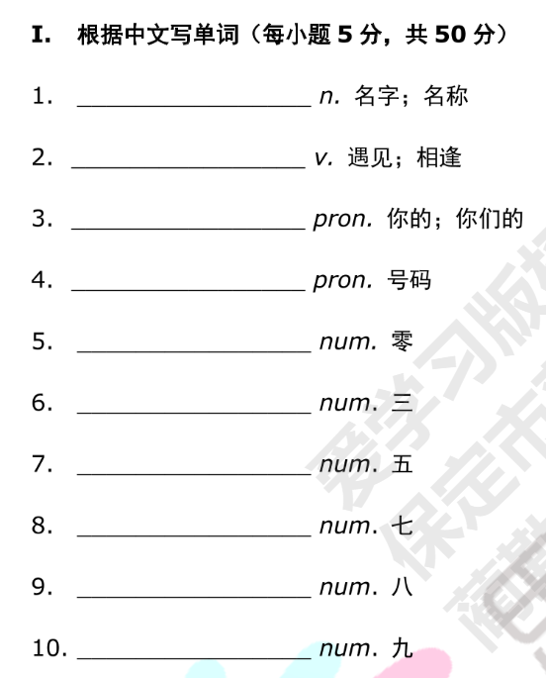
课堂落实P3-4
name
meet
your
number
zero
three
five
seven
eight
nine

Slide 23
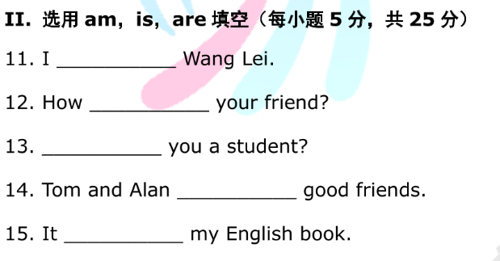
am
is
Are
are
is

Slide 24
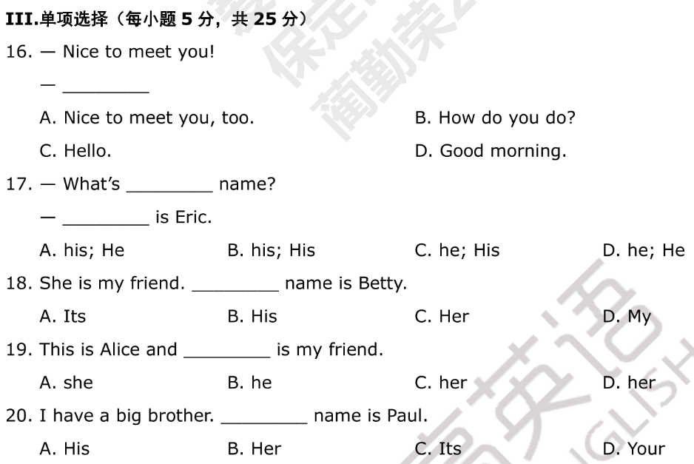
A
A
C
A
A

