Slide 1
Unit 1
Me and My Class
Lesson 2
Many Faces, One Picture

Slide 2
Li Ming and Wang Mei are looking at their photos for the class picture.
Li Ming: That's a good picture of you, Wang Mei. You are wearing traditional clothes. You look like a dancer.
Wang Mei: Thank you, Li Ming. That's a picture of me from our Spring Festival show. Remember? You played the erhu, and I performed ❶ a dance. May I see your picture?
Li Ming: Sure. I have two pictures. Which one should I use? What do you think?
Wang Mei: Hmm... I like this one. You are wearing a red jacket and you are planting trees.
Li Ming: Danny likes the picture of me on the ca­mel. He advised ❷ me to choose that one.
Wang Mei: I like the colour in the first picture，but it's up to ❸ you.
Li Ming：I agree ❹ with you. Thanks! Let's glue❺ our pictures on the big paper. Then we can write some sentences to describe the pictures.

Slide 3
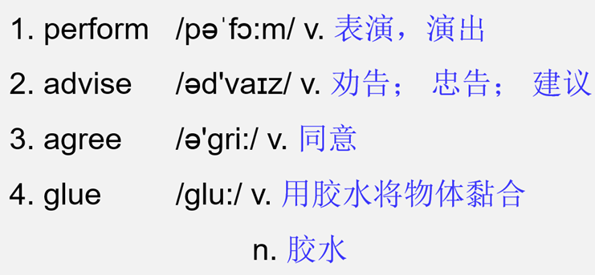
Word list
1. advise sb. to do sth.
建议某人做某事
2. agree with 同意某人
3. be up to... 由...决定

Slide 4
单词讲解
perform /pəˈfɔːm/ v. 表演，演出；表现
单词 1
考向
performer n. 表演者，演员
performance n. 表演，演出；表现

Slide 5
Practice
典例
用所给单词的正确形式填空
Today is the Art Festival of our school. Look! Our classmates are giving a _____________ (perform) on the stage(舞台).
performance

Slide 6
单词 2
advise/əd'vaɪz/ v.劝告；忠告；建议
考向
“建议某人做某事”可用advise sb. to do sth.
“建议某人不要做某事”用advise sb. not to do sth.
advise对应的名词为advice，为不可数名词，
如要表达“一条建议”，应为“a piece of advice”。
eg：He advised me not to do that.
他建议我别那么做。
I want to get some advice about my job.
我想要获得一些关于我工作的建议。
What good advice！
好棒的建议！

Slide 7
Practice
典例
1. Peter advises his cousin ______ early and run ten miles every day.
A．get up B．to get up C．gets up D．getting up
2. --Could you give some ______ on how to learn English well?
--Sure. Practice makes perfect.
A．advice B．advices C．advise D．advises
B
A

Slide 8
单词 3
agree /ə'ɡriː/ v.同意
考向一
agree的常见用法： 1. agree with sb. 同意某人。
考向二
2. agree to do sth.同意做某事。
eg：He agreed with them about the need for change.
他同意他们需要变革的意见。
eg：His friends agreed to help him.
他的朋友们同意帮助他。

Slide 9
Practice
典例
Ⅰ. 根据句意及所给提示填空。
1. My teacher a________ me to join an English club last year.
Ⅱ.单项选择。
2. —Everyone should do something for our country.
—I agree ________ you.
A. to B. on C. at D. with
greed
D

Slide 10
glue /ɡluː/ v. 用胶水将物体黏合
单词 4
n. 胶水
glue sth. on sth. 把某物黏到某物上。
Ⅰ. 根据句意及所给提示填空。
Let's g________ the photo on the big paper.
典例
lue
咱们把这照片粘在那个大纸上。

Slide 11
短语讲解
短语 1
advise sb. to do sth. 建议某人做某事
短语 2
agree with sb. 同意某人
短语 3
be up to... 由……决定
eg：Whether we will go to the park is up to your brother.
我们是否去公园由你哥哥定。

Slide 12
Practice
典例
单项选择。
1． —When shall we go shopping?
—________ I'm free all these days.
A. Good idea.
B. Why not?
C. Sounds great.
D. It's up to you.
D
由你定

Slide 13
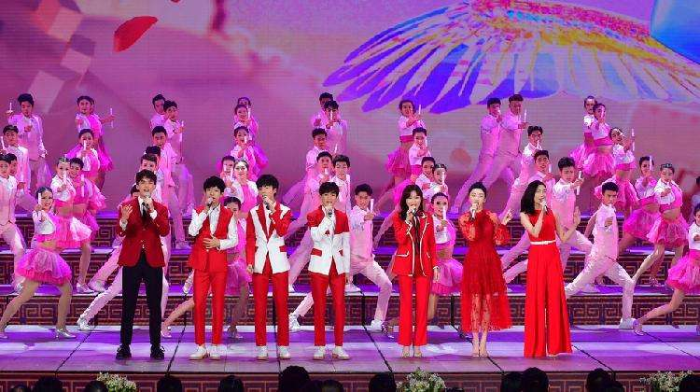
课文讲解
句子 1
That's a picture of me from our Spring Festival show.
那是一张我来自春晚的照片。
考向
from prep. 来自

Slide 14
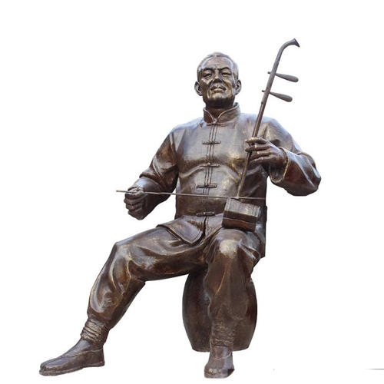
课文讲解
句子 2
You played the erhu, and I performed a dance.
你拉二胡，我表演跳舞。
考向
play the erhu
乐器前要加the.
C
Piano is _____ instrument. Langlang can play ______ piano well.
A. a; the B. a; / C. an; the D. an; /

Slide 15
课文讲解
句子 3
I like the colour in the first picture.
我喜欢第一幅图里的颜色。
first 第一 （序数词）
考向
(2018河北,75) In the_____ (one) class, Mr. Du came in and asked
me to go to the front.
2. (2017河北,73) My friend Sam is in the______ (ten) grade.
3. Tomorrow is my ________ (twelve) birthday.
first
tenth
twelfth

Slide 16
Summary
L1
physics, recent
one....the other..., introduce...to..., be the same as
L2
perform, advise, agree, glue
advise sb. to do sth., agree with, be up to...

Slide 17
PracticeL1&L2
B
1．In Chinese class, our teacher introduced Mo Yan ________ us.
A．for B．to C．with D．at
2．My family has two dogs. One is white, and ________ is black.
A．other B．another C．the other D．others
3．She says her favorite ________ is English.
A．color B．sport C．subject
4．—What are you doing?
—I'm ________ my basketball, but I can't ________ it.
A．looking for; find B．finding; find out
C．looking; find out D．finding out; look for
C
C
A

Slide 18
B
5．My sister is ________ a lovely girl. We all like her.
A．so B．such C．too D．very
6．The movie Zootopia is ________ .I'm ________ in it.
A．excited; interested B．exciting; interesting
C．exciting; interested D．excited; interesting
7．If he comes tomorrow, I ________ you.
A．tell B．have told C．am telling D．will tell
8．—Next week I'll join in the oral English competition.
—________
A．Have a nice day! B．No problem!
C．Good luck to you! D．Not too bad!
9．—________do you like this new school?
—It is nice and big.The teachers and classmates are friendly.
A．What B．How C．When D．Who
C
D
C
how do you like...?
=What do you think of...?
B

Slide 19
二、用所给词的适当形式填空
11．What about ____________ (practice) swimming this
summer vacation？
12．We Chinese are happy ________ (hear) the good news.
13．It's too hard for me to learn it. Can you show me how
________ (throw) the ball?
14．Don't worry, Mum. I can look after ________ (I)．
15．I like my ________ (one) day of the new term.
practicing
to hear
特殊疑问词+to do 不定式
做宾语
to throw
myself
first

Slide 20
B
1. Your toys are cool . I'd like to buy _______ for my cousin.
A．it B．one C．this D．that
2. Look! It's a picture ________ my family.
A．of B．on C．after D．with
3. Let's ________ a picnic. It's a fine day.
A．have B．to have C．has D．Having
4. Tony, remember ________ with your mouth full of food.
A．to talk B．not to talk C．talking
A
A
B

Slide 21
B
5．—That mountain in Guilin ________ an elephant.
—So it does.
A．looks up B．looks like C．looks for D．looks after
6. We ________ be more careful, or we will make the same mistake in the experiment.
A．might B．can C．may D．should
7. —What do you think of the house, dear?
— ________ I can't find a better one.
A．Too bad. B．Too expensive.
C．Good idea! D．Pretty good!
8．Anna ________ a red dress. She looks more beautiful.
A．wear B．wore C．is wearing D．will wear
确实如此
D
D
C

Slide 22
根据短文内容，补全文中单词或用所给单词的正确形式填空。
Today is the Art Festival of our school. Look! Our classmates are ________21 (perform) a dance on the stage (舞台). I plan to take ________22 (photo) of them. And then g________23 them on the wall of our classroom. I am going to advise my classmates ________24 (write) some sentences about the pictures. Do you a________25 with me? I think it's a good idea.
performing
photos
lue
to write
gree

Slide 23
Ⅲ.连词成句。
11．again, nice, you, meet，to
_______________________________________________.
12．question, asks, me, he, a
_______________________________________________.
13．those, pictures, I, like
_______________________________________________.
14．you, did, last year, have a trip
_______________________________________________?
15．have, exciting, I, talk, Jenny, with, an
_______________________________________________.
Nice to meet you again
He asks me a question
I like those pictures
Did you have a trip last year
I have an exciting talk with Jenny

Slide 24
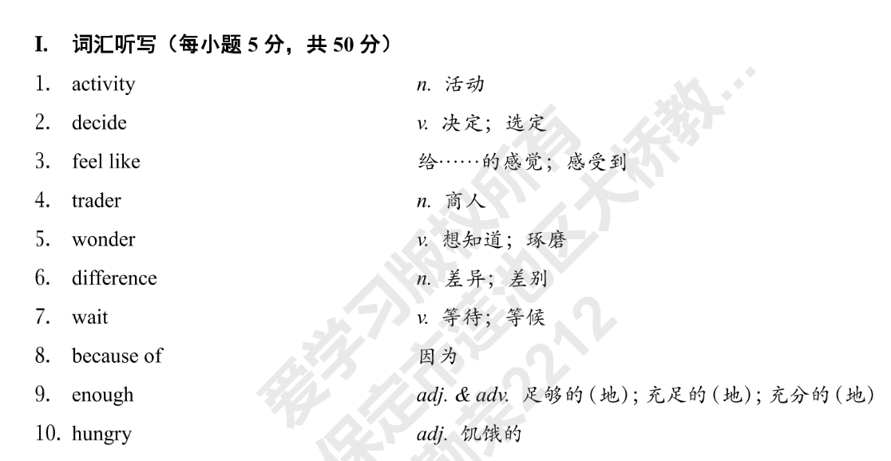
课堂落实P3-4

Slide 25
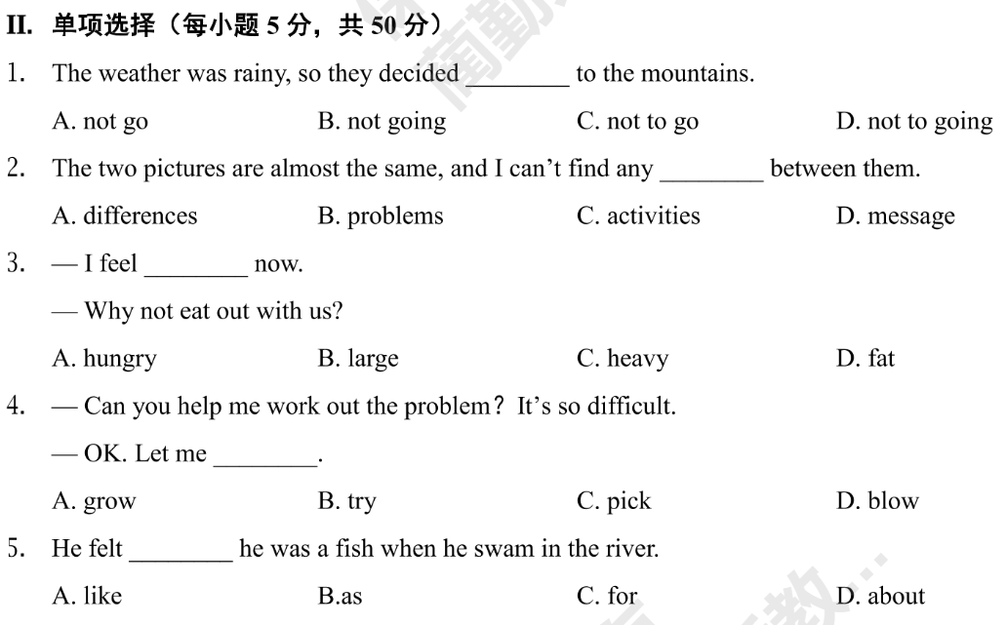
C
A
A
B
A

Slide 26
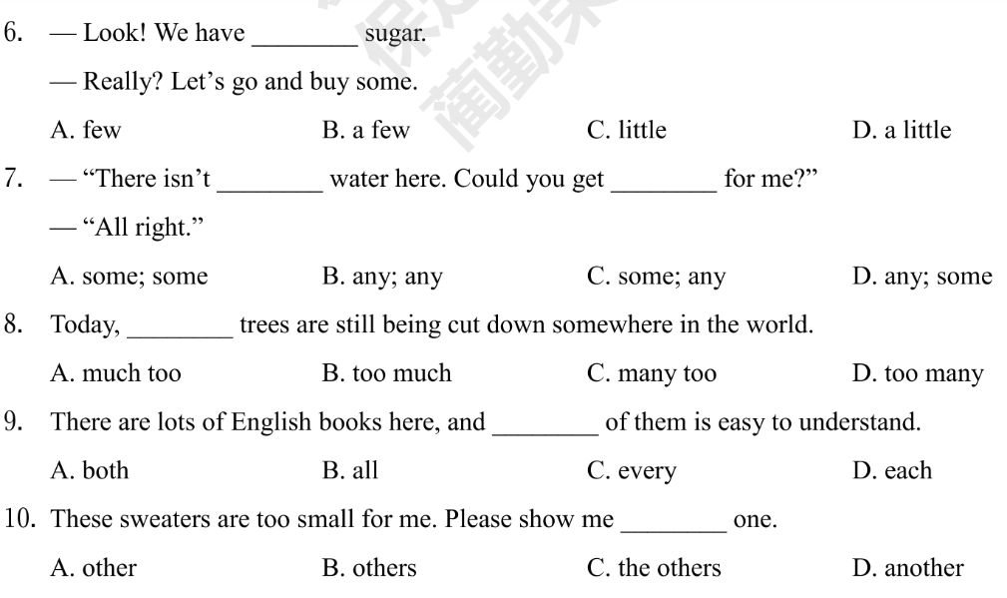
C
D
D
D
D

Slide 27
自我巩固—单选P9
1. --My favourite ___is Animal World. What about you?
--I like CCTV News best.
A. movie B. subject C. sport D. program
2. It is healthy to eat when you are hungry and to stop when you are _____.
A. full B. busy C. young D. free
3. He has dance lessons ________.
A. once two week B. once a week C. two a week D. three a week
4. Peter exercises _____three times a week ,sometimes six times .
A. at most B. at first C. at least D. at last
D
A
B
C

Slide 28
B
5. Vince is interested in sports, ____volleyball, soccer and basketball.
A. hardly ever B. such as C. because of D.at least
6. --Do you like eating junk food ,Jack?
--No,I ______eat it. It's bad for our health.
A. often B. always C. sometimes D. hardly ever
7. --____do you do in the evening?
--I do my homework or watch TV.
A. What B. When C. Where D. Why
8. My uncle_____every day, but yesterday he _____.
A. exercises; doesn't B. exercises; didn’t
C. exercised; doesn't D. exercised; didn't
D
A
B

Slide 29
A
9. --_______?
--Twice a week.
A. How often do you use the Internet? B. How do you like the Internet?
C. What time do you use the Internet? D. What do you usually do on the Internet?
10. --What does Cindy usually do after school?
--__________.
A. She has piano lessons on Monday B. Her favourite sport is swimming
C. She usually goes swimming D. She thinks it's interesting
C

Slide 30
Thank you!

