Slide 1
冀教版七年级上册
U1 L1-2

Slide 2
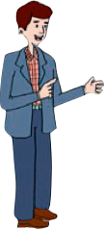
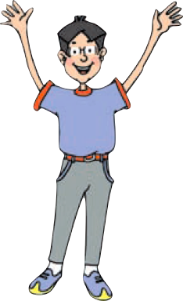
Unit 1
School and Friends

Slide 3
Lesson 1 Hello!
重点单词：
Canada 加拿大
thanks 谢谢
重点短语：
be from… 来自
What's your name ? 你叫什么名字?
My name is .../ I'm... 我的名字是.../ 我是...
How are you ? 你好吗？
I'm fine . And you ? 我很好，你呢？
Nice to meet you ,too. 遇见你也很开心。

Slide 4
1.Canada n. 加拿大
Canadian n. 加拿大人
adj.加拿大的
根据首字母或汉语提示填空
1．Mike is from________(加拿大)．
Canada

Slide 5
2.thanks n. 谢谢
1.Thanks. = Thank you.
2.Thanks for +n./doing sth. 因某事而感谢某人
3.回答：You are welcome.
B
1.Thank you for______the window.
A.open B.opening C.openning
2.----Thank you . ----You are ______ . A. not thank B.welcome C.welcomes
B

Slide 6
3.be from… 来自
be from=come from
eg：J.K.Rowling is from the U. K.＝
J.K.Rowling comes from the U. K.
J·K·罗琳来自英国。

Slide 7
单项选择
1．Mo Yan is________China.
A．to B．from C．on D．/
B
2.----Where ____you from ?
----I’m from Canada.
A. are B.do C. is
A

Slide 8
4.-What's your name ? -My name is .../ I'm...
询问对方的名字，What is your/his/her name?
My/His/Her name is...
I am.../ She/He is...

Slide 9
辨析you和your
 | 词义 | 词性 | 用法 | 例句
you | 你/你们 | 人称 代词 | 可单独用作主语或宾语 | You are from China.你来自中国。(主语) Nice to meet you.很高兴见到你。(宾语)
your | 你的/ 你们的 | 形容词性物主代词 | 后加名词 | What’s your name？ 你叫什么名字？

Slide 10
1．My name is Jenny.(改为同义句)
_______________________________________
2．Her name is Anne．(对画线部分提问)
________ _____ ________ name?
I am Jenny.
What is her
3．—Hi! What's________English name?
—Hi! My English name is Mary.
A．your B．you C．my D．I
A

Slide 11
5.-How are you ? -I'm fine . And you ?
How + be + 主语 ？ (be的选择要看后面的主语)
1．He is fine.(对画线部分提问)
________ ________ he?
2. How ______their parents ? - Well, thank you .(be)
How is
are

Slide 12
6. -Nice to meet you -Nice to meet you ,too .
—Nice to meet you.—________
A．Fine，thank you.
B．How do you do?
C．Nice to meet you，too.
D．The same to you.
C
too 也
I like English, too.

Slide 13
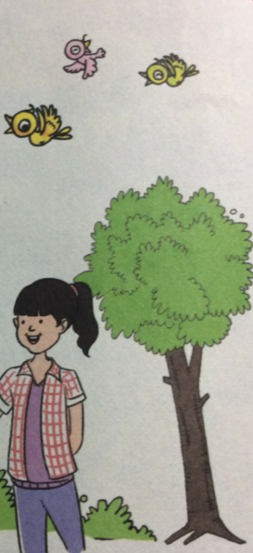
1. Hello!
Hello，I’m Li Ming！I’m from China.
Hello，I’m Jenny! I’m from Canada.
Hello，I’m Danny！I’m from Canada，too.
2. How are you?
Li Ming：Hello，I’m Li Ming！What’s your name？
Wang Mei：Hi！My name is Wang Mei.
Li Ming：How are you？
Wang Mei：I’m fine . And you?
Li Ming：I’m good，thanks . Nice to meet you.
Wang Mei：Nice to meet you，too.

Slide 14
Lesson 2 Teacher and Students
重点单词：
重点短语：
1.student n.学生
1.Good morning. 早上好
2.four num.四
2.over there 在那里
3.five num.五
4.over adv.在那边；
在另一处
3.homeroom teacher
指导教师
5.homeroom n.年级教室
6.classmate n.同班同学

Slide 15
1.over adv.在那边；在另一处
e.g.Bob is standing over there.
over there 在那边
1.The man o______ there is Mr. Wang.
2.is there my over boss (连词成句)
______________________________.
ver
My boss is over there.

Slide 16
2.Good morning. 早上好
Good afternoon. 下午好
in the +早/午/晚
Good evening. 晚上好
at noon 在中午
Good night. 晚安
at night 在夜晚
例题：
—Good morning！
— _______
A.How are you? B.Good morning!
C.Good afternoon! D.Good evening!
B

Slide 17
Article
1.This is my friend.
Li Ming：Good morning，Wang Mei.
Wang Mei：Good morning，Li Ming.
Li Ming：Wang Mei，this is my friend . His name is Yang Hao .
He's in Class Four.
Wang Mei：Nice to meet you，Yang Hao .
Yang Hao ：Nice to meet you，too.
Wang Mei：This is my friend，Li Lin. She’s in Class Five.
Yang Hao ：Nice to meet you，Li Lin.
Li Lin：Nice to meet you，too.

Slide 18
1.This is my friend.
This is ... 这是...
介绍近处的人或物时常用此句式.
eg：Jenny，this is my friend. 詹妮，这是我的朋友.
Good morning,class.____is our new student,Lily.
A. This B.That C.She D.He
A

Slide 19
2.He's in Class Four.
in+班级，年级
I am in Class Two，Grade Three.
Class+数字 (英语首字母大写)
Class 6=Class Six
eg：I’m in Class 2，Grade 7.
-What class is Jenny in?-She is in_______.
A. Grade Seven, class three B. Grade Seven, Class three C. grade seven, class three D. Class Three, Grade Seven
D

Slide 20
2.What's her name？
Danny：Jenny，who's the man over there？
Jenny：He's Mr. Jones—our homeroom teacher.
Danny：And who's the girl with Mr. Jones？
What's her name？
Jenny：Her name is Kate.
,Danny：Is she a student？
Jenny：Yes. She's our classmate.

Slide 21
3.Who's the man over there?
who 谁 对人提问
who is +单数
who are +复数
e.g.Who is that girl?
e.g.Who are they?
-_______ is that man in the black shirt? -He is my teacher. A. Where B.What C.Who D.How
C

Slide 22
4.Who's the girl with Mr. Jones?
with 和
play with 和...一起玩
talk with 和...谈话
be with sb. 和...在一起
with 有
e.g.The boy with short curly hair is handsome.
with 用
e.g.We can eat with our mouth.
You see, Kevin is writing ______his left hand. A. at B.as C.for D.with
D

Slide 23
Grammar
He's in Class Four.
His name is Yang Hao.
She's our classmate.
Her name is Kate.
句首用主格；翻译不带“的”
形物代+名词；翻译带“的”
 | 单数 |  |  | 复数
 | 第一人称 | 第二人称 | 第三人称 | 第一人称 | 第二人称 | 第三 人称
主格人称代词
形物代
I
you
he/she/it
we
you
they
my
your
his/her/its
our
your
their

Slide 24
例题：
1. ____ name is Betty. A. She B.You C.My D.I 2.-Are you Mike? -_________ A. Yes, I’m not B.No, he isn’t C.Yes, I am D.No, he is
3. His name is Tom.(改为同义句) ______ ______ Tom.
C
C
He is

Slide 25
1.My friend ____Shijiazhuang.
A.is from B.are from C.come from D.comes in
2.I am from Hebei.(改为一般疑问句)
_____ _____ from Hebei?
3.I am good.(划线部分提问)
_____ are you?
4. ____ name is Betty.
A.She B.You C.My D.I
5.-Are you Mike? -_________
A.Yes, I’m not B.No, he isn’t C.Yes, I am D.No, he is
B
Are you
How
C
C

Slide 26
6.-_______is her name? -Jane.
A.Who B.How C.Where D.What
7.-_______ is that man in the black shirt? -He is my teacher.
A.Where B.What C.Who D.How
8. Bob is standing o_____ there.
9.His name is Tom.(改为同义句)
______ ______ Tom.
D
C
ver
He is

