Slide 1

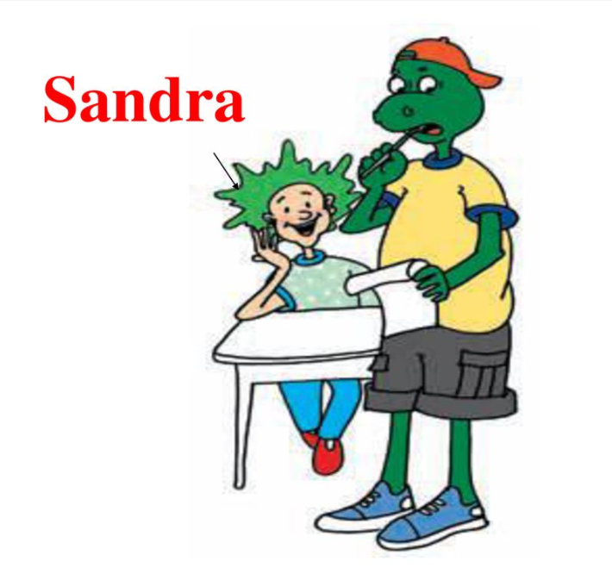
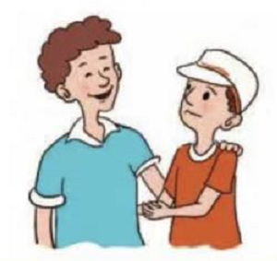
Lesson 4
Best Friends
Patrick
Grant

Slide 2
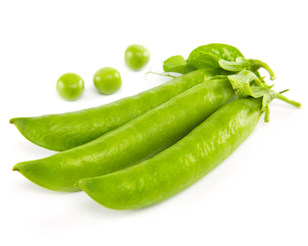
pod
pea
Patrick and Grant are best friends. They are like __two peas in a pod.

Slide 3
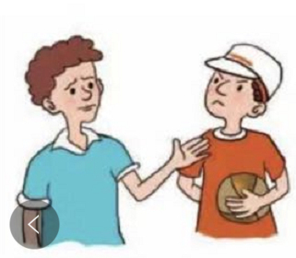


One day
They stopped talking to each other.
Grant wanted to copy Patrick’ homework.
That way,he could spend more time playing
basketball.
copy v.抄写/复制
n. 复制品
to one’s surprise
让...感到惊奇的是
To his surprise, Patrick didn’t agree.

Slide 4
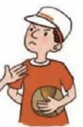
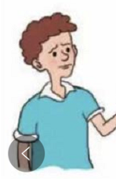
What a friend!
Grant said angrily.
lend v. 借出
cheat v./n.作弊
I won’t lend you my homework.
That’s cheating.

Slide 5
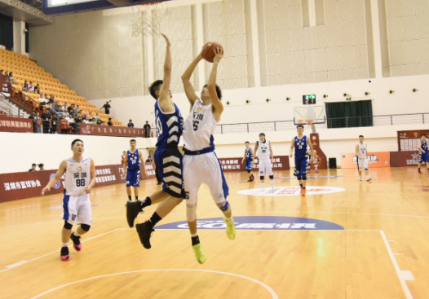
A few days later.
we could make a deal.We could do our own homework first and play basketball later.
gym n.体育馆
I want to be your friend，
not your enemy.
embarrassed
尴尬的，窘迫的
enemy n.敌人
deal n.交易
make a deal 达成交易
Grant felt embarrassed.

Slide 6
WordsWords
lend
cheat
following
gym
embarrassed
enemy
deal
n. 豌豆
pea
pod
copy
surprise
angrily
v. 借给，借出
n. 豆荚
v&n 欺骗；作弊
v.抄写，复制 n. 复制品
adj. 接着的，接下来的
n. 体育馆，健身房
n. 意想不到的事
v. 使惊奇
adj. 尴尬的
n. 敌人
adv. 愤怒地，生气地
n. 交易 v. 处理，应付

Slide 7
Self-learning 独学
Finish the following exercises by yourself(12min)
Task 1 ( E1, P9 )
Task 2 ( E2, P9)
Task 3 (Fill the blanks and retell it)
Task 4 (E4, P9)

Slide 8
Self-learning 独学
Finish the following exercises by yourself(12min)
Task 1 ( E1, P9 )
Task 2 ( E2, P9)
Task 3 (Fill the blanks and retell it)
Task 4 (E4, P9)
独学要求：坐姿端正、书写工整、注重质量

Slide 9
Group-learning 群学
1. Discuss Tasks1-4 and try to describe the pictures. If you find something wrong, you should correct them quickly.
2. Stand up straight and be serious.
3. Discussion time is 7 mins, and every group member should discuss.
4. Try to use more English properly.
展示要求 | 分值
发音标准 | 2分
表达流利 | 2分
仪态大方 | 2分
全面新颖 | 4分

Slide 10

Pre-reading
P9
Listen and number the sentences in the correct order.
1
1. They parted and went their own ways.
2. They stopped talking to each other.
3. The two boys saw each other at the
school gym.
4. Patrick and Grant are best friends. They
are like “two peas in a pod”.
5. They made a deal. They would do their homework first and play basketball later.
The correct order is: __________________
4, 2, 1, 3, 5

Slide 11

Read the lesson and answer the questions.
1. What did Grant like to play after class?
2. Why did the two boys stop talking to each other?
3. What made the two boys become friends again?
4. What agreement did the two boys make?
2
He liked to play basketball after class.
Because Patrick didn't lend his homework to Grant.
A school basketball game.
They would do their own homework first and play basketball later.

Slide 12
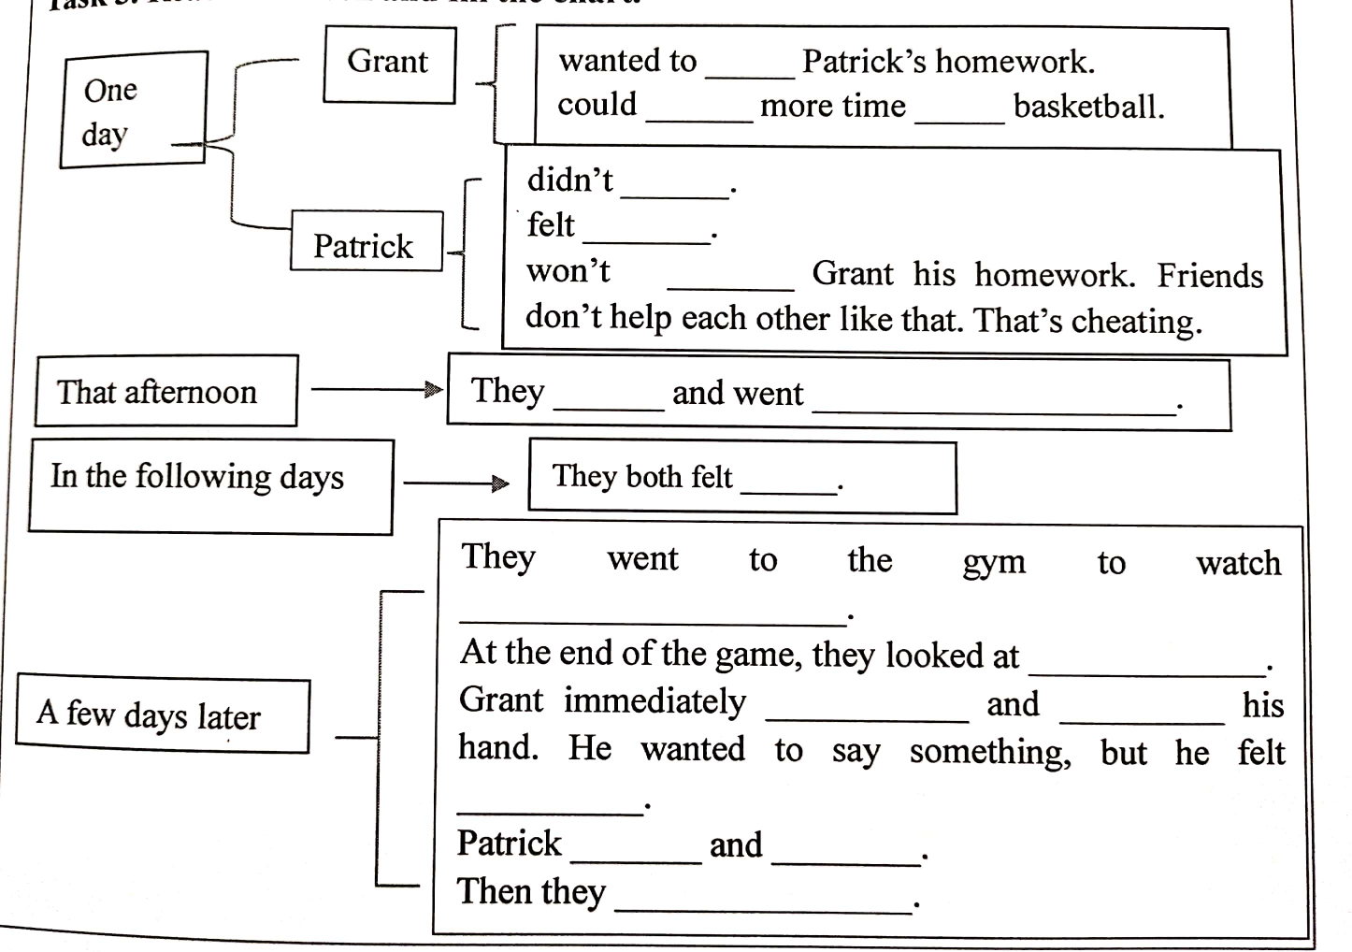
Task 3. Read the lesson and fill the chart.
copy
spend
playing
agree
awful
lend
parted
their own ways
bad
a school basketball game
each other
came over
held out
embarrassed
smiled
said
made a deal

Slide 14
Task4. In your opinion, what makes a best friend? Collect some sayings about friendship and share them with you partners.
A friend in need is indeed. 患难见真情
A friend is easier lost than found. 得朋友难，失朋友易
A friend to all is a friend to none. 滥交者无友
Friendship cannot stand always on one side.
来而不往者非礼也。
The best mirror is an old friend. 最好的镜子是老朋友。
Friendship the older it grows the stronger it is.
友谊地久天长

Slide 15
Summary
1.two peas in a pod 一个豆荚里的两粒豆子
2. to one’s surprise 让……感到惊奇的是
3.make a deal 达成协议
4.come over 过来
5. hold out 伸出
6.at the end of 在……末，在……尽头

Slide 16
2. One day, the two best friends stopped talking to each other.
有一天, 这对最好的朋友相互不再说话。
______________, boys and girls.
同学们, 别读了。
When I was cooking yesterday evening, someone knocked at the door. I ________________ the door.
昨天晚上我正在做饭，这时候有人敲门，我停下来去开门。
stop doing sth. “停止正在做的事”，
stop to do sth. “停下来做另一件事”
Stop reading
stopped to open

Slide 17
3. That way, he could spend more time playing basketball.
那样的话，他就有更多的时间打篮球。
He ________ 150 yuan _____ this dress.
他买这条连衣裙花了150元钱。
The children today _____too much time _______ TV.
如今的孩子们花费了太多的时间看电视。
He _______ two hours ______ _____ _____ every day.
他每天花两个小时拉小提琴。
spend “花费时间/金钱”
sb. spend ... on sth.
sb. spend ... (in) doing sth. 某人花费...做某事
spent on/buying
spend on/watching
spends
playing the violin

Slide 18
5. I won’t lend you my homework.
我不会借给你我的作业。
Can you lend me your dictionary?----用改写borrow
你能把字典借我用一下吗？
My brother lent me his bike yesterday. =My brother lent his bike to me yesterday.—用改写borrow
lend 借给(借出)
lend sb. sth.=lend sth. to sb. 借给某人某物
Can I borrow your dictionary ?
borrow 借进
borrow sb. sth.=borrow sth from sb借某人某物（借进）
I borrowed my brother his bike.

Slide 19
ACROSS
2. We _______ at the airport with good wishes for each other.
3. My bike is broken. Can you _____ me yours?
5. A joke never gains an _______, but loses a friend.
6. Hi Danny! ______ to meet you!
parted
lend
enemy
Glad

Slide 20

DOWN
hate
I _____rainy days!
4. I find my new ________ class very difficult!
7. The NBA players refused to play. They were hoping for a better _____.
physics
deal

