Slide 1
UNIT
1
Lesson 1 Back to School

Slide 2

New words
Sandra /ˈsændrə/ 桑德拉（人名）
Cox /kɒks/ 考克斯（姓氏）
physics /ˈfɪzɪks/ n. 物理学
recent /ˈriːsnt/ adj. 最近的；近代的
in recent years 在近几年
recently adv.

Slide 3
Leading in
THINK ABOUT IT
. How do you like the first day of a new term/school year?
· Do you have any new subjects?
. Do you think you will like them?

Slide 4

Task 1-Listening
Listen to the passage and repeat.(P2)
Listen to the passage and try to imitate(模仿) the pronuciation and intonation.

Slide 5
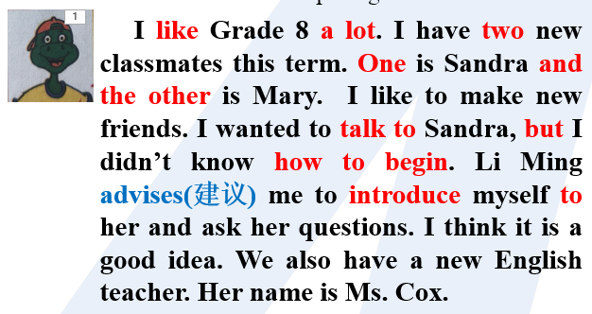
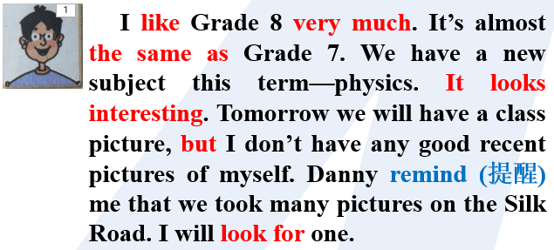
Self-learning 12mins
Task 2: Read the lesson and answer the questions.
Task 3: Role play:work in pairs.One is Li Ming, and the other is Danny.
Task 4: Read the following passages and then write a short passage.
Transitional words

Slide 6
Group-learning 7mins
Demands:
Task 2: Check answers in the group.
Task 3: Role play:You can choose 4 or 6 of your teammates to show.
Task 4: Show us your paragraph
Choose one or two of your teammates to show.

Slide 7
Task 2-Reading
Read the lesson and answer the questions.
1．How many new classmates does Danny have?
What are their names?
2．What advice does Li Ming give Danny on how to start a conversation with Sandra?
3．Li Ming has a new subject this year. What is it?
Two. They are Sandra and Mary.
He can introduce himself to her. He can also ask her questions.
Physics

Slide 8
Task 2-Reading
Read the lesson and answer the questions.?
4. What will Li Ming do to prepare for his class tomorrow? Why?
He will prepare some good recent pictures of himself.
Because they will make a class picture.

Slide 9
Task 3-having a role play
Role play show

Slide 10
Paragraph show
Today is my first day of this new term.I like Grade 8 a lot.I find a few changes between last term and this term.
What is new this term?
Are there any new students or teachers in your class? Introduce them.
Do you have any new subjects? What are they? What will you do to learn them well?
......
I am happy to go back to my school.....

Slide 11
Example：
Today is my first day of this new term. I like Grade 8 a lot. I find there are a few changes between last term and this term.
First of all,there are two new students in my class! One is Kevin, and the other is Louis. Kevin is hard-working,and Louis looks so cool. He looks like my idol Wang Yibo. What’s more,I have a new teacher, too. She is Lynn.She is friendly to us. At the same time, she is very strict with our study. Last but not least, I have a new subject this year：physics . I think physics is hard but helpful.
I am happy to go back to my school. I hope I can get along well with my classmates and my teacher.

Slide 12
概评 Language notes
1
I was happy to see my classmates after such a long holiday.
这么长的假期之后，再见到我的同学我很高兴。
主语+be +adj. + to do sth.
sb. be happy / sad /glad/sorry/surprised/to do sth.
我很高兴听到这位新冠肺炎患者康复了。
l'm glad to hear that the COVID-19 patient has recovered.
很抱歉让你久等了。
l'm sorry to keep you waiting for such a long time.

Slide 13
I was happy to see my classmates after such a long holiday.
2
such adj. 这样的；如此的;修饰名词
He is such a smart boy.
This is such an interesting story.
These are such interesting stories.
That is such good news.
so adv. 这样的；如此的;修饰形容词或副词
His speech was so exciting.
两种特殊情况：
He is such a smart boy.= He is so smart a boy.
There are so many interesting books.
当名词前有many，much，little （少）few 等词修饰时，用so ，不能用such.

Slide 14
such | 修饰（ ） | such+a/an+形容词+可数名词单数 | 一部如此有趣的电影
 |  | such+形容词+可数名词复数/不可数名词 | 如此有用的书
so | 修饰( )或（ ） | so+形容词+a/an+可数名词单数 | 一个如此聪明的男孩
 |  | So+形容词/副词 | 如此干净 学习如此努力
 |  | So+many/few+可数名词复数 So+much/little（少）+不可数名词 | 如此多的苹果 这么少的钱

Slide 15
3
I have two new classmates this term.
One is Sandra and the other is Mary.
one ...the other... (两者中)一个...另一个
I like two writers very much. One is Lu Xun and the other is Mo Yan.
He has two pets. One is a dog, the other is a cat.
another 另一又一（指三者或三者以上中的另一个）
I don’t like this donut, can have another one.
another two days=two more days

Slide 16
4
You can introduce yourself to her.
introduce A to B 把 A 介绍给 B
introduce oneself 自我介绍
让我向你自我介绍一下。
Let me introduce myself to you.
你能把你朋友介绍给我吗?
Can you introduce your friend to me?
首先你可以自我介绍一下。
You can introduce yourself first.

Slide 17
5
I wanted to talk to Sandra, but I didn't know how to begin. 我想和桑德拉说话，但我不知道如何开口。
【用法详解】how to begin属于"特殊疑问词+动词不定式"结构,在句中作know的宾语“特殊疑问词(why除外) +动词不定式"结构在句中可以作know，tell, wonder, ask, learn等动词的宾语,也可以作主语或表语。
我想知道
I wonder ______ to solve the problem.（如何解决这个问题）
I wonder ______ to solve the problem.（什么时候去解决这个问题）
I wonder ______ to solve the problem.（去哪里解决这个问题）
I wonder ______ to solve the problem.（谁来解决这个问题）
how
when
where
who

Slide 18
Summary：
1.做...很高兴
2.这么长的假期
3.这么多有趣的书
4.一个...另一个...
5.再两天
6.介绍自己给...
7.我不知道如何开始
8.结交新朋友
be happy to ...
such a long holiday
so many interesing books.
one...the other...
another two days=two more days
introduce onself to ...
I didn’t know how to begin.
make new friends

Slide 19

检改：
Task 1 Fill in the blanks with the words or phrase in the box.
When you have trouble finding answers to questions on your own,there are a few things you can do. You can________ your teacher or your classmates for help. You can also ________ books from the library. If you can't find the answers in a book, you can________ the answers on the Internet. These days you can search the web for almost everything.You are sure to find a website that can ________ you the answers you need.
ask
borrow
look for
give

Slide 20
LOVE
Thank you!
Have a nice day!

Slide 21
Leading
THINK ABOUT IT
. How do you like the first day of a new term/school year?
· Do you have any new subjects?
. Do you think you will like them?
physics

