Slide 1
Unit 8 Celebrating Me!
Lesson 47: I Made It!
冀教版八年级上册Lesson47

Slide 2
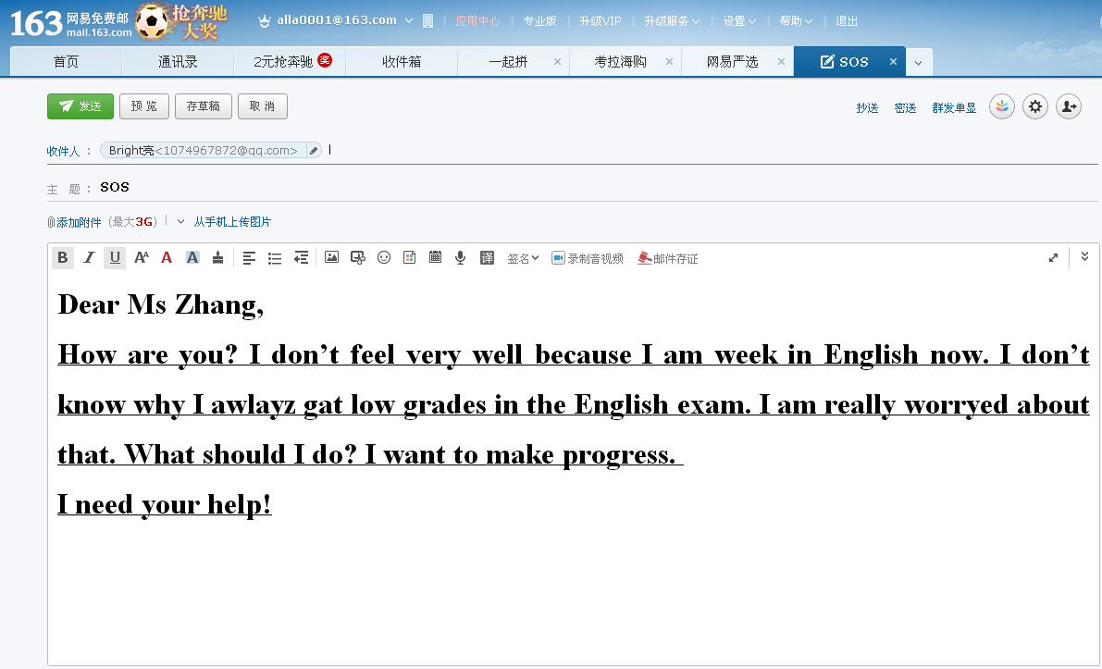

Slide 3
What is his problem?
Dear Ms Zhang,
How are you? I don’t feel very well because I am week in English now. I don’t know why I awlayz gat low grades in the English exam. I am really worryed about that. What should I do? I want to make progress.
I need your help!
weak
Spelling mistakes(misspelled words)
always
get
worried
misspelled adj. 拼错的
[mɪs’speld]

Slide 4
Can you get it?
understand ---------- misunderstand
理解 误解
fortune ---------- misfortune
运气 不幸
spell ---------- misspell
拼写
拼错
misspelled adj.
[mɪs’speld]
拼错的

Slide 5
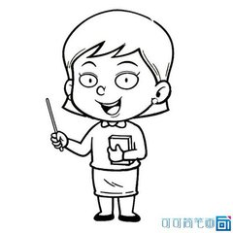
Do you make spelling mistakes?
What should you do to make fewer mistakes?

Slide 6
Lesson 47: I Made It!

Slide 7
New Words
loser /'lu:zə/
fail /feɪl/
misspelled /mɪs'speld/
accept /ək'sept/
award /ə'wɔrd/
n. 失败者；输者
v. 失败，不及格
adj.拼错的（misspell的过去式）
v. 接受；承认
n. 奖品

Slide 8
Knowledge Links
SKIMMING :Read the title, the first and the last paragraph

Slide 9
How to skim
The first paragraph
The last paragraph
The title
Prediction: What is the story about?

Slide 10
What is the story about?
It is about a boy named Peter. At first, he thought he was a loser in English. But at last, he made much progress.
loser

Slide 11
Can you get it?
farm + er =farmer
work + er =worker
lose + er =loser
失败者；输者
[lu:zə(r)]

Slide 12
Can you get it?
“I just failed my English exam,”replied Peter.
If you don’ t work hard, you may fail.
He failed to catch the bus.
[feɪl]
没做成某事
不及格
失败
---failure n.失败 Failure is the mother of success.
[’feɪljə(r)]

Slide 13
Can you get it?
[ək’sept]
I received his invitation, but I could not accept it.
Because I was busy those days.
v. 接受

Slide 14
02
Basic Sense

Slide 15
Why
His spelling was perfect.
Because he just failed his English exam.
How was Peter’s spelling at last?
Why did Peter look sad?
How
Who
fail
He worked very hard, both by himself and with Krista.
？
What did Peter do after accepting the challenge?
?
Krista helped him.
accept
Who helped Peter?
What
What
The Top 500 Often Misspelled Words.
What book did Peter receive?
Where did Peter come from?
He came from Mexico.
Where
Misspelled

Slide 16
03
Overcome
Difficulties

Slide 17
Why did Peter make spelling mistakes?
How did Peter improve his spelling?
What do you think of Peter?

Slide 18
At first
Why did Peter make spelling mistakes?
What do you think of Peter?
http://home.rapidbbs.cn/?fromuid=22138
Because English was not
his____________.
Because he.…
He was careless.
He was not confident…
first language

Slide 19
Later
How did Peter improve his spelling?
What do you think of Peter?
http://home.rapidbbs.cn/?fromuid=22138
With Krista’s help.
He worked very hard.
He didn’t give up…
He was careful.
He was hard-working.
He was confident…

Slide 20
Translation:
award
She presented many awards that day, but she was most excited to present one very special award: the Most-Improved Student Award.
present
她那天颁发了很多奖， 但是最令她兴奋的是颁发了一个特别奖——最大进步奖。

Slide 21
Can you get it?
They presented the heroes with many flowers.
How many people were present at the meeting.
I always get a present on my birthday.
[prɪ’zent]
[’preznt]
[’preznt]
n. 礼物
v. 颁发；授予
adj. 出席的；在场的

Slide 22
Can you get it?
award
奖状；奖品
The Most-Improved Student Award

Slide 23
Exploration
good will(意愿)
He failed and felt bad.
The keys to Peter’s success
He accepted the challenge.
Confidence
4 words each day…
Working hard
Persistence(坚持不懈)
There are 125days…

Slide 24
Group Work
According to the mind map, retell the story or act the story out.
Why did Peter make spelling mistakes?
How did Peter improve his spelling?
First
Later
http://home.rapidbbs.cn/?fromuid=22138
He was careless.
He was not confident…
He was careful.
He was hard-working.
He was confident…

Slide 25
PRESENTATION
Why did Peter make spelling mistakes?
How did Peter improve his spelling?
First
Later
http://home.rapidbbs.cn/?fromuid=22138
He was careless.
He was not confident…
He was careful.
He was hard-working.
He was confident…

Slide 26
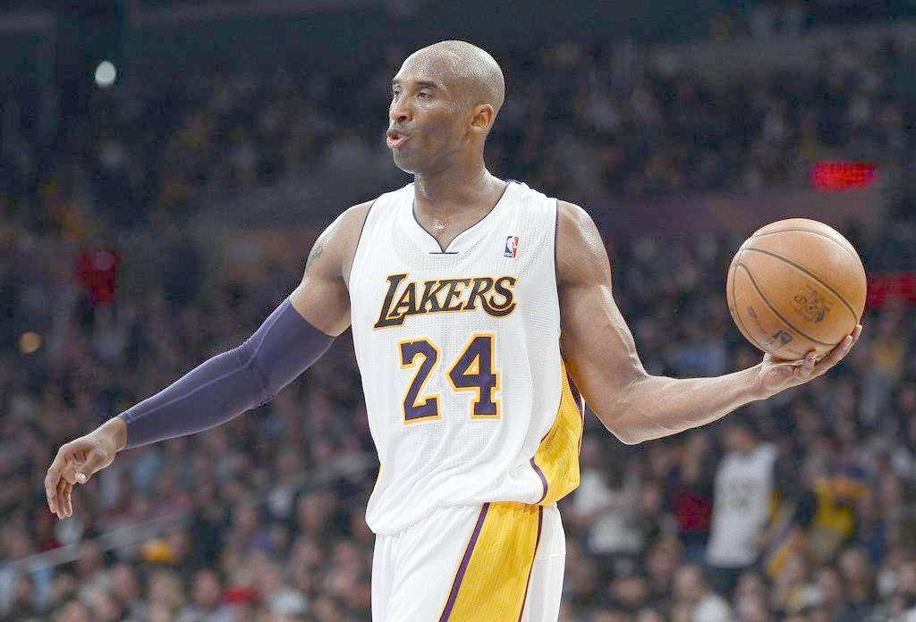
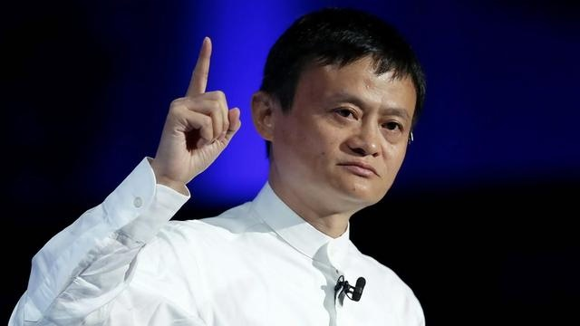
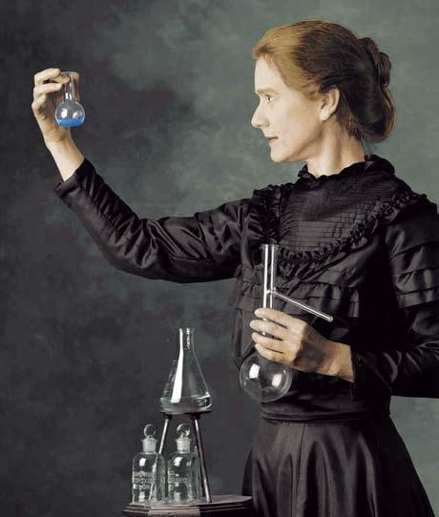
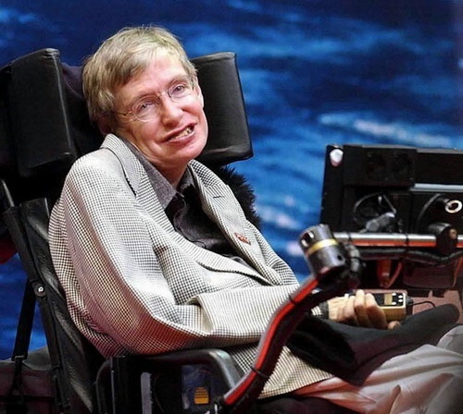
THE HERO IN OUR MIND

Slide 27
Dream and Reality
Goals
Never
give up.
A proper
way
Confidence
Good will
.
work hard

Slide 28
2
0
1
9
感谢聆听，批评指导
THANK YOU

