Slide 1
Unit 8 Celebrating Me!
Lesson 48

Slide 2
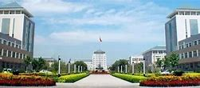
college /'kɑlɪdʒ/ n.学院，大学
New words
I work hard in school and I hope to go to college someday.

Slide 3
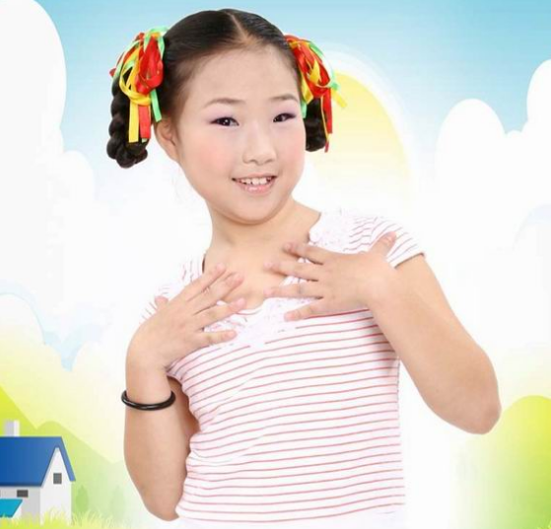
Lead-in
Do you like to talk about yourself to others? Why or why not?

Slide 4
What do you do when you feel nervous?

Slide 5
Basic Sense
Read the lesson and number the following key sentences in the correct order.
Task1
□ My friends are important to me.
□ I am not well organized.
□ I work hard at school.
□ I am good at English.
□ I have many interests.
1
5
2
3
4

Slide 6
My friends are important.
I work hard in school.
Li Ming’s report
I am not well organized.
I’m good at English.
I have many interests.

Slide 7
Task2
Complete the chart according to the lesson.
Li Ming’s Report
Friends | 1.His friends are ________ to him. 2.They ________ together, and they help ______ _____.
Dream | 1. He hopes to go to ________ someday. 2. He would like to be an ________ _______ when he grows up.
Subject | 1. He does well in _______. 2. He practices English ____ ______ in class and after school.
Hobbies | 1. He loves to _____ and play _________. 2. He is one of ____ _____ ______ in the school.
Weak points | He is not well ________. He will try to _______.
important
play
each other
college
English teacher
English
a lot
sing ping-pong
the best players
organized
improve

Slide 8
Read their information and finish the chart.
2
I am very active at my school，so
I make a lot of friends. We always
study and play together.
Sometimes I feel shy speaking in front of the class. I don't have much confidence in myself. But I enjoy playing with my friends. My favourite sport is football.
I like listening to music because it helps
me calm down and feel good.

Slide 9
Task3
Read Ex2 and finish the table.
Name | Strong points | Weak points
Nick | He enjoys ____ ____his friends.His favourite sport is ______. | Sometimes he feels shy _______ in front of class. He doesn’t have much _______ in himself.
Bob | He is very _____ at school, so he has ___ ____ ____ friends.
Lucy | She likes _____ ___ music because it helps her _____ _____ and feel good.
playing with
speaking
football
confidence
active
a lot of
listening to
calm
down

Slide 10
Read the article and fill in the missing sentences.
Task3
How to Be Yourself
Everyone is born to be unique. It's important to know yourself, to like yourself, and to always be yourself. However, it's not always easy to be yourself. Here are some tips.
●__________ You can't be yourself if you don't know, understand or believe in yourself first.
●__________ “Do you think I'm funny? Does he like me? Does she think I'm silly?" It's impossible to be yourself if you are always worrying about these things. To be yourself, you have to let go of these worries and have confidence in yourself.
●__________ Stop thinking about the worst that could happen. If something embarrassing happens to you, learn to laugh at yourself and turn it into a funny story that you can share with others. It lets them know that you are not perfect and makes you feel more relaxed, too.
●__________ If your favourite way of doing something is different from others, do it and don't give up. You should learn to be proud of what makes you unique.
Find yourself
Stop caring about what others think of you.
Relax
Develop and express yourself.

Slide 11
Group- work
According to the mind map,talk about yourself with others.
Active or shy?
Your hobbies
myself
friends
What is your dream?
Favourite subject
Weak points

Slide 12
Presentation
According to the mind map,talk about yourself with others.
Active or shy?
Your hobbies
myself
friends
What is your dream?
Favourite subject
Weak points

Slide 13
Language Points
1.Complete the chart and then fill in the blanks with the correct pronouns.
I | my | me | mine | myself
you | your | you | yours
he | his | him | his
she | her | her | hers
it | its | it | its
we | our | us | ours
you | your | you | yours
they | their | them | theirs
yourself
himself
herself
itself
ourselves
yourselves
themselves

Slide 14
1. Mike told his mother to relax. He said he could take care of _________.
2. Steven is very confident. _______ thinks of himself as a good person.
3. Help _______ to some fish, please!
4. We enjoyed ______ on the palyground.
5. The mother encouraged the little girl to clean her room by _________.
6. Don't worry about ________. We can look after ourselves.
himself
He
yourselves
ourselves
herself
us

Slide 15
2.be important to sb.
对......人来说是重要的.
be important for sb to do sth
对于某人来说做........是重要的 强调事情
钱对我来说很重要。对你来说早点到那很重要。
Money is important to me.
It is important for you to get there early.

Slide 16
3.confident adj 形容词，自信的。
confidence n，自信、信心;
give sb.confidence to do sth. 给某人做......的信心
have confidence in = be confident of 对……有信
He is a very confident person.
他对他自己有信心
He is confident of himself.=He has confidence in himself.
Ms.Liu always gives us confidence to speak English.
刘老师总是让我们有信心开口讲英语。

Slide 17
4.“one of+ the +最高级+复数名词”，意为“最…之一”。
北京是中国最大的城市之一。
Beijing is one of the largest cities in China.
高晨逸是我们班最高的男生之一。
Gao Chenyi is one of the tallest boys in our class.
我是这所学校里最好的队员之一。
I am one of the best players in the school.

Slide 18
self-check
Read Mike's report and complete the passage with the words in the box.
college singer excellent introduce ourselves
Hello everyone! Let me __________ myself. I am Mike — a good person，an ________ student and a hard worker. I have many friends. We work together and help each other. We make ________ strong! My dream is to go to ________ someday，and I want to be a ________ in the future. I love to sing
and play hockey. I like myself. Thank you！
introduce
excellent
ourselves
college
singer

Slide 19
I. 汉译英：
他的朋友给了他一些建议。
His friends _____ _____ some _______.
2. 我们使我们自己强壮。
We make ________ _______.
3. 我努力在学校里表现好。
I work hard ___ do _____ _____ school.
4. 我想某天去上大学。
I would like ____ ____ _____ ______ someday.
gives him advice
ourselves strong
to well in
to go to college

Slide 20
II. 用所给词的适当形式填空。
1. He is one of the best ________ (play) in the country.
2. They enjoyed __________ (they) during the holiday.
3. Can you give me some methods for ________ (learn)
English?
4. This gives me confidence _________ (speak) English.
players
themselves
learning
to speak

Slide 21
Easier said than done.
说得容易，做得难。

Slide 22
Thank You

