Slide 1

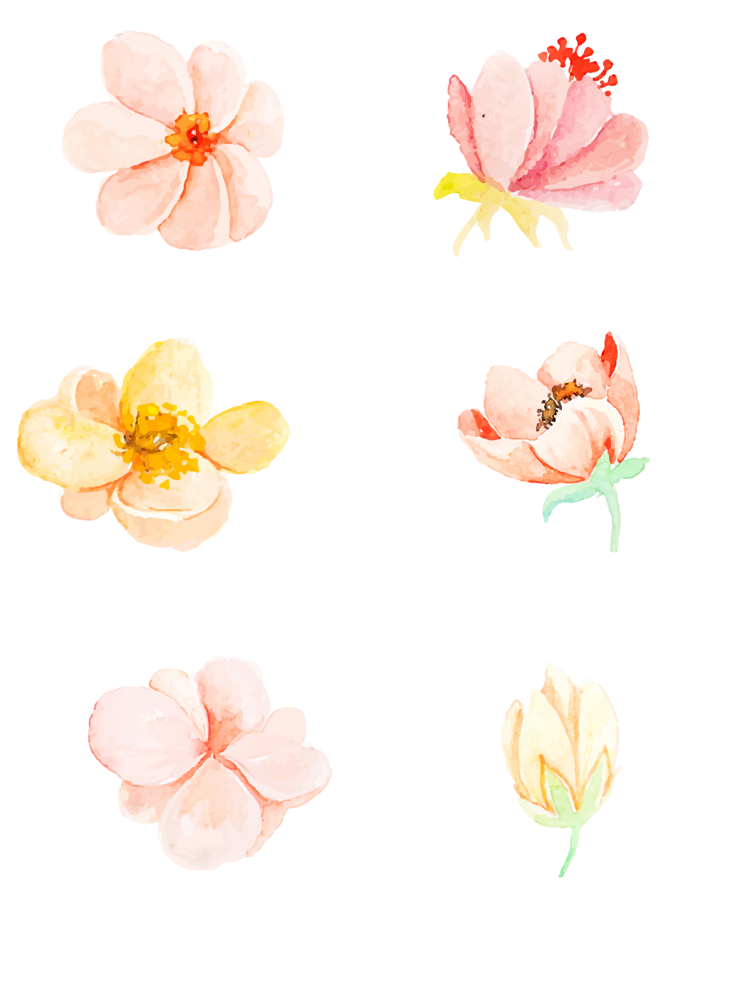
Lesson 43
What Makes You Unique?
He that walks with wise men shall be wise.
与智者同行，也将成为智者

Slide 2
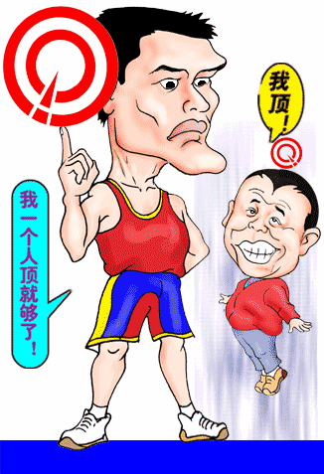
What makes them unique?
adj.独特的

Slide 3
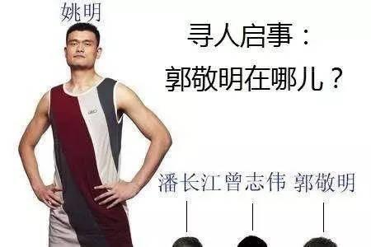
He is a unique person.
person n.人
personal adj.
personally adv.
personality n.
性格;人格
His height is his personal strength.
n.长处;力量

Slide 4
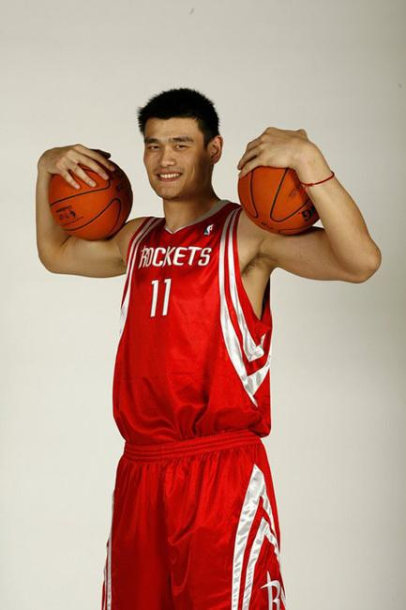
He has a special talent for playing basketball.
n.天赋

Slide 5
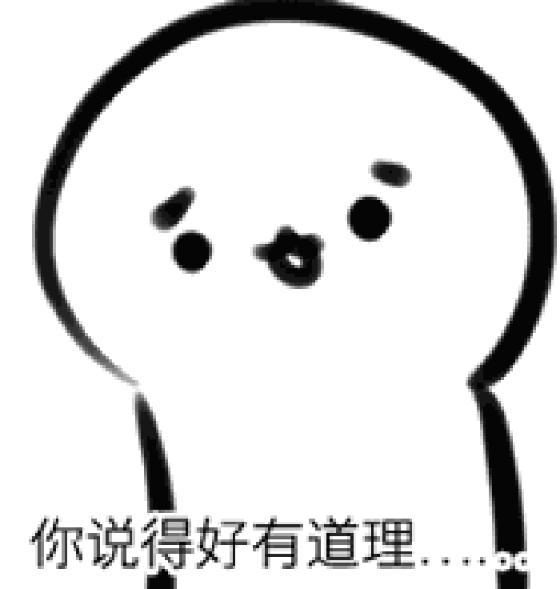
有意义；讲得通
That makes sense.
n.意义
Pan Changjiang has a good sense of humor.
n.(对某事的)感觉

Slide 6
New Words

Slide 7
Words
unique
suppose
ourselves
person
talent
personal
strength
sense
adj.独特的
v.假定；认为
pron. 我们自己
n. 人
n.才智；天赋
adj. 个人的
n. 长处；力量
n. 意义；感觉

Slide 8
Are you proud of yourself ?
What are you good at?
What makes you different from others?

Slide 9


Listen to the audiotape and the dialogue
Try to finish Exercise 2.

Slide 10

Listen to the dialogue and fill in the blanks.
Mike: Hi Helen! Are you there?
Helen: Yes, Mike. What’s up?
Mike: Could you help me with my ___________
this week?
Helen: Sure. Tell me more about it.
project

Slide 11
supposed
Mike: We are ____________to write about Dr.
Hawking. I know he is a famous
_____________. But what should I write
about him? I’m not sure.
Helen: He wrote some interesting books. Maybe
you can talk about one of his books.
Mike: That’s a great idea. Thank you for your
help.
Helen: It’s my _____________.
scientist
pleasure

Slide 12
Task1
1. What does Li Ming want to get from Jenny?
He wants to get her help.
2. How dose Li Ming like the report?
He thinks it a little hard.
3. What does Jenny tell Li Ming to write about?
She tells him to write about his special talents and personal strengths. And write about what makes him unique?

Slide 13
Task2
Read the lesson and write true (T) or false (F).
1. Jenny and Li Ming are talking on the phone. （ ）
2. Jenny can write the report for Li Ming. （ ）
3. Li Ming doesn’t know how to describe himself in the
report at first. （ ）
4. Li Ming is a good student and has many friends. （ ）
F
F
T
T

Slide 14
Exploration
What’s your personal strength?
What makes you unique?
You can write about your special talents and personal strengths.

Slide 15
Groupwork
1.Introduce your personal strengths.
What do you do well in?
How do you do with it?
Make a dialogue between three or four students. Then present it in front of the class.
Task tips :
-

Slide 16

PROJECT
What are your personal strengths?
Unique
Do you have any talents?
What are you proud of ?

Slide 17
PROJECT
I have a talent for…
I have many talents, such as…
I have many strengths, such as…
I can…
I am good at…
I am proud of…
Unique

Slide 18
Example
-What are your personal strengths?
I’m good at playing the piano.
What do you do well in?
I do well in sports.

Slide 19
Language points

Slide 20

What’s up?
怎么回事？/ 有什么事？
类似用法：
What's wrong with you?
What's the matter/trouble with you?
What happened to you?

Slide 21
Suppose you are talking to a friend.
suppose v. 假定；认为
Suppose you are talking to your friend.
假定你在跟朋友交谈。
I suppose him very clever.
我认为他很聪明。

Slide 22
I suppose he’ll come back now.
我想他这会儿该回来了。
You can’t suppose whom I met in the street.
你准猜不着我在大街上看见谁啦、

Slide 23
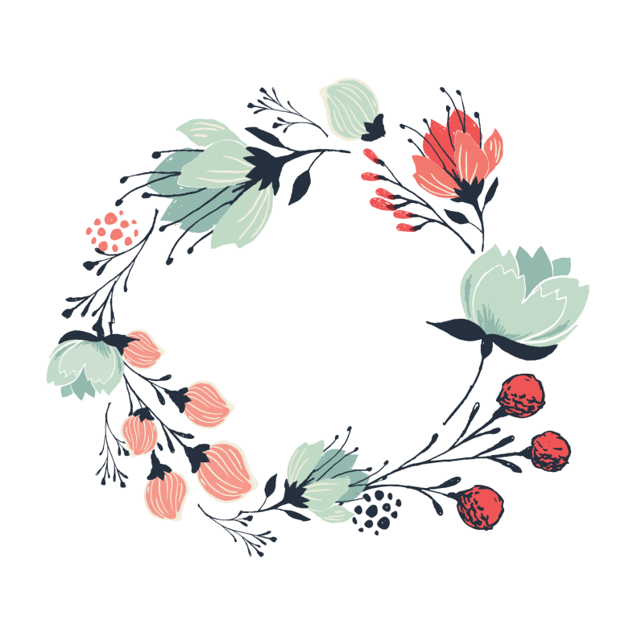

be supposed to do 应该 ；认为应该；被期望
We are supposed to describe ourselves in a report.
应该;被期望
=情态动词 should
译：我们应该努力学习。
We are supposed to study hard.

Slide 24
Make sentences using the given information.
Example: We are supposed to describe ourselves
in a report.
Danny/meet Steven at 8 a.m. in the library (be
supposed to)
__________________________________
__________________________________
Danny is supposed to meet Steven at 8
a.m. in the library.

Slide 25
2. I/do my homework tomorrow evening (be
supposed to)
__________________________________
__________________________________
3. Celina/perform on Christmas Day next week
(be supposed to)
__________________________________
__________________________________
I’m supposed to do my homework
tomorrow evening.
Celina is supposed to perform on
Christmas Day next week.

Slide 26
Yes, that makes sense. 对，很有道理。
make sense
有意义，有道理
I guess that makes sense.
我想这蛮有道理。
It makes sense to care for your health.
保重身体是明智的。

Slide 27
It’s my pleasure. 我的荣幸（乐意效劳）。
可以用于人家请求帮忙时或者你已经帮助别人，别人感谢你时所说的话，表示你很荣幸能帮他这个忙，用于事情发生之后。
It’s my pleasure.
It’s a pleasure.
My pleasure.
With pleasure.
多用于别人请求帮忙时，自己很愿意
去做，用于事情发生之前。

Slide 28
Test

Slide 29
I、根据汉语完成句子
1. 我们可以自己做这件事。
We can do it _____ _________.
2. 你擅长弹钢琴吗？
______ you ______ _______ playing the piano?
3. 她应该按时回家。
She______ ________ ______go back home on time.
4. 碗里有一点儿汤。
There is_____ ________soup in the bowl.
5. ——谢谢你在英语方面帮助我。
——不客气。
—Thank you for helping me with my English.
—______ ______ _________.
by ourselves
Are
good at
is supposed to
a little
It's my pleasure

Slide 30

Ⅱ.用方框中所给词的适当形式补全短文
We are unique.Each has his own special
and strengths.Some of us are good
at drawing;others are talented at singing.But it doesn’t matter.We should be confident.It makes sense.I
we will be proud of in the future.
ourselves person talent suppose personal
person
talents
personal
suppose
ourselves

