Slide 1
Unit 7 Enjoy Your Hobby
Lesson 41 Show and Tell!
Happy is the man who is living by his hobbies.
醉心于嗜好的人是快乐的。

Slide 2
Presentation
New Words
spin [spɪn]
performance[pəˈfɔːməns]
common[ˈkɒmən]
v. （使）快速旋转
n. 表演；演出
adj. 普通的；一般的

Slide 3
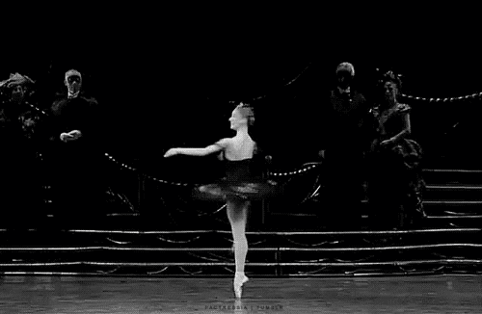
My sister can spin on her toes like a dancer.

Slide 4
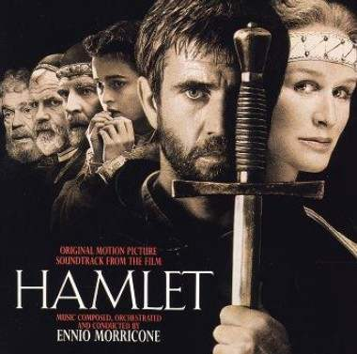
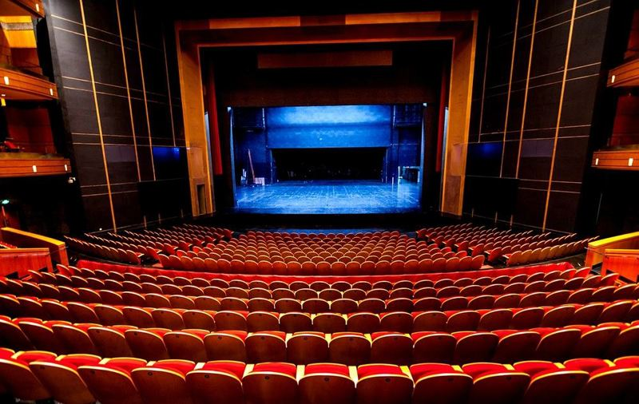
Inside the theatre, they were giving a performance of Shakespeare's Hamlet.

Slide 5
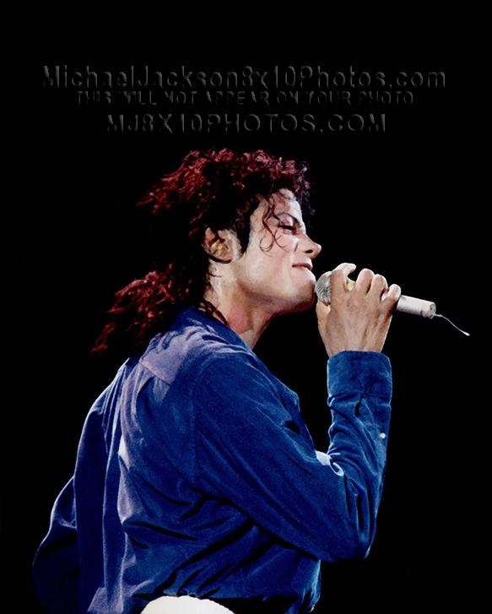
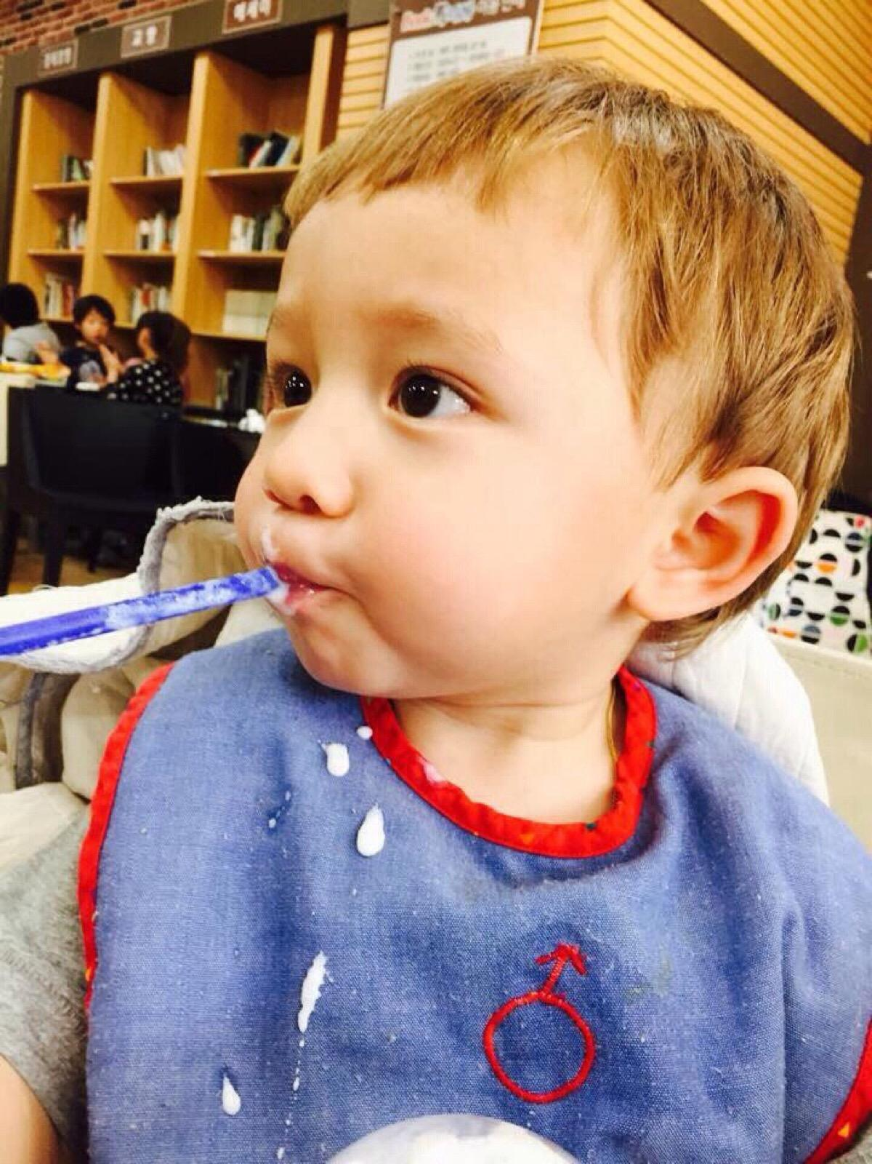
Jackson is a common English name.

Slide 6
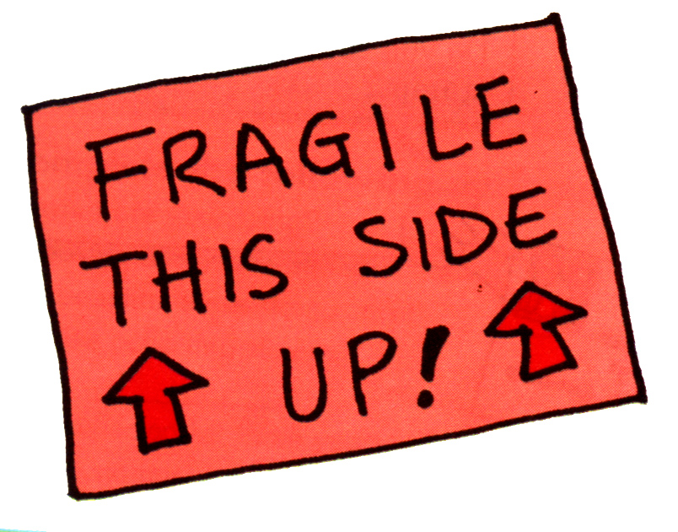
What does this sign mean?
It means something is fragile.
You should put this side up.

Slide 7
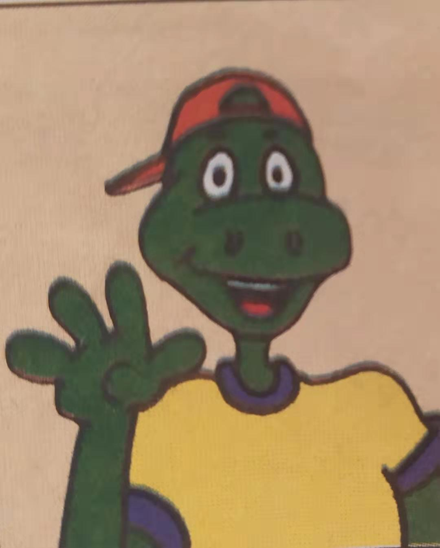
Warm-up
1)Does anyone remember what Danny’s hobby is?
2)If there is a hobby show, what will Danny present?

Slide 8
Read the lesson and tick the correct answers.（para1-para5）
1.
1.What are the students doing today?
They are playing in the parking lot.
They are showing their hobbies to their classmates.
2. What is Steven’s hobby?
He likes collecting stamps.
He likes playing with his yo-yo.
3. Where is Danny’s hobby?
In a tall box. In a tree.
4. What does the teacher ask the students to do?
To come to the parking lot. To stay in the classroom.

Slide 9
Read para6-para12 and answer:
1.What can you see on the box? What does it say?
2.Can the box fit through the door?
3.Who helps Danny get his hobby out of the box?
We can see a sign. It says “FRAGILE. THIS SIDE UP!”.
No,it can't
Danny’s classmates.

Slide 10
请认真完成攻坚克难里的Task3-Task4.

Slide 11
Task3: Read the lesson and fill in the chart.
 | What are their hobbies? | How did they show their hobbies?
Brian | Collecting stamps | He shows ________________
Steven |  | He _______ it up and down.
Danny |  | He tells some _____and _________ about his family. Besides, he plant a real family tree.
Others | Riddles, chess, ______,_______.________.
four books full of stamps.
Playing yo-yo
spins
facts
Learning about his family and gardening
stories
reading, models trains, model rockets

Slide 12
Task3: Complete the passage with “a”, “an” or “the”.
Today Danny’s class had _______hobby show.
Brian brought his stamp collection. He had four
books full of stamps! Steven showed _______class
his yo-yo. He is _______good performer.
a
the
a

Slide 13
Danny’s hobby was in _____big box in the
parking lot. But ______box was too tall! So the
teacher asked _______class to come to the parking
lot. Danny took his hobby out of ______box. It
was his family tree! It’s ______interesting hobby.
Most people draw their family trees. They don’t
plant them!
a
the
the
the
an

Slide 14
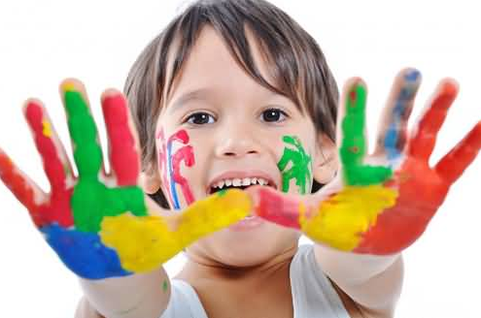
Think about it!
What would you present at a hobby show?

Slide 15
Group-Learning
If there is a hobby show, what will you present?
Task tips:
What's your hobby? (such as collecting stamps, postcards,doing sports, listening to music)
When did you begin your hobby?
What do you do with your hobby?
What do you love most about your hobby?
......
Presentation

Slide 16
Language Points
1.He has four books full of stamps.
1）full of stamps 作books的后置定语。
2）be full of=be filled with=be crowded with “充满，装满”。

Slide 17
2.Finally, it’s Danny’s turn.
It’s one’s turn (to do sth.)意思是 “轮到某人(做某事)”。
turn的其他用法：
1) turn+颜色 变成……色
2) turn on/off/up/down 打开/关掉/调大/调小
3) turn left/right 向左/右转

Slide 18
3.It won’t fit through the door.
1) through表示从物体的内部空间中“穿过”，强调一个立体范围。
2) across 表示从物体的表面“横过” 。

Slide 19
4.Take your hobby out of the box and get it ready, Danny.
take…out of …相当于get…out of… ，表示“把……从……中取出来”。

Slide 20
Practice
根据课文内容填空。
Today all the students are ________ their hobbies to the class. Some students show their stamp collections. There are many other hobbies. Finally, it’s Danny’s _____ . His hobby is in a big box in the parking lot, but it won’t fit _______ the door. The teacher asks the class ___ _____ to the parking lot to see his hobby. Danny’s hobbies are _______ ______ his family and ________.
telling
turn
through
to
come
learning
about
gardening

Slide 21
Exercise
一、根据提示完成单词。
1.May I j_____ you? I want to play games with you.
2.The man is too fat to go t________ the door.
3.My daughter has a ________ (collect) of Barbie dolls(芭比娃娃).
4.________(garden) is one of the old man’s hobbies.
oin
hrough
collection
Gardening

Slide 22
Exercise
二、单项选择。
1.The basket is ______ roses.
A. fill with B. full with
C. fill of D. full of
2.—How long has your father ______ the Party?
—For about 20 years.
A. joined B. taken part in
C. been in D. been joining

Slide 23
Thank You

