Slide 1

Lesson38 Hobbies Are Fun!
只工作不玩耍，聪明的孩子也变傻。
醉心于嗜好的人是快乐的。

Slide 2
confidence
∕’kɔnfidəns∕
n. 自信 confident
A hobby can build your confidence.
postcard
∕’pəustka:d∕
n. 明信片
I like collecting postcards.
outdoor
∕’ autdɔ:∕
adj. 户外的；露天的
indoor
Outdoor activities are fun.

Slide 3
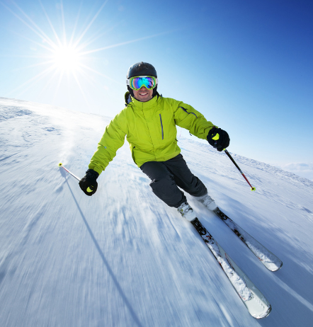
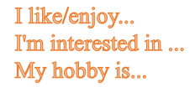

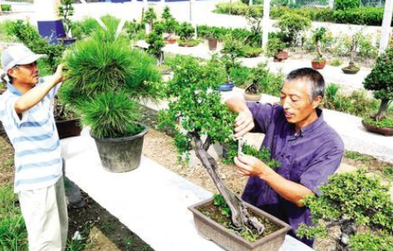
What do you like to do in your spare time?
travelling
skiing
gardening

Slide 4
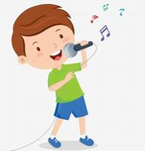
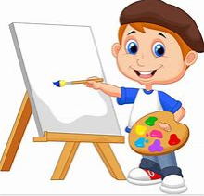
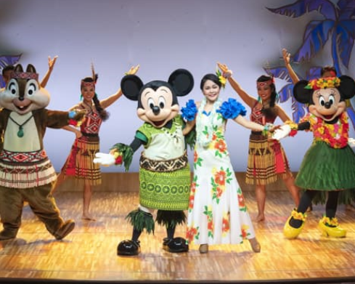
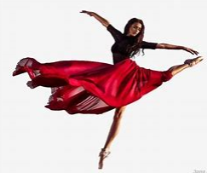
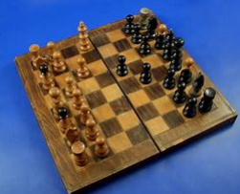
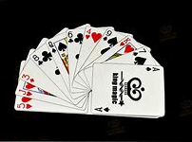
What do you like to do in your spare time?
singing
drawing
acting
dancing
playing chess
playing cards

Slide 5
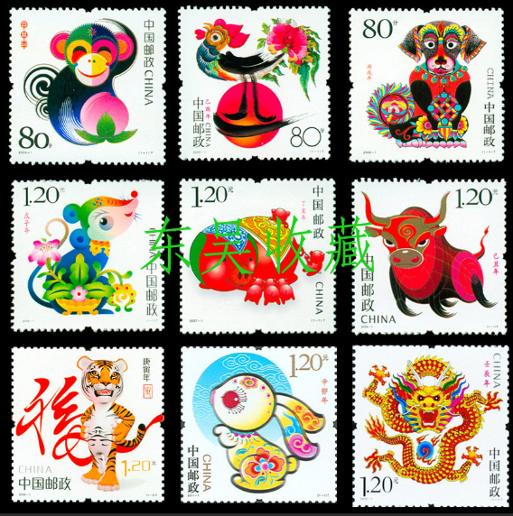
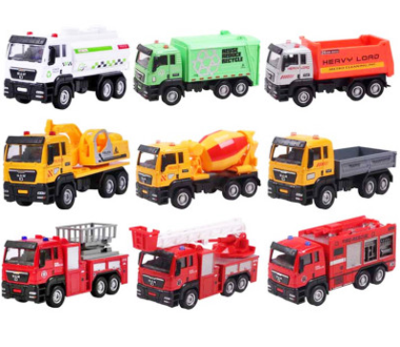
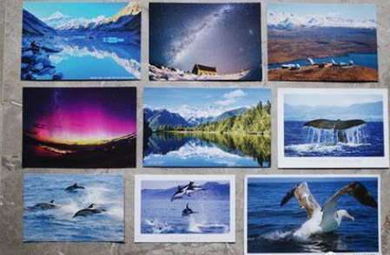
What do you like to do in your spare time?
cllecting toy cars
collecting postcards
collecting stamps

Slide 6

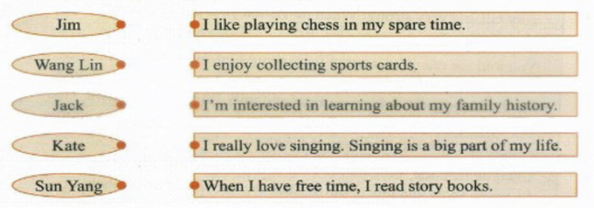
听听力，完成课后练习2的连线题。

Slide 7

跟录音朗读、纠正发音。

Slide 8
坐正、安静、专注、高效
Complete Task1-Task3

Slide 9
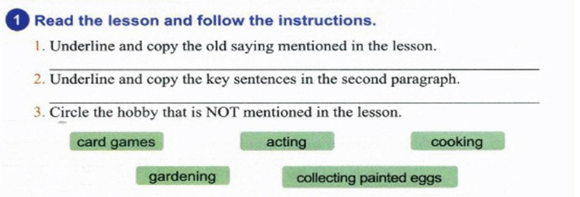
A happy child has a hobby.
There are many different types of hobbies.

Slide 10
Answer the questions.
2
1. Why is a hobby useful?
2. How many types of hobbies are mentioned in the text?
What are they?
3. When do people usually take up their first hobby?
A hobby can help build your confidence and make your life more colouful. It can help you make more friends and teach you to work well with others.
Five.
Collections, outdoor activities, games, arts and others.
People usually take up their first hobby when they are kids.

Slide 11
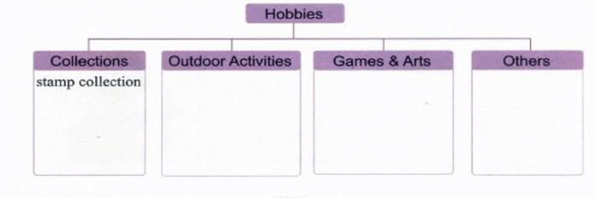
3
Complete the chart.
gardening
travelling
skiing
cards
chess
drawing
dancing
acting
singing
sewing(缝纫)
toy cars
collection
postcards
collection

Slide 12
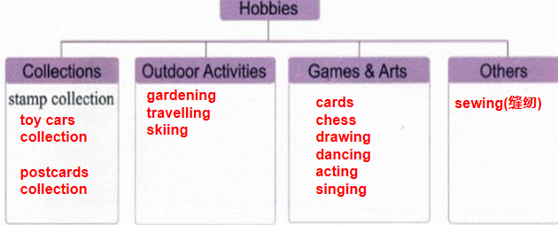
选择至少两个类型的好爱逐一进行介绍。
Discussion
1. 句型提示：
I like/enjoy...
I'm interested in ...
My hobby is...
2. 叙述这两个类型中自己拥有的爱好，并简述原因和好处。
Think about them:
1. What's your hobbies in each type?
2. How to make good use of your hobbies?
Tips: I like/enjoy... because...
I' m interested in.... because it can make/help me...
My hobby is ...
It is not only... but also....
It can not only... but also...
I can improve... It's good for me to...

Slide 13
选择至少两个类型的好爱逐一进行介绍。
Presentation
1. 句型提示：
I like/enjoy...
I'm interested in ...
My hobby is...
2. 叙述这两个类型中自己拥有的爱好，并简述原因和好处。
Think about them:
1. What's your hobbies in each type?
2. How to make good use of your hobbies?
Tips: I like/enjoy... because...
I' m interested in.... because it can make/help me...
My hobby is ...
It is not only... but also....
It can not only... but also...
I can improve... It's good for me to...

Slide 14
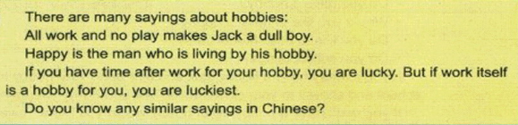
Summary
1.Old sayings about hobbies.
A happy child has a hobby.

Slide 15
Summary
2.not only...but also...不但……而且……
A hobby is not only fun but also useful.
Not only I but also Tom enjoys watching television.
I not only know English but also know Russian.
I not only heard it, but (also) I saw it.

Slide 16
Exercise
一、短语。
不但……而且……
开始从事
一些……另一些……
收集东西
户外活动
not only...but also...
take up
some...others...
collect things
outdoor activities

Slide 17

Exercise
二、单项选择。
1. — _____ hobbies do you have?
—Two.
A. How much B. How many C. How
2. Rose likes _____ to music very much.
A. listen B. listens C. listening
3. The old man took up _____ the stamps at the age of 60.
A. collect B. collecting C. collects D. to collect

Slide 18
三、词语运用
Exercise
1. A hobby can build your ______________ (自信).
2. Some people like to collect stamps and ___________ (明信片).
3. Another type of hobby is _________ (户外的) activities.
4. Do you know the old ____________ (谚语)？
5. They like to ___________ (收集) things such as stamps, toy cars and postcards.
confidence
postcards
outdoor
saying
collect

Slide 19

Thank U

