Slide 1
Unit 4 My Neighbourhood
Lesson 24: I Need a Map

Slide 2
words
flu [fluː]
流行感冒
mile [maɪl]
英里
across [əˈkrɒs]
横过……；从……一边到另一边

Slide 3
Free Talk
Is it easy to live in a new place?
What do you do if you get lost?

Slide 4
How can I get to...?
Police
Station
Book-
shop
Fruit
Shop
Bus
Stop
C
Sorry...
B
Clothing
Factory
Post
Office
Park
Toilet
Walk along...
A
Excuse me...
Tea
House
Zoo
School
Hospital

Slide 5
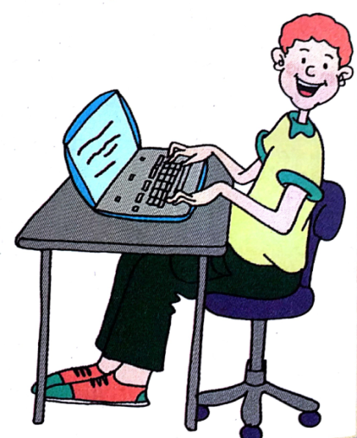
Task1: Listen to the passage and follow it.
How does Brian like his life in his new neighbourhood?
Not easy.

Slide 6
Task 1: Read the passage and write true (T) or false(F).
1) Brian has the flu now. ( )
2)Jenny and Brian go by the coffee shop when they walk to school. ( )
3)Across from the bookstore, there’s a beautiful park. ( )
F
F
T

Slide 7
Task 1: Read the passage and write true (T) or false(F).
4)Brian didn’t have a good time on Thanksgiving because he missed England. ( )
5)Brian hopes his parents come to see him someday. ( )
F
T

Slide 8
请认真完成攻坚克难里的 Task1 和Task 2.
要求：端正坐姿，积极思考，独立完成。

Slide 9
Task 2:Listen and answer the questions.
1.What did Jenny and Brian do on Monday?
2.How far is the school from Uncle David’s home?
3.What happened to him yesterday?
4.What will Brian do tomorrow? Why?
They walked to school.
It’s about one mile.
He got lost.
He will buy a map of the city because he doesn’t want to get lost again.

Slide 10
Task 2:Listen and answer the questions.
5. What did Brian do on Thanksgiving Day?
He met all of his Canadian cousins.

Slide 11
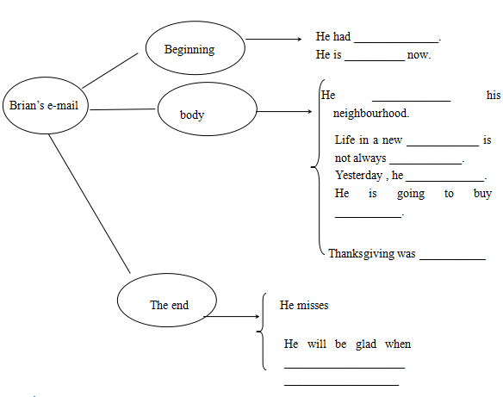
Task3: How does Brian write an e-mail?
the flu.
better
got to know
neighbourhood
easy.
got lost.
a map of the city.
a lot of fun
his parents.
his parents come to see him.

Slide 12
Group-learning
1. Discuss the exercises above.
2. Try to retell the passage.
5、6号同学复述e-mail的开头和结尾，1-4号同学两人一组，复述neighbourhood和迷路的经历。

Slide 13
Language Points
1.I’m doing very well.
我一直（做得）很好。
本句用进行时态强调“一直，一向”。
do well in 擅长...

Slide 14
Language Points
2.This week, I got to know my neighbourhood.
get to know 强调“从不认识到认识的渐进过程”。

Slide 15
3.When we walk to school, we go by the bakery.
本句是含有when引导的时间状语从句的复合句。go by = pass by “从旁边经过”。

Slide 16
Exercises
go by across from on our way get lost
on our way
1. We go to the bakery. It is _____ to school.
2. You'll ________ a grocery store when you come to my home.
3. The movie theatre is _______ the museum.
4. I need a map of the city because I don't want to _________ again.
go by
across from
get lost

Slide 17
Exercises
1. We are going to have _______.
lot of fun a lot of fun
2. A: What is the way _____ the factory?
B: Turn left _____ the second turning.
to; at of; to
3. Go down this street until you ____ the end of the street.
reach arrive

Slide 18
Exercises
4. Twenty minutes _______, the old woman finally found her grandson.
in later
5. It was very dark last night. Jimmy ______.
got lost lost

Slide 19
Thank You!

