Slide 1
Unit 5 My Future
L25:I Want to Be a Teacher
&L27: What's Your Advice?

Slide 2
Lead-in
A riddle
What is always in front of you, but
you can never see it?
Your future

Slide 3
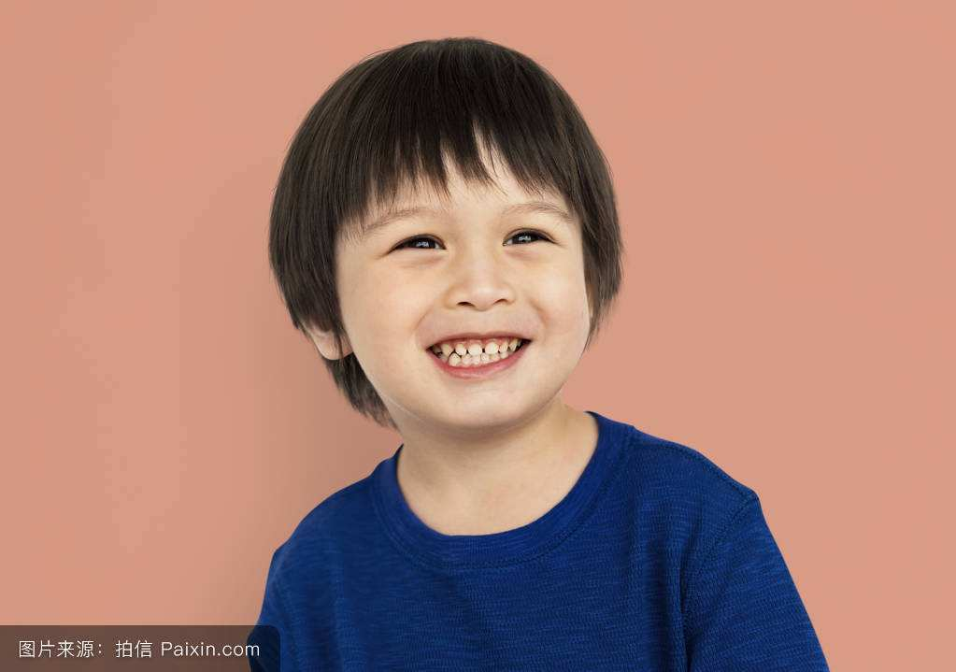
Guess
What will he be when he grows up?
grow-grew-grown

Slide 4
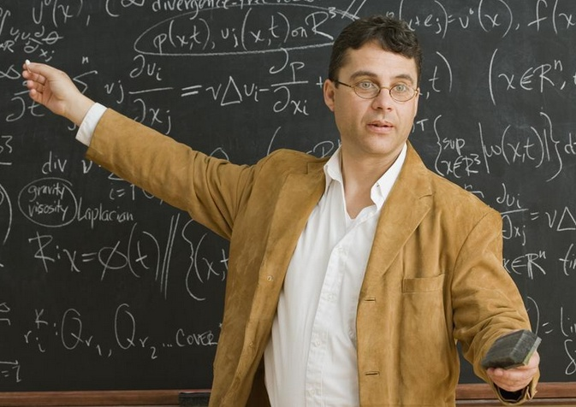
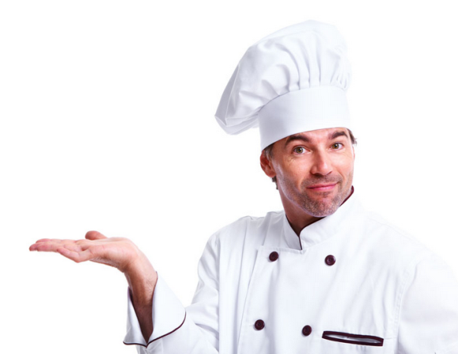
Maybe he is good at teaching.
So he might be a teacher.
[maɪt] 可能
Maybe he is good at ....
So he might be ....

Slide 5
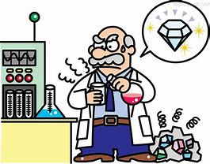
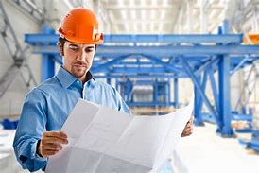
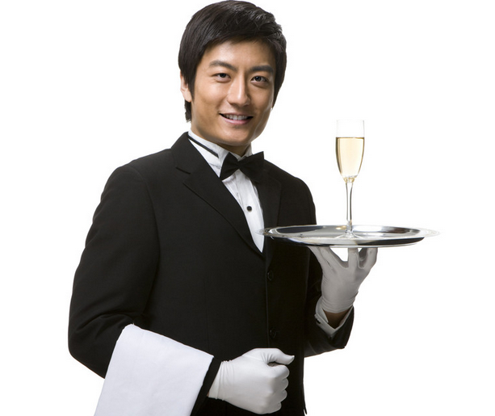
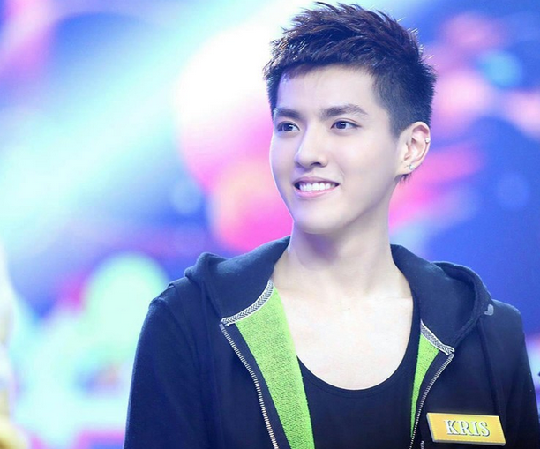
Maybe he ...
So he might be....
scientist
engineer
科学家 _______
工程师 _____
[ˈsaɪəntɪst]
[.endʒɪ'nɪr]
Can you give him some advice?
actor
waiter
演员 ______
服务员 ______

Slide 6
1. Always do homework carefully.
2. Go to bed and get up early.
3. Be nice to his classmates and teacher.
4. Help his parents with the housework.

Slide 7
words
might 可能，也许
scientist 科学家
grow-grew-grown 生长；增加
engineer 工程师；技师
advice 建议，劝告
number 数字
opposite 相反的，相对的

Slide 8
Listen to the tape and answer:
What will Li Ming and Wang Mei be in the future ?
① Li Ming might be a ___________. ② Wang Mei might be a ____________.
teacher
doctor

Slide 9
Finish the left exercises. 坐姿端正，黑笔做答。

Slide 10
Task1：
The Future
Li Ming
Wang Mei
Wang Mei's advice:
Maybe he will be a ________.
Because_________________________________________.
Li Ming's suggestions:
1. She might be a ________.
Because___________________________
2. She might be a _________.
3. She might be an _________.
teacher
scientist
she studies very hard.
he is good at talking to people.
doctor
engineer
teacher
doctor
1. Wang Mei hopes to be a _______.
2. She would help ______________________.
1. Li Ming wants to be a _______.
2. He would be _____ to his students.
3. He wouldn't give them ______________on weekends.
nice
sick children.
too much homework

Slide 11
Task2：
Read the lesson and fill in the blanks.
Li Ming and Wang Mei are talking
about the future. Li Ming doesn’t have
any ______ about his future. He is good
at talking to people so Wang Mei says he
might be a ________. Li Ming hopes so.
idea
teacher

Slide 12
He would be ______ to his students.
He wouldn’t give his students too much
__________ on weekends. What might
Wang Mei be when she ______ up? Li
Ming gives her some suggestions — a
__________, a _______, or an ________.
She hopes to be a ________. Each of
them will have a good future.
nice
homework
grow
scientist
doctor
engineer
doctor

Slide 13
Task3：Answer the questions. 1. What are you going to be in the future?/What will you be in the future?/What do you want to be in the future?
_____________________________________________________. 2. Can you give yourself some advice for the future? ______________________________________________________________________________.

Slide 14
Discussion
Make a conversation like this:
A: What are you going to be in the future?/What will you be in the future?/What do you want to be in the future?
B: I might be ..../I hope to be.../Maybe I will be .../I would be.../I wouldn't be... Can you give me some advice?
A: You should..../You'd better.../You're supposed to .../或用祈使句 Wish you a better future.
B:...

Slide 15
Presentation
Make a conversation like this:
A: What are you going to be in the future?/What will you be in the future?/What do you want to be in the future?
B: I might be ..../I hope to be.../Maybe I will be .../I would be.../I wouldn't be... Can you give me some advice?
A: You should..../You'd better.../You're supposed to .../或用祈使句 Wish you a better future.
B:...

Slide 16
Language Points
1.询问别人对未来的想法：
1. What are you going to be in the future?
2. What will you be in the future?
3. What do you want to be in the future?
4. What will you be when you grow up?
5. What are you going to be when you grow up?

Slide 17
2. 回答有关于未来的问题：
1. I might be a/an...
2. I would be ....
3. I wouldn't ....
4. Maybe I will be....
5. I hope to ....
6. I want to ...
7. I'm not sure...
The kids may be in the classroom. 孩子们有可能在教室。

Slide 18
3. 提建议：
1. You might be....
2. What/How about....
3. You'd better....
4. You are supposed to....
5. Why don't you....
6. Why not....
The kids may be in the classroom. 孩子们有可能在教室。

Slide 19
4. 表达祝福：
1. Wish you a wonderful future.
2. Wish you have a great future.
3. Wish all your dreams come true.
4. I hope you can ...
The kids may be in the classroom. 孩子们有可能在教室。

Slide 20
Exercises
你能辨别maybe与may be吗？
1.________ he is a teacher.
2.He ________ in the library.
3.________ he is ill.
4.They may be at home now. (改为同义句)
______ they ______ at home now.
5.Maybe he is late for school. (改为同义句)
He ______ be late for school.
Maybe
may be
Maybe
Maybe are
may

Slide 21
Practice
B
1. Da Wa is good at _____ football.
A play B playing C to play D played
A
2. Han Mei hopes _____ a good teacher.
A to be B is C am D are
B
3. I don’t like winter because there is too___ snow.
A many B much C some D few
to learn
4. It is useful for me __________ ( learn) English.

Slide 22
Dear class,I Belive,What you will be, you will be! And what you want to be, you will be!But please remember: You must work hard at everything to make your dream come ture!So,please be strict with yourselves!Try to be a useful and helpful person in the future!Clear?!
亲爱的同学们，我相信，你们能成为你们可以成为的人！你们也可以成为你们想成为的人！但是请记住：你们必须努力才能使你们的梦想成真!因此，请严格要求你们自己！力求在未来做一个有用的、有益于社会的人！明白吗？！

Slide 23
Thank You

