Slide 1
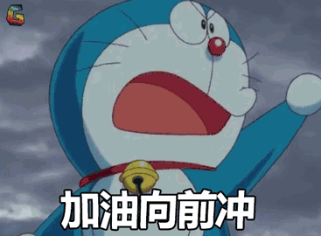
Get ready for the test!

Slide 2
1-5 CCBBB
6-10 CCDBC
11-15 DCCBA
16-20 BBBBC
21-22 CC
23-26 CBAD
27-30 ACDA
31-35DBCCA

Slide 3
36. history 37. introduce 38. it includes spoken parts, singing, dancing and acrobatics. 39. Beijing Opera is the most representative of all Chinese traditional dramatic art forms and the largest Chinese opera form .
40. 京剧是中国的国粹并且承载的满是中国的传统。
41. Everyone/Everybody 42. just 43. stops 44. best 45. stranger 46. helped 47.a part- time job 48. chances 49. Or 50. for

Slide 4
51. Is this pen yours
52. The special garden is full of flowers/ The garden is full of special flowers
53. How often do you play sports
54. My father made a model plane for me
55. Remember to bring your homework here tomorrow

Slide 5
Composition
你对自己的未来有何打算?你有什么远大的理想吗?为了理想你应该怎么做呢?请以“My future”为题写一篇70词左右的英语短文,和同学们交流一下。
提示:
1.What do you want to be in the future?
2.Why do you want to be a(n)…?
3.What will you do to make your dream come true?

Slide 6
One possible version:
My future
I’m thinking about my dream job in the future.Maybe I can be a reporter.That sounds interesting.Reporters talk with people and write stories.I can be a magazine or newspaper reporter,or I can work for a TV station.I want to meet interesting people and go to many places.Or maybe I can be an actor.Actors sing and dance,and they work with young people.Actors often work late,but I don’t mind that.Or maybe I can be a policeman.It is exciting and it is also dangerous.I’ll try my best to make my dream come true.

Slide 7
Dear Li Ming
I'm glad to know that you want to be a scientist when you grow up. In your letter, you asked me to give you some suggestions on how to realize your dream. I am glad to share my opinions with you.
As far as I’m concerned, you should listen to the teacher carefully in class and take notes well at first. Second, you must work hard at all your subjects, because a scientist needs rich knowledge. Besides, reading more science books is very helpful to you. Finally, you’d better ask your teachers for help and discuss questions with your classmates when you have some difficulties. Keep on trying and believe you will succeed in the end.
I hope your dream will come true.

