Slide 1
新概念英语第一册
Lesson 123
A trip to Australia

Slide 2
Greetings
Hello, everyone.
How are you?
Nice to see you.
Notes:
Everybody, stand up! Hello, everyone. How are you? Nice to meet you.

Slide 3
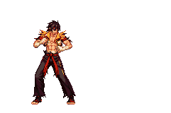
Dividing
T1
T2

Slide 4
Speech
Do you like traveling?
Which country do you want to go?

Slide 5
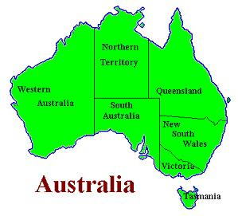
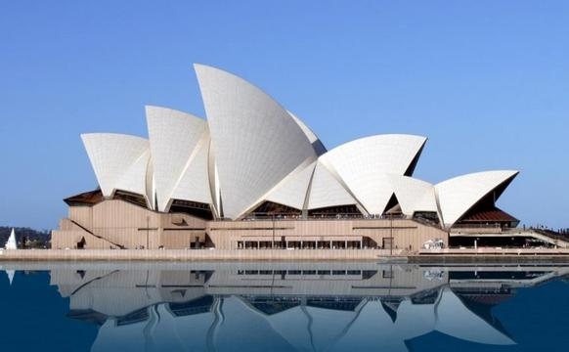
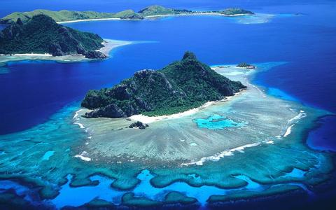
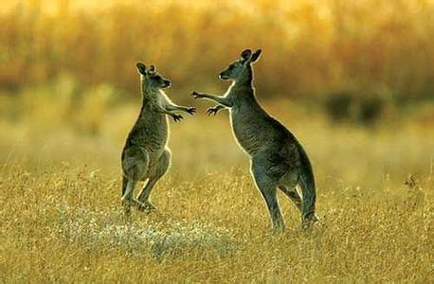
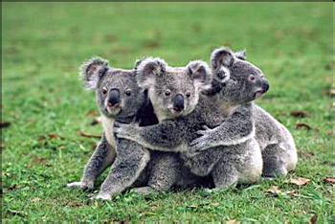
Lead in:
A trip to Australia
Notes:
Game: act and say

Slide 6
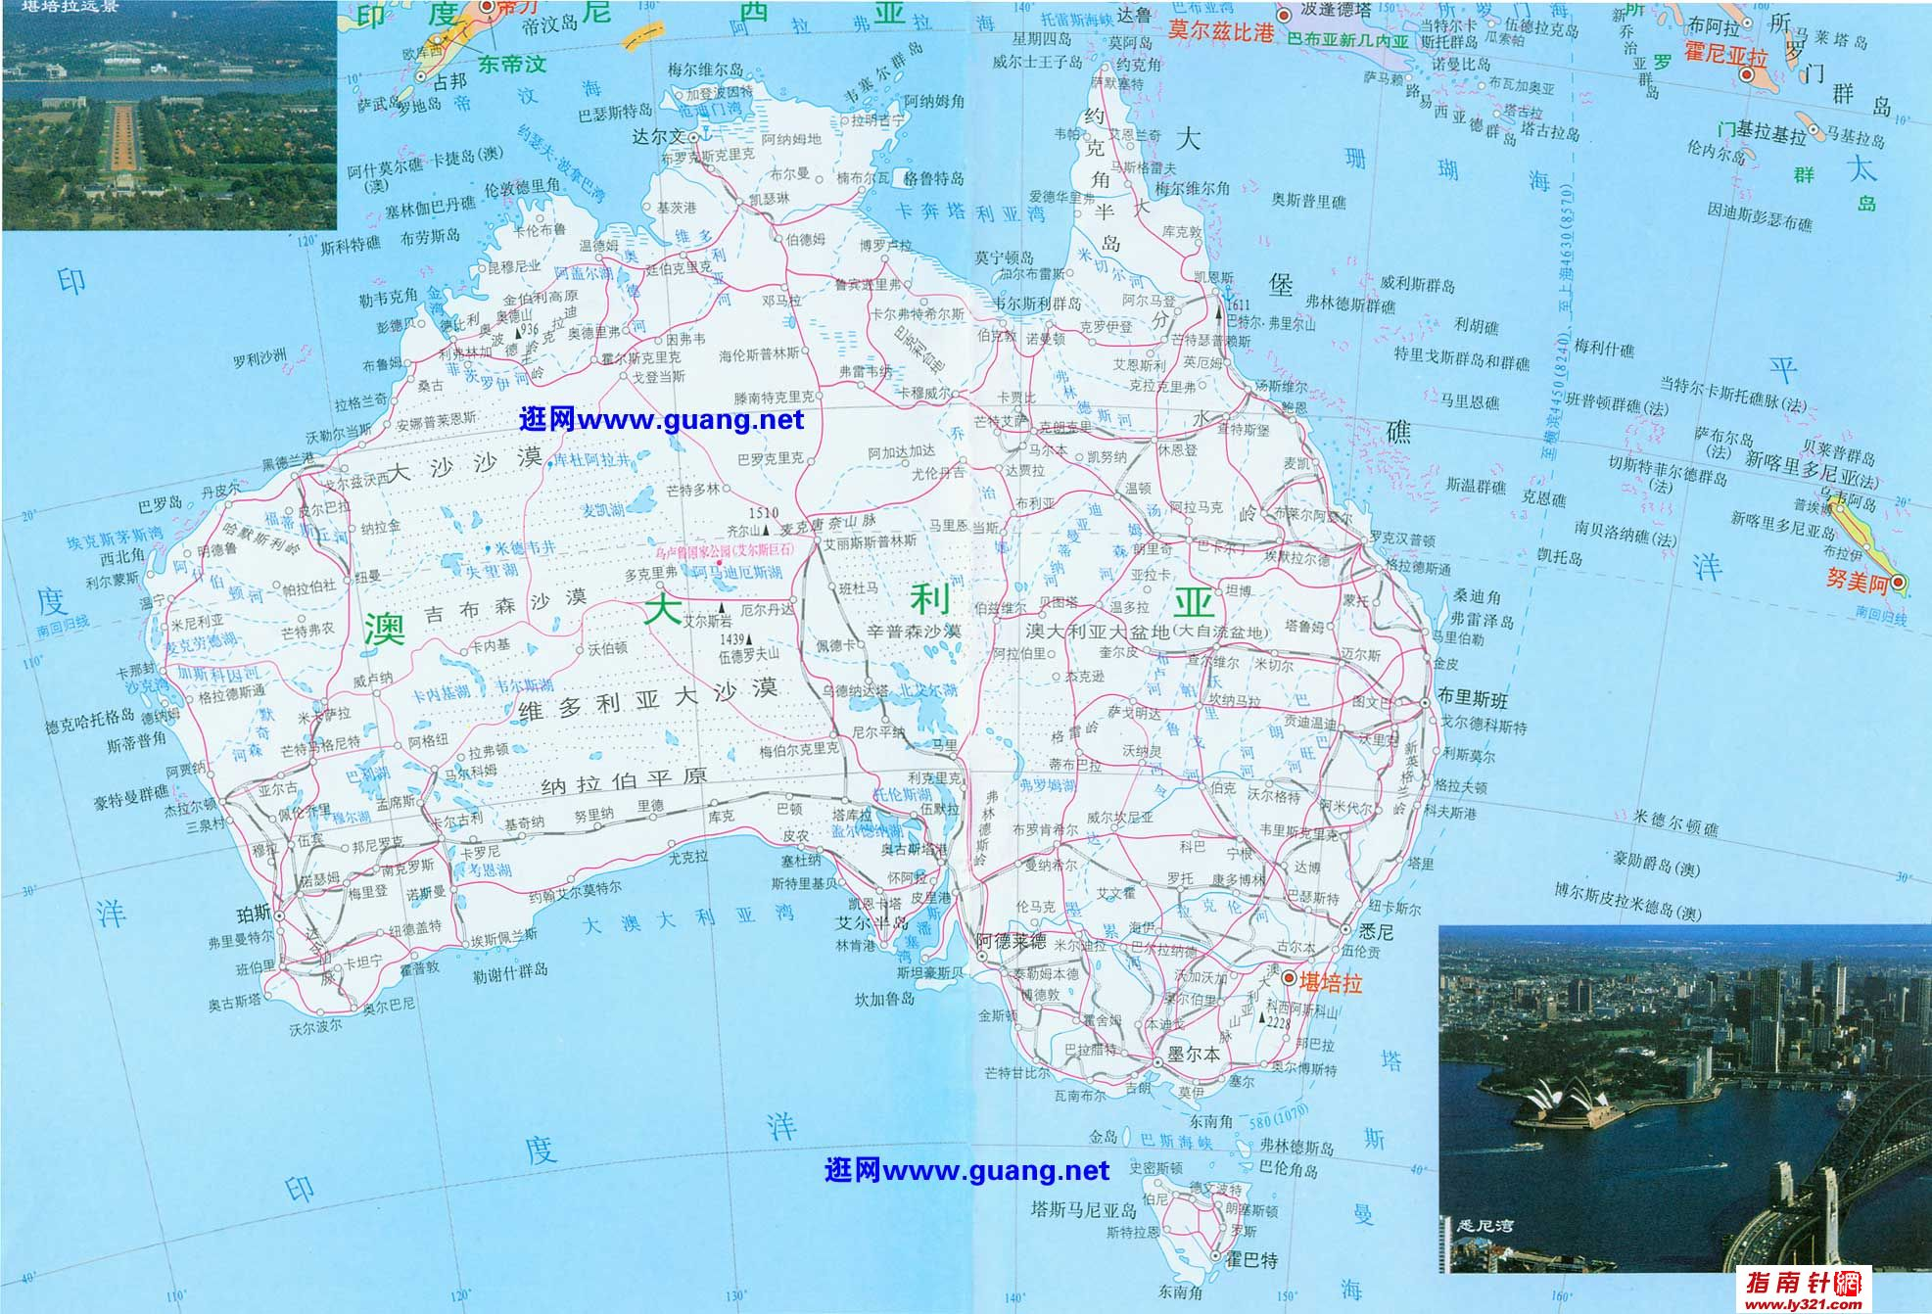
澳大利亚：南方的大陆
坐在矿车上的国家
骑在羊背上的国家
最适宜居住地之一
体育强国
Capital city:
Canberra

Slide 7
A trip to Australia
You are going on a trip.
My family and I are going on a picnic near the lake .
go on a trip=have a trip
go on a picnic = have a picnic
Notes:
冀教链接： 七下U4 L21冀教链接：七上U5 L28

Slide 8
They take a tour around the city.
Their journey lasted about twenty years.
Do you need a tour guide when you go on a trip?
trip/ tour / journey
trip: 短途旅行
tour:观光
journey: 强调长途陆路旅行，旅程
go on a trip to sp.
take a tour to sp.
Notes:
冀教链接： 七下U1 L5冀教链接： 七下U2 L8 冀教链接：七下U1 L3

Slide 9
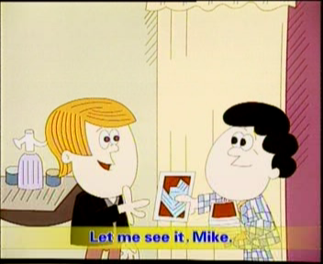
Scot
Mike

Slide 10
Look at the pictures and guess:
What is in Mike's hand?
Who took it?
Notes:
live 加题

Slide 11
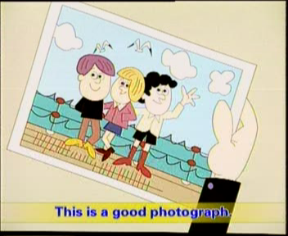
How many people are there in the photo?
Who met these people ?

Slide 12
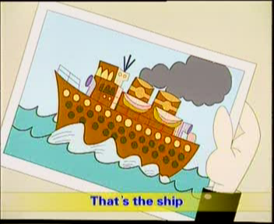
/'trQvEl/
What is this?
Who travelled on it?
Is it beautiful?
Notes:
stay 加题

Slide 13
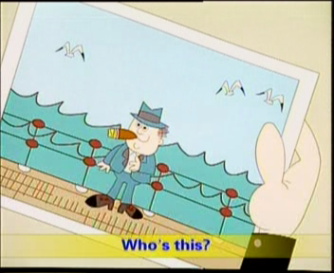
Who is the man?
Is he like a big boss?

Slide 14
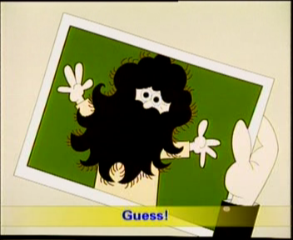
Who is he?
grow/grew/grown
Is he handsome?
grow up
grow a beard
/bɪəd/
=wear/have a beard

Slide 15
C
1. Simon wants to be an engineer when he ________.
A.was old B. stands up C. grows up
B
2. People are _______ trees on the hills.
A. making B. growing C. reading
grown
3. He has _______(grow) the flowers for three years.

Slide 16
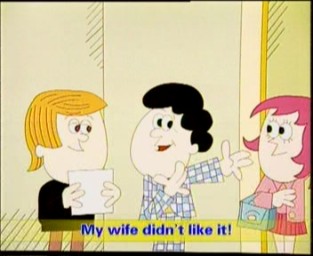
Who is the woman?
Does his wife like the man with long beard?

Slide 17
Watch and answer the questions:
Where did Mike go on the trip?
He went to Australia.
Did he take many photos?
Yes, he did.
Did he meet some people during the trip?
Yes, he did.
Did he get a job during the trip?
Yes, he did.
What did he look like during the trip?
He had a long beard.

Slide 18
Listen and repeat

Slide 19
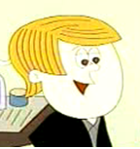
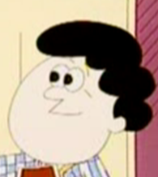
Picture 1
/'djʊərɪŋ/
Look, Scott. This is a photograph I took during the trip to Australia.
先行词
定语从句
Mike
Scott
Let me see it, Mike.
a trip to … 去…的旅行
一次去中国的旅行
a trip to China
Notes:
['kʌstəmə]

Slide 20
during/'djʊErIN/ 在...期间
We went to the Great Wall during the trip.
在夜晚期间
during the night
Amy has been studying English
___ the winter holiday.
A. at B. during C. between

Slide 21
We can play with our friends and get together with our families during holidays.
Welcome to our hotel! I hope you’ll have a good time ____ your stay here.
A. after B. during C. with D. since
B
Notes:
冀教链接： 七上U7 L41

Slide 22
Picture 2
Who are these people?
They are the people (who/that) I met during the trip.
定语从句
先行词
关系词为宾语可以省略

Slide 23
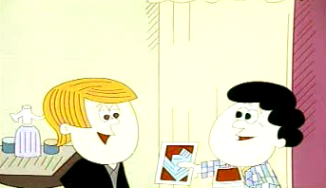
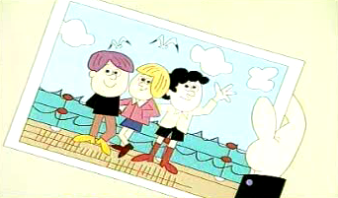
Repeat：
people ,met
photo, took

Slide 24
Picture 3
Mike
Scott
That’s the ship
we travelled on.
定语从句
What a beautiful ship!
先行词
travel /'trævl/
感叹句

Slide 25
由what引导的感叹句 what修饰名词或名词短语，
1. What+a(an)+（形容词）+单数可数名词+主语+谓语！
What an apple this is!
What a fine day it is!
2. What+(形容词）+可数名词复数或不可数名词+主语+谓语！
What kind women they are!
What nice music it is!

Slide 26
由How引导的感叹句
how用来修饰形容词、副词或动词。
其结构是：How+形容词（副词）+主语+谓语！
How clever the girl is!
How quickly the boy runs!

Slide 27
1. _____ pretty your dress is! Where did you get it?
A. How B. How a C. What D. What a
2. ---_____ lovely day! Let’s go for a picnic, shall we?
---Good idea!
A. What B. How C. What a D. How a
3. ______exciting match it is between Wang Liqin and Ma Lin in the 49th World Table Tennis Championships!
A. How B. What C. What a D. What an

Slide 28
5. ____ lovely weather! Let’s go on a picnic!
A. What B. What a C. How D. How a
6. The sun is shining. ______ fine day it is!
A. How B. How a C. What D. What a
7. _____ it’s blowing!
A. What strong B. How strong
C. How strongly D. What strongly
8. ____ great fun it is to hike!
A. What B. What a C. How D. How a

Slide 29
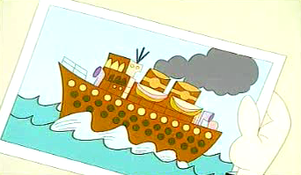
Repeat
ship, travelled on
what

Slide 30
Picture 4
Who is this?
That’s the man.
Mike told him about the man.
That’s the man(whom/that) Mike told him about.
定语从句
先行词
关系词为宾语可以省略

Slide 31
offer （主动）提供 /'XfE/
The one who offered Mike a job in Australia.
The one = the man(先行词）
Who作主语不能省

Slide 32
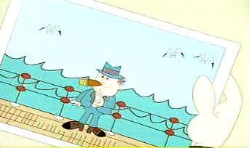
Repeat
Scot: Who’s this?
Mike: That’s the man_______________
Remember?
Scot: Ah yes.
Mike: The one___________________.
Scot: That’s right.
I told you about.
Who offered you a job in Australia.

Slide 33
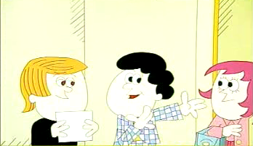
Picture 5&6
1.Who’s this?
It’s Mike.
2.When did Mike grow a beard?
During the trip.
3.Why did Mike shave it off?
Because his wife didn’t like it.

Slide 34
Repeat
Scott: Who’s this?
Mike: Guess!
Scott: ___________________?
Mike: That’s right.
Mike: I ______ a beard during the trip, but I __________ it _____ when I _______ home.
Scott: Why did you shave it off?
Mike: My wife didn’t like it.
It’s not you, is it?
grew
shaved
off
came

Slide 35
guess /ges/
Let’s play a guessing game.
guessing game
猜谜游戏
guess what
猜猜看，你猜怎么着
Notes:
冀教链接：七上U2 L4和冀教链接： 七下U1 L1

Slide 36
It’s not you, is it?
这不是你, 对吗？
That’s right.= Yes, it is.
不，是我。

Slide 37
反意疑问句要根据实际情况来回答，不对对方的话进行肯定或否定。
You are a student, _____ _______?
_____, ______ _______.
You are not a teacher, _____ ______?
______, _______ _______.
aren’t
you
Yes
I
am
are
you
No
I’m
not

Slide 38
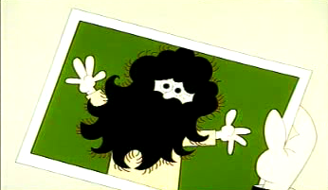
Repeat
photo, took
people ,met
ship, travelled on
grew a beard
Why…?
offered a job

Slide 39
Summary
在什么期间
旅行n.
旅行v.
提供
猜
成长
胡子
小猫
during
trip
travel
offer
guess
grow
beard
kitten

