Slide 1
Unit 1
Me and My Class
Lesson 2
Many Faces, One Picture

Slide 2
L2 Many Faces, One Picture
words:
1. perform /pəˈfɔːm/ v.表演；演出
2. advise /ədˈvaɪz/ v.劝告；忠告；建议
3. agree /əˈɡriː/ v.同意
3. glue /ɡluː/ v.用胶水将物体黏合 n.胶水
phrases:
1. advise sb. to do sth.
建议某人做某事
2. agree with 同意某人
3. be up to... 由...决定

Slide 3
Li Ming and Wang Mei are looking at their photos for the class picture.
Li Ming: That's a good picture of you, Wang Mei. You are wearing traditional clothes. You look like a dancer.
Wang Mei: Thank you, Li Ming. That's a picture of me from our Spring Festival show. Remember? You played the erhu, and I performed a dance. May I see your picture?
Li Ming: Sure. I have two pictures. Which one should I use? What do you think?
Wang Mei: Hmm... I like this one. You are wearing a red jacket and you are planting trees.
Li Ming: Danny likes the picture of me on the camel. He advised me to choose that one.
Wang Mei: I like the colour in the first picture，but it's up to you.
Li Ming：I agree with you. Thanks! Let's glue our pictures on the big paper. Then we can write some sentences to describe the pictures.

Slide 4
课文讲解
句子 1
That's a good picture of you, Wang Mei.
考向
a picture of ... ...的图片
B
Is that a picture _____ your sister? She peformed well in the performance.
A. with B.of C. in D. at

Slide 5
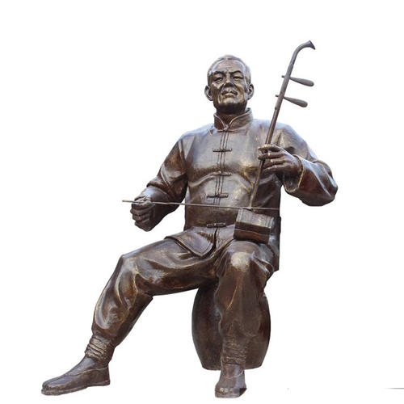
课文讲解
句子 2
You played the erhu, and I performed a dance.
play the erhu 乐器前要加the.
考向
C
Piano is _____ instrument. Langlang can play ______ piano well.
A. a; the B. a; / C. an; the D. an; /
考向
perform v. 表演
performer n. 表演者，演员
performance n. 表演，演出；表现
Today is the Art Festival of our school. Look! Our classmates are giving a _____________ (perform) on the stage(舞台).
performance

Slide 6
课文讲解
句子 3
He advised me to choose that one.
考向
v. advise sb. (not) to do sth. “建议某人(不要)做某事”
n. advice，为不可数名词[U] a piece of advice
B
1. Peter advises his cousin ______ early and run ten miles every day.
A．get up B．to get up C．gets up D．getting up
2. --Could you give some ______ on how to learn English well?
--Sure. Practice makes perfect.
A．advice B．advices C．advise D．advises
A
give some advice on...

Slide 7
课文讲解
句子 4
I like the colour in the first picture，but it's up to you.
考向
first 第一 序数词
1. (2018河北,75) In the_____ (one) class, Mr. Du came in and asked
me to go to the front.
2. (2017河北,73) My friend Sam is in the______ (ten) grade.
3. I like my ________ (one) day of the new term.
first
tenth
first

Slide 8
课文讲解
句子 4
I like the colour in the first picture，but it's up to you.
考向
be up to.... 由...决定
D
—When shall we go shopping?
—________ I'm free all these days.
A. Good idea. B. Why not?
C. Sounds great. D. It's up to you.

Slide 9
课文讲解
句子 5
I agree with you.
考向
agree with sb. 同意某人
agree to do sth.同意做某事
greed
1. My teacher a________ me to join an English club last year.
2. —Everyone should do something for our country.
—I agree ________ you.
A. to B. on C. at D. with
D

Slide 10
课文讲解
句子 5
Let's glue our pictures on the big paper.
考向
glue sth. on sth. 把某物黏到某物上
咱们把这照片粘在那个大纸上。
Let's g________ the photo on the big paper.
lue

Slide 11
Summary
L2 Many Faces, One Picture
1.单词： perform, advise, agree, glue
2.词组： ...的图片
拉二胡
建议某人去做...
同意去做
同意某人
把某物黏到某物上
由...决定
a picture of ...
play the erhu (乐器有the)
advise sb. to do
agree to do sth.
agree with sb.
glue sth. on sth.
be up to...

Slide 12
Practice L2
I.单选。
1. Do you have toys? I'd like to buy _______ for my cousin.
A．it B．one C．this D．that
2. Look! It's a picture ________ my family.
A．of B．on C．after D．with
3. Let's ________ a picnic. It's a fine day.
A．have B．to have C．has D．Having
4. Tony, remember ________ with your mouth full of food.
A．to talk B．not to talk C．talking
B
A
A
B

Slide 13
5．—That mountain in Guilin ________ an elephant.
—So it does.
A．looks up B．looks like C．looks for D．looks after
6. We ________ be more careful, or we will make the same mistake
in the experiment.
A．might B．can C．may D．should
7. —What do you think of the house, dear?
— ________ I can't find a better one.
A．Too bad. B．Too expensive.
C．Good idea! D．Pretty good!
8．Anna ________ a red dress. She looks more beautiful.
A．wear B．wore C．is wearing D．will wear
B
D
D
C

Slide 14
II.根据短文内容，补全文中单词或用所给单词的正确形式填空。
Today is the Art Festival of our school. Look! Our classmates are
1. ________ (perform) a dance on the stage (舞台). I plan to take
2._______(photo) of them. And then 3. g____ them on the wall of our classroom. I am going to advise my classmates 4. _______(write) some sentences about the pictures. Do you 5. a_____with me? I think it's a good idea.
performing
photos
lue
to write
gree

Slide 15
Ⅲ.连词成句。
1．again, nice, you, meet，to
_______________________________________________.
2．question, asks, me, he, a
_______________________________________________.
3．those, pictures, I, like
_______________________________________________.
4．you, did, last year, have a trip
_______________________________________________?
5．have, exciting, I, talk, Jenny, with, an
_______________________________________________.
Nice to meet you again
He asks me a question
I like those pictures
Did you have a trip last year
I have an exciting talk with Jenny

Slide 16
Thank you!

