Slide 1


I’m going to study computer science.
新目标八年级上册
Unit 6

Slide 2

Warm up

Slide 3
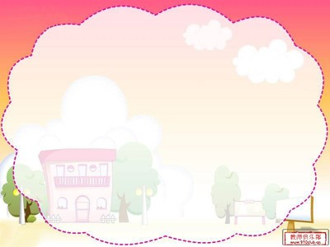
Phonetics

Slide 4

Phonetics
/ʊ/
//
/ʊ/
pilot
//
reason
sitcom
army

Slide 5
Phonetics
//

Slide 6
Phonetics
//

Slide 7
Phonetics
//

Slide 8
Phonetics
//

Slide 9






Phonetics
1.He became very _____/rItS/ and successful.
2.He was always ______/redi/ to try his best.
3.Mickey became the first cartoon ________ /kQrEKtE/ .
4. I can’t _____/st/the pictures .
5.When people say________/kVltSE/ , we think
of art and history.
rice
ready
character
stand
culture

Slide 10
Phonetics
Read .Notice the linking.
A: What do you think of the news on CCTV 9?
B: I like watching the English news. I watch it
every day.
A:Why ?
B: Because I hope to find out what’s going
on around the world .

Slide 11




Exercise
1. My sister is serious ___ her homework.
A. to B. with C. about
2. The movie is ____,I feel very ____.
A. relaxing ; relaxing B. relaxed; relaxed
C. relaxed ; relaxing D. relaxing ; relaxed
3.Her father __Sports World, but her mother
___.
A .like ; don’t B. like; doesn’t
C. likes ; doesn’t D. likes ; don’t

Slide 12
Exercise
4.What do you think of the new book ?--___.
A. I’d love to B. I think so
C. I love it D. That’s right
5.Would you mind ____the door ?
A. open B. opens C. opening D. opened
6.It’s ___hot. I can’t ____ it .
A. also ; stand B. also; standing
C. too; standing D. too; stand
7.Please give it to my wife if anything should__.
A. to happen me B. happen with me
C. to happen with D. happen to me

Slide 13
Exercise
8.___ I use your new bike ?---Certainly !
A. Should B. May C. Might D. Must
9. She expects ___ Hong Kong next week.
A. to go to B. her to go to
C. going to D. that going
10. Are you ____ there tomorrow ?
A. ready for B. ready to go
C. ready going D. ready to

Slide 14
Exercise
用所给词的适当形式填空
1. My friend asked me ______(go) out with
him, but I had no time.
2. I don’t want my sister _____(walk) to school,
so I lend my bike to her.
3. Are you ready _______(help) the blind man
with us ?
4. I hope ______(buy) a big house for my
parents.
5.Mr. Li asks the students ________( not swim)
in the river, because it’s too dangerous.
to go
to walk
to help
to buy
not to swim

Slide 15
Exercise
1. What do you think of the town ?(同义句)
___ ____ you ____ the town ?
2.The story is very interesting. (划线提问)
____ ____ you ____ of the story ?
3.Does your sister love the game ?(变陈述句)
____sister ____ the game.
4. Tom likes playing soccer because it’s exciting. (划线提问)
____ ____ Tom_____ playing soccer?
How do like
What do think
My loves
Why does like

Slide 16
Grammar

Slide 17

Grammar
How are you going to do that?
你打算怎样去做呢？
I’m going to practice basketball every day.
我打算每天练习篮球。
一般将来时
be going to +动词原形
表示将来要发生的动作或将要存在的状态，或表示某人计划，打算或准备做某事。
(天气用be going to 不用will)

Slide 18
Grammar
标志性时间状语
tomorrow,
the day after tomorrow ,
在…以后, in two days
this afternoon
this evening/tonight
next week/month/year , when I grow up.
in the future
明天和后天
in+段时间
今天下午和今晚
下周，下月和明年
当我长大，在未来
soon/later记心间。

Slide 19
Grammar
I am going to see my friend tomorrow.
(X)
I’m not going to see my friend tomorrow.
( ?)
Are you going to see your friend tomorrow?
(肯,否)
Yes , I am.
No , I’m not.
_____ ___ you going to ___tomorrow?
What are
do

Slide 20
Grammar
He is going to read some books later.
(X)
He isn’t going to read any books later.
( ?)
Is he going to read any books later?
(肯,否)
Yes , he is. / No, he isn’t.
____ _____ he going to read later?
What is

Slide 21

Exercise
Tom and Lily are going to see a movie next week.
(X)
Tom and Lily aren’t going to see a movie next week.
(?)
Are Tom and Lily going to see a movie
next week ?
(肯,否)
Yes , they are. / No, they aren’t.
Who
______are going to see a movie next week?

Slide 22
Sum up
一般将来时的肯定句：
主语+be going to +动词原形+其他。
一般将来时的否定句：
主语+be not going to +动词原形+其他。
一般将来时的一般疑问句：
Be+主语+going to +动词原形+其他?
肯定回答：
否定回答：
Yes ,主语+be.
No,主语+be not.
一般将来时的特殊疑问句：
疑问词+be+主语+going to +动词原形+其他?

Slide 23
Exercise
1.My mother is going to cook this evening.(否定句)
My mother ____ going to____ this evening.
2.I am going to see my friends this weekend(一般)
___ you going to see ____friends this weekend?
3.Is your sister going to play the game. ?
_____ , ____ _______.(否定回答)
4.Are the twins going to clean the room?
____, ____ _____.(肯定回答)
isn’t
cook
Are
your
No she isn’t
Yes they are

Slide 24
Exercise
划线提问
1.We are going to have dumplings for supper.
____ ___ ___ ____ __ ____ for supper?
2.A new teacher is going to come to my school.
____ __ _____to come to your school?
3.They are going to meet in the library next week.
_____ are they _____ ___meet next week?
4.I am going to study English tonight.
____ ___ ___ going to study English?
5.Tom and Bob are going to help the old man.
_____ are Tom and Bob going to____?
What
are
you
going
to
have
Who
is
going
Where
going
to
When
are
you
What
do

Slide 25
Grammar
be going to +动词原形 将要…
= will +动词原形
We’re going to …
I’m going to …
He / She is going to…
We will=We’ll
I will=I’ll
He will/She will
=He’ll / she’ll

Slide 26
Grammar
be going to与will的区别
1.对未来事情的预测用will.
We___ ____ (not) use books to study in the future.
will not
2.will常表示说话人相信或要发生的事.
be going to 指某事肯定发生,常指事情很快要发生。
I believe Lucy_____ ____ (be) a good doctor.
will be
3.陈述将来的某个事实用will.
He _____ ten years old next year.
will

Slide 27
Grammar
4.表示现在决定将来的事用will.
I’m tired .I _____ go to bed.
will
5.表示意愿用will.
I _____tell you the truth .
will
6.表示计划，打算或准备做某事用be going to。
I ___ ___ ___ buy a computer this month.
be going to

Slide 28
Exercise
( )1. Next week he ___his pen pal in London.
A. is going to visit B. visit C. visits D. visited
( )2.They ___a picnic tomorrow .
A. have B. is having C. are going to have D. had
( )3.She__ a math teacher when she grows up.
A. is B. be C. am D. is going to
( )4. Next Monday Lily ___ to Paris on vacation .
A. is going B. goes C. go D. went
( )5.Ms. Green ____ her e—mails next week.
A. checks B. is checking C. checked D. is going to check
A
C
D
A
D

Slide 29
Unit6
I’m going to study computer science.
SA

Slide 30
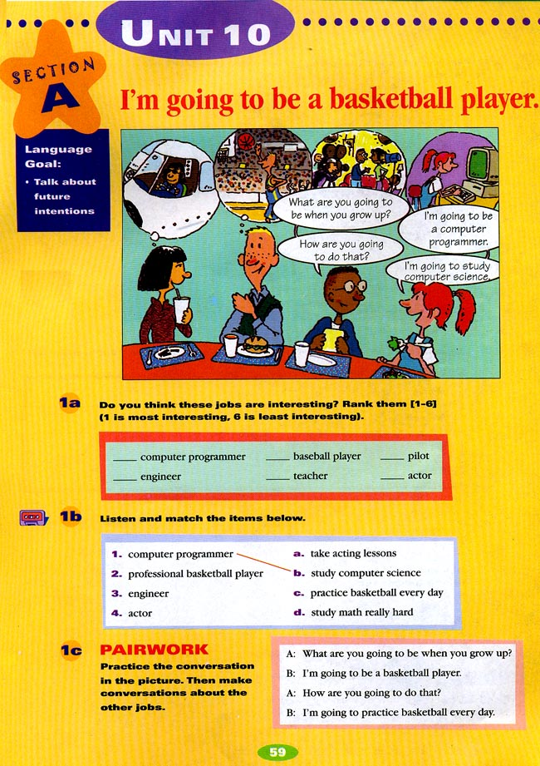
Lead in
What do you want to be when you grow up ? Let’s talk about your future intentions.
when you grow up当你长大时

Slide 31
New lesson
Guess their future intentions.

Slide 32
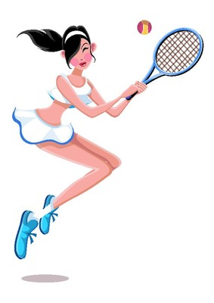




New lesson
What do you want to be when you grow up ?
I want to be a/an…
nurse
player
actress
singer

Slide 33
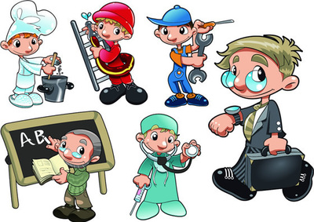
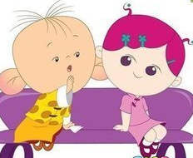
New lesson
What do you want to be when you grow up ?
I want to be a/an…
officer
worker
teacher
cook
doctor

Slide 34

New lesson
I want to be a/an…
pilot/palt/
飞行员
engineer/end n  /
工程师

Slide 35

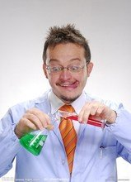
New lesson
I want to be a/an…
computer programmer
/prʊgrm/
电脑程序设计师 ,程序师
scientist //
科学家

Slide 36
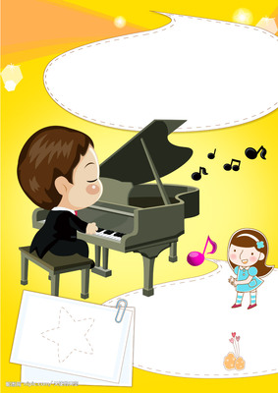
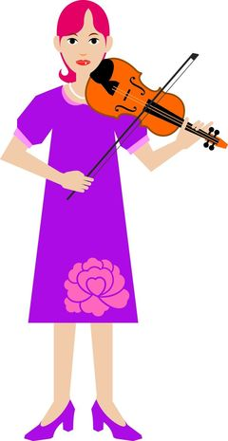
New lesson
I want to be a/an…
pianist/pnst/
钢琴家
violinist /vl/
小提琴手

Slide 37
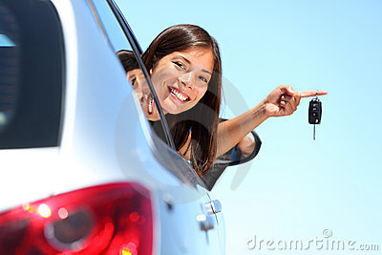
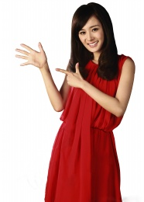
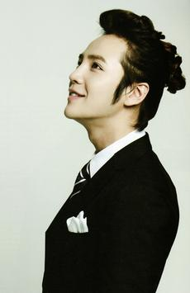
New lesson
I want to be a/an…
driver/drav/
驾驶员,司机
actor/kt/
演员
actress/ktr/
女演员

Slide 38

Sum up
intentions
--er
sing singer歌手
teach teacher教师
report reporter记者
play player运动员
--or
act actor演员
--ist
art artist画家
violin violinist小提琴家

Slide 39
Sum up
intentions
--ian
music musician音乐家
library librarian图书管理员
Others
doctor医生
nurse护士
bank clerk银行职员
policeman警察
shop assistant售货员

Slide 40
1a Do you think these jobs are interesting ? Rank them [1-12](1 is most interesting, 12 is least interesting) .
___computer programmer ___cook ___ doctor
____engineer ____ teacher ____ violinist
____bus driver_____ pilot _____ pianist
___basketball player ____ scientist ____actor

Slide 41

Notes
1.cook 1）n.厨师 2）v.烹调，煮
cooker n.厨具
1.My father is great_______.(cook)
2.My mother is ______(cook) the fish.
3.He bought a new _______.(cook)
cook
cooking
cooker

Slide 42
Notes
2.violinist n.小提琴手
violin n.小提琴
1.My sister is a _______.(violin)
2.My mother bought a ______(violin) for me.
violinist
violin
3. pianist n.钢琴家
piano n.小提琴
1.Lang Lang is a famous _______(piano).
2.I like playing the ______(piano) .
pianist
piano

Slide 43

1b
Listen and fill in the blanks. Then match the items.
1. computer programmer a. take ______lessons
2.basketball player b. study _______science
3.engineer c. practice _____ every day
4. actor d. study ____really hard
acting
computer
basketball
math

Slide 44

1c
Practice the conversation in the picture . Then make conversations about the other jobs in 1a.
What do you want to be when you grow up ?
I want to be a basketball player.
I’m going to practice basketball every day.
How are you going to do that?

Slide 45
Notes
1.What do you want to be when you grow up?
你长大后打算做什么呢？
when 与while 的用法
when | “当……时候”既指时间点，又指时间段，引导时间状语从句的动词可以是终止性的也可以是延续性的。 | When the teacher came in, the children were talking .
while | “当……时候”仅指一段时间，从句中的动词必须是延续性的，一般强调主语从句的动词同时发生。可作并列连词，意为“而”“却”，表示对比关系。 | Lisa was singing while her mother was playing the piano.

Slide 46
Exercise
用while ，when 填空
1._____ your father went to work , I was having breakfast.
2.Tom is strong _____ his younger brother is weak.
When
while

Slide 47
Notes
1.What do you want to be when you grow up?
你长大后打算做什么呢？
when 引导的时间状语从句。
若主从句的动作均未发生，则主句用一般将时 ,
祈使句或含有情态动词的句子，从句都用一般现在时代替一般将来时。
主将(祈，情）从现
我完成作业后，打算去打篮球。
I__ ____ __ play basketball when I______ (finish) my homework.
当他长大时，他打算成为一名医生。
He___ ____ __ be a doctor when he_____
(grow) up.
am going to
finish
is going to
grows

Slide 48
Notes
2.What do you want to be when you grow up?
你长大后打算做什么呢？
grow
/grEʊ/ v. 种植,生长,发育
grow-grows-growing-grew /gru:/
grow up 成长,长大
1.I want to be a teacher when I g___ up.
2.The farmers g___ strawberries from December to June.
row
row

Slide 49

Notes
3.I’m going to practice basketball every day.
我打算每天练习篮球。
practice v.练习
practice 后接名词，代词或动词的ing
1.My brother is _________(practice) the guitar
in the room.
2.You need to practice ________(speak)English
every day.
practicing
speaking

Slide 50
Notes
4.I’m going to practice basketball every day.
我打算每天练习篮球。
every day 每天
副词短语
everyday 每天的
adj.
1.He reads books_______.
2.This is our _______ homework.
A. everyday B. every day
B
A

Slide 51
Phrases
1想要成为
2长大
3学习电脑科学
4每天练习篮球
5上表演课
6打算
7努力学习数学
8电脑程序设计师
9每天
10公共汽车司机
want to be
grow up
study computer science
practice basketball every day
take/have acting lessons
be going to
study math really hard
computer programmer
every day
bus driver

Slide 52

Exercise
根据句意和首字母填空
My father is a d_____ in the hospital.
Tom plays the violin very well and he wants to be
v ______ .
3.My uncle is a c ____ and he makes the food well.
4.My father is a d_____ .He always drives the bus very day.
5. I like science but I don’t want to be a s________.
octor
iolinist
ook
river
cientist

Slide 53
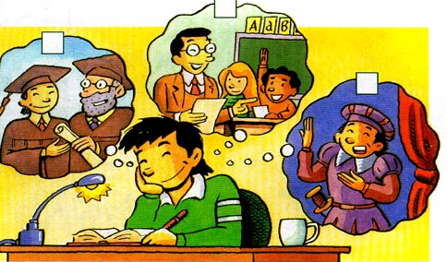
2a
Listen. What is Cheng Han going to do? Check(V) the correct boxes in the picture.
√

Slide 54
Listen again. What are Cheng Han’s plans for the future ? Complete the chart.
2b
What
He wants to be a teacher.
Where
He’s going to move to Shanghai.
He’s going to learn how to teach
children.
How
When
He’s going to finish high school and college first.

Slide 55
2c
Ask and answer questions about Cheng Han’s plans.
What does Cheng Han want to be?
He wants to be…

Slide 56

2d
2d
Listen and answer these questions.
1.Who is the writer of The Old Man and the Sea .
2. What does Ken want to be?
3.What do Andy’s parents want him to be?
Hemingway.
He wants to be a writer.
They want him to be a doctor.

Slide 57
2d
Role- play the conversation.
Andy:What are you reading ,Ken?
Ken :The Old Man and the Sea by Hemingway.
Andy:Wow , now I know why you’re so good at writing stories.
Ken : Yes ,I want to be a writer.
Andy: Really ? How are you going to become a writer?
Ken :Well, I’m going to keep on writing stories ,of course . What do you want to be ?
Andy :My parents want me to be a doctor , but I’m not sure about that.
Ken :Well, don’t worry . Not everyone knows what they want to be. Just make sure you try your best . Then you can be anything you want!
Andy : Yes , you are right.

Slide 58
Notes
1.The Old Man and the Sea by Hemingway.
1.by +作者 由……所著
Do you know the music by Mozart?
2.by +交通工具 乘……
I go to school by bus.
3.by +时间 到……点钟(为止）
He has to go home by 10:00p.m.
4.by +地点 在……旁边
We went camping by the river last week.
3.by +名词/动名词 通过，靠
He made a living by teaching.他以教书为生。

Slide 59
Notes
2.I know why you’re so good at writing stories.
be good at=do well in 擅长，在某方面做得好
后接名词，代词或动词的ing
My brother is good at________(speak)English.
speaking
=My brother ___ ____ ___speaking English.
does well in
write a story写故事
write stories写故事
My uncle is _____ (write) a story.
writing

Slide 60
Notes
3.I’m going to keep on writing stories ,of course .
keep on doing sth. 不断地做某事
后接名词，代词或动词的ing
keep on doing “不断地做”表示动作的反复
keep doing “不停地做”表示动作或状态的持续
1.Jim kept on_______(ask) questions
asking
2.He kept ______(wait) there for an hour.
waiting
3.( )Lucy___ on _____in class.
keep; stand B. kept ; stand
C. kept ; standing D. keep ; standing
C

Slide 61
Notes
4. My parents want me to be a doctor , but I’m not sure about that.
1)be sure about =be sure of对有把握；相信
后接名词，代词或动词的ing
This man is sure about _____(live) to ninety.
living
2)be sure to do sth.切记，必定，必然会
It is sure _____(rain).
Be sure not _______(forget)it !
to rain
to forget
3)be sure +从句 确信某事一定会……
We___(be)sure he will get good grades this term.
are

Slide 62

Notes
5. Well, don’t worry .
worry v. 担心
Tell your mother not ________(worry).
to worry
worry about 担忧，烦恼
Don’t worry ____me and look after yourself.
A. of B. about C. on D. after

Slide 63
Notes
6. Not everyone knows what they want to be.
what they want to be宾语从句,用陈述语序
1)I want to know______.
what you are doing B. where are you doing
C. when you are do D. what are you doing
2)We should think _______ to help others.
A. what can we do B. what we can do
C. how can we do D. how we can do

Slide 64
Notes
6. Not everyone knows what they want to be.
not everyone不是每一个人 不完全否定式
everyone不定代词作主语，谓语动词用单三
Not everyone ____(like)hamburgers.
A. like B. liking C. likes D. liked
Not every book is educational. (同义句)
= Every book is not educational.

Slide 65

Notes
7. Just make sure you try your best . Then you can be anything you want!
1)make sure 确保，核实，查证
2)make sure that 切记，必定，必然会
3)make sure of 弄明白，确信
--I’m leaving now.--- __you turn off the lights.
A. To make sure B. Make sure
C. Made sure D. Making sure
try one’s best to do sth.尽某人最大努力去做某事
You must try your best______(study).
to study

Slide 66
2d
Fill in the bkanks..
Andy:What are you reading ,Ken?
Ken :The Old Man and the Sea b___ Hemingway.
Andy:Wow , now I know why you’re so good a___ writing stories.
Ken : Yes ,I want to b__ a writer.
Andy: Really ? How are you g___ to become a writer?
Ken :Well, I’m going to keep o__ writing stories ,of course . What do you want to be ?
Andy :My parents w____ me to be a doctor , but I’m not sure about that.
Ken :Well, don’t worry . Not everyone k____ what they want to be. Just make sure you t___ your best . Then you can b___ anything you want!
Andy : Yes , you are r____.
y
t
e
oing
n
ant
nows
ry
e
ight

Slide 67
Phrases
1擅长
2写故事
3不断地做某事
4成为一名作家
5当然
6对有把握；相信
7想让某人做某事
8确保，核实
9必定，必然会
10尽某人最大努力
be good at=do well in
write a story=write stories
keep on doing sth.
become a writer
of course
be sure about/of
want sb. to do sth
make sure
be sure to do
try one’s best

Slide 68
Grammar Focus
What____ you ______(want)to be when you grow up?
I want to___(be) an engineer.
How are you going ______(do) that?
I’m going _______(study)math really hard.
Where are you going ________(work)?
I’m going _________(move) to Shanghai.
When are you going _______(start)?
I’m going ________(start)when I finish high school and college.
do
want
be
to do
to study
to work
to move
to start
to start

Slide 69
Notes
I’m going to start when I finish high school and college.
finish v,结束，完成
后接名词，代词或动词的ing
finish doing sth.结束做某事
1.When do you finish_______ your homework?
A. do B. doing C. does D. did
2.He finished _______(clean) the room .
cleaning

Slide 70
3a
Match what these people want to do with what they are going to do.
___1.My friend wants to be an engineer.
___2.My brother wants to be an actor.
___3.I want to be a scientist.
___4.My sister wants to be a school teacher.
___5.Those boys want to be soccer players.
___6.My friend and I wants to be singers .
___7.My cousin wants to be a cook.
___8.I want to be a race car driver.
e
h
f
d
a
c
g
b
a. They’re going to practice every day.
b. I’m going to buy a fast car.
c. We’re going to take singing lessons.
d. She’s going to student education.
e. She’s going to study math.
f. I’m going to study science .
g. He’s going to go to a cooking school.
h. He’s going to take acting lessons.

Slide 71
3b
Fill in the blanks . Then practice the conversation.
A :Kelly , what do you want to be _____you grow up?
B:I ________to be a doctor.
A:Wow ! _________ are you going to do that?
B:I’m ________ to study medicine at a university.
A :Hmm…sounds difficult . ____ are you ____ to study?
B:I’m going to ______in London.
A:_______are you going to start?
B:I’m going to ________next September.
when
want
How
going
Where
going
sound + adj.听起来……
study
When
start

Slide 72
3c
Complete the chart and discuss it with your partner.
A:What do you want to be when you grow up?
B:I want to be a reporter.
A:How are you going to do that?
B:I’m going to write articles and send them to magazines and newspaper.
What
Where
How
When

Slide 73
Notes
I’m going to write articles and send them to magazines and newspaper.
send…to 把…… 送到……
send sb. sth.=send sth.sb. 把某物送给某人
Anna sent me a toy.
=Anna sent ____ a toy___ ___.
send to me
send for 派人去请
你应该派人去请医生。
You should _____ ___a doctor.
send for

Slide 74
Exercise
1.If you are going to be an actor ,you have to_____.
A. take acting lessons B. take act lessons
C. take acting lesson D. take act lesson
2.He’s going to buy a big house when he__ more money.
A. has B. have C. will have D. is going to have
3.What’s your son going to ___when he grows up?
A. do B. have C. be D. play
4. There ____an interesting play on TV tonight.
A. are going to have B. is going to be
C. is going to have D. are going to be
5.Mary are going to take ____ lessons every day.
A.act B.acted C.acts D.acting

Slide 75
Exercise
1.I try ____ best ____English.
A. me;to study B. my; studying
C. my;to study D. me ;studying
2.-__did you tell him about the news. –By __an e-mail.
A. What ; sending B. How ; send
C. How ; sent D. How ;sending
3.Don’t ___ about me . I can look after myself.
A. look B. talk C. worry D. listen
4.The piano music ___very beautiful .
A. tastes B. looks C. sounds D. touches
5.Mary practices ____in the garden every morning.
A. sing B. sang C. to sing D.singing

Slide 76
Exercise
1.Tom and Bob are going to shop this afternoon. (一般)
____ Tom and Bob ____ to shop this afternoon?
2. She is going to fly kites this Sunday (划线提问).
____ __ she_____ to ____this Sunday?
3.The man is to work in New York next week (划线提问).
_____ is the man _____ ___work next week?
4.John is going to study English tonight. (否定句)
John ____ going to study English tonight?
5.My parents are going to clean the room. (划线提问)
_____ are your parents going to __?
Are
going
What
is
going
do
Where
going
to
isn’t
What
do

Slide 77
Unit6
I’m going to study computer science.
SB

Slide 78

Lead in
The new year is coming.
Are you going to make your New Year’s Resolutions?

Slide 79
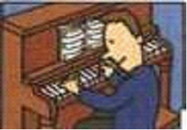
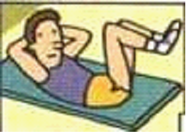
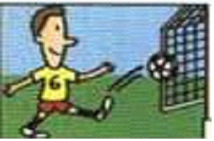
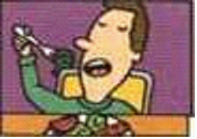
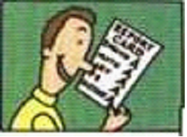
1a
Match the pictures with the New Year’s resolutions .
New Year’s Resolutions
Next year , I’m going to:
1. learn to play the piano
2. make the soccer team
3. get good grades
4. eat healthier food
5. get lots of exercise
1
5
2
4
3

Slide 80

1b What are you going to do next year ? Tell your partner.
A: What are you going to do next year ?
B: Well, I’m going to take guitar lessons.
I really love music .
A: Sounds interesting . I’m going to learn
another foreign language.
B: Are you ? Great! But foreign languages
are not for me.

Slide 81
Notes
1.Sounds interesting.
sound 声音 （自然界的一切声音）
noise 噪音
voice 嗓音
____ goes more slowly than light.
The ____ kept me awake.
I didn’t recognize my mother’s ___ on the phone.
Sound
noise
voice

Slide 82
Notes
2.But foreign languages are not for me.
foreign adj.外国的
foreigner n.外国人
1.I don’t understand what he says .He must be a
______.
2.He can speaks four kinds of ___languages
A. foreigner B. foreign
A
B

Slide 83
1c Listen and circle the resolutions you hear in 1a.
1a
Match the pictures with the New Year’s resolutions .
New Year’s Resolutions
Next year , I’m going to:
1. learn to play the piano
2. make the soccer team
3. get good grades
4. eat healthier food
5. get lots of exercise
1
5
2
4
3

Slide 84
1d Listen again . Write how the people are going to
make their resolutions work.
 | How are you going to do it ?
Lucy | She’s going to take piano lessons .
Kim
Mike
He’s going to study hard and do his homework every day.
He’s going to practice soccer really hard and go to a soccer camp this summer.

Slide 85
1e Make a list of other resolutions and how you are going to make them work. The discuss them with your group.
A:I want to be a teacher .
B:How are you going to do that?
A: Well ,I’m going to study hard and get good grades .
B:Sounds like a good plan . I want to get a lot of exercise.

Slide 86
Phrases
1取得好成绩
2 学习弹钢琴
3组建足球队
4多锻炼
5吃更有益健康的食品
6新年决心
7听起来像
8学另一门外语
9适合
10努力学习
get good grades
learn to play the piano
make a soccer team
get lots of exercise
eat healthier food
New Year’s Resolution
sound like
learn another foreign language
be for
study hard

Slide 87

Exercise
1.are , going, to, grow, up ,be, what, you, when ,you
_____________________________________?
2.I’m, get ,good ,going , to, grades.
__________________________________.
3.piano,brother,take,and,to,going,I,my,lessons,are
_____________________________________.
4.some, readers , are going to, more ,eat , vegetables
____________________________________.
What do you going to be when you grow up
I’m going to get good grades
My brother and I are going to take piano lessons
Some readers are going to eat more vegetables

Slide 88
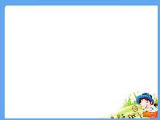
Lead in:
2a. Discuss the questions with your partner.
1.Dod you make any resolutions last year ?
2.Were you able to keep them? Why or why not?
be able to +v.原 “能”（用于多种时态）
I ____(be) able to speak English when I was
two years old.
was

Slide 89
2b
Read the passage and match each paragraph [1-3]
With the box. Underline the words and phrases that helped you decide .
3
___To question the idea of making resolutions
___ To give the meaning of resolution
___ To discuss the different kinds of resolutions
1
2

Slide 90
Notes
1.To question the idea of making resolutions
质疑下决心的观点。
question v.对表示质疑 ，提问
n.问题
1)He ________ (question)if you could do this.
2)Can I ask you some _______ (question)?
questioned
questions
2.To give the meaning of resolution
给出决心的含义
meaning n.含义，意思
1)Do you know the _______ (mean)of the word?
2)This is a word with six _______ (meaning).
meaning
meanings

Slide 91
Notes
3.To discuss the different kinds of resolutions
讨论不同类型的决心
different kinds of 不同种类的
a kind of 一种
all kinds of各种各样的
some kinds of 几种
1) He has many _______ fishes at home.
2)There are ______shoes in the store .
3)This is _____machine.
A
B
C
A. different kinds of B. all kinds of C. a kind of

Slide 92

1.Do you know what a resolution is? It’s a kind of promise . Most of the time , we make promises to other people.(“Mom, I promise I’m going to tidy my room when I get back from school.”)However, promises you make to yourself are resolutions ,and the most common kind is New Year’s resolutions. _______ When we make resolutions at the beginning of the year , we hope that we are going to improve our lives .Some people write down their resolutions and plans for the coming year. This helps them to remember their resolutions . Other tell their family and friends about their wishes and plans.
D
improve v. 提高
improve in在……有所提高

Slide 93
Notes
4.Mom, I promise I’m going to tidy my room when I get back from school.
promise v.保证，许诺
n.允诺，诺言
1.promise to do .许诺去做某事
2.promise sb. sth .许诺某人某事
3.promise + that 从句 答应……
My mother promised ________(buy) a piano for me.
My aunt _________(promise)me a bike .
Tom _________(promise) that he can return on time.
Lucy never keeps a _______(promise) .
to buy
promised
promises
promise

Slide 94
Notes
4.Mom, I promise I’m going to tidy my room when
I get back from school.
tidy v.整理，收拾
tidy adj.干净的
tidy up 整理收拾
untidy adj.不整洁的
Lily is ______(tidy) up her bedroom.
Please help me ____(tidy) my room.
My room is tidy but my younger sister’s is _______(tidy).
tidying
tidy
untidy

Slide 95
Notes
5.and the most common kind is New Year’s resolutions.
common adj.普通的，常见的
Grass is a very ______(普通的) plant.
common
common n.共有，平常
in common 共同，共有
He has a lot ___ ____(共同之出）with his father.
in common
common 不稀奇，平常的（指人没有职位，不高贵）
He wasn’t a hero but just a ________man.
common
usual 经常的，惯用的（强调习惯）
Playing chess is his ______ pastime.
usual

Slide 96
Notes
6.When we make resolutions at the beginning of the year , we hope that we are going to improve our lives .
at the beginning of在……初
at the beginning 起初
from beginning to end 从头到尾
这学期初，我发现学数学很难。
__ ___ ______ ___ this term ,I found it hard to learn math.
起初我不喜欢这条狗。
I dislike this dog __ ___ ______ .
我从头到尾读了这本书。
I read the book ____ ______ ___ ___ .
At the beginning of
at the beginning
from beginning to end

Slide 97
Notes
7.Some people write down their resolutions and plans for the coming year.
write down写下；记下
write it/them down
Please write down these new words. (同义句)
=Please write these new words down.
Please write______.
A. down it B. it down
B

Slide 98
Notes
8.This helps them to remember their resolutions .
remember sb./sthj记得某人/某物
remember to do sth.记得去做某事（未做的事）
remember doing sth.记得做过某事（已做的事）
Remember ______ (close) the windows when you leave the room.
I remember________(meet) you in Beijing.
to close
meeting

Slide 99
2.There are different kinds of resolutions . Some are about physical health . For example , some people promise themselves they are going to start an exercise program or eat less fast food . Many resolutions have to do with self-improvement. _______ Some people might say they are going to take up a hobby like painting or taking photos, or learn to play the guitar. Some resolutions have to do with better planning, like making a weekly plan for schoolwork.____________
B
A

Slide 100
Notes
9. Many resolutions have to do with
self-improvement.
1）have to do with关于,与……有关
2）have nothing to do with与……无关
Most of these questions _____(have) to do with his lessons.
Miss Wang ___(have) to do with this matter.
had
has
I ____ _____ ____ ___ _____ Tom.(与……无关 )
have nothing to do with

Slide 101
Notes
10.Some people might say they are going to take up a hobby like painting or taking photos, or learn to play the guitar.
1.take up学着做;开始做
2.take up占用
My father______(take) up the study of English at the age of forty.
When did you ____ (take) up music?
The chair _____(take)up too much room.
took
take
takes

Slide 102
3.Although there are differences, most resolutions have one thing in common. People hardly ever keep them !_____ Sometimes the resolutions may be too difficult to keep . Sometimes people just forget about them .
For this reason, some people say the best resolution is to have no resolutions !How about you --- will you make any next year?
C

Slide 103
2c
Which paragraph in the passage do you think each
sentences goes in ?Write the letters [A-D]in the correct places in the passage.
A. There are about making yourself a better person.
B. For example , a student may have to find more time
to study.
C. There are good reasons for this .
D. The start of the year is often a time for making
resolutions
D
B
A
C

Slide 104
2d
Answer the questions with short sentences.
1.What is a resolution?
____________________________
2.When do people usually make resolutions?
______________________________
3.Why do people usually make resolutions?
_________________________________
4. How can people remember their resolutions?
_________________________________
________________________________
5.How many kinds of resolutions does the writer talk about ?
________________________________
6.Why do you think resolutions may be difficult to keep?
____________________________________
7.Do you think the best resolution is to have no resolutions? Why or why not?
____________________________________
It’s a kind of promise
At the beginning of the year.
They hope that they are going to improve their lives .
Some people write them down and other tell their family and friends about their wishes and plans.
Three.
Because sometimes people just forget about them.
Yes. Because last year
I made my resolutions but I didn’t keep it.

Slide 105
2e
Find these phrases in the passage . Then write your own sentences with them.
have to do with_______________________
make promises_______________________
have…in common____________________
write down________________________
for this reason_______________________
take up___________________________
关于,与……有关
许下诺言
有……共同之处
写下;记下
由于这个原因
学着做;开始做

Slide 106
Exercise
1.每个人都不应该轻易地跟别人许下诺言。
Everyone shouldn’t _____ _____ _____ other people easily .
2.她尽力实践新年所下的决心。
She tried to carry her ____ _____ ______.
3.如果你同意我的话，请说“是的”。
If you ____ _____me ,please say “yes”.
4.汪东城明年打算学习一门新的外语。
Wang Dongcheng is going to _____ a new _____
language next year.
5.她打算每天锻炼以改善她的身体健康状况。
She is going to exercise every day to _______ her
_____ ______
make promises to
New Year’s resolution
agree with
learn
foreign
improve
physical health

Slide 107
3a
Complete the first two paragraphs about resolutions with the words in the box.
Resolutions____ promises to yourself. They may____ to make you a better person and to make your life easier . I am going to ____ four
resolutions.
The first resolution is about my own personal improvement . Next year, or maybe sooner, I am going to ____ up a new hobby . I think singing ____a great activity so I am going to ____ to sing. I think this will also make my family happy because they love to_____ to music and sing together.
are
help
make
take
is
learn
listen

Slide 108
3b
Write your resolutions under the following headings.
1.Ideas for improving my physicals health
_________________________________
2. Ideas for improving my relationships with my
family and friends
__________________________________
3. Ideas for doing better at school
_________________________________
get more exercise
go to bed early
help my parents with housework
help my classmates with their homework

Slide 109
3c
Use your notes to write three more paragraphs about your resolutions . In each paragraph , write what you are going to do and why
The second resolution is about improving my physicals health._________________________________
______________________________________
The third resolution is about improving my relationships with my family and friends. _________
_______________________________________
_______________________________________
The last resolution is about how to do better at school.
______________________________________
______________________________________

Slide 110
4
Imagine you work for your city . Think of a plan to make it cleaner and greener.
1.We are going to make the subway better. Then people don’t have to drive to work.
2.______________________________
_______________________________3._____________________________________________________________
4._____________________________________________________________
5._____________________________________________________________

Slide 111
Self check
1.Match the jobs with the school subjects.
1. computer programmer medicine
2. engineer computer science
3.doctor math
4. basketball player science
5.scientist P.E.

Slide 112
Self check
2Fill in the blanks in the conversation.
A:What do you _____ to be when you grow up?
B:I want _____ a scientist.
A:Wow ! That sounds cool . But it’s also different. _____ are you ______to do that?
B:After I finish high school, I’m ____ to go to university.
A:_____ are you ____ to study ?
B:In Hefei. I’m _______ to study there for four years.
A:I think I want _____ a teacher .I’m _____teach in Wuhan.
want
to be
How
going
going
Where
going
going
to be
going

Slide 113
Self check
3.Write about your plans.
Tomorrow ,I’m going to__________________
Next week ,_____________________________
Next month,______________________________
Next year,_______________________________

Slide 114
Exercise
cooking
My father finished _______(cook) dinner.
2.We are going to start________(study) Chinese
3.That sounds ________ (interest)!
4.Be sure not________(forget) it!.
5.Don’t worry about__________(swim) in the sea .
6.The girl is going to take _____(act) lessons.
7. Tom and I going _____(send) a letter to our teacher .
8.I am going to call him up when he_______(come)
here tomorrow.
9.We wanted__________ ( have) lunch .
10.Do you enjoy _______(play) soccer?
studying
interesting
to forget
swimming
acting
to send
comes
to have
playing

Slide 115
Exercise
1.Bob with his parents ___going to New York next year.
A. are B. will C. is D. were
2.I think what he said __his MP5 . It was lost yesterday.
A. has to do B. has to find
C. has to do with D. has to do for
3.My mother isn’t at home ,so I’m going to ___ the meal.
A. take out B. take up C. take off D. take away
4.If you want to talk to the foreigners ,you have to ____
your English.
A. enjoy B. write C. travel D. practice
5.If you work hard , you’ll get good ____.
A. grades B. notes C. lessons D. answers

Slide 116
Exercise
1.I’m going to be a basketball player.(同义句)
I ______ __ _____ a basketball player.
2. Did you have fun in the open air ?(同义句)
Did you ______ _______ in the open air ?
3.They are going to Beijing next month. （划线提问） _______ are they ______ next month?
4.He is going to play basketball tomorrow. (一般疑问句)
___ he ______ to play basketball tomorrow?
5.My father is going to learn French. （划线提问）
_____ is your father going to ___?
want
to
be
enjoy
yourself
Where
going
Is
going
What
do

Slide 117

Thank you !

