Slide 1

How often do you exercise?
新目标八年级上册
Unit 2

Slide 2
Warm up
everything something
anything nothing
everybody somebody
anybody nobody
everyone someone
anyone no one

Slide 3
Warm up
频度副词表频率,标志一般现在时
never从来不，hardly ever 几乎不
seldom 表很少，sometimes 是有时
often是经常，usually是通常
always 表总是，实前be后要记牢
其它频度有短语，放在句尾就可以
提问 how often记心里

Slide 4

Phonetic
//
//
//
dentist
//
online
swing
//
//
writer
hardly
coffee
least

Slide 5
Phonetic
Internet
program
percent
although
however

Slide 6
Phonetic
dentist
television
together
magazine
almost

Slide 7
Listen and read


We waited over an hour for the train because there were too many people. When we got to the top, it was raining really hard. We didn’t have an umbrella so we were wet and cold. It was terrible! And because of the bad weather, we couldn’t see anything below. My father didn’t bring enough money, so we only had one bowl of rice and some fish. The food tasted great because I was so hungry!





















Slide 8
Listen and read
Notice the stress and rhythm.
There’s a sport just for you,
So what can you do?
Badminton or basketball?
How about swimming?
Or just try them all!










Slide 9
Listen and read
Notice the stress and rhythm.


You don’t have to compete ---
Just stay healthy and fit!
Who cares if you’re not number one?
Just go out and have fun!







Slide 10
Listen and read
Notice the stress and rhythm.
Exercise every week,
At least once or twice.
Twenty minutes a day?
Now that’s really nice!









Slide 11
Phonetic
( )1./I/
( )2./s/
( )3./Q/
( )4./A:/
( )5./Eʊ/
A.did
A.test
A.father
A.date
A.most
B.size
B.is
B.have
B.past
B.dog
C.like
C.always
C.was
C.cabbage
C.potato
A
A
B
B
A

Slide 12
Phonetic
找出划线部分读音与其它不同的选项
（ ） 1. A. take B. man C.bag
（ ） 2. A. other B. much C. not
（ ） 3. A. boat B. town C. coat
( ) 4. A. three B. than C. think
( ) 5. A. her B. term C. shower
A
C
B
B
C

Slide 13
Oral English
Rick: Hi, Helen. Long time no see.
Helen: Hi, Rick. Yes, I was on vacation last month.
Rick: Oh, did you go anywhere interesting?
Helen: Yes, I went to Guizhou with my family.
Rick: Wow! Did you see Huangguoshu Waterfall?
Helen: Yes, I did. It was wonderful! We took quite
a few photos there. what about you? Did
you do anything special last month?
Rick: Not really. I just stayed at home most of
the time to read and relax.

Slide 14
Revision
Rick: Hi, Helen. Long time no see.
Helen: Hi, Rick. Yes, I was on vacation last month.
Rick: Oh, did you go anywhere interesting?
Helen: Yes, I went to Guizhou with my family.
Rick: Wow! Did you see Huangguoshu Waterfall?
Helen: Yes, I did. It was wonderful! We took quite
a few photos there. What about you? Did
you do anything special last month?
Rick: Not really. I just stayed at home most of
the time to read and relax.

Slide 15
Exercise
1).I ______（play） soccer yesterday.
played
2). We_____ (live) in Shanghai two years ago.
lived
3).He_______ (study) English the day before yesterday.
studied
4).He ________(stop) to have a rest just now.
stopped
5).They _______(build) a house last year.
built

Slide 16
Exercise
6).Where _____you_____(go)last weekend?
did
go
7).How ______(be)your weekend?
was
8).I ______(go)to the mountains yesterday?
went
did
do
9).What _____Tom______(do)last Monday?
He ______(stay)at home.
stayed
10).She ______(study)English in Beijing
last year.
studied

Slide 17
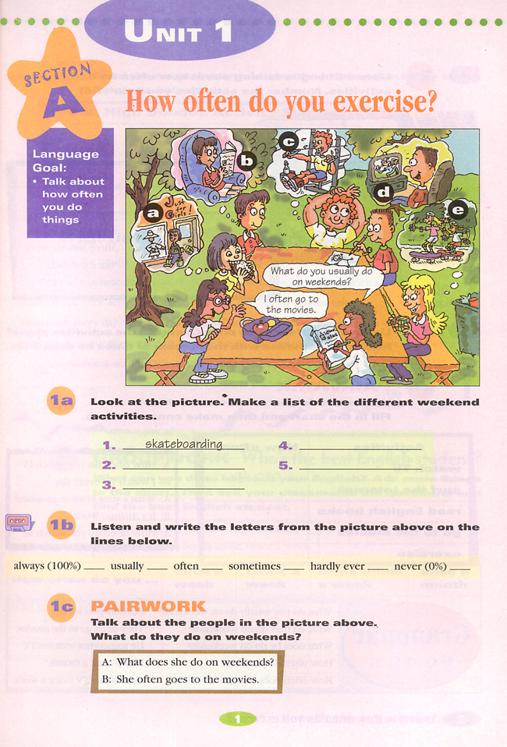
Free talk
What do you usually do on weekends ?
watch TV

Slide 18
What do you usually do on weekends ?
read

Slide 19
What do you usually do on weekends ?
exercise
/ˊeksEsaIz /
Exercise 专项练习（不可数）
指锻炼的这件事（可数）
do morning exercises做早操

Slide 20
What do you usually do on weekends ?
go shopping

Slide 21
What do you usually do on weekends ?
use the Internet

Slide 22
Ask and answer
A: What do you usually do on weekends?
B: I usually…
go to the movies
go shopping
go swimming
do some reading
stay at home
watch TV
listen to music
exercise
go skateboarding
Role play

Slide 23
Ask and answer
A: How often do you watch TV? B: I watch TV once a week.
every day once a week twice a week three times a week once a month twice a month

Slide 24
Exercise
常见的频度副词有：
always, usually , often,
sometimes, hardly ever, never
b. Once a week
twice a month
two or three times a year
every day
频度副词表频率,标志一般现在时
never从来不，hardly ever 几乎不
seldom 表很少，sometimes 是有时
often是经常，usually是通常
always 表总是，实前be后要记牢
其它频度有短语，放在句尾就可以
提问 how often记心里
I watch TV once a week.
How often do you watch TV ?
表频率

Slide 25
Exercise
频度副词短语 = 次数+ 一段时间.
eg.一年一次
一个月两次
两周三次
三天一两次
一个月三四次
一次两次特殊记，三次以上基数词+times
once a year
twice a month
three times two weeks
once or twice three days
three or four times a month

Slide 26
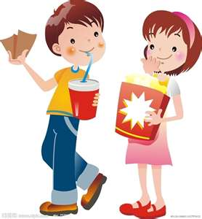
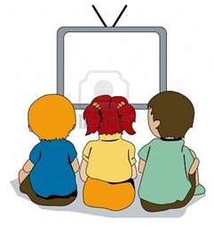
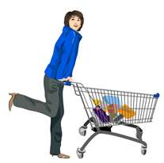
Exercise
频率短语
放句尾
How often do you … ?
does he
every day
every week
once a day
twice a day
three times a day
three or four times a day
I
He

Slide 27
Exercise
1. Mary usually goes shopping.
How often does Mary go shopping?
2. I go to the movies every day.
How often do you go to the movies?
3. I go to the movies every day.
What do you do every day?
4. Tom watches TV once a day.
How often does Tom watch TV?
5. Tom watches TV once a day.
What does Tom do once a day?

Slide 28
1a. Look at the picture. Make a list of the weekend activities.
help with housework
1.________________ 4._________________
2.________________ 5._________________
3.________________
play sports
go shopping
watch TV
read books

Slide 29

1b. Listen and write the activities next to the correct frequency words.
always (100%) __________________
usually __________________
often __________________
sometimes __________________
hardly ever __________________
never (0%) __________________
exercise
read
watch TV
help with housework
go shopping
watch TV
go shopping

Slide 30
1c. Practice the conversation in the picture above. Then make your own conversations about what you do on weekends.
A: What do you do on weekends?
B: I usually watch TV.
A: Do you go shopping?
B: No,I never go shopping.

Slide 31
Listening
2a. Listen. Cheng Tao is talking about how often he does these activities . number the activities(1-5) in the order you hear them.
2b. Listen again. Match the activities in 2a with how often Cheng Tao does them.
Activities How often
____ go to the movies every day
____ watch TV once a week
____ shop twice a week
____ exercise three times a week
____ read once a month
twice a month
3
1
5
4
2

Slide 32
2c. How often do you do these activities? Fill in the chart and then make conversations.
Activities | How often
Watch TV | Every day
Use the Internet
Read English books
Go to the movies
exercise
twice a week
A: How often do you watch TV?
B:I watch TV every day.
A:What’s your favorite program?
B:Animal World.
A:How often do you watch it?
B:Twice a week.
你最喜欢的节目是什么？

Slide 33
2d. Role-play the conversation.
嗨，杰克，你下周有空吗？
嗯，下周对于我来说相当忙，杰克
Jack: Hi, Claire, are you free next week?
Claire: Hmm… next week is quite full for me, Jack.
Jack: Really? How come?
Claire: I have dance and piano lessons.
Jack: What kind of dance are you learning?
Claire: Oh , swing dance. It’s fun! I have class once a
week, every Monday.
Jack: How often do you have piano lessons?
Claire: Twice a week , on Wednesday and Friday.
Jack: Well , how about Tuesday?
Claire: Oh , I have to play tennis with my friends .
But do you want to come?
Jack: Sure!
真的吗？怎么回事？
我要上舞蹈课和钢琴课
你在学什么种类的舞蹈？
哦，是摇摆舞，它很有趣！我每周上一节课，每个周一上
你多久上一次钢琴课
一周两次，周三和周五上
哦，那周二呢？
我要和我的朋友们打网球，那么你想来吗？
当然了

Slide 34
2d. Role-play the conversation.
be free空闲
be busy繁忙的
be full 充满的
Jack: Hi, Claire, are you free next week?
Claire: Hmm… next week is quite full for me, Jack.
Jack: Really? How come?
Claire: I have dance and piano lessons.
Jack: What kind of dance are you learning?
Claire: Oh , swing dance. It’s fun! I have class once a
week, every Monday.
Jack: How often do you have piano lessons?
Claire: Twice a week , on Wednesday and Friday.
Jack: Well , how about Tuesday?
Claire: Oh , I have to play tennis with my friends .
But do you want to come?
Jack: Sure!
怎么回事
…的种类
want to do sth. = would like to do sth.
想要去做某事
want sb. to do sth. 想要某人去做某事
e.g. She wants ____ (I) ________ (help) her with her English.
have+学科
钢琴课
have to +动词原形
e.g. I’m sorry, I can’t. have to _____ (do) my homework.
在星期前用on
do
play with sb 和…一起玩耍
e.g. Can you play _____ (with, and) us?
me
with
to help

Slide 35
Grammar Focus
What do you usually do on weekends?
What do they do on weekends?
What does she do on weekends?
How often do go to the movies?
How often does he watch TV?
Dong you go shopping
I always exercise.
They often help with housework.
She sometimes goes shopping.
I go to the movies maybe once a month.
He hardly ever watches TV.
No, l never go shopping.

Slide 36
3a.Complete the questions with do or does. Then match the questions and answers.
does
Yes. she usually does.
Hardly ever. I don’t them
He plays at least twice s week.
No , they don’t. They’re too busy.
Never. They always go to bed early.
Yes, I do. Every day.
How often _____ he play soccer?
____you drink milk?
How often ___ they stay up late?
________ Sue eat a healthy breakfast?
How often ___ you eat apples?
___ -your parents play sports?
Do
do
Does
do
Do

Slide 37
3b. Use the words given to write questions. Then ask and answer then with a partner.
Questions My parent’s answers
_________________________? __________
(how often/help with housework)
_________________________? __________
(what/usually/do/weekends)
_________________________? __________
(how often/best friend/exercise)
_________________________? __________
(what/usually/do/after school)
How often do you help with
housework
What do you usually do
on weekends
How often does your best
friend exercise
What do you usually do
after school

Slide 38
3c. What can you do to improve your English? Add more things to the chart. Then practice with your partner.
How often do you… | Names | Frequency
Read English books? | Lin Ying | twice a week
watch English program
listen to English tapes
join the English club
practice speaking English
sing English songs
A: How often do you read English books?
B: I read English books about twice a week.

Slide 39
Exercise
短语英汉互译
摇摆舞
每月两次
be full
at least
use the Internet
swing dance
twice a month
充满的
至少
使用互联网

Slide 40
Exercise
1. – Would you like some cakes and bread?
-- No, thanks. I’m f________.
2. M_______ you shouldn’t do like that. It is not good for you.
3. Animal World is very interesting, and it’s also my son’s favorite TV p________.
4. – Let’s search(搜索) the word on the I_______.
5. I h_______ ever see him now. What about you?
ull
aybe
rogram
nternet
ardly

Slide 41
Exercise
用所给词的适当形式填空.
1.The boy never______ (have) junk food .
2.Reading helps me __________ (learn) English well.
3. My brother _______ (surf) the Internet every day .
4.They __________(exercise) every weekend .
5.Jim goes to the library______ (two) a week .
has
(to)learn
surfs
exercise
twice

Slide 42
Exercise
单项选择
( ) 1. --How ______ do you watch TV? --Once a week.
A. much B. long C. often
( ) 2. Mr. White said that he had ________ visited the Great
Wall before. It’s his first time to come to China.
A. ever B. never C. once
( ) 3. I was so tired that I could ________ walk any farther.
A. hardly B. nearly C. really
( ) 4. I visit my grandparents ________ a month.
A. two times B. twice C. second time
( ) 5.Vegetable is good ______ people’s health.
A. on B. about C. for
C
B
A
B
C
be good for 对…有好处

Slide 43
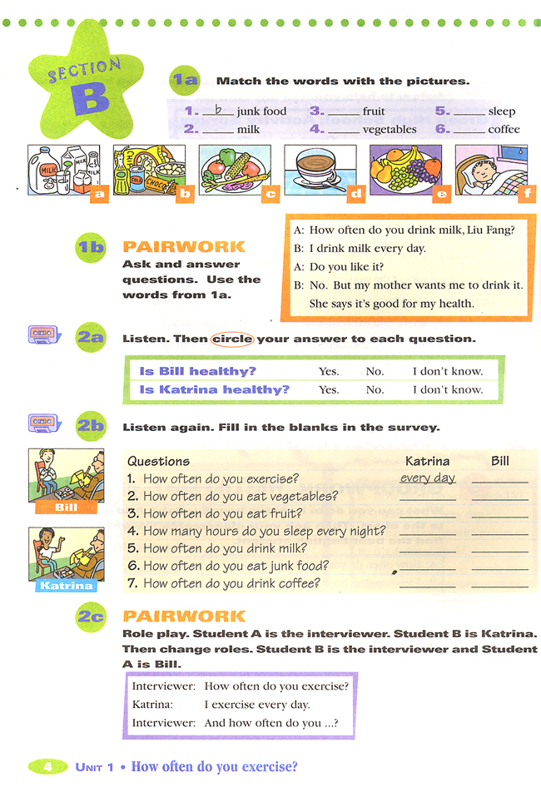
Look at the pictures
milk
junk food
/mIlk/
/dZVNk/

Slide 44
Look at the pictures
coffee
vegetables
/kXfI/

Slide 45
Look at the pictures
fruit
sleep

Slide 46
1a. Math the words with the pictures.
b
1.___junk food 2.___milk
3.___fruit 4.___vegetables
5.___sleep 6.___coffee
a
e
c
f
d

Slide 47
1b. Ask and answer questions. Use the words form 1a.
喝牛奶
A: How often do you drink milk, Liu Fang?
B: I drink milk every day.
否定：She doesn’t say
it’s good for my health.
A: Do you like it?
B: No. But my mother wants me _______(drink) it.
She says it’s good for my health.
to drink
从句
主句
be good for sth.对某事有好处
be good to sb.对某人有好处
be good at=do well in擅长做某事
(that)

Slide 48
Pay attention
1.be good for 对……有好处
2.be bad for 对……有坏处
3.be good at 擅长某事
4.be good to sb. 对某人友好
eg: 1.Mary is good ______ Chinese.
2.Drinking milk is good ____ your
health.
3.My teacher is good ____me.
at
for
to

Slide 49
1c. Listen to an interview about two people’s daily habits. Circle your answer to each question.
Is Tina have a good habits?
Yes. No. I don’t know.
Does Bill have a good habits?
Yes. No. I don’t know.

Slide 50
1d. Listen again. Fill in the blanks in the survey.
Questions Tina Bill
1. How often do you exercise? __________ __________
2. How often do you eat fruit? __________ __________
3. How many hours do you sleep every night?
______________ ________________
4. How often do you drink milk? _________ _________
5. How often do you eat junk food?
________________ ________________
6. How often do you drink coffee? _________ _________
every day
hardly ever
every day
never
nine
nine
every day
never
two or three times a week
three or four times a week
never
four times a day

Slide 51
2a. Rank these activities according to how often you think your classmates do them.
1=最经常
6=最不经常
(1=most often, 6=least often).
( ) watch TV
( ) go to the movies
( ) play computer games
( ) exercise or play sports
( ) use the Internet
( ) go camping in the country

Slide 52
2b. Read the article and complete the pie charts on the next page.
第五中学做什么的学生们在他们的业余时间？
上个月我们向学生询问了他们活动业余情况。
What Do NO. 5 High School Students Do in their Free Time?
Last month we asked our students about their free time activities. Our questions were about exercise, use of the Internet and watching TV. Here are the results.
我们的问题是关于锻炼， 网络的使用及看电视。
我们发现仅有15%的学生每天锻炼。
这是我们的调查结果。
We found that only fifteen percent of our students exercise every day. Forty-five percent exercise four to six times a week. Twenty percent exercise only one to three times a week. And twenty percent do not exercise at all!
45%的学生每周锻炼4到6次
20%的学生每周仅锻炼1到3次。
20%的学生根本不锻炼。

Slide 53
2b. Read the article and complete the pie charts on the next page.
我们都知道许多学生经常上网。
We all know that many students often go on line, but we were surprised that ninety percent of them use the Internet every day. The other ten percent use it at least three or four times a week. Most students use it for fun and not for homework.
但让我们吃惊的是90 %的学生每天都用互联网。
其他10%的学生每周至少使用3或4次。
大部分的学生用互联网只是为了娱乐而不是为了作业。
关于电视这个问题的回答也很有趣。
The answers to our questions about watching television were also interesting . Only two percent of the students watch TV one to three times a week. Thirteen percent watch TV four to six times a week. And eighty-five percent watch TV every day!
只有2%的学生每周看1到3次。
13%的学生每周看4到6次。
85%的学生每天都看电视。

Slide 54
2b. Read the article and complete the pie charts on the next page.
尽管许多学生喜欢看运动类节目，但游戏类节目是做受欢迎的。
Although many students like to watch sports, game shows are the most popular. It is good to relax by using the Internet or watching game shows, but we think the best way to relax is through exercise. It is healthy for the mind and the body. Exercise such as playing sports is fun, and you can spend time with your friends and family as you play together. And remember , ‘‘ old habits die hard”.
So start exercising before it ’too late!
通过上网和看游戏类节目是很好的放松方式，
但是我们认为最好的放松方式是锻炼。
比如进行体育活动这方面的锻炼是有趣的，
它对身心健康都有益。
当你们一起运动的时候，你可以和朋友家人一起度过时光。
请记住：“积习难改”。
因此在为时太晚之前就开始锻炼吧！

Slide 55
2b. Read the article and complete the pie charts on the next page.
What Do NO. 5 High School Students Do in their Free Time?
Last month we asked our students about their free time activities. Our questions were about exercise, use of the Internet and watching TV. Here are the results.
We found that only fifteen percent of our students exercise every day. Forty-five percent exercise four to six times a week. Twenty percent exercise only one to three times a week. And twenty percent do not exercise at all!

Slide 56
The points of 2b.
1. ask sb. about sth
为某人关于某事的情况
ask for + help 请求帮助
ask sb. to do sth.叫某人做某事
ask sb. not to do sth. 叫某人别做某事
about
I ask my teacher _____ today’s homework
about
Mary asked me something ______ my
birthday party.
He asks his friend _____help.
for
My mother asks me ______ do my
homework.
to

Slide 57
The points of 2b.
2. in one’s free time
在某人的空闲时间
3. Here are the results.
这是调查结果
Here is /here are 取决于后面的名词
Here位于句首要倒装
①如果主语是名词需完全倒装
Eg: Here is a letter for you .
②如果主语是代词需用部分倒装
Eg :Here it is.

Slide 58
The points of 2b.
4. found 原形是 find .
① find +人宾+名词 .
We found ______(he) a good boy.
him
② find +人宾+形容词.
He found the room ______(肮脏的）.
dirty
5. persent
基数词+percent
E.g.: She is richer than 90 _____ her neighbors.
A. percent B. percents C. percent of
C
6. not…at all
一点也不；根本不
I ________(not) know about it at all
don’t
He _____ (n0t）do his homework at all yesterday.
didn’t

Slide 59
2b. Read the article and complete the pie charts on the next page.
We all know that many students often go online, but we were surprised that ninety percent of them use the Internet every day. The other ten percent use it at least three or four times a week. Most students use it for fun and not for homework.
The answers to our questions about watching television were also interesting. Only two percent of the students watch TV one to three times a week. Thirteen percent watch TV four to six times a week. And eighty-five percent watch TV every day!

Slide 60
The points of 2b.
7. go online
上网
8. be surprised
惊讶
be surprised to do sth.
很惊讶做某事
e.g. I’m very surprise ________ (read) this newspaper.
to read
9. use the Internet
使用网络
10.at least
至少
11.The answers to our questions
这些问题的答案
to 有指向；对于；针对
the key to the door
门上的钥匙

Slide 61
2b. Read the article and complete the pie charts on the next page.
Although many students like to watch sports, game shows are the most popular. It is good to relax by using the Internet or watching game shows, but we think the best way to relax is through exercise. It is healthy for the mind and the body. Exercise such as playing sports is fun, and you can spend time with your friends and family as you play together. And remember , ‘‘ old habits die hard”.
So start exercising before it ’too late!

Slide 62
The points of 2b.
12.although连词意为虽然；尽管，用来引导让步状语从句
Although my grandpa is old, he looks very strong
and healthy. 我的爷爷虽然老了，但他看上去还是很健壮。
Although it rained , the boy still played outside.
=It rained ,but the boys still played outside.
but也有然而,但是的意思,但是不能与 although/though连用
Eg: My cousin knows a lot about geography ,
_____ he is only four years old
A. because B. so C. although
C
B
Eg: I get up very early today,___ I didn’t
catch the early bus.
A. and B. but C. although

Slide 63
The points of 2b.
13.It ’s +形容词（+for +sb.)+to do sth.
(对某人来说）做某事是…的
E.g. I often have hamburgers f’or lunch.
—You’d better not. It’s bad for you ______ too
much junk food.
A.eat B. to eat C. eating D.ate
B
14.by doing sth.
通过做某事
E.g. I go to school by _________(take )bus.
taking
15. the best way to do sth
做某事的最好方式
learn
E.g. The best way to ______(learn) English is
speaking English.

Slide 64
The points of 2b.
14. spend time with sb
和某人一起度过时光
Come and spend the weekend with us
人 spend 金钱 /时间 on sth
在某方面花费时间或金钱
人 spend 时间 in doing sth
花费时间或金钱做某事
E.g. I enjoy playing computer games , but I can’t
______ too much time _____ that.
A .take; doing B. spend; doing C. spend; for doing
B
15. die及时及物动词也是不及物动词
dead 形容词 死亡的
death 名词 死亡
16. start doing sth
开始做某事
watching
E.g. I start __________(watch) TV.

Slide 65
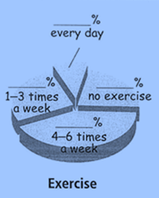
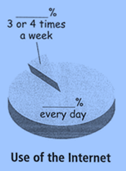
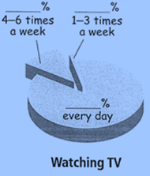
Complete the pie charts
10
13
2
15
20
20
90
85
45

Slide 66
2c. Read the article again and answer the questions.
1.How many percent of the students do not exercise at all?
2. How many percent of the students use the Internet every day?
3. How often do most students watch TV? What do they usually watch?
4. What does the writer think is the best way to relax? Why?
5. Do you think the students at No. 5 are healthy? Why or why not?
20% /Twenty percent of the students do not exercise t all.
90% /Ninety percent of the students use the Internet every day.
Every day. They usually watch game shows
Exercise. Because it’s healthy for the mind and the body.
No ,I don’t think so. Because they use the Internet for
fun not for homework and they watch TV too much.

Slide 67
2c. Read the article again and answer the questions.
1.How many percent of the students do not exercise at all?
2. How many percent of the students use the Internet every day?
3. How often do most students watch TV? What do they usually watch?
4. What does the writer think is the best way to relax? Why?
5. Do you think the students at No. 5 are healthy? Why or why not?
20% /Twenty percent of the students do not exercise t all.
90% /Ninety percent of the students use the Internet every day.
Every day. They usually watch game shows
Exercise. Because it’s healthy for the mind and the body.
No ,I don’t think so. Because they use the Internet for
fun not for homework and they watch TV too much.

Slide 68
2d. According to the article and the pie charts, write sentences with the percentages using always, usually or sometimes.
1. 90% Ninety percent of the students always use the Internet.
2. 85% _______________________________________
3. 45% _______________________________________
4. 10% _______________________________________
5. 13% _______________________________________
6. 2% _______________________________________
Eighty-five percent of the students watch TV every day.
Forty -five percent of the students exercise four to six times a week.
Ten percent of the students use the Internet at least three or four times a week.
Thirteen percent of the students watch TV four to six times a week.
Two percent of the students watch TV one to three times a week.

Slide 69
2e. Choose one of these free time activities or think of your own. Then ask your classmates how often they do this activity and make a pie chart.
How often do you play computer game?
How often do you …? | Names of classmates
1—3 times a week
4– 6 times a week
every day
Amy: I play computer games 1—3 times a week.
play computer games read books
go shopping draw pictures
play sports

Slide 70
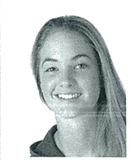
3a. Look at the information in the chart and complete the report.
Activities Days a year
Exercise 365
Read books 365
Watch TV for over 2 hours 320
Drink juice 210
Eat hamburgers 95
Help with housework 20
Stay up late 15
Go to the dentist 0
over 超过 = more than
反义词组：less than

Slide 71
3a. Look at the information in the chart and complete the report.
Jane is a 16-year-old high school student in the United States. American Teenager magazine asked her about her habits. Jane has a lot of good habits. She _________ exercises and she reads books _________. Also, she_______ drinks juice and she_________ stays up late. However, she has some bad habits, too. She________ watches TV for ⑴ more than two hours a day, and she_________ eats hamburgers. Her parents are not very happy because she _________ ⑵ helps with housework and she________ ⑶ goes to the dentist for teeth cleaning. She says she ⑷ is afraid!
always
every day
often
hardly ever
usually
sometimes
hardly ever
never

Slide 72
The points of 3a.
1.more than
相当于over意为 ；超过；多余
I lived in Shanghai for more than ten years. =
I lived in Shanghai for _______ ten years.
over
2.help sb. with sth.
在某方面帮助某人
E.g: I help Tom ______（to;at ;with)English .
3.go to the dentist
去看牙医
4, be afraid to do sth.
害怕去做某事
travel
E.g :I afraid to ________(travel) by plan.
be afraid of /sth.
害怕某人某事
be afraid of doing sth.
害怕做某事
E.g :Don’t afraid of ______ (ask) questions
asking

Slide 73
3b. Complete the chart with your own information. In the last column, use expressions like always, every day, twice a week and never.
 | Activities | How often?
Good habits
Bad habits
read English books
every day
do eye exercises
never

Slide 74
3c. Write a report about your good and bad habits. Say how often you do things. Use the report in 3a as an example.
______________________________
______________________________
______________________________
______________________________
______________________________
______________________________
I have a healthy lifestyle. I eat vegetables
at least four times a week. I …

Slide 75
4. Take the health quiz. Compare your results with your partner’s. Who’s healthier?
1. a=0, b=1, c=2 2. a=2, b=1, c=0
3. a=0, b=1, c=2 4. a=0, b=1, c=2
5. a=2, b=1, c=0 6. a=0, b=1, c=2
1. How often do you eat breakfast?
a. Never. b. A few times a week
c. Almost every day.
2. How often do you eat fast food?
a. Never. b. A few times a week
c. Almost every day.
3. How often do you eat vegetables and fruit?
a. Never. b. A few times a week
c. Almost every day.

Slide 76
4. Take the health quiz. Compare your results with your partner’s. Who’s healthier?
4. How often do you exercise?
a. A few times a year b. A few times a month
c. A few times a week
5. How many hours do you watch TV every week?
a. None b. One to four c. Five or more
6. How many hours do you usually sleep at night?
a. Less than six. b. Six or seven c. Eight or more
9—12 points: You’re really healthy! Good for you – and you health.
4—8 points: You’re smart about your health most of the time.
0—3 points: You have to learn more about healthy habits. Don’t worry – you can do it!

Slide 77
1. Complete the chart with activities you do and don’t do. What about your mother/father?
 | I | My mother or father
always
usually
often
sometimes
hardly ever
never
do homework
clean the room
use the computer
watch TV
……
……

Slide 78
3. Fill in the blanks in the conversation.
A:What do Tom and Mike ______ do on
weekends?
B:They sometimes go to the museum.
A:_________do they go to the shopping center ?
B::________ ever. Maybe about twice a month .
A:__________ to they watch TV ?
B:Mike never watches TV, but Tom watches TV______ day.
A: Oh, I ’m just like Tom. I ______watch TV, too.
usually
How often
Hardly
How often
every
always

Slide 79
Exercise
1. My sister watches TV twice a week. (划线提问)
_____ ______ _____ your sister watch TV?
2. I exercise two hours a day. (划线提问)
_____ _____ _____ do you exercise a day?
3. She eats junk food once a week. (划线提问)
_____ _____ _____ does she eat junk food a week?
4. Mr. Wang may be in poor health. (同义句)
______ Mr. Wang ____ unhealthy.
How
often
does
How
many
hours
How
many
times
Maybe
is

Slide 80
Exercise
1. I sometimes read storybooks at home. (划线提问)
______ ______ do you read storybooks at home?
2. They often play basketball on Saturdays and Sundays. (同义句)
They often play basketball ______ _______.
3. I like English best in the school. (同义句)
English is my _______ _______ in the school.
4. She often goes shopping with her friend. (划线提问)
______ ______ she often do with her friend?
How
often
on
weekends
favorite
subject
What
does

Slide 81
Exercise
1. It isn’t warm today, ___ the sun is shining.
A. or B. and C. because D. although
2. I think twenty percent of the students ___ Wang Dongcheng’s new songs.
A. likes listening to B. like to listen
C. likes to listen D. like listening to
3. Summer holiday is coming. Li Lei with his father ___ to go to Shanghai.
A. want B. will want C. wants D. wanted
4. Can you speak a little louder? I can ___ hear you.
A. hard B. really C. hardly D. clearly

Slide 82
Exercise
用所给词的适当形式填空
1. Where _______ (do) Mary go on vacation?
2. How often does Mary __________(exercise)?
3. Mr Li ________(run) two miles in the morning.
4. Tom probably_________(work) out twice a day.
5. Billy always ________(wear) a uniform.
does/ did
exercise
runs
works
wears

Slide 83
Exercise
句型转换
1.My brother often play sports every day. (划线提问)
_____ ______ does your brother play sports?
2.Peter usually goes to the park.(一般疑问句)
______ Peter usually_____ to the park ?
3. drink, often, how, your, does, milk, mom (连词成句)
_____________________________________
4. I always watch TV. (否定句)
I ______ ______ TV.
How
often
Does
go
How often does your mom drink milk ?
never
watch

Slide 84
Exercise
I don’t like tomatoes, so I _______ (ever) eat them.
Are there a lot of ________ (act) in you school?
Tom’s aunt is very lazy. She ______ (hard) exercises. Now she’s getting fatter and fatter.
Mrs. Green eats dumplings ______ (two) a month.
How often do you go ________ (shop), Linda?
never
activities
hardly
twice
shopping

Slide 85
Exercise
1. Most students read English books ___.
A. everyday B. every day
C. every days D. everydays
2. – Steve, ___ do you play basketball after school?
-- Twice a week. It can keep the healthy.
A. how far B. how soon
C. how long D. how often
3. Cathy was born blind so she has ___ seen our beautiful world.
A. often B. sometimes C. seldom D. never
4. What ___ your father usually do in the evening?
A. do B. does C. did D. is

Slide 86
Exercise
1.The boy never______ (have) junk food .
2.Reading helps me __________ (learn) English well.
3. My brother _______ (use) the Internet every day .
4.Please keep _________ (health) .
5.Jim goes to the library______ (two) a week .
has
(to)learn
uses
healthy
twice

Slide 87
Exercise
根据句意填写疑问词，每句一词。
1. -- ______ ______ children are there in the picture?
-- Six.
2. -- ______ do you often do on weekends?
-- I often draw pictures.
3. -- ______ ______ will we have the school sports meeting?
-- In two weeks.
4. -- ______ ______ does Mary have a music class?
-- Twice a week.
5. -- ______ ______ does the girl play the piano every day?
-- Three hours.
How
many
What
How
soon
How
often
How
long

