Slide 1
I’m more outgoing than my sister.
新目标八年级上册
Unit 3

Slide 2
Sing a song!
Warm up

Slide 3
Phonetics
/ʊ/
/`aʊʊ/
Phonetics
better
which
/`☹ʊ☹/
/bʊ /
reach
/w  n/
grade
/ʊ/
kid
care

Slide 4
Phonetics
选出发音不同的一项
( )1.A.quietly B. win C. which D. swing
( )2.A.through B. together C. than D. although
( )3.A.such B. full C. junk D. result
( )4.A.health B. least C. weather D. bread
( )5.A.swing B. dentist C. television D. such
A
A
B
B
C

Slide 5
Phonetics
给下列句子标重音:





1.My mother told me good friend is like a mirror.
2.I think friends are like looks—you don’t need a lot of them as long as they’re good.
3.My best friend helps to bring out the best in me.
4.A true friend reaches for your hand and touches your heart.



















Slide 6
Oral English
My life
I’m a student and I think I’m healthy. First, I like eating vegetables and fruit. And I drink milk every day. But I never eat junk food because it’s bad for health. Then I exercise four times a week. I like swimming. Finally, I sleep nine hours every night. I can go to bed early. On weekends, I have time to play basketball. So you see, I am healthy.
Oral English

Slide 7
Chant
频度副词表频率,标志一般现在时
never从来不，hardly ever 几乎不
seldom 表很少，sometimes 是有时
often是经常，usually是通常
always 表总是，be后动前要记牢
every day, every week,
every month, every year,
once a day, twice a day,
three times a day, four or five times a day
以上短语放句尾， 提问都用 how often
Revision

Slide 8
Revision
never
从不, 从未
0%
很少, 几乎不 否定
hardly ever
频度副词放在
be，情，助动后，实意动词前。
有时
sometimes
often
经常, 常常
usually
通常, 一般
always
总是
100%

Slide 9
Revision
I usually exercise.
He hardly ever watches TV.
Bob uses the Internet twice a week.
She reads every day.
How often do you exercise?
How often does he watch TV?
How often does Bob use the Internet?
How often does she read?

Slide 10
Phrases
1对……有好处
2少于
3比如，诸如
4超出，多于
5一点也不，根本不
6花费时间或金钱做某事
7害怕做去做某事
8 (对某人来说)做某事是…
be good for
less than
such as
more than
not… at all
spend … (in) doing sth.
be afraid to do
= be afraid of doing
it’s +adj.+for sb.+to do sth.

Slide 11
Exercise
1.Bill_____(drink)coffee once a week.
2.It’s easy ____ (eat)healthy food.
3.You must try_____(take)care of your health.
4.Jim doesn’t want______(play)tennis
with his mother.
5.What are the_________(different)
between your mother’s and your father’s
habits?
drinks
to eat
Exercise
to take
to play
differences

Slide 12
Exercise
6.My mother goes to Beijing_____(two) a year.
7.How many_____ ( hour ) do you read English every day.
8.Tom usually_____( start ) the day with breakfast.
9.Li Lei often_____(help) me with my Chinese.
10.He is afraid _____(go) out at night?
twice
hours
starts
helps
to go

Slide 13
Exercise
1. I usually play soccer on weekends.(划线提问)
____ ___ you usually ___ on weekends?
2. He watches TV twice a week. (划线提问)
_____ _____ ___he watch TV?
3. Jim does his homework at 8 every day.(否定句)
Jim ____ ____ his homework every day.
4. My favorite food is bread. (划线提问)
______ ____ favorite food?
5. She practices piano two hours every day.(划线)
_____ _____ ____ does she practice piano
every day?
What do do
How often does
doesn’t do
What’s your
How many hours

Slide 14
Exercise
1.I never do my housework.(划线提问)
2. Peter does his homework every day.(一般疑问)
3.My aunt shops three times a week. (划线提问)
4.He usually swims on weekends. (划线提问)
How often do you do your housework?
Does Peter do his homework every day?
How often does your aunt shop?
What does he usually do on weekends?

Slide 15
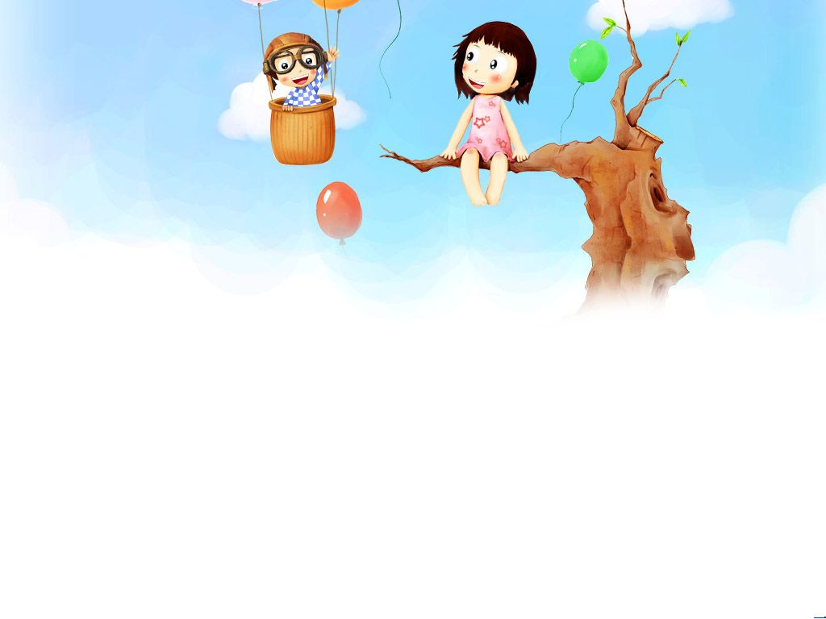
Unit 3
I’m more outgoing than my sister.
Grammar

Slide 16
My hair is long.
Lead in
My hair is longer than yours.
I’m taller
than you.
I’m tall.

Slide 17
Grammar
形容词副词比较级构成：
1. I am taller than my sister.
2.The flower is nicer than that.
3.This question is easier than that one.
4.Today is hotter than yesterday.
5.He is more careful than me.
6.Mrs. Wang is more friendly/friendlier
than Mr. Wang.
7.They go shopping more often than before.

Slide 18
Grammar
形容词副词比较级构成：
1.一般单词加 er,
2.以e结尾只加r,
3.辅音加y, y变 ier ,
4.元辅重读双写加 er,
5.多音节词，more+形原。
tall---taller
nice---nicer
easy---easier
hot---hotter
careful---more careful
friendly---more friendly/friendlier
除了单音节副词,和个别双音节副词词尾加er ,绝大多数副词前加more.
大胖子热,红瘦子湿和伤心的
big , fat , hot , red , thin , wet , sad

Slide 19
Exercise
tall
happily
big
calm
early
clever
fat
nice
heavy
interesting
taller
more happily
bigger
calmer
earlier
cleverer /more clever
fatter
nicer
heavier
more interesting

Slide 20
Exercise
serious
red
easily
late
thin
athletic
often
busy
smart
outgoing
more serious
redder
more easily
later
thinner
more athletic
more often
busier
smarter
more outgoing

Slide 21
Grammar
特殊单词特殊记：
合二为一共三对，坏病两多并两好；
一分为二有两个，一是远来，二是老
还有一词含双义，只记少来不记小。
特殊变化
bad(badly)/ill—worse—worst
many/much—more—most
good/well—better—best
little—less—least
far—farther—farthest
further—furthest
old—older—oldest
elder--eldest

Slide 22
usefully
easy
long
short
tall
careful
high
near
slow
warm
cool
fat
thin
wet
nice
dark
fast
hot
happy
red
sad
big
22

Slide 23
Exercise
写出下列词的比较级。
1.bad ________ 2. clean _______
3. dirty _________ 4. big _______
5. small ________ 6. ill ________
7. little ________ 8. happy ______
9. good _______ 10. new ________
11. easy ________ 12. well _________
13. hot ______ 14. interesting ________
15. beautiful _______ 16. late ________
17. carefully _______ 18. quickly _______
19. early ________ 20. many______
worse
cleaner
dirtier
bigger
smaller
worse
less
happier
better
newer
better
easier
hotter
more interesting
more beautiful
later
more carefully
more quickly
earlier
more

Slide 24
Knowledge points
形容词副词比较级的用法：
1.两者之间比较级，形式是 A 动词+ 比较级 + than B.
露西比我更高
Lucy is taller than me.
than+宾格
=I am _____than Lucy.
shorter
Lucy is taller than I am.
than+主格 be
=I am ______ than Lucy is.
shorter

Slide 25
Exercise
shorter
1.A rabbit’s tail is ______(short)than a cat’s tail.
2.Spring is coming . It becomes _____ (warm).
3.Jim runs fast. But Ben runs ______ (fast) than him.
4.Rock climbing is _______________ (dangerous ) than walking.
5.Jim is very tall. However, the basketball player is________(tall) than him.
warmer
faster
more dangerous
taller
Book P3 2

Slide 26
Knowledge points
形容词副词比较级的用法：
2.very , quite , so , pretty , too,修饰原级
friendly
She is very ______(friendly).She always help
others.
I live quite_____ (far)from Beijing than before.
Your shirt is so______(dirty).
The vacation is pretty______(good).
He eats too_____(much) things than before.
far
dirty
good
much

Slide 27
Knowledge points
形容词副词比较级的用法：
3.双方程度相等时，as+形原+as
变否定加not，第一个as可变 so not so…as
露西和我一样高
tall
Lucy is as ________(taller ) as me.
露西和我不一样高
Lucy is not so ________(taller ) as me.
tall

Slide 28
Knowledge points
形容词副词比较级的用法：
4.越来越… 比 and 比, more and more+形原
5. 越…就越… the+ 比 , the+ 比…
Spring is coming . The weather is ________
and _________(warm) .
warmer
warmer
The flower is more and more _______ (beautiful) .
beautiful
We often think things are the ___________ (expensive) the _____(good) .
more expensive
better

Slide 29
Knowledge points
形容词副词比较级的用法：
6.表示比某人大几岁,✗✗years older than…
7. like…better更喜欢 , like…best最喜欢
I am ten years old. My sister is eight years old.
=I am _____ years older than my sister.
two
younger
=My sister is two years ________ than I am.
better
Which subject do you like______ (well),English
or math ?
I like English ____ (well) at school .
best

Slide 30
Knowledge points
形容词比较级最高级的用法：
8. a lot ,a little, far , even和much, +比较级
taller
She is a lot_____(tall) than her sister.
This paper is a little_____(big) than that one.
The buildings look far ____ (ugly)in London than here.
Tom seemed even ______(strong )than before .
He eats much_____(much) meat than me.
bigger
uglier
stronger
more

Slide 31
Chant
原级，比较级用法总结
very , quite , so , pretty , too,修饰原级要记住
原级用在as…as间,(否定not so/as…as间)
比较级用在than前面；
and前后比较级,more and more+形原
译为越来越怎样
表示比某人大几岁,✗✗years older than…
the+比较级,the+比较级，越怎样就越怎样
like…better更喜欢 , like…best最喜欢
far , even和much,比较级前更怎样，
还有a lot和a little,比较级前也很牛。

Slide 32
Exercise
1.Tom is_______(calm) than Sam.
2. Allan is ________(thin) than Peter.
3. Tina is ___________(serious) than Ann.
4. Whose hair is _____(curly),yours or Lucy’s?
5.She is _____(fat) than her sister.
6.Ben runs_____(fast) than Jim.
7.I’m ______(young) than you.
calmer
thinner
more serious
curlier
fatter
faster
younger
Notes:
做3页4页习题。

Slide 33
Exercise
用所给词适当形式填空。
1.My mother is very____(old), but she looks________(young) than her age.
2. Mr. Wang is not as ___(tall) as Mr. Zhang.
3. Whose hair is _______(curly),
yours or Lucy’s?
4. Our teacher is much _________
(friendly) to us.
5. This apple is a little_______(big) than that one.
old
younger
tall
curlier
more friendly
friendlier
bigger

Slide 34
用所给词适当形式填空。
1.Which do you like_______(well),
English or Chinese?
2.She is a lot_____(fat) than her sister.
3.I’m not as_________(careful) as him.
4.The weather is getting _______ and_______(warm).
5.The_____(easy),the______(good).
6.Your classroom is ____(wide) and _______(bright) than ours.
Exercise
better
fatter
careful
warmer
warmer
better
easier
wider
brighter
Notes:
做书上4，5页习题

Slide 35
Exercise
用所给词适当形式填空。
7.She is _____(bad) than me at drawing.
8.The dog is barking all the time . It is so ______(noisy).
9.Who has _____(many) apples ,
Lucy or Lily?
10.It’s raining_______(heavy).
11.Does Jim run as ______(slow) as David? Yes, but Mike runs___________(slow) than them.
worse
noisy
more
heavily
slowly
more slowly
Notes:
做书上4，5页习题

Slide 36
Unit 3
I’m more outgoing than my sister.
Section A

Slide 37
Lead in
Here is a concert . The musicians are three pairs of twins . Can you compare them?

Slide 38
1a Match each word with its opposite.
tall loudly
thin short hair
long hair heavy
quietly short

Slide 39
1b
Listen and number the pairs of twins the picture [1-3].
1
2
Is that Sam?
No, that’s Tom . Sam has longer hair than Tom.
3
Peter
Both Sam and Tom can play the drums, but Sam plays them better than Tom .
both …and两者……都
这里原级是well

Slide 40
1c Practice the conversation in the picture above.
Then make conversations about the other twins.
A: Is that Tara, isn’t it?
B:No, it isn’t . It’s Tina . Tina is taller than Tara . And she also sings more loudly than Tara.

Slide 41
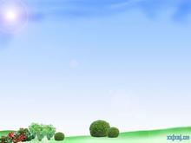
Notes:
1.That’s Tara, isn’t it?
那是塔拉，对吗？
本句是一个附加(反意)疑问句,表示提出情况
看法问对方同意与否。这种问句都由两部分成，
前一部分为陈述形式，后一部分为简短问句。
前肯后否，前否后肯
人称一致，前名后代
时态一致

Slide 42
Notes:
Your mother goes to work every day,
________ ________ ?
2. It’s a nice day, ______ _______?
3. Mary can’t play the piano, ______ ____?
doesn’t she
isn’t it
can she

Slide 43
2a
Listen. Are the words in the box used with-(i)er or
more? Complete the chart.
funny
friendly
outgoing
hard- working
smart
lazy
(run)fast
(jump)high (work )hard
(get up)early
-er/ier | more
friendly | outgoing
funny
hard--working
fast
high
hard
early
smart
lazy

Slide 44
2b
Listen again . How are Tina and Tara different ? Fill in the boxes.
__________________________________________________________________________________________________
________________________________
________________________________
Tina…
is more outgoing than Tara.
is friendlier and funnier
than Tara.
_____________________________________________________________________________________________________
__________________________________
_________________________________
can run faster and jump higher than Tara.
Tara…
works as hard as Tina .
gets up earlier than Tina.

Slide 45
Notes:
hard-working , hard work ,work hard
hard-working adj.勤勉的,努力工作的
hard work 名词短语 辛苦的工作
work hard 动词短语 努力工作
He is a ___________ boy.他是一个勤奋的男孩。
What _____ ______it is !这是多么辛苦的工作啊！
He always _____ ____.他总是努力工作。
hard-working
hard work
works hard

Slide 46
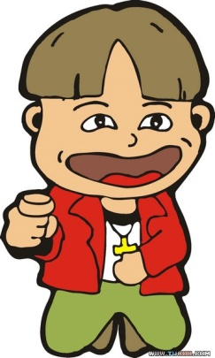
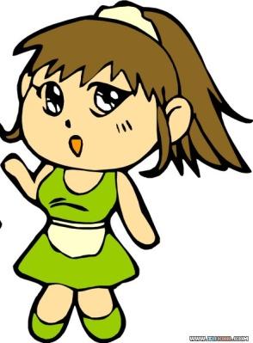
2c
Students A ,look at the chart on the right . Student B, look at the chart on page 81.Ask and answer questions about Sam and Tom.
Is Tom smarter than Sam?
No , he isn’t . Sam is smarter than Tom.

Slide 47
Students A ,look at the chart on the right . Student B, look at the chart on page 81.Ask and answer questions about Sam and Tom.
2c
Note:
…means Sam is taller than Tom.
 | Sam | Tom
smart
tall
run fast
get up early
thin
funny
hard-working
friendly

Slide 48
2d
Role play the conversation.
Julie: Did you like the singing competition yesterday ,
Anna?
Anna:Oh, it was fantastic! Nelly sang so well!
Julie:Well, I think Lisa sang better than Nelly.
Anna:Oh,which one was Lisa?
Julie:The one with shorter hair. I think she sang more clearly than Nelly.
Anna:Yes,but Nelly danced better than Lisa.
Julie:You can tell that Lisa really wanted to win,though.
Anna:Well, everyone wants to win . But the most
important thing is to learn something new and have fun.

Slide 49
2d
Fill in the blanks.
J: Did you like the_____ (sing) competition yesterday ,
Anna?
A:Oh, it was fantastic! Nelly sang so _____(well)!
J:Well, I think Lisa sang ____(well) than Nelly.
A:Oh,w_____ one was Lisa?
J:The one w___ _____(short) hair . I think she sang __________ (clearly) than Nelly.
A:Yes,but Nelly danced ______(well) than Lisa.
J:You can tell that Lisa really wanted _____(win) , though.
A:Well, everyone wants _____(win) . But the most important thing is ______(learn) something new and h___ fun .
singing
well
better
hich
ith
shorter
more clearly
better
to win
to win
to learn
ave

Slide 50
Notes:
1.Did you like the singing competition yesterday, Anna?
the singing competition歌唱比赛
the dancing club 舞蹈俱乐部
动名词作定语
2.Nelly sang so well!
sing so well唱得这么好

Slide 51
Notes:
3.Oh , which one was Lisa?
which “哪一个,哪一些”既可以指人也可指物,既可以
指可数名词单数,也可以指复数.
1)我不知道该选哪一个.
I don’t know ____ to choose.
2)他住在哪个城市？
____ ___ does he live in ?
哪本书更有趣，这本还是那本。
____is more interesting , this book or that one?
which
Which
city
Which

Slide 52
Notes:
4.You can tell that Lisa really wanted to win , though.不过你能看得出来,丽萨的确想赢。
win
赢得，获得
--won
--won
winning
win | “赢得，获得”后接比赛项目，奖品等 | 我们赢得了篮球比赛。
beat | “打赢，战胜”后接战胜的对手 | Tom在百米赛跑中战胜了所有的对手。
We won the basketball game.
Tom beat all the runners in the 100-meter race.
though
不过,然而,可是,常用于句末用逗号隔开。
吉姆说他会来，可是他没来。
Jim said he would come , he didn’t, ______ .
though
though=although不与but连用

Slide 53
Notes:
5. But the most important thing is to learn something
new and have fun.但是最重要 的是学到一些新东西并获得乐趣。
the most important 最重要(最高级）
have fun获得快乐，玩得开心
have fun= enjoy oneself= have a good time
have fun doing sth. 做某事很有趣
Do you have fun ______ (visit) that country?
visiting

Slide 54
Notes:
6. But the most important thing is to learn something
new and have fun.但是最重要 的是学到一些新东西并获得乐趣。
learn something new 学到一些新东西
something不定代词
不定代词若有定语修饰，定语要置于其后。
1.I see ________ _____.
我看到一些的东好西。
2.Is there_______ ________in today’s newspaper?
今天的报纸上有重要的事吗？
something
good
anything
important

Slide 55
Notes:
6. But the most important thing is to learn something
new and have fun.但是最重要 的是学到一些新东西并获得乐趣。
learn sth.学东西
learn to do sth 学习做某事
1.I am ________(learn) tennis .
2.He learned _______(swim)two years ago.
learning
to swim

Slide 56
Phrases
1歌唱比赛
2唱得这么好
3哪一个
4留着短发的这个
5想赢
6最重要的事情
7学到一些新东西
8获得乐趣/玩得开心
the singing competition
sing so well
which one
the one with short hair
want to win
the important thing
learn something new
have fun

Slide 57
Exercise
1.Do you like the ______( dance)competition ?
2.Do you have fun ______ (play) chess ?
3.He learned _______(speak) English 3 years ago.
4.Tom _____(sing )more clearly than Peter yesterday.
5.We really want _______ (win) the game.
6.He played the computer games ______(well) than
his brother.
dancing
playing
speaking
song
to win
better

Slide 58
Grammar Focus.
Is Tom_________ (smart) than Sam?
No , he isn’t. Sam is_________ (smart)than Tom.
Is Tara _____________ (outgoing) than Tina?
No , she isn’t. Tina is __________ (outgoing) than Tara.
Are you as_________ (friendly) as your sister?
No , I’m not. I’m ________ (friendly)
Does Tara work as______ (hard) as Tina ?
Yes, she does.
Who’s ________________ (hard-working) at school?
Tina thinks she works ________(hard) than me.
smarter
smarter
more outgoing
more outgoing
friendly
friendlier
hard
more hard-working
harder

Slide 59
3a
Use the words to write question and answers.
1.Julie / tall/you
Q:Is Julie as tall as you?
A:No, she isn’t .She’s ______ than me .
2.Jack / run / fast / Sam
Q:___________________________
A:No, he doesn’t . He runs_______ than Sam.
3.your cousin /outgoing / you
Q:___________________________
A:No, she isn’t . She’s ____________ than me .
4Paul / funny /Carol
Q:___________________________
A:No, he isn’t .He’s ________ than Carol.
taller
Does Jack run as fast as Sam?
faster
Is your cousin as outgoing as you?
more outgoing
Is Paul as funny as Carol?
funnier

Slide 60
3b
Think of yourself two years ago . Write about how you are different now.
1.Are you taller?
_____________________________
2.Are you funnier?
_______________________________
3.Are you more outgoing?
_____________________________
4.Do you study English harder?
___________________________
5.Do you sing better?
__________________________
Yes , I am .I am taller now than I was two years ago .
Yes , I am. / No , I’m not. I’m…
Yes , I am. / No , I’m not. I’m…
Yes , I do. / No , I don’t. I…
Yes , I do. / No , I don’t. I…

Slide 61
3c
Compare your parents . Check (V) who is smarter, funnier , etc. in the chart .Then ask your partner about his/her parents.
 | Mother | Father
smart
funny
work hard
outgoing
friendly
sing well
A:Who is smarter, your mother or your father?
B:I think my mother is smarter than my father.

Slide 62
Exercise
1.Lucy is very ___________(外向的).
2. I want to take part in the singing_________ (比赛).
3.Is Tara as__________ (勤奋的) as Tina ?
Yes , she is.
4. Don’t speak so ______(大声地) .
5. Allan , please speak more _______(清楚地).
outgoing
competition
hard-working
loudly
clearly

Slide 63
Exercise
1.Is Tom_________ (smart) than Sam? No , he isn’t.
2. Is Tara _____________ (outgoing) than Tina?
No , she isn’t.
3.Does Tara work as_____ (hard) as Tina ? Yes , she does.
4.Tom is_______(calm) than Sam.
5. Allan is ________(thin) than Peter.
6. She is interested in this _________(interest) film.
7. Beth is as ________(friendly) as Tara.
8. Tina is much___________(serious) than Ann.
9.The weather is getting _______and _____ (warm).
10.The_____(easy),the______(good).
smarter
more outgoing
hard
calmer
thinner
interesting
friendly
more serious
warmer
warmer
easier
better

Slide 64
Exercise
单项选择
( ) 1. I enjoy with you very much.
A. work B . to work C. working
( ) 2. The sweater is than that one.
A. much cheaper B. more cheaper C. more cheap
( ) 3. Jane is than me.
A. smarter B. smartest C. the smartest
( ) 4. Lucy and Lily students. They hard.
A. are both; both study B. both are; both study
C. are both; study both
( ) 5. Oh , all the cars here ! How can you pick up yours?
A. look like B. look the same C. look same
C
A
A
C
B

Slide 65
Unit 3
I’m more outgoing than my sister.
Section B

Slide 66
Oral English
My friend
I’m Susan . I have a good friend . Her name is Mary . We are both outgoing and smart. I am as hard-working as her . But I am different from Mary. I am taller than her . Her hair is longer than mine. What about you and your best friend?

Slide 67
Lead in
What do you think a friend? What kind of things are important in a friend ? Let’s talk about them.

Slide 68
1a What kind of things are important in a friend? Rank the things below[1-7](1 is the most important).
A good friend …
__a. has cool clothes.
__b. is talented in music.
__c. likes to do the same things as me.
__d. is good at sports.
__e. truly cares about me.
__f. makes me laugh.
__g. is a good listener.

Slide 69
1a What kind of things are important in a friend? Rank the things below[1-7](1 is the most important).
A good friend …
__a. has cool clothes.
__b. is talented in music.
__c. likes to do the same things as me.
__d. is good at sports.
__e. truly cares about me.
__f. makes me laugh.
__g. is a good listener.
be talented in music在音乐方面有天赋
the same as 与。。。。。。相同
be different from 与……不同
be good at=do well in擅长，在……方面做得好+名词/代词/动名词
care v. care about关心 care for喜欢，照顾
care n. take care 小心take care of =look after 照顾，照看
make sb. adj.使某人……
make sb. do sth.让某人做某事
laugh v.笑，大笑 smile v.微笑laugh at sb.嘲笑某人

Slide 70
1b
Talk about what you think a good friend should
be like .
A:I think a good friend makes me laugh.
B: For me , a good friend likes to do the
same things as me.
C:Yes,and a good friend is talented in music,too.
D: That’s not very important for me.

Slide 71
1c
Listen .What do Molly and Mary like about their best friends? Fill in the first column of the chart.
 | Like about their best friends | The same as their best friends | Different from their best friends
Molly | Peter likes to do the same things. |  | Molly studies harder.
Mary |  | They’re both tall. | Lisa is quieter .
Peter is popular , too.
Yes, she did. She went to a fun park.
Lisa is a good listener.
1d
Listen again. How are Molly and Mary the same
as and different from their best friends? Complete the rest of the chart in 1c.

Slide 72
Talk about Molly and Mary and their best friends.
A: Molly studies harder than her best friend.
B:Well , Mary and her best friend are both tall.
both两者都(系动词,助动词或情态动词后,行为动词前。)
we are both=both of us
We are both tall.
=_____ ____ ____ are tall.
Both of us
both A and B 既A又B。
I can speak____ English __Chinese very well.
both and

Slide 73
1在音乐方面有天赋
2关心
3与…相同
4与…不同
5擅长
6嘲笑某人
7使某人做某事
8两者都
Phrases
be talented in music
care about
the same as
be different from
be good at …=do well in…
laugh at sb.
make sb. do sth.
both… and…

Slide 74
用所给词适当形式填空。
1.I think a good friend make me_____(laugh).
2 ____(for, of) me, a good friend____(like) to do the same things as ___(I).
3. A good friend is good at _________(study).
4.It’s important for me ____(do) the same things.
5.He is ______(true) care about me.
Exercise
laugh
For
likes
me
studying
to do
truly

Slide 75
Exercise
句型转换
1.He likes swimming. She likes swimming, too.
(合成一句)
They _____ ____ swimming.
2. Kin is tall. Lucy is taller. (合成一句)
Lucy is _____ _____ Kin.
3. Lin Ping is funnier than Lin Li. (一般疑问句)
__ Lin Ping _______ than Lin Li?
4.They are both good students .（同义句）
___ ___ ___ are good students.
5.Jim is 12 years old.Tom is 14 years old.(同义句)
Tom is ____ ____Jim.
both like
taller than
Is funnier
Both of them
older than

Slide 76
Exercise
6.Liu Li is more outgoing than Liu Ying.(同义句)
Liu Ying is _____ _____ Liu Li.
7. Wang Jie is taller than Wang Hui. (同义句)
Wang Hui is _____ _____ Wang Jie.
8. This bike is different from that one. (同义句)
This bike isn’t the____ ___that one.
9. Jane has longer hair than July.(一般疑问句)
_____ Jane ____ longer hair than July?
10.He has fun playing tennis. (同义句)
He ___ _____ ____ _____playing tennis.
quieter than
shorter than
same as
Does have
has a good time

Slide 77
Lead in
Should friends be the same or different?
Let’s talk about you and your friends.

Slide 78
2a
Write the comparative forms of the following adjectives . Then use them to write five sentences about you and your friends.
popular ____________ funny__________
quiet_________ hardworking _____________
serious__________ friendly___________
outgoing __________ smart______shy______
more popular
funnier
quieter
more hard-working
more serious
friendlier
more outgoing
smarter
shier
My friend David is more hard-working than me , but I am funnier than him.
My friend Mary is more outgoing than me , but I am smarter than her.
My friend Mary is more popular than me , but I am more serious than her.

Slide 79
2b
Should friends be the same or different ? Read about what these people think . Underline the
comparative words and phrases in the passages.
My mother told me a good friend is like a mirror. I’m quieter and more serious than most kids . That’s why I like reading books and I study harder in class. My best friend Yuan Li is quiet too , so we enjoy studying together . I’m shy so it’s not easy for me to make friends . But I think friends are like books– you don’t need a lot of them as long as they’re good.
Jeff Green

Slide 80
Notes:
1.My mother told me a good friend is like a mirror.我妈妈告诉我，好朋友就像一面镜子。
1)like prep.像，和……一样
Our class is _____(像)a big family.
2)look like看起来像 （外貌像）
He_____ ____(看起来像) a teacher.
3)be like 看起来像（性格像)
My brother ____ (be ) like my father.
like
looks like
is

Slide 81
Notes:
2.I’m quieter and more serious than most kids .
我比大多数的孩子更文静，更稳重。
serious adj.严肃的，稳重的
（1）nothing serious 没什么严重的
（2）be serious about 对……认真
你的病没什么大不了的。
There is _____ ______ with you.
她说要辞职是认真的吗？
__ she _____ _____ giving up her job?
nothing
about
Is
serious
about

Slide 82
Notes:
3.kid n.小孩，年轻人 pl. kids
=child pl. children
All the ______(kid)are playing games.
=All the _______(child)are playing games.
kid v.欺骗，哄骗
kid-kidding-kidded
You are________(kid) me?
kids
children
kidding

Slide 83
Notes:
4.That’s why I like reading books and study harder in class.那就是我在课堂上喜欢读书，学习刻苦的原因。
That’s why…那就是……的原因
那就是我不想离开这里的原因。
_____ ____I don’t want to leave here .
我起晚了，那就是我没赶上公共汽车的原因。
I got up late, ____ _____I missed the bus .
That’s why
that’s why

Slide 84
Notes:
5.I’m shy so it’s not easy for me to make friends .
我很腼腆,因此对我来说交朋友不是很容易.
it 是形式主语，真正的主语是后面的动词不定式
it’s +adj.+(for sb)+to do(对某人来说)做某事是……
1)It’s bad for you _____(eat) so much junk food.
2)It’s dangerous for a child ______(stay) at home alone.
3)It’s important _____ English.
A. for us study B. of us to study C. for us to study
to eat
to stay
C

Slide 85
Notes:
6. …you don’t need a lot of them as long as they’re good. ..….你不需要很多，只要它们好就行。
1.as long as 只要，既然 （ 引导条件状语从句）
只要你努力学习，就会取得好成绩。
You will get good grades___ ___ __you work hard .
2.as long as 既然（引导原因状语从句）
既然你想待在家里，那就让我们在家下棋吧。
___ ____ ___you want to stay at home , let’s play chess at home.
as long as
As long as

Slide 86
It’s not necessary to be the same .
My best friend Larry is quite different from me. He is taller and more outgoing than me. We both like sports, but he plays tennis better,so he always wins. However, Larry often helps to bring out the best in me . So I’m getting better at tennis . Larry is much less hard-working,though.I always get better grades than he does, so maybe I should help him more.
Huang Lei

Slide 87
Notes:
1.It’s not necessary to be the same .
（和朋友）一样是没有必要的。
necessary必要的,必须的
比较级 more necessary
It’s necessary that you should be more careful.
=It’s necessary ___you __ ___more careful.
for
to be

Slide 88
Notes:
2.My best friend Larry is quite different from me.
我最好的朋友拉里与我很不一样。
1)与…相同
2)与…不同
the same as
be different from
Her skirt is the same as mine.
=Her skirt is not________ _____ mine.
different from

Slide 89
Notes:
3.Larry often helps to bring out the best in me .
然而，拉里经常帮助我显现出好的一面。
1)bring out 使显现，使表现出
2)bring out 出版，生产
展现给我们你最好的一面。
____ ___your the best in us.
我们上个月出版了新书。
We ______ __ new books last month.
Bring out
brought out

Slide 90
Notes:
4.I always get better grades than he does, so maybe I should help him more.我总是比他取得更好的成绩， 因此也许我应该更多的帮助他。
get better grades取得好的成绩
1）grade n.成绩
2）grade n.年级
Healthy lifestyle helps me get better______(grade).
He is in Class Five,_____(grade) Eight.
grades
Grade

Slide 91
I don’t really care if my friends
are the same as me or different .
My favorite saying is , “A true
friend reaches for your hand and
touches your heart.”My best friend
Carol is really kind and very funny .
In fact , she’s funnier than anyone I know . I broke my arm last year but she made me laugh and feel better . We can talk about and share everything. I know she cares about me because she’s always there to listen .
Mary Smith

Slide 92
Notes:
1. I don’t really care if my friends are the same as me or different .我真的不介意我的朋友是与我一样还是不同。
if 是否，引导宾语从句，常用于ask , know , wonder, find out
我不知道他是否在家。
I don’t know ____ he is at home.
if
if 如果，引导条件状语从句，“主将从现”。
如果明天下雨，我将不和你们一起去。
I won’t go there with you ___ it rains tomorrow.
if

Slide 93
Notes:
2. A true friend reaches for your hand and
touches your heart.真正的朋友是一个可以援手帮助并感动你心扉的人。
1） reach for sth.伸手取物
reach for your hand 援手帮助
2） reach +swh.到达某地
reach Beijing=arrive in Beijing=get to Beijing
3） touch your heart感动你心扉
put one’s heart into sth.全心做某事
take heart 鼓起勇气，振作起来

Slide 94
Notes:
3.I broke my arm last year but she made me
laugh and feel better .去年我的胳膊断了，但是她让我开心并感到更好。
break-broke-broken 破，碎，裂
今天早上这个男孩打破了窗户。
The boy ______(break)the window in the morning.
broke
4.We can talk about and share everything.
我们可以谈论并分享每一件事。
1)talk about sth.谈论某事
2)talk to/with sb.和某人谈话
share v.分享，共享
share sth.with sb.和人分享某物
My sister _____(share) the room with me.
shares

Slide 95
2c
Are the following statements true or false?
( )1.Jeff is less serious than most kids.
( )2.Jeff and Yuan Li are both quiet.
( )3.Jeff thinks it is easy for him to make friends.
( )4.Huang Lei is taller than Larry.
( )5.Huang Lei isn’t as good at tennis as Larry.
( )6.Larry works harder than Huang Lei .
( )7.Mary thinks her friends should be the same as her.
( )8.Carol broke her arm last year and Mary made her
feel better.
F
T
F
F
T
F
F
F

Slide 96
Exercise
to be
1.It’s necessary for you __ ___(be)more careful.
2. It’s important ______(stay)English.
3.A true friend ______(reach) for your hand and______ (touch) your heart.
4.We both like sports, but he plays tennis better , so he always_____ (win).
5.I always get better_____ (grade) than he does.
6.Larry often _____(help) to bring out the best in me .
7.I know she_____ (care) about me because she’s always there to listen .
8.She’s funnier than_____ (someone) I know.
to stay
reaches
touches
wins
grades
helps
cares
anyone

Slide 97
2d
How do you and your friends compare with the people in the article ?Write five sentences.
I’m different from Jeff because I’m louder than the other kids in my class . My best friends is similar to Larry because she’s less hard-working than me.
be similar to 与...相像的/相似的
His hat is similar to mine.
I am as hard-working as Huang Lei.
My best friends is as funny as Carol.
I play tennis better than Huang Lei .
My best friends is taller than Larry.
I like the saying better than Mary.

Slide 98
Notes:
1. I’m different from Jeff because I’m louder than the order kids in my class . 我与杰夫不同,因为在班里我比其他的孩子声音更响亮.
the other | 两个或两部分中的另一个或另一部分，“一个……另一个……”one……the other | He has two sisters , one is a teacher , the other is a doctor.
the others | 其他的人或物 =the other +复数 | You two stay here , the others go with me .
other | 作代词或形容词，可修饰可数名词单数 | We learn Chinese , Math , English and other subjects.
others | 其他的人或事物 | Some students are doing homework , others are talking loudly.
another | 三者或三者以上的“另一个”+单数可数名词 | I don’t like this one , Please show me another.

Slide 99
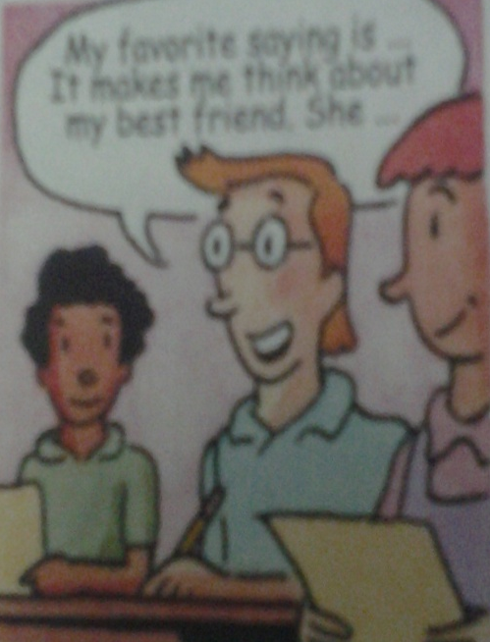
2e
Which saying about friends is favorite ? Which friend do you think about when you read this saying ? Why ? Tell your partner about it.
1.A good friend is like a mirror.
2.Friend are like looks—you don’t need a lot of them as long as they’re good.
3.My best friends helps to bring out the best in me.
4.A true friend reaches for your
hand and touches your heart.
My favorite saying is…
It makes me think about my best friend . She…

Slide 100
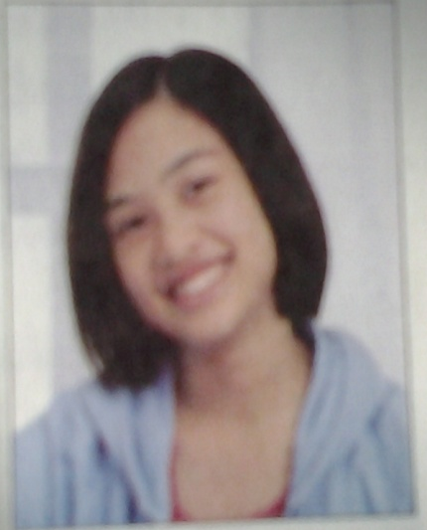
3a
Wang Lingling and Liu Lili are best friends Look
At the chart below and compare them.
Wang Lingling | Liu Lili
tall | tall
long straight hair | short straight hair
likes reading | likes sports
popular | popular
outgoing | outgoing
serious | funny
hard-working | smart

Slide 101
Wang Lingling’s best friend is Liu Lili . They are both tall , but…
they are different .
Wang Lingling’s hair is longer hair than Liu Lili’s . She likes reading. Liu Lili likes sports. Wang Lingling is more serious and more hardworking than Liu Lili . Liu Lili is funnier and smarter than her .They are both outgoing ,so they are very popular .

Slide 102
4
Read the job ad . Then compare two of your classmates . Decide which classmate is better for the job.
Student Help Wanted !
The English Study Center needs a
weekend student helper for primary
school student.
be a middle school student
have good grades in English
be good with children
be outgoing
Call the English Study Center at
443-5667 for more information.
call …at拨打……找……
Please ____Mr. Brown ___ 400-438756.
call at
information信息，消息（不可数名词）
Can you give me some ___________(information)?
information
A:Who do you think should get the job , Jerry or Jill?
B:Well , Jerry is smarter . I think she should get the job.
C: Jerry is smarter , but I think Jill is more outgoing.

Slide 103
Self check
1.Put the words in the correct columns in the chart.
hard-working run fast quiet serious jump high smart
What people are like | What people can do
hard-working
run fast
quiet
jump high
serious
smart

Slide 104
2.Fill in the blanks using the correct forms of the words in brackets.
1.My brother is _______(funny) than me . He makes people laugh a lot.
2.I’m outgoing,but my best friend is a lot ___________ (outgoing) than me.
3.My brother is as _______(serious) as my sister . They both like to study.
4.My cousin can run _____(fast) than me . She is taller than me , too.
5.Jim is __________(friendly)than Tom, so Tom has more friends than Jim.
funnier
more outgoing
serious
faster
less friendly

Slide 105
3.Think of your best friend .Write down two ways in which you
are similar , and two ways in which you are different.
Use comparatives .
1._____________________________________
2._____________________________________
3._____________________________________
4._____________________________________
I am as outgoing as Mary.
I am as hard-working as Mary.
I am lazier than Mary.
I sing better than Mary.

Slide 106
Exercise
( )1.She is not good at___ a bike.
A .ride B. to ride C. riding D. rides
( )2.Lily’s book is _____ nicer than yours .
A. very B. quite C. much D. too
( )3.Tom is quieter than Jim , _______?
A. is he B. does he C. isn’t he D. doesn’t he
( )4._____do you like better, this one or that one?
A. What B. Which C. Who D./
( )5.This watch is ______ than that one.
A. more cheaper B. much cheap
C. more cheap D. much cheaper
C
C
C
B
D

Slide 107
Exercise
( )6.Maybe bamboo is more useful than __in the world A. any plant B. all the plants
C. other plate D. the other plants
( )7.The more you smile , the ____you will feel.
A. happy B. happier C. happily D. more happily
( )8.They can help us get much_____ on the Internet.
A. game B. information C. idea D.message
( )9.Who is _____,Tom or Jim?
A.outgoing B.more heavy C.thinner D. hard-working
( )10.-What’s on __side of the hill, mum?-A big lake.
A. other B. others C. another D. the other
D
B
B
C
D

Slide 108
Exercise
1.Who ____(win) the race yesterday?
2.Tom’s shoes are as _____(cheaper)as Jim’s.
3.My best friend often makes me ____(laugh).
4.Did you have fun ______(visit)that country?
5.My brother is ___________(serious)than me.
6.He is good at _______ (swim) .
7.Tom __(be)similar to his brother.
8.It’s necessary for me _______ (make)friends.
9.Jack is much _____(thin) than any other boys.
10.He can do the work _____(well)than others.
won
cheap
laugh
visiting
more serious
swimming
is
to make
thinner
better

Slide 109
Exercise
1.He is smart . His brother is smart , too.(合成一句)
He is ____ ____ ____his brother.
2. Kin is taller than Lucy. (合成一句)
Lucy is _____ _____ Kin.
3. Lin Ping is funnier than Lin Li. (一般疑问句)
____ Lin Ping _______ than Lin Li?
4.We are both good students .（同义句）
____ ____ ____ are good students.
5.Jim is 12 years old . Tom is 14 years old.(同义句)
Tom is ____ ______ ____ _____Jim.
as smart as
shorter than
Is funnier
Both of us
two years older than

Slide 110
Exercise
6.Liu Li is older than Liu Ying.(同义句)
Liu Ying is _____ _____ Liu Li.
7. Mingming is heavier than Tingting. (同义句)
Tingting is _____ _____ Mingming.
8. This book is the same as that one. (同义句)
This book isn’t _______ ___that one.
9. Jane has longer hair than July.(一般疑问句)
_____ Jane ____ longer hair than July?
10.He does well in playing tennis. (同义句)
He __ ____ ___ playing tennis.
younger than
thinner than
different from
Does have
is good at

Slide 111
See you !

