Slide 1
新目标八年级上册
Unit 10
If you go to the party, you’ll have a great time!

Slide 2
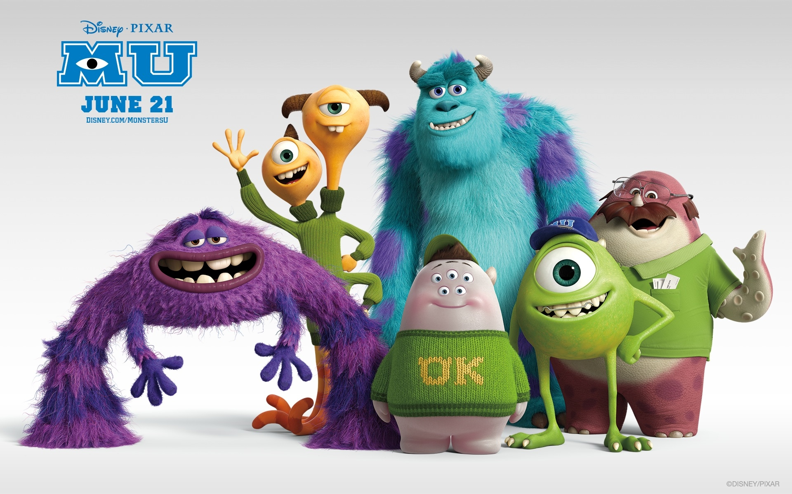
Greetings
Greetings

Slide 3
Warm up
if引导条件句，主从时态有规律，
含有if为从句，另外一句为主句。
从句一般现在时，原形单三看主语；
主句必须将来时，结构选择要注意，
will , won’t加动原，
“主将从现”牢牢记 ！

Slide 4
Phonetics
/vIdiEʊ/

Slide 5
Phonetics
/O:gEnaIz/

Slide 6
Phonetics
/tSXklEt/

Slide 7
Phonetics
/eIdZEnt/

Slide 8
Phonetics
/ti:neIdZE/

Slide 9
Phonetics
angry

Slide 10
Phonetics
expert

Slide 11
Phonetics
advice

Slide 12
Phonetics
upset

Slide 13
Phonetics
meeting

Slide 14
Revision
1. if引导的条件状语从句
可以放在句末也可以放在句首，当放在句首时，后面用逗号。
主将从现
2. have a great time
=have a good time
=have fun
=enjoy oneself 玩得开心；过得愉快
3. half the class 一半的同学

Slide 15
Exercises
生日聚会
1. birthday party ________________
2. watch a video _________________
3. play the games ________________
4. give sb. some advice _____________
5. 玩得愉快 ___________________________
6. 开班会 _____________________________
7. 乘坐出租车 _________________________
8. 炸土豆片；炸薯条 ___________________
看录像
做游戏
给某人一些建议
have a great time
have a class meeting
take a taxi
potato chips

Slide 16
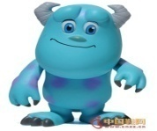
Exercises
1. ___ we don’t save water, we will have no water
to drink one day.
Where B. When C. Although D. If
2. March is a good time ____ Lijiang.
A. visit B. visits C. to visit D. visiting
3. I don’t know how to deal with my family
problem. Can you give me some ____?
A. advice B. messages C. information
4. Don’t speak loudly ____ the party. If you do,
you’ll ____ leave.
at;must B. of;have to C. at; have to
5. I wonder ____ Jenny will come this evening.
A. that B. what C. if D. which

Slide 17
Exercises
I stay at home. It rains tomorrow. (用if把
两句连在一起)
I _____ _____ at home if it _____ tomorrow.
2. I think. It won’t get warmer tomorrow. (合并
成复合句)
I _____ think it _____ get warmer tomorrow.
3. You can’t bring friends from other schools to
the party. (改为祈使句)
_____ ______ friends from other schools to
the party.
will stay rains
don’t will
Don’t bring

Slide 18
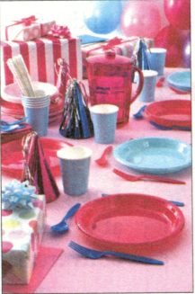
Lead in
Listen : What will people get if they play the games?
What are these?

Slide 19
2d
Listen and fill in the blanks.
Jeff: Hey, Ben. ____ the party next week, should we _____ people _____ bring food?
Ben: No, let’s _____ food from a restaurant. If we ask people to bring food, they’ll just bring __________ and chocolate because they’ll be too ____ to cook.
Jeff: OK. For the games, do you think we should give people some small _____ if they win?
Ben: I think that’s a great idea! If we do that, _____ people will want to play the games.
Jeff: Yes, the games will be ___________, too.
For
ask
to
order
potato chips
lazy
gifts
more
more exciting

Slide 20
Notes
1. … let’s order food from a restaurant.
咱们从饭店里订购食物吧。
order 及物动词 “订购；订货；点菜；命令”
order sth. from +地点 “从某地订购某物”
我从那家商店订购了些衣服。
I ______ some clothes ______ that shop.
order from
order sb. to do sth. “命令某人做某事”
命令他立即行动！
_____ him _____ act at once!
Order to

Slide 21
Notes
2. If we ask people to bring food, they’ll just bring potato chips and chocolate because they’ll be too lazy to cook.
如果我们让人们带食物来，他们将只带炸薯条和
巧克力， 因为他们太懒而不去做。
ask sb. to do sth. “要求某人做某事”
ask sb. not to do sth. “要求某人不要做某事”
我们的老师要求我们每天阅读。
Our teacher asks us ____ ____ every day.
to read

Slide 22
Notes
2. If we ask people to bring food, they’ll just bring potato chips and chocolate because they’ll be too lazy to cook.
如果我们让人们带食物来，他们将只带炸薯条和
巧克力， 因为他们太懒而不去做。
potato chips 炸土豆片；炸薯条
名词potato 作定语，变复数时只变后面的名词
表示性别的man或woman作定语修饰名词时，
如果变复数则man/woman以及其修饰的名词都要
变
a man teacher--
two men teachers
a woman doctor--
two women doctors
potato noodle--
potato noodles

Slide 23
Notes
2. If we ask people to bring food, they’ll just bring potato chips and chocolate because they’ll be too lazy to cook.
如果我们让人们带食物来，他们将只带炸薯条和
巧克力， 因为他们太懒而不去做。
too…to… “太……而不能……”
too…for sb. to… “对某人来说太……而不能……”
too…to…=not…enough to do sth. =so…that…
He is too young to go to school. (同义句)
He is not old enough to go to school.
He is so young that he can’t go to school.

Slide 24
Exercises
1. Let’s ______ (order) some books from the
bookshop.
2. Mum often asks me ____ more vegetables.
eat B. to eat C. eating D. ate
3. The little boy is ____ young ____ go to school
this year.
too;to B. to;too C. so;that D. too;too
4. –What are you doing? --They are talking about
_____ make Lily surprised.
A. how B. how to C. why D. what
order

Slide 25
Grammar
Focus
take
I think I’ll _______ (take) the bus to the party.
If you ______ (do), you ____________ (be) late.
I think I’ll ________ (stay) at home.
4. If you ______ (do), you ____________ (be) sorry.
do
will be
stay
do
will be

Slide 26
Grammar
Focus
will happen
5. What ____________ (happen) if they __________ (have) the party today?
6. If they _________ (have) it today, half the class _____________ (not come).
7. Should we _______ (ask) people to bring food?
8. If we _______ (ask) people ____________ (bring) food, they’ll just bring potato chips and chocolate.
have
have
won’t come
ask
ask
to bring

Slide 27
3a
Fill in the blanks with the correct forms of the verbs in brackets.
Dear Su Mei,
I don’t _______ (know) what to _______ (do) about going to Mike’s birthday party tomorrow night. My parents _______ (think) I should study for my English
exam next week. If I ______ (go) to the party, they ________ (be) upset. Mike _______ (tell) us to wear nice clothes, but I don’t _______ (have) any. If I ________ (wear) jeans, I ___________ (look) the worst. Also, I’m not sure how to _______ (go) to the party. If I _______ (walk), it ___________ (take) me too long. If I _______ (take) a taxi, it _______ (be) too expensive. Can you give me some advice please?
Tina
know
do
think
go
will be
told
have
wear
will look
go
walk
will take
take
will be

Slide 28
Notes
3. If I go to the party, they will be upset.
如果我去参加聚会，他们将会很难过。
upset adj. “难过的；失望的；沮丧的”
当他听到这个坏消息时，他将会感到很失望。
He will feel u _____ when he hears the bad news.
pset

Slide 29
Notes
4. If I take a taxi, it will be too expensive.
如果我乘出租车去，它将会太昂贵。
take a taxi“乘出租车”=by taxi
我有时乘出租车去上学。
I sometimes _____ _____ _____ _____
school.
take a taxi to
交通方式提问用疑问词how
How do you get to school?

Slide 30
Notes
5. Can you give me some advice please?
你能给我一些建议吗？
advice 不可数名词“劝告；建议”
一条建议 a piece of advice
许多条建议 some pieces of advice
给某人提一些建议 give sb. some advice
--Could you give us _____ about the party,
Mr. Zhang?
--Sure. I’m glad to do that.
A. some advices B. a advice
C. some advice D. an advice

Slide 31
3b
Complete the sentences using your own ideas.
1. If I get up late tomorrow,
_____________________________
2. If I don’t finish my homework,
_______________________________
3. If I don’t get enough exercise,
_____________________________
4. I will not have enough time to study if
___________________________
5. I will not make any friends if
__________________________
I will be late for school.
my teacher will ask me to do it after school.
I will be fat.
I play computer games.
I am not frinedly.

Slide 32
Sum up
1. order sth. from +地点 从某地订购某物
2. order sb. to do sth. 命令某人做某事
3. ask sb. to do sth. 要求某人做某事
ask sb. not to do sth. 要求某人不要做某事
4. too…for sb. to… “对某人来说太……而不能……”
too…to…=not…enough to do sth. =so…that…
5.一条建议 a piece of advice
许多条建议 some pieces of advice
给某人提一些建议 give sb. some advice

Slide 33
Exercises
1. We often have class m ______ on Monday.
2. Can you give me some a ______ on how to
learn English well?
3. We can help you to ________ (组织) an English
party.
4. I think we can’t watch a _______ (录像) at the
party.
5. My brother usually takes a ______ (出租车)
to work.
eeting
dvice
organize
video
taxi

Slide 34
Exercises
1.I will go to the party with Anna. (划线提问)
_____ _____ you go to the party ______?
2. Finish your homework and you can watch TV.
(改为条件状语从句)
___ you finish your homework, ____ can watch TV.
3. The teacher will be angry if we eat in class.
(划线提问)
____ will _________ if we eat in class.
4. They enjoyed themselves at the party yesterday. (变同义句)
They _____ ______ ______ ______ at the party
yesterday.
Who will with
If you
What happen
had a great time

Slide 35
Exercises
1. you, time, a, if, go, have, to, great, you, will,
party, the
___________________________________
2. will, what, the, they, today, if, have, happen,
party
___________________________________
3. bring, from, schools, don’t, your, other, friends
___________________________________
4. going, tonight, think, movies, I’m, to, to, go, I,
The
___________________________________
If you go to the party, you will have a great time.
What will happen if they have the party today?
Don’t bring your friends from other schools.
I think I’m going to go to the movies tonight.

Slide 36
Homework

