Slide 1
Do you want to watch a game show?
新目标八年级上册
Unit 5

Slide 2
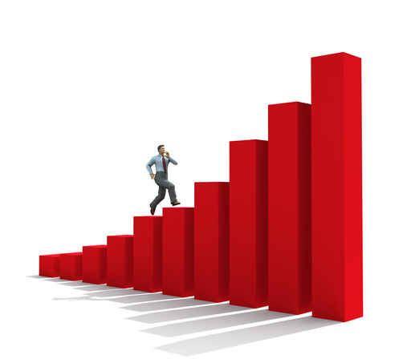
The first day

Slide 3
A : Hi, I’m Greg. I’m new in town.
B : Hi, I’m Helen . Welcome to the neighborhood! How do you like it so far?
A : It’s fantastic, but I still don’t really know my way around.
B : Well, the best supermarket is on Center Street. You can buy the freshest food there.
A : Oh, great. Is there a cinema around here? I love watching movies.
B: Yes , Sun Cinema is the newest one. You can sit the most comfortably because they have the biggest seats.
A: Thanks for telling me.
B: No problem.

Slide 4
Phonetics
action
hope
joke
cartoon
t
w3:s
tSi:pli
plan
klEʊs
skri:n

Slide 5
Revision
I. 写出下列形容词和副词的比较级和最高级.
1.tall _______ 2.hot______
3.short ______ 4.late_____
5.little_______ 6.wet_______
7.beautiful______ 8.often_____
9.wild_____ 10.funny_______
taller/tallest
hotter/hottest
shorter/shortest
later/latest
less/least
wetter/wettest
more beautiful
/most beautiful
more often
/most often
wilder/wildest
funnier/funniest

Slide 6
Revision
II. 用所给词的适当形式填空.
What’s the ____(good) movie theater ?
You can buy clothes the most ______( cheap ) there.
The DJs choose songs the most _______(careful)
Thanks for ____(tell) me.
We went to the ____(bad) restaurant last night.
best
cheaply
carefully
telling
worst

Slide 7
Revision
III.句型转换:
1.Funky Fashions has the worst clothes in town. (?)
_____ Funky Fashions ____ the worst clothes in town ?
2.Mike’s hair is 5 cm long. Jack’s hair is 6 cm long. (合并)
Mike’s hair is _____ _____ _____.
3.This jacket is cheaper than that one. (改为同义句)
That jacket is _____ __________ than this one.
4.This shirt is cheaper than that one. (改为同义句)
That shirt is _____ ________ than this one.
5.The seats in this cinema are comfortable. (划线提问)
_____ _____ seats in this cinema ?
Does
have
shorter
Jack’s
than
more expensive
more expensive
How was

Slide 8
Lead in

Slide 9
New lesson

Slide 10
Look and say
love
加to do 或doing
love

Slide 11
Look and say
like
加to do 或doing
like

Slide 12
Look and say
mind加doing
don’t mind

Slide 13
Look and say
stand
表忍受加doing
can’t stand

Slide 14
Look and say
don’t like

Slide 15
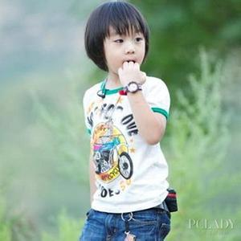
like
love
don’t mind
can’t stand
don’t like
Who’s he?
What do you think of him?

Slide 16
like
love
don’t mind
can’t stand
don’t like
Who’re they?
What do you think of them?

Slide 17
like
love
don’t mind
can’t stand
news(单数)回答用it
don’t like
What do you want to watch?
What do you think of news?

Slide 18
like
love
don’t mind
can’t stand
soap operas(复数回答用them)
don’t like
What do you want to watch?
What do you think of soap operas?

Slide 19
我是超链接
How do you like talent shows?
What do you think of talent shows?

Slide 20
我是超链接
How does he like cartoons?
What does he think of cartoons?

Slide 21
Section A

Slide 22
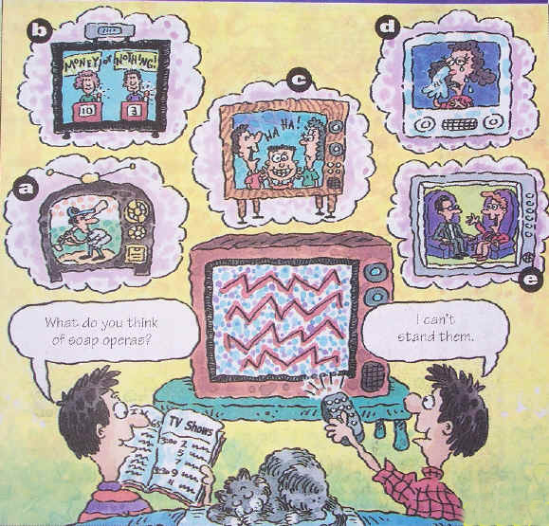
a
mind: v.介意,反对
mind +n./pron./doing
n. 思想,主意
How do you like
talk shows ?
b
What do you think of
talk shows ?
I don’t mind them.
1a
Match the TV shows with the pictures.[a---g] .
e
c
f
1.talk show ____ 4.sitcom ____ 7.news____
2.soap opera____ 5. game show ____
3.sports show ____ 6. talent show ____
d
a
b
g

Slide 23
Exercises
1.Do you mind _______(watch) movies ?
2.I don’t mind _______(she).
3.Do you want to change your______(mind)?
watching
mind+ doing
her
mind+ 代词宾格
mind
mind n. 不可数

Slide 24
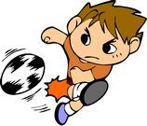
1b
Listen and number the shows [1—4] I the
order you hear them.
3
1
____ talent show
____ talk show
news不可数，
a piece of news
一条新闻
4
2
____ soccer game
____ news

Slide 25
Notes
show n. 表演,展览 v. 出示,把……给(别人)看
①TV show电视节目
②show sb. sth. = show sth. to sb.(同give)
展示某人某物, 把某物给某人看
Show me your books.(同义句)
Show your books to me.

Slide 26
Exercise
句型转换
She likes talk show.(否定句)
She _____ _____ talk shows.
I don’t mind cooking .(划线提问)
_____ ____you _____ ____ cooking?
What does he think of his teacher ?(同义句)
_____ ____he _____ his teacher ?
doesn’t like
2.What do you think of the town ?(同义句)
___ ____ you ____ the town ?
How do like
What
do
think of
How does like

Slide 27
Exercise
A
( )1. --What does he think of English Today? --____
A. He loves it. B. He can see it .
C. He doesn’t see it. D. That’s all right.
( )2. In my family everyone ____ sitcoms.
A. like B. likes C. is like D. are like
( )3. --I think this show is very interesting.
I agree ___you .
A. to B. about C. of D. with
( )4. My brother likes playing ping-pong. And I ____.
A. like it B. likes playing C. do, too D. like, too
( )5. Her father ___Sports World, but her mother ___.
A .like ; don’t B. like; doesn’t
C. likes ; doesn’t D. likes ; don’t
B
D
C
C

Slide 28
Exercise
Do you mind ______(take)care of my dog ?
Do you want to change your______(mind)?
Jim likes science and ___________(education) films.
He doesn’t plan ______(go) to Beijing on vacation .
I hope ______(see) your father as soon as possible.
I wish you _____(get) good grades.
I can’t stand _______(dance) .
taking
mind
educational
to go
to see
to get
dancing

Slide 29
The second day

Slide 30
Warm up

Slide 31
What do you want to watch?
What do you think of talk shows?
I like them.

Slide 32
What does he want to watch?
What does he think of game shows?
He loves them.

Slide 33
What does she want to watch?
How does she like news?
She doesn’t mind it.

Slide 34
Phonetics

Slide 35
//

Slide 36
/u/

Slide 37
//

Slide 38
//

Slide 39
//

Slide 40
happen

Slide 41
comedy

Slide 42
cartoon

Slide 43
appear

Slide 44
discussion

Slide 45
Exercise
句型转换
She likes talk show.(否定句)
She _____ _____ talk shows.
I don’t mind cooking .(划线提问)
_____ ____you _____ ____ cooking?
What does he think of his teacher ?(同义句)
_____ ____he _____ his teacher ?
doesn’t like
2.What do you think of the town ?(同义句)
___ ____ you ____ the town ?
How do like
What
do
think of
How does like

Slide 46
Exercise
A
( )1. --What does he think of English Today? --____
A. He loves it. B. He can see it .
C. He doesn’t see it. D. That’s all right.
( )2. In my family everyone ____ sitcoms.
A. like B. likes C. is like D. are like
( )3. --I think this show is very interesting.
I agree ___you .
A. to B. about C. of D. with
( )4. My brother likes playing ping-pong. And I ____.
A. like it B. likes playing C. do, too D. like, too
( )5. Her father ___Sports World, but her mother ___.
A .like ; don’t B. like; doesn’t
C. likes ; doesn’t D. likes ; don’t
B
D
C
C

Slide 47
Exercise
Do you mind ______(take)care of my dog ?
Do you want to change your______(mind)?
Jim likes science and ___________(education) films.
He doesn’t plan ______(go) to Beijing on vacation .
I hope ______(see) your father as soon as possible.
I wish you _____(get) good grades.
I can’t stand _______(dance) .
taking
mind
educational
to go
to see
to get
dancing

Slide 48
New lesson

Slide 49
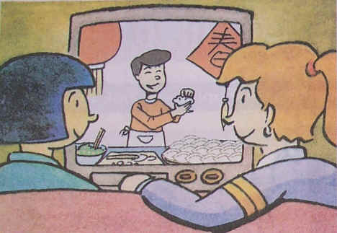
2a
Listen to Lin Hui and Sally’s conversation .Number
the TV shows [1—5] in the order you hear them.
1
______ sitcoms
______ game shows
______ soap operas
______ news
______ talk shows
4
5
2
3

Slide 50
2b
Listen again. Complete the sentences.
Sally likes to watch _____________.
Lin Hui thinks she can learn ___________
from sitcoms.
Sally thinks ______________ are more educational than sitcoms.
Sally loves ________ . She plans to watch
Days of Our Past __________.
news or talk shows
some great jokes
game shows
soap operas
tonight

Slide 51
Notes
1.plan /plQn/ v. & n. 打算，计划
① plan-plans-planning-planned
② plan to do sth. 计划做某事
to go
eg. He doesn’t plan ______(go) to Beijing
on vacation .
I’m planning _______(buy) a new piano
for my son.
to buy
③ plan n. 计划(可数名词)
make a plan 制定一个计划

Slide 52
Notes
2.learn from 向……学习， 从……获得
learn from sb. 向某人学习
eg.We should learn f_____ Lei Feng .
rom
education-educational比较级more educational
educational
Eg. Jim likes science and __________
(education) films.

Slide 53
Notes
3. hope /hEʊp/ v. & n. 希望
① hope to do sth. 希望做某事
eg. I hope ______(see) your father as soon
as possible.
to see
② hope that +从句 希望……
指能实现的愿望,从句用一般现在时或将来时。
eg. I hope ____ you have a good time.
A. what B. that C. to
B

Slide 54
Notes
hope 和 wish 区别
hope:① hope to do sth. 希望做某事
② hope that +从句 希望……
wish:① wish to do sth. 希望做某事
to go
eg. They wish ____(go) to a movie.
② wish sb. to do sth.
to get
eg. I wish you _____(get) good grades.
③ wish that +从句 希望……
指难以实现或无法实现的愿望。

Slide 55
Notes
4. happen:
happen /hQpEn/ v. 发生， 出现 ，碰巧
happen-happens-happening-happened
① sth . happens to sb. 某人发生某事
to
eg. A traffic accident happened ____ (介词)
the girl yesterday.
② sth. happens +地点/时间
某地/某时发生了某事
eg. An accident happened on Park Street.

Slide 56
Notes
③ sb. happens to do sth.
某人碰巧做某事
to see
eg. I happened ______(see) my uncle.
辨析 happen 与 take place
happen : 发生，碰巧，
一般用于偶然或突发性事件。
②take place : 发生，举办，举行
一般指非偶然性事件的“发生”，
即这种事件的发生一定有某种原因或事先的安排。
B
eg. The meeting will ____ next Friday.
A. happen B. take place

Slide 57
Notes
5.around the world
=all over the world全世界

Slide 58
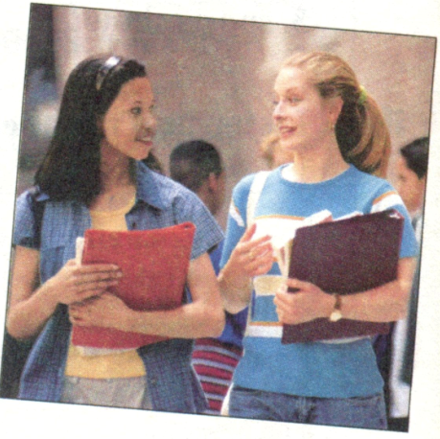
2d
Listen to the conversation and answer the
questions.
1.What are they talking
about ?
2.What does Grace think of
soap operas ?
3.What does Sarah think of
soap operas ?
TV shows .
She loves them.
She doesn’t mind them.

Slide 59
Notes
1.in class在课上,in the classroom在教室里
2.discussion /dIskVSn/ n. 讨论，商量
① discuss v. 讨论
② have a discussion about …
就……讨论
eg. We had a _________(discuss) about TV
shows.
discussion

Slide 60
3. stand /stQnd/ v. 忍受，站立
stand-stands-standing-stood
① can’t stand 不能忍受
can’t stand doing sth. 不能忍受做某事
eg. I can’t stand _______(dance) .
dancing
② stand v. 站，站立
eg. Don’t _____ (stand) here.
stand

Slide 61
4.follow the story跟着故事
follow sb. to do sth.跟着某人做某事
eg. I follow you_____(sing).
to sing
5.happen:
happen on sth.
happen to sb.
6.favorite=like …best
Eg.My favorite color is red=I like red best.

Slide 62
7. may /meI/ modal v. 也许，可能，可以
may+动原，否定may not+动原
be
eg.They may_____(be)exciting.
They______(not may)watch the movies.
may not
8. expect /IksPekt/ v. 预料，期待
expect-expects-expecting-expected
② expect to do sth. 预计做某事
to come
eg. Lily expects ______(come) back next week.
eg. Lily expects _____(come) back next week.

Slide 63
Grammar
Focus
joke /dZEʊK/
n.笑话，玩笑
to watch
Do you want ________(watch)
the news ?
do
don’t
Yes, I ____./No, I ______.
tell jokes 讲笑话
to watch
to watch
What do you plan _______
(watch) tonight??
I plan ________(watch) Days
of Our Past.
to learn
jokes
What can you expect _______
(learn) from sitcoms?
You can learn some great ____
(joke).
watching
Because I hope _______(find)
out what’s going on around the
world.
Why do you like _________
(watch) the news ?
to find
think of
I don’t mind them! / I can’t
_____ them! / I love ______
(watch) them !
What do you ______ ___ talk
shows ?
stand
watching

Slide 64
3a
Make a conversation and then practice it
with a partner.
A: What do you plan to watch on
TV tonight ?
B: I hope to ____________,
but I also want to_______________.
How about you ?
Do you_______ a talk show
or____________?
A: Oh, I want to __________.
to watch talk shows
watch game shows
like
a game show
watch a game show

Slide 65
3b
Answer these questions . Give answers that
are true for you .
comedy /kXmEdi/n.喜剧
comedy-comedies
1.What do you think of game shows ?
________________________
2.What comedy shows do you like to watch ?
________________________
3.Do you plan to watch a sports show tonight ?
________________________
4.What can you expect to learn from the news?
________________________
I don’t mind them.
I like to watch sitcoms.
Yes, I do.
I can learn what’s going on around the world.

Slide 66
Exercises
I hope ______(see) your father as soon as possible.
I wish you _____(get) good grades.
I can’t stand _______(dance) .
I happened ______(see) my uncle.
Lily expects _____(come) back next week
to see
to get
dancing
to see
to come

Slide 67
Exercises
What did you do ____ class today ?
The soccer game starts ____ 5:00 p.m.
What can you expect ____learn ____them?
in
at
4.I plan ____watch Days ____Our Past tonight.
from
to
to
of
5.We had a discussion ____TV shows.
6.I expect ____learn a lot ____them.
about
to
from

Slide 68
Exercises
A
( )1.The movie is too scary. I can’t___ it.
A. stand B. see C. have D. play
( )2. They plan ____ Lijiang on National Day of 2013.
A. go to B. to go to C. to go D. going to
B
C
( )3. --What do you think of the new book? --___.
A. I’d love to B. I think so C. I love it D. That’s right
( )4.Would you mind ____the door?
A. open B. opens C. opening D. opened
C

Slide 69
The third day

Slide 70
Warm up

Slide 71
Grace: What did you do in class today , Sarah ?
Sarah: We had a discussion about TV shows. My classmates like game shows and sports shows.
Grace : Oh, I can’t stand them. I love soap operas. I like to follow the story and see what happens next.
Sarah: Well, I don’t mind soap operas .But my favorite
TV shows are the news and talk shows .
Grace : They’re boring !
Sarah: Well, they may not be very exciting, but you can
expect to learn a lot from them. I hope to be a TV reporter one day.

Slide 72
Phonetics

Slide 73
Phonetics
//
army
film
joke
//
//
ready
//
simple
//

Slide 74
Exercises
I hope ______(see) your father as soon as possible.
I wish you _____(get) good grades.
I can’t stand _______(dance) .
I happened ______(see) my uncle.
Lily expects _____(come) back next week
to see
to get
dancing
to see
to come

Slide 75
Exercises
What did you do ____ class today ?
The soccer game starts ____ 5:00 p.m.
What can you expect ____learn ____them?
in
at
4.I plan ____watch Days ____Our Past tonight.
from
to
to
of
5.We had a discussion ____TV shows.
6.I expect ____learn a lot ____them.
about
to
from

Slide 76
Exercises
A
( )1.The movie is too scary. I can’t___ it.
A. stand B. see C. have D. play
( )2. They plan ____ Lijiang on National Day of 2013.
A. go to B. to go to C. to go D. going to
B
C
( )3. --What do you think of the new book? --___.
A. I’d love to B. I think so C. I love it D. That’s right
( )4.Would you mind ____the door?
A. open B. opens C. opening D. opened
C

Slide 77
New lesson

Slide 78
Section B

Slide 79
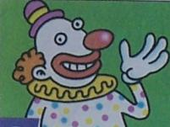
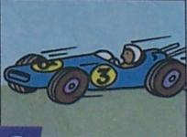
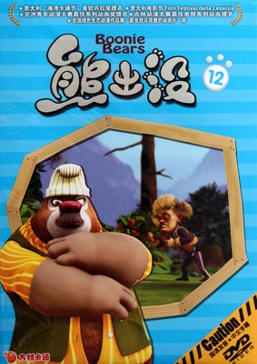
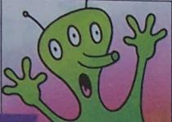
1a
What do you think of these TV shows and movies ? Choose words from the box and write them under the pictures .Each picture can have more than one word.
educational serious wonderful relaxing
meaningless enjoyable exciting boring
talent show
________
comedy
________
action movie
________
wonderful
relaxing
exciting
cartoon
________
scary movie
________
enjoyable
meaningless

Slide 80
Notes
1. serious adj. 严肃的,认真的
① be serious about sb./sth. 对某人/某事认真
② be serious about doing sth.对做某事认真
eg. Peter is serious _____(介词) Jenny.
He’s serious about ______(sell) his house.
about
selling

Slide 81
2. meaningless adj. 毫无意义的
meaningless是meaning加否定意义的后缀
--less 构成的派生词.
eg. Lots of people think scary movies are
meaningless.
许多人认为恐怖片毫无意义.
常见的加—less后缀构成的词汇有:
homeless
无家可归的
② careless
粗心的
无希望的
③ hopeless

Slide 82
3. relaxing adj. 轻松的
relax v. 放松
① relaxing 令人轻松的,指物
② relaxed 放松的,指人
eg. I want to have a _______ vacation.
Tom looks very _____ after a ______
vacation.
relaxing
relaxed
relaxing

Slide 83
1b
Listen and circle the description words you
hear in the box in 1a.
educational serious wonderful relaxing
meaningless enjoyable exciting boring
1c
Listen again. Write down the words John and Mary use to describe the TV shows or movies.
Action movies
Scary
movies
Game shows
Talk shows
Sitcoms
John
exciting
exciting
boring
boring
enjoyable
Mary
meaningless
meaningless
relaxing
relaxing
wonderful

Slide 84
Notes
4. action movie 动作影片
/QKSn/
action n. 行动,动作
指抽象的行为,持续而复杂的行动.
② act v. 行动,动作
③ actor n. 演员
④ actress n. 女演员
eg.Jackie is an_______(act)
actor

Slide 85
Lead in

Slide 86
2b
Listen to the passage and complete the time line .
Mickey became the first cartoon character to have a star on the Hollywood Walk of Fame.
Steamboat Willie
came out in New
York.
He made 87 cartoons with Mickey.
November 18,
1928
November 18,
1978
1930s

Slide 87
Paragraph 1
Notes
1.But one very famous symbol in American
culture is a cartoon.
但是美国文化的一个非常著名的标志是卡通片。
① be famous for +闻名的原因 因为……而出名
②be famous as+职位,名称的词 作为……而闻名
③ be famous to +sb. 为……所熟知
for
eg. This place is famous ____ its cotton.(棉花)
Jet Li is famous ___ a great actor in the world.
This singer is famous ____ lots of old people.
as
to

Slide 88
2. Over 80 years ago, he first appeared in the
cartoon Steamboat Willie.
80多年前，他首次在卡通片威利号汽船中出现。
① over=more than 超出，比……多
②appear v.出现,露面
eg. My friends didn’t a _____ until seven o’clock.
ppear
appear v.(出现)---disappear v.(消失)
appearance n.(出现,露面)---disappearance

Slide 89
3. come out
① 发行,出版
eg. My first book came out in 2003.
我的第一本书于2003年出版了.
② 出来,出现
eg. The sun is coming out.
太阳出来了.
③ 开花,发芽
eg. Some flowers begin to come out.
一些花开始开花了.
④ 透露,传出
eg. The truth has come out at last.
真相终于大白.

Slide 90
4. He became very rich and successful.
他成功了,而且变得非常富有.
① become 连系动词 +n./adj.
ecame
eg. Last year my father b_______(成为) a
headmaster.
② rich adj.富有的
③ successful adj.成功的
successful(adj.)-success(n.)-succeed(v.)
--successfully (adj.)
successful
eg. He is a _________(success) man.

Slide 91
Paragraph 2
5. might modal v. 可能
情态动词,没有人称和数的变化,
后面直接加动原,表示可能性很小。
eg. Your uncle might ____(is) having a meeting
but I’m not sure.
be
be popular with sb.深受某人的欢迎
eg. Yao Ming is popular _____people.
A. to B. in C. with
C

Slide 92
7. …but he always tried to face any danger.
但他面对危险时总是全力以赴。
① face v.面对，面向
eg. Everyone must f_____ the facts.
ace
② try (one’s best)to do sth. 尽力去做某事
eg. He always tried _______(face)any danger.
to face

Slide 93
8. …Mickey was unlucky and had many problems such
as losing his house or girl-friend , Minnie.
米奇是不幸的，他经常遇到许多问题，
比如失去房子和女朋友明妮。
① unlucky adj.不幸的，倒霉的
unlucky(adj.不幸的)-lucky(adj.幸运的)
-luckily(adv.幸运地)-luck (n. 运气)
②lose(lost , lost) v.丢失,指因事故或过失失去
原有的东西,也可指人陷入沉思中.
be lost 丢失的，不见的
eg. I l____ my key ,but now I find it .
ost

Slide 94
9. …Mickey was unlucky and had many problems such as losing his house or girl-friend , Minnie.
米奇是不幸的，他经常遇到许多问题，
比如失去房子和女朋友明妮。
① 辨析such as 和 for example
such as: 用来列举同类人或事物中的几个例子。
for example: 一般只以同类事物或人中的“一个”
为例,做插入语,用逗号隔开,可置于句首,
句中或句末。
such as
eg. I like balls, _____football and ping-pong.
He, ________ is a good student.
for example

Slide 95
10. However, he was always ready to try his best.
然而，他总乐于竭尽全力。
①be ready to do sth.
乐于做某事，愿意迅速做某事
to help
eg. In our class, Tom is ready ______(help)
other people .
to start
eg. We are ready _______(start) our work.

Slide 96
11. However, he was always ready to try his best.
然而，他总乐于竭尽全力。
①try one’s best to do sth.
=do one’s best to do sth.
尽某人的最大努力做某事
eg. Children are trying their best _______
(learn) English.
to learn

Slide 97
Paragraph 3
12. On November 18,1978, Mickey became the first cartoon to have a star on the Hollywood Walk of Fame.
在1978年11月18日，米奇成为第一位入选
好莱坞星光大道明星的卡通人物。
13. not so +adj./adv.(原级)as… 不如……一样
as +adj./adv.(原级) as … 和……一样
cheap
eg. This bike is as ________(cheap) as that one.
Today’s cartoons are usually not so ______
(simple) as little Mickey Mouse.
simple

Slide 98
14.Everyone still knows and loves him.
everyone不定代词+v.单三
likes
Eg. everyone ______(like)comedies.
15.Who has a pair of ears more famous than Mickey’s.
a pair of ears一双耳朵
famous比较级more famous,最高级most famous
Eg. Which one is_________(famous)this one or that one?
more famous
16.in the 1930在20世纪30年代
17.in 1930 在1930年

Slide 99
Read the passage again and fill in the facts about Mickey.
2c
What does
he look
like ?
What was his first cartoon?
Who
created
him ?
Who is his girlfriend?
Why is he
popular?
He was like a common people , but he always tried to face any danger.
He’s a black mouse with two large round ears.
Mickey
Mouse
Walt Disney.
Steamboat Willie.
Minnie.

Slide 100
2d
Read the passage again and discuss the questions with a partner.
What is Mickey Mouse a symbol of ? What cartoon character is a symbol of Chinese culture ?
Do you think Walt Disney is a smart man ? Why or why not ? Do you want to be like him ?
Why did people want to be like Mickey ? Do you want to be like Mickey ? Why or why not?
Can you think of another cartoon character that is as famous as Mickey ? Why is the character popular?
One famous symbol is cartoon.
Mickey Mouse.
Yes ,because he became very rich and successful.
Yes.
be popular with…受。。。欢迎
Because he is very famous and successful.
Donald Duck,he is very friendly.

Slide 101
Exercises
In the 1930s, he ____(make) 87 _______(cartoon)
with Mickey.
2.One of the main_______(reason) ____(be)
that he is like a common man.
3.He always tried______(face) any _____(dangerous).
4.He had many _______(problem) such as ______
(lose)his house.
5.______(Today) cartoons are not so_____(simple)
as little Mickey Mouse.
6.Everyone still _____(know) and ____(love) him.
made
cartoons
reasons
is
to face
danger
problems
losing
Today’s
simple
knows
loves

Slide 102
Exercises
1. Lin Shuhao is famous for playing basketball. (同义句)
Lin Shuhao is famous _____a basketball_______.
2. There are some good movies showing right now.(?)
____ ____ ____ good movies showing right now?
3. Talk shows are a little bit boring. (同义句)
Talk shows are ____ ____boring.
as
player
Are there any
kind of

Slide 103
Exercises
I think this dress is ugly .(划线提问)
What ___ you ____ ____ this dress ?
do
think of
2.My brother likes playing soccer because it’s exciting.
____ ____ your brother ___playing soccer?
Why does
like

Slide 104
Exercises
This place is famous ____ its cotton.(棉花)
Jet Li is famous ___ a great actor in the world.
Yao Ming is popular _____people.
for
as
with
4.This cartoon came ____ ____ New York
____November 18, 1928.
5.It was the first cartoon ____sound and music.
6.Mickey was ____a common man.
out in
on
with
like

Slide 105
The fourth day

Slide 106
Warm up

Slide 107
2b
When people say “ culture”, we ____ ____art and history. But one very ____ ____ in American culture ____ a cartoon. We all know and love the black mouse ____ two large round ears--- Mickey Mouse . ____ 80 years ago, he first _______ ____ the cartoon Steamboat Willie. When this cartoon ____ ____ in New York ____November 18, 1928, it was the ____cartoon with ____and ____. The man ____Mickey was Walt Disney . He became very ____and ______. In the 1930s, he ____87 cartoons with Mickey.
think
of
famous
symbol
is
with
Over
appeared in
came out
on
first
sound
music
behind
rich
successful
made

Slide 108
Phonetics

Slide 109
army

Slide 110
unlucky

Slide 111
action

Slide 112
character

Slide 113
simple

Slide 114
//

Slide 115
//

Slide 116
//

Slide 117
//

Slide 118
//

Slide 119
Exercises
In the 1930s, he ____(make) 87 _______(cartoon)
with Mickey.
2.One of the main_______(reason) ____(be)
that he is like a common man.
3.He always tried______(face) any _____(dangerous).
4.He had many _______(problem) such as ______
(lose)his house.
5.______(Today) cartoons are not so_____(simple)
as little Mickey Mouse.
6.Everyone still _____(know) and ____(love) him.
made
cartoons
reasons
is
to face
danger
problems
losing
Today’s
simple
knows
loves

Slide 120
Exercises
1. Lin Shuhao is famous for playing basketball. (同义句)
Lin Shuhao is famous _____a basketball_______.
2. There are some good movies showing right now.(?)
____ ____ ____ good movies showing right now?
3. Talk shows are a little bit boring. (同义句)
Talk shows are ____ ____boring.
as
player
Are there any
kind of

Slide 121
Exercises
I think this dress is ugly .(划线提问)
What ___ you ____ ____ this dress ?
do
think of
2.My brother likes playing soccer because it’s exciting.
____ ____ your brother ___playing soccer?
Why does
like

Slide 122
Exercises
This place is famous ____ its cotton.(棉花)
Jet Li is famous ___ a great actor in the world.
Yao Ming is popular _____people.
for
as
with
4.This cartoon came ____ ____ New York
____November 18, 1928.
5.It was the first cartoon ____sound and music.
6.Mickey was ____a common man.
out in
on
with
like

Slide 123
New lesson

Slide 124
Lead in

Slide 125
3a
Fill in the blanks in the movie review . Use the words in the box to help you .
fantastic shows action want
comes from played about like exciting plan
Mulan is an ______ ______ movie. It _______
an old Chinese story. The movie is ______a village
girl ,Mulan. She dresses up like a boy and takes her
father’s place to fight in the army. I think the actress
_____Mulan’s role well. The other actors are also ________ and they did a good job in the movie. I _____ Mulan very much. The movie _____ her love
for her family, friends and country. If you ____to watch a movie this weekend and you _____ to see
something enjoyable, choose Mulan!
exciting action
comes from
about
played
fantastic
like
shows
plan
want

Slide 126
Notes
She dresses up like a boy and takes her father’s place to fight in the army.
他打扮成男孩模样替父从军打仗。
①dress up 打扮，梳理
eg. Mrs. Brown always d ____ her children up.
resses
②dress up 着特殊服装,为取乐而穿别人的衣服
eg. Miss. Jones dressed up for this party.
为这个聚会，琼斯小姐穿上盛装。

Slide 127
Notes
2.She dresses up like a boy and takes her father’s place to fight in the army.
他打扮成男孩模样替父从军打仗。
①take sb’s place =replace sb. 代替某人
eg. I had to go out so Jane took my p____ at the
meeting.
lace
②take the place of 代替
eg.It would be difficult to find a man to take the
p_____ of the secretary.(秘书)
lace

Slide 128
Notes
3. do a good job 干得好
ob
eg. You have done a good j ___ of it.
do the job 奏效，起作用
eg. The extra strong glue(强力胶) should
do the job.
这个强力胶应该起作用的。

Slide 129
Notes
4. something enjoyable 令人愉快的东西
不定代词+形容词
B
Eg. CCTV-10 often plays ___around the world.
A. new something
B. something new
C. anything new
5.enjoy+v.ing/oneself
watching
Eg.I enjoy________(watch)the movies.
He enjoys _______(he)in the park.
himself
6.enjoy oneself=have a good time=have fun=play happily

Slide 130
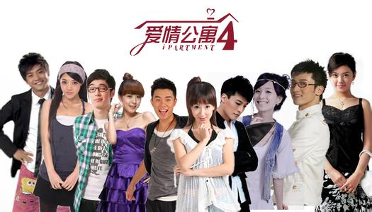
3b
Xiaoxian
Yifei
The name of
the movie
The kind of
movie
The movie
is about
Love apartment
The story of love about the youth
Comedy
Fantastic

Slide 131
3c
Write your movie review using the notes in 3b.
I like Love Apartment best. It is a comedy. The movie is about the life of some young people.Xiaoxian and Yifei are fantastic.They always fight with others.They usually talk about something interesting.They are very funny.
I think you will like it. Please see it!

Slide 132
Self Check
1. Write questions and answers using the words in
brackets.
What do you think of soap operas?
1.A: ____________________________________
(what / think of /soap operas)
B: ____________________________________
(can’t stand)
2.A: ____________________________________
(what show/ want to watch / tonight)
B:_____________________________________
(talent show)
3.A:_____________________________________
(what/ expect to learn/ game show)
B: _____________________________________
(interesting information)
I can’t stand them.
What show do you want to watch tonight?
I want to watch a talent show.
What do you expect to learn from a game show ?
I expect to learn interesting information.

Slide 133
Notes
1. interesting information 有趣的资料
不定代词+形容词
①interesting 令人感兴趣的 指物
②interested 感兴趣的 指人
③ be/become interested in … 对……感兴趣
eg. What kind of books do you like ?
---I like funny storybooks .They are _____.
A. boring B. lazy C. quiet D. interesting
D
B
eg. I think this book is _____.
The girl is ____in the book.
A. interested B. interesting
A

Slide 134
Self Check
1. Write questions and answers using the words in
brackets.
4.A: ____________________________________
(what / hope to watch /tomorrow)
B: ____________________________________
(news)
5.A: ____________________________________
(do / plan to watch / action movie)
B:_____________________________________
(no / plan to watch / comedy)
What do you hope to watch tomorrow ?
I hope to watch news.
Do you plan to watch an action movie ?
No, I plan to watch a comedy.

Slide 135
Self Check
2.Which of these statements do you agree with (✓) or disagree with (✗) ? Give at least one reason.
1.I think game shows are meaningless. ( )
2. I can’t stand soap operas. ( )
3. I think sitcoms and talent shows are relaxing. ( )
4. I love talk shows. ( )
5. I think comedies are fantastic. ( )

Slide 136
Exercises
( )1. I think the old people don’t like ___movies.
A. act B. actor C. action D. actress
( )2. Han Ming is a helpful boy.
He is ready ___anything for others.
A. do B. to do C. doing D. does
( )3. Look ! What a beautiful hill! Yes, and it’s also
famous ___ its old trees.
A. about B. with C. by D. for
( )4. The officer told Tom there was nobody ___.
A. to take his place B. taking his place C. to take place
C
B
D
B

Slide 137
Exercises
1.He’s serious about ______(sell) his house.
2.Tom looks very _____ after a ______vacation (relax).
3.He is a _________(success) man.
4.We are ready _______(start) our work.
5.Children are trying their best _______(learn) English.
6.This bike is as ________(cheap) as that one.
7.Are you ready _______(help) the blind man with us ?
8.I hope _______(buy) a big house for my parents.
selling
relaxed
relaxing
successful
to start
to learn
cheap
to help
to buy

Slide 138
Exercises
at
1.Let me look ____the newspaper.
at
2.Maybe we should stay ____home.
of
3.I don’t really like those kinds ____TV shows.
to
out
4.I like ____find ____what different people
think ____a subject.
of
In
5.____his early films, Mickey was unlucky.

Slide 139
Thank you!

