Slide 1
Can you come to my party?
新目标八年级上册
SA 1a—2c
The second day

Slide 2
Warm up
Can you come to my party?
Sure, I’ d love to.
Can you come to my party?
Certainly, I’d love to.
Can you come to my party?
I’m sorry. I have to
prepare for an exam.
I’m sorry. I have to
meet my friend.

Slide 3
Phonetics
//
//
//

Slide 4
Phonetics
prepare
available
accept

Slide 5
Exercise
Thank you for ___(invite) me, but I can’t go to Lily’s party with you.
Paul has to study _ (at/ for) the English test tonight.
I have too __ (much/ many) water to drink.
Can you come to my party _ (at/ on) Sunday night?
5. Sorry ,I ’m so busy .______(Maybe/May be) another time!
inviting
for
much
on
Maybe

Slide 6
Exercise
1. I can come to your party. (变一般疑问句)
_____ you _____ to ______ party?
2. He has to go to see the doctor. (变否定句)
He ______ ______ ____ go to see the doctor.
3. She has to stay at home and do her homework.
(对划线部分提问)
______ ______ she ______ to ______?
4. Thanks for helping me today. (同义句)
Thanks for ______ _______ today.
5. Can you go shopping with me. (肯定回答)
____ ___ ______
Can come my
doesn’t have to
What does have do
your help
Yes , I can .

Slide 7
Exercise
come
1. Can you _____ (come) to my birthday party?
2. We _________ (have) a piano lesson now.
3. They had two English _______ (lesson)
yesterday morning.
4. Do you often help your mother _____ (do )
housework?
5. She ______ (can not) go with you.
are having
lessons
do
can’t

Slide 8
Lead in

Slide 9
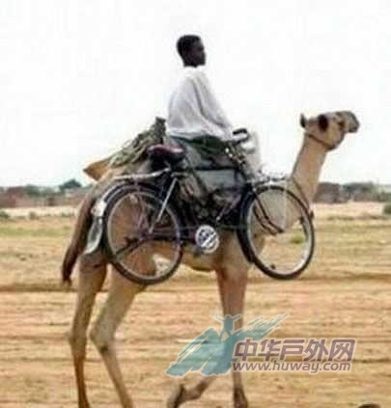
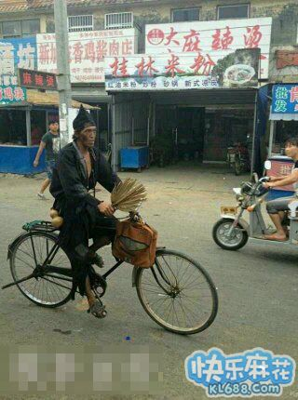
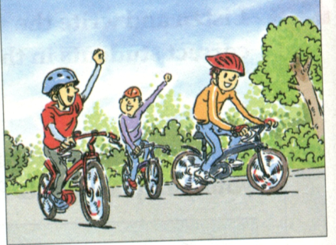
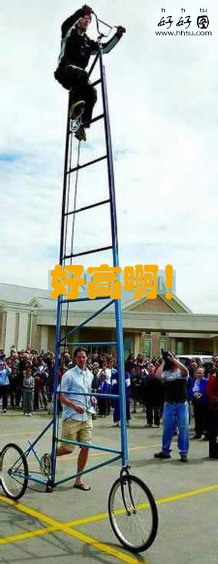
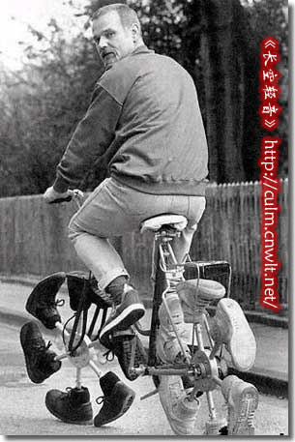
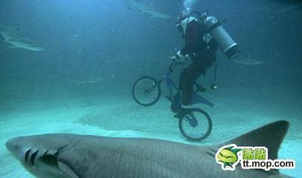
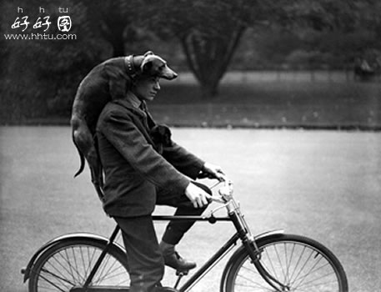
Look at these pictures , guess what
we will learn about

Slide 10
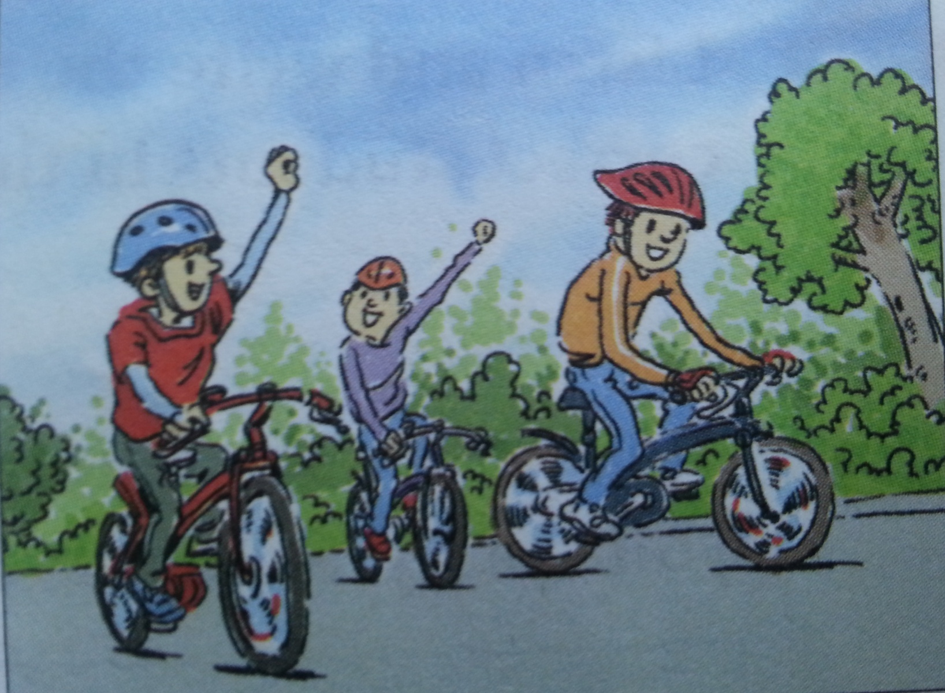
2d. Role-play the conversation.
Listen : Can Nick come to Jeff’s house on Saturday? Why?

Slide 11
Notes
I remember we went bike riding
together last fall when he visited you.
★remember v. 记住 反义词： forget
★remember doing sth. 记得曾做过某事
★remember to do sth. 记得要去做某事
doing
e.g. I remember _______ (do) my homework
Please remember _______ (bring) your homework tomorrow.
to bring
go bike riding 骑车旅行

Slide 12
Notes
2. I’d love to come, but I’m afraid I can’t.
be afraid to do 担心、害怕做某事
be afraid of doing 担心、害怕做某事
Eg :I ’m afraid to peel apples.(同义句)
afraid of peeling
I ’m ______ ___ ______ (peel) apples.
I ’m afraid so .恐怕是这样的。
I ’m afraid not .恐怕不是这样的。
Eg :I ’m afraid so.(否定句)
afraid not
I ’m ______ ______ .

Slide 13
Notes
3. Oh, but Sam isn’t leaving until next Wednesday.
until prep. 到……时；直到……为止 (表示动作，状态的继续)
用于肯定句中
until常用于否定句中，与not构成固定结构，即 not…until,“直到……才”
e.g. It may last until Sunday. 这可能要持续到星期五。
e.g. 噪音一直到午夜才停止。
The noise ______ stop ______ midnight.
didn’t until

Slide 14
Notes
4.Can you hang out with us on Monday night?
hang out “常去某处；泡在某处；”
hang v. “悬挂；垂下” 过去式：hung
e.g.
1. she likes going shopping and she usually
_____ (hang) out in the shop.
2. ______ (hang) the flag on the wall, please.
hangs
Hang

Slide 15
Notes
5. Catch you on Monday! 周一见！
catch you 口语 “再见”
catch 动词 “及时赶上；接住；抓住”
过去式：caught
e.g. I _______ (catch) the bus just now .
caught

Slide 16
Grammar Focus
on
Can you come to my party ___(介词）Saturday?
Can you go to the _____(movie) tomorrow night?
Can he ____(go) to the party?
movies
go
for
I must______ (study) ____（介词） a math test.
That ______(sound) great.
He has to ____(help) his parents.
No, she’s not a_______.
They’re not free. (同义句）They’re ______
study
sounds
help
vailable
busy

Slide 17
3a. Complete the answers with might and one of
the phrases in the box.
1. A: What are you going to do on Saturday?
B: I’m not sure. I might __________________.
2. A: What are you planning to do after school?
B: I don’t know. _____________________.
3. A: When will you finish the science homework?
B: _______________________________.
4. A: Who are you going to the movies with?
B: _______________________________.
5. A: Are you free to come to
my place on Saturday?
B: _________________
_________________.
visit my grandparents
I might watch TV
I might finish it on the weekend
I might go with my cousin
watch TV
on the weekend
my cousin
visit my grandparents
practice the violin
Sorry, I might practice
the violin

Slide 18
3b. Complete the sentences below. Use the
words in brackets to help you.
Can you play tennis with me?
1. Inviting: _____________________
(can/play tennis )
Accepting: _____________
2. Inviting: _________________________
(would like to/go to the movies)
Refusing:___________
Reason: __________________________
(might have to)
Sure, I’d love to.
Would you like to go to the movies?
Sorry, I can’t.
I might have to study for a math test.

Slide 19
Exercise
All of us have to ( 为… 而学习)
the English test.
2.I have to ___ .
(上钢琴课）
3.I (必须）go to see the dentist.
4.Can he （ 来到 ）my party?
5.He is _ ( 弹吉他)
study for
go to the piano lesson
have to
come to
playing the guitar

Slide 20
Exercise
I can come to your party. ( 变一般疑问句)
you to party?
Thanks for your help .( 同义句转换)
Thanks for .
It’s seven o’clock . (对划线部分提问)
is it ?
We have to study for the math test .
( 改为否定句 )
We study for the
math test.
She can play the guitar. (对划线部分提问)
can she ?
Can come my
helping me
What time
don’t have to
What do

Slide 21
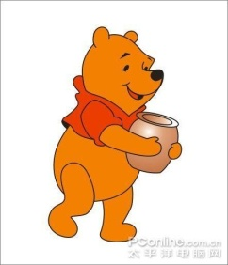
Exercise
1. --Can you stay here longer?
--___. But I have to be back tomorrow.
A. I’d love to B. I’m afraid not
C. I’m sorry, I can’t D. No, thank you
2. They didn’t go to bed ____ the work was
finished .
A. when B. while C. until D. after
3. --With ____ are you going to London?
--My parents.
A. what B. who C. whom D. which
4. ___ you dance? We need some more actors for
the talent show.
A. Need B. Shall C. Must D. Can

